Slide 1
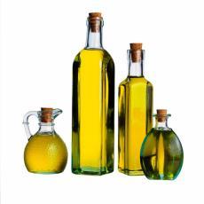
Fat
ADI Presentation
2016
Notes:
Today I will present on ‘Fat’.
The presentation will last about 15-20 minutes and then we will do an activity called:: ‘Which has more fat?’

Slide 2
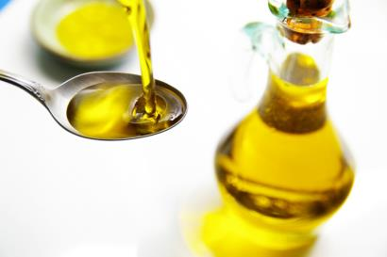
Outline
The role of fat
Harmful fats
Saturated fats
Trans fats
Healthy fats
Monounsaturated fatty acids
Polyunsaturated fatty acids
Omega-3 fatty acids
Omega-6 fatty acids
How much fat should I eat daily?
Tips for choosing healthy fats
Ways to cut down on fat
Notes:
Here’s an outline of what we will talk about during today’s presentation.

Slide 3
The role of fat
Important for our overall health
Helps us use vitamins
A, D, E & K
Is the main form of stored energy
Adds taste to our food
Can help you feel full longer
The type of fat you choose to eat can
affect your heart health
Notes:
Fat is important for our overall health. Fat is essential to your health because it supports a number of your body's functions and helps to fight diseases, line and insulate our nerves, protect vital organs, insulate our bodies against environmental temperature changes.
Fats tend to get a bad reputation, but not all fats are created equal. Some fats are important to keep our heart healthy while others should be limited.
Helps us use vitamins A, D, E & K – These vitamins must have fat to dissolve so they can be used by your body.
Is the main form of stored energy - Our body uses the fat we eat, and fats we make from other nutrients in our bodies, to provide the energy for most of our life-functions.
Essential fatty acids are essential for growth development and cell functions, but cannot be made by our body’s processes
We need fat to maintain healthy skin and other tissues. All our body cells need to contain some fats as essential parts of cell membranes, controlling what goes in and out of our cells.
Fat also:
Adds taste to our food
Can help you feel full longer. Fat can delay feelings of hunger since fats are digested more slowly than carbohydrates and proteins.

Slide 4
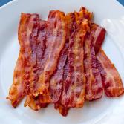
Harmful fats: saturated fats
Naturally found in foods
Raises our bad blood cholesterol
Food that have saturated fats include:
Fatty cuts of meat
Poultry with the skin on
Lard, shortening and butter
Higher fat milk, cheeses and yogurts
Palm kernel oil
Limit These!
These fats are usually hard
at room temperature!
Notes:
Saturated fat is a type of fat naturally found in foods. It is usually hard at room temperature and opaque. Opaque means you cannot see through it.
Some saturated fats have been linked to a higher risk of heart disease. This is because too much saturated fat raises LDL cholesterol, which is the “bad cholesterol.” Higher LDL cholesterol levels can lead to plaque build up in your arteries.
Saturated fat should be limited to no more than 10 percent of your daily calorie intake. If you have diabetes, no more than 7% of your total energy daily intake should come from saturated fat since people with diabetes are at greater risk of developing cardiovascular diseases.
Replace saturated fat with healthier monounsaturated and polyunsaturated fats.

Slide 5
Harmful fats: trans fats
Avoid These!
These fats are made through a process called “hydrogenation” – when oil is made solid
Raises our bad cholesterol
Aim to have 0 trans fats in your diet
Comes from …
- hard margarines - french fries
- commercial baking - microwave popcorn
- processed foods - pre-packaged foods
- deep fried foods (chips and cookies)
Hint: Look for ‘trans fat free’ on the label!
Notes:
This is a type of fat that occurs naturally in some foods (meat, milk and butter) in small amounts. But most trans fats are made from oils through a food processing method called partial hydrogenation where the liquid oil is changed into a solid fat. These partially hydrogenated trans fats can increase unhealthy LDL cholesterol and lower healthy high-density lipoprotein (HDL) cholesterol. This can increase your risk of cardiovascular disease. The trans fat found naturally in foods is different than manufactured trans fat and does not increase your risk of heart disease.
To avoid trans fat, check food labels and look for the amount of trans fat listed. Also, check ingredient lists and avoid foods that include "partially hydrogenated“ in the ingredient list.
Trans fat adds texture and flavour to food and are most often found in commercially baked goods, fried foods and processed foods like packaged salty snacks and convenience foods including frozen foods.

Slide 6
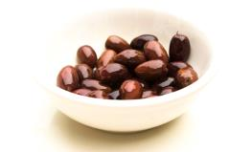
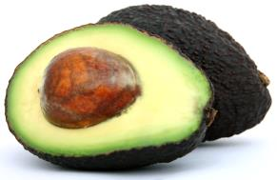
Healthy fats: monounsaturated fats
Helps to lower our blood cholesterol and keeps our heart healthy
Comes from PLANT SOURCES
- Canola oil
- Olive oil
- Nuts
- Avocado
- Olives
Try to eat ¼ cup nuts 2-3x / week!
Notes:
Monounsaturated fat is a healthy fat naturally found in olive and canola oil, non-hydrogenated margarines, avocados and nuts like almonds, pistachios, pecans and cashews.
Studies show that eating foods rich in monounsaturated fatty acids improves blood cholesterol levels, which can decrease your risk of heart disease. Research also shows that these fatty acids may benefit insulin levels and blood sugar control, which can be especially helpful if you have type 2 diabetes.
You should replace the saturated fats in your diet with monounsaturated and polyunsaturated fats.

Slide 7
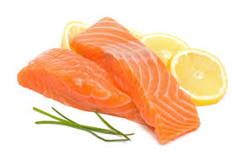
Healthy fats: polyunsaturated fats
Mostly found in plant-based foods and oils
Helps to lower our bad cholesterol and keeps our heart healthy
They include omega-3 and omega-6 fats
Sources of polyunsaturated fats include:
soybean oil
corn oil
sunflower oil
fatty fish (salmon, mackerel, herring and trout)
Notes:
This is a type of fat found mostly in plant-based foods and oils. Evidence shows that eating foods rich in polyunsaturated fatty acids improves blood cholesterol levels, and can lower bad cholesterol levels (LDL cholesterol) which can decrease your risk of heart disease. These fatty acids may also help decrease the risk of type 2 diabetes.
Foods made up mostly of monounsaturated and polyunsaturated fats are liquid at room temperature, such as olive oil, safflower oil, peanut oil and corn oil.
Polyunsaturated fats can help reduce bad cholesterol levels in your blood which can lower your risk of heart disease and stroke. They also provide nutrients to help develop and maintain your body’s cells. Oils rich in polyunsaturated fats also contribute vitamin E to the diet, an antioxidant vitamin most Americans need more of.
Oils rich in polyunsaturated fats also provide essential fats that your body needs but can’t produce itself – such as omega-6 and omega-3 fatty acids. You must get essential fats through food. Omega-6 and omega-3 fatty acids are important for many functions in the body.

Slide 8
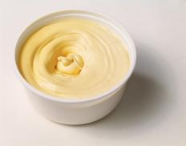
Healthy fats: omega-3 fats
Add ground flax seed to your baking!
Many health benefits
Adults:
Helps to lower blood cholesterol and keep the heart healthy
Infants:
Helps with brain, nerve and eye development
Sources include:
Fatty fish (mackerel, salmon, tuna, trout, sardines)
Canola oil
Nuts and seeds
Soft margarines
Notes:
Omega-3 fats are healthy fats with many health benefits for adult and children. This type of polyunsaturated fat is especially beneficial to your heart and appears to decrease the risk of coronary artery disease. It can help prevent clotting of blood, reducing the risk of stroke and also helps lower triglycerides, a type of blood fat linked to heart disease.
In infants, omega-3 fats help with brain, nerve and eye development.
Research is currently being done to see if omega-3 fats play a role in lowering the risk of cancer, dementia, Alzheimer’s disease and depression.
Sources include:
some types of fatty fish (salmon, tuna, trout, mackerel, sardines and herring)
oils (canola, flaxseed, soybean)
Some soft margarines
flaxseed (ground)
nuts (walnuts, pecans, pine nuts)
seeds (sunflower)
added to eggs, milk products and some juices

Slide 9
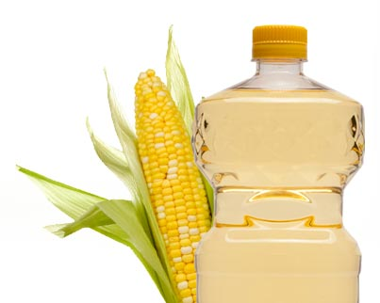
Healthy fats: omega-6 fats
Essential fatty acids
Necessary for human health – cannot be made by the body (need to get it from food)
Play a role in brain function, normal growth and development
Sources include:
Sunflower oil
Safflower oil
Soy oil
Sesame oil and
Corn oil
Notes:
Another type of polyunsaturated fat is omega-6. Omega-6 fatty acids are essential fatty acids. They are necessary for human health, but the body cannot make them. You have to get them through food. Along with omega-3 fatty acids, omega-6 fatty acids play a crucial role in brain function, and normal growth and development. It also helps lower LDL cholesterol, but in large amounts it's thought to also lower the good HDL cholesterol.
Omega-6s help stimulate skin and hair growth, maintain bone health, regulate metabolism, and maintain the reproductive system.
Sources include:
Sunflower oil
Safflower oil
Soy oil
Sesame oil and
Corn oil

Slide 10
Pop Quiz:
You should eat less of…
Trans fats
Saturated fats
Omega 3 fats
a and b
Answer: d

Slide 11
How much fat should I eat daily?
Men: 90 grams per day
Women: 60 grams per day
Fat is high in calories
If you eat too many calories you will gain weight
Excess weight is linked to poor health
Notes:
Men aim for about 90 grams of fat, women aim for about 60 grams of fat per day depending on caloric intake.
Dietary fat is very similar in composition to body fat, so it takes less energy to convert dietary fat to body fat.
High in calories – 9 calories per gram (whereas carbohydrates and protein have 4 calories per gram). If you eat more calories than you need, you will gain weight. Excess weight is linked to poor health. In addition, some types of dietary fat are thought to play a role in cardiovascular disease.
Research about the possible harms and benefits of dietary fat is always evolving. And a growing body of research suggests that when it comes to dietary fat, you should focus on eating healthy fats and avoiding unhealthy fats.

Slide 12
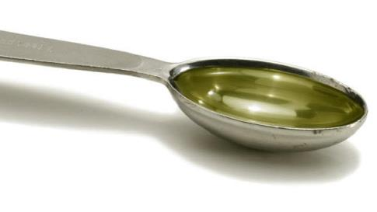
Each teaspoon of fat
= 4 grams of fat
= 36 calories!

Slide 13
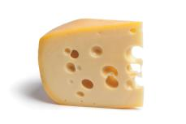
Tips for choosing healthy fats
Use soft tub non-hydrogenated margarine instead of hard margarines
Use oil instead of shortening, lard and hard margarine
Choose meat alternatives such as beans and lentils as part of your meals instead of processed meats like bologna, hot dogs, bacon and sausage
Choose low fat dairy instead of full fat dairy products
- Skim, 1% or 2% milk
- Low fat yogurt (<2%)
- Light part-skim cheese (<20%)
Notes:
Use oil instead of solid fats. For example, saute with olive oil instead of butter, and use canola oil when baking.
Prepare fish, such as salmon and mackerel, instead of meat at least twice a week to get healthy omega-3 fatty acids. Limit sizes to 4 to 6 ounces of cooked seafood a serving, and bake or broil seafood instead of frying.
Choose lean meat and skinless poultry. Trim visible fat from meat and poultry, and remove skin from poultry.
Snack smart. Many popular processed snack foods are high in fat, especially solid fats. Be sure to check food labels for saturated fat. Better yet, snack on whole fruits and vegetables.

Slide 14
Ways to cut down on fat
Use lower fat cooking methods
Flavour foods with garlic, lemon, herbs & spices
Trim visible fat from meat
Remove skin from poultry
Limit foods covered with gravy or sauces
Ask for dressings and sauces on the side
Eat smaller portions
Limit ice cream, coffee cream & whipping cream
Notes:
Use lower fat cooking methods such as baking & stir frying.
Instead of butter, flavour foods with garlic, lemon, vinegars, herbs and spices
Limit foods covered with gravy, sauces or sour cream
Ask for dressings and sauces on the side and use sparingly.
Consider sharing a large portion with someone else or taking half the meal home for tomorrow’s lunch

Slide 15
THANK YOU!
Notes:
Do you have any questions about today’s presentation?
Are there other topics you’d like to hear about at future sessions? If so, please let me know.
Now, let’s play a game called: ‘Which has more fat?’

