Slide 1
Fibre!
ADI presentation
2017
Notes:
Today I will present on ‘Fibre’.
The presentation will last about 15-20 minutes and then we will do an activity called: “Fill up on Fibre”, OR: “Which food has more fibre?”

Slide 2
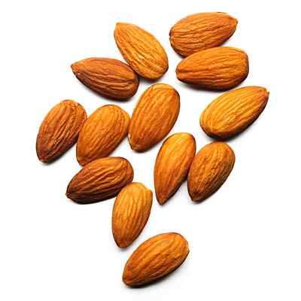
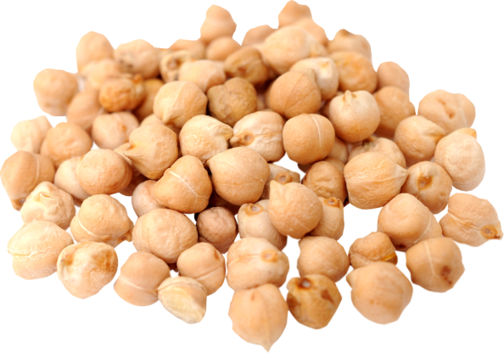
A question for you….
What do chickpeas, apples and almonds have in common?
Notes:
They all contain fibre.
Dietary fiber, also known as roughage or bulk, is a carbohydrate that includes the parts of plant foods your body can't digest or absorb. Unlike other food components, such as fats, proteins or carbohydrates — which your body breaks down and absorbs — fiber isn't digested by your body. Instead, it passes relatively intact through your stomach, small intestine and colon and out of your body.

Slide 3
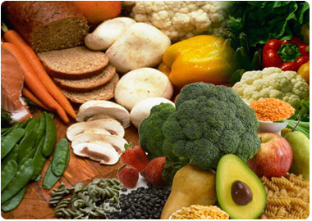
Outline
Fibre’s role
Different types of fibre
How much fibre do you need?
Which foods have fibre
How to get more fibre in your diet
Vegetables and fruit
Grain products
Meat alternatives
Notes:
Here’s an outline of what we will talk about during today’s presentation.

Slide 4
Fibre’s role
Keeps you regular
Lowers your cholesterol
Controls your blood glucose (blood sugar)
Helps to achieve a healthy body weight
May protect against colon cancer
May lower your risk of heart disease
Notes:
A high-fiber diet has many benefits, which include:
Keeps you regular. Dietary fiber increases the weight and size of your stool and softens it. A bulky stool is easier to pass, decreasing your chance of constipation. If you have loose, watery stools, fiber may help to solidify the stool because it absorbs water and adds bulk to stool.
Lowers your cholesterol. Soluble fiber found in beans, oats, flaxseed and oat bran may help lower total blood cholesterol levels by lowering low-density lipoprotein, or "bad," cholesterol levels. Studies also have shown that high-fiber foods may have other heart-health benefits, such as reducing blood pressure. We will discuss soluble and insoluble fibre in the next couple of slides.
Helps control blood sugar levels. In people with diabetes, fiber — particularly soluble fiber — can slow the absorption of sugar and help improve blood sugar levels. A healthy diet that includes insoluble fiber may also reduce the risk of developing type 2 diabetes. Sugar levels don’t rise as rapidly if the food eaten is higher in fibre compared to being a low fibre food, since it takes longer for food to digest if it is higher in fibre. For example, it takes our body longer to digest a whole apple compared to digesting apple juice.
Helps to achieve a healthy weight. High-fiber foods tend to be more filling than low-fiber foods, so you're likely to eat less and stay satisfied longer. And high-fiber foods tend to take longer to eat and to be less "energy dense," which means they have fewer calories for the same volume of food.
Another benefit of fiber is prevention of colon cancer. However, the evidence that fiber reduces colon cancer is mixed.
Studies also show that diets high in fiber, especially cereal fiber are associated with a decreased risk of cardiovascular disease.

Slide 5
Soluble fibre
Soft fibre that helps to:
lower cholesterol and
control blood glucose
Manage diarrhea
Found in:
some fruits (apples, oranges, strawberries)
vegetables (carrots, peas, okra and eggplant)
oats, barley, psyllium, and
legumes (beans and lentils)
Notes:
There are two main types of fibre: soluble and insoluble fibre.
Soluble fibre is the soft fibre that dissolves in water to form a gel-like material.
It helps control blood glucose (sugar) and reduces cholesterol. It also helps in managing diarrhea. Soluble fibre is present in oat bran, oatmeal, legumes (dried beans and lentils) and fruits such as apples and strawberries.
Aim for at least 10 grams of soluble fibre every day.

Slide 6
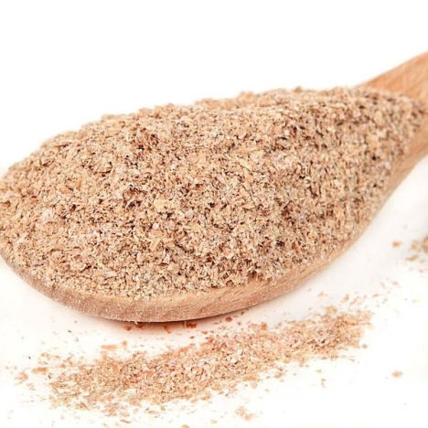
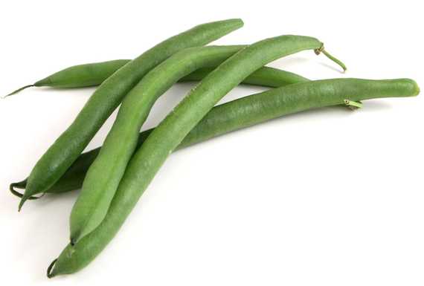
Insoluble fibre
Promotes the movement of material through your digestive system
Helps to keep you regular
Found in:
some vegetables (cauliflower, green beans, potatoes)
some fruit
whole grains and wheat bran
nuts
Notes:
Insoluble fiber promotes the movement of material through your digestive system and increases stool bulk, so it can be of benefit to those who struggle with constipation or irregular stools. Whole-wheat flour, wheat bran, nuts, beans and vegetables, such as cauliflower, green beans and potatoes, are good sources of insoluble fiber.
It is important to eat a variety of fibre-rich foods to get the health benefits of both types of fibre.
Most plant-based foods, such as oatmeal and beans, contain both soluble and insoluble fiber. However, the amount of each type varies in different plant foods. To receive the greatest health benefit, eat a wide variety of high-fiber foods.

Slide 7
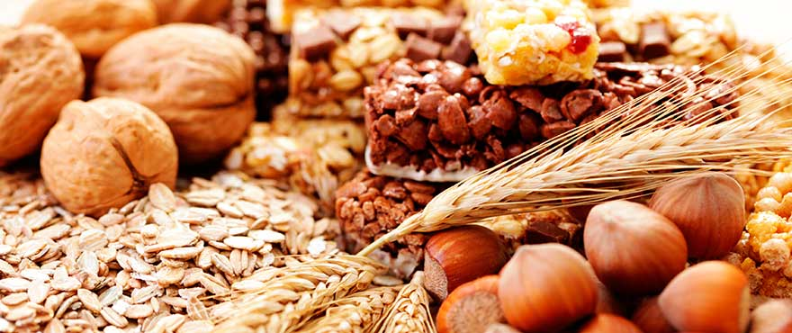
How much fibre do you need?
Men (under 50 years old) - 38 grams/day
Men (over 50 years old) - 30 grams/day
Women (under 50 years old) – 25 grams/day
Women (over 50 years old) – 21grams/day
People with diabetes – 25-50 grams/day
Notes:
The amount of fibre you need per day depends on your age and your gender and whether or not you have diabetes.
Here are the fibre recommendations for men and women. Please note that people with diabetes should be getting 25-50 grams of fibre each day.
Typically Canadians get about 15 grams of fibre per day – about ½ the amount that we should be getting.
In the next few slides I’ll share with you ways that you can increase the amount of fibre in your diet.
Recommended grams of fibre per day
Children 1-3 years old 19 grams
Children 4-8 years old 25 grams
Boys 9-13 years old 31 grams
Boys 14-18 years old 38 grams
Girls 9-13 years old 26 grams
Girls 14-18 years old 26 grams
Men 19-50 years old 38 grams
Men 51 and over 30 grams
Women 19-50 years old 25 grams
Women 51 and over 21 grams
Pregnant women 28 grams
Breastfeeding women 29 grams

Slide 8
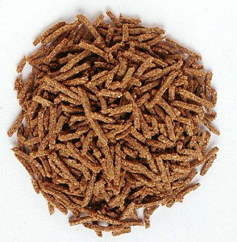
Boost up your fibre
Choose a high-fibre breakfast cereal
Eat at least ½ of all grains as whole grains
Include more legumes in your diet
Add barley, beans and lentils to soups, salads and casseroles
Eat more vegetables and fruit
Eat the skins and seeds
Include dried fruit in your diet
Add ground flax seeds to yogurt or cereal
Add nuts to salads and baked goods
Notes:
Here are some ideas for adding more fiber to your meals and snacks.
For breakfast choose a high-fiber breakfast cereal — 5 or more grams of fiber a serving. Opt for cereals with "whole grain," "bran" or "fiber" in the name. Or add a few tablespoons of unprocessed wheat bran to your favorite cereal.
Switch to whole grains. Consume at least half of all grains as whole grains. Look for breads that list whole wheat, whole-wheat flour or another whole grain as the first ingredient on the label and have least 2 grams of dietary fiber a serving. Experiment with oats, brown rice, wild rice, barley, whole-wheat pasta and bulgur wheat.
Add whole wheat flour, corn meal, bran flakes or rolled oats to bannock
Substitute whole-grain flour for half or all of the white flour when baking. Try adding crushed bran cereal, unprocessed wheat bran or uncooked oatmeal to muffins, cakes and cookies.
Include more legumes in your diet. Beans, peas and lentils are excellent sources of fiber. Add kidney beans to canned soup or a green salad. Or make nachos with refried black beans, lots of fresh veggies, whole-wheat tortilla chips and salsa.
Eat more fruit and vegetables. Fruits and vegetables are rich in fiber, as well as vitamins and minerals. Try to eat five or more servings daily. Choose whole vegetables and fruit instead of juice.
Eat the skins and seeds of vegetables and fruit.
Try having fruit as a snack, or as dessert.
Add ground flax seeds to yogurt, cereals, salads or baked goods.
Add nuts to salads and baked goods.
Use bran, oats to mix into ground meat.

Slide 9
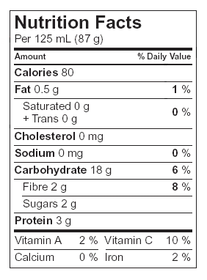
Read food labels
Compare products and pick the one with the most fibre
Be sure you are comparing the same serving sizes
Check for grams of fibre
Source of fibre – at least 2 grams
Good source of fibre – at least 4 grams
Excellent source of fibre – at least 6 grams
Look for ingredients such as bran, whole grain whole wheat or oatmeal
Notes:
One great way to make sure that you’re getting enough fibre in your diet is to read the nutrition food labels.
When reading food labels, look for breads, bagels, English muffins, pitas, tortillas and wraps with 2 to 4 grams of fibre per serving on the Nutrition Label.
Read the ingredient lists and look for ingredients such as bran, whole grain, whole wheat and oatmeal for the grain products.

Slide 10
Too much, too quickly?
Increase the fibre in your diet slowly to avoid gas, bloating and diarrhea
Divide fibre-containing foods throughout the day at both meals and snacks
Drink plenty of water
Notes:
High-fiber foods are good for your health. But you want to increase fiber in your diet gradually over a period of a few weeks. This allows the natural bacteria in your digestive system to adjust to the change. Otherwise adding too much fiber too quickly can lead to discomfort, intestinal gas, abdominal bloating, cramping and diarrhea.
Drink plenty of water. Fiber works best when it absorbs water, making your stool soft and bulky. When too little water is drank, constipation may occur.
You need to drink 6-8 cups of fluid each day for the fibre to work best.

Slide 11
Sample low vs high fibre meal
Low fibre:
¾ cups corn flakes (0.8 g)
1 cup of milk (0 g)
1 slice white toast (0.9 g)
15 ml jam (0.2 g)
½ cup orange juice (0.5 g)
Total: 2.4 grams
High fibre:
½ cup bran flakes (5 g)
1 cup of milk (0 g)
1 slice whole wheat toast (3.2 g)
15 ml peanut butter (0.9 g)
1 orange (3.1 g)
Total: 12.2 grams
Notes:
You can easily make small changes to your diet to include more fibre. This slide includes a low and high fibre meal plan. The meals look very similar, yet the amount of fibre is quite different between both meals.
With just breakfast, the person eating a high fibre meal has already reached almost ½ of his or her fibre requirements for the day. The changes in the diet are not huge, but the amount of fibre in the diet are.

Slide 12
Thank you
Notes:
Do you have any questions about today’s presentation?
Are there other topics you’d like to hear about at future sessions? If so, please let me know.
Now, let’s do one of the activities:
“Fill up on Fibre” OR: “Which food has more fibre?”

