Slide 1
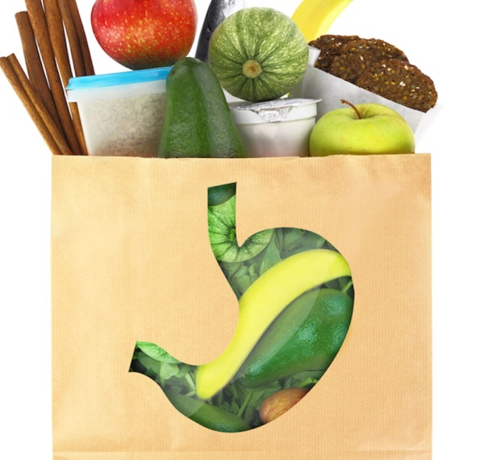
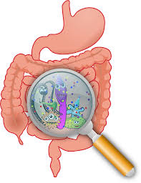
Eating for a Healthy Gut
Notes:
Hi, My name is ____________ and today we are going to talk about how to help keep your gut healthy

Slide 2
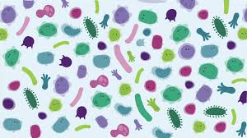
Outline
What makes a healthy gut?
  Gut microbiota
Gut Bacteria
Probiotics
Prebiotics
Activity

Slide 3
What Makes a Healthy Gut?
Human gut (intestines) are filled with trillions of microorganisms, most live in the colon
These microorganisms are called the Gut Microbiota
These microorganisms are important to keep us healthy!
Microbiota video: http://cdhf.ca/en/videos/introducing-the-human-gut-microbiome
Notes:
Our body is a host to trillions of microscopic organisms that live on our skin, in our mouth, and nose, and intestines. Most of them live in the colon.
There are many different types of microorganisms including bacteria and viruses, all together these microbes make up a system called the GUT MICROBIOTA
These tiny microbes play many important roles in our body to keep us healthy!
We have a quick video that helps to explain what the gut microbiota is and what it does for you

Slide 4
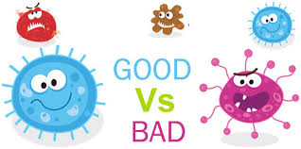
Gut Bacteria
Help with immune system
Help with digestion
Help protect us from bad bacteria
Unbalanced gut bacteria= increased risk for disease
Balance + Diversity = Healthy gut!
Notes:
Although there are many different types of microorganisms living in the gut, there is the most known about the gut bacteria. We know that the bacteria in our gut does a lot of things to help keep us healthy, this includes:
Helping to keep our immune system strong to protect and fight off infections quicker.
Helps to digest food and make some vitamins (B12 and K), to make sure we are getting the most nutrition possible from the food we eat.
Finally, the good bacteria also works to protect us from letting bad bacteria grow in our body. When there is an imbalance of good and bad bacteria, we have a greater chance of becoming sick.
The more good bacteria we have in our gut, the less room there is for the bad bacteria to grow and make us sick!
It is important to have a Balance of many Different types of bacteria in the gut. Each different type of bacteria plays a special role to keep you healthy

Slide 5
Gut Bacteria
Imbalance is associated with disease:
  Colorectal Cancer
  Obesity
  Diabetes
  Allergies
  Asthma
  Irritable Bowel Syndrome (IBS)
  Inflammatory Bowel Disease (IBD)
Notes:
Some diseases have been linked to an imbalance in our gut bacteria:
Colorectal Cancer
Obesity
Diabetes
Allergies
Asthma
Irritable Bowel Syndrome (IBS)
Inflammatory Bowel Disease (IBD)
There is still a lot of research being done to see how we can use the gut microbiota to help prevent and treat disease

Slide 6
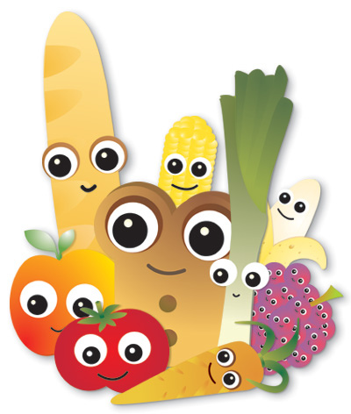
What can affect our gut bacteria?
Mode of delivery (how we are born)
Infant feeding
Antibiotics
Environment
Diet
  Probiotics
  Prebiotics
Notes:
There are many different things that can affect the amount and diversity of bacteria in the gut. Each of these factors play a role into the development and diversity of your gut bacteria. For the purpose of today’s presentation, we are going to mainly focus on diet.

Slide 7
What can affect our gut bacteria?
1. Mode of Delivery
The way we are born affects the first types of bacteria to grow in our gut
  2. Infant Feeding
How we are first fed helps to grow the bacteria in our gut
  Breastfeeding
  Formula
Once we are about 2 ½ years old, we have our “adult” gut bacteria
Notes:
When we are born, our gut does not yet have bacteria. The first few years are when we develop and grow our personalized gut microbiota.
Mode of delivery- the way we are born affects the first types of bacteria to grow in our gut.
Infants born by caesarean section have gut bacteria similar to skin
Infants born naturally have gut bacteria similar to the mothers gut, giving them a great start to their gut microbiota!
Infant Feeding- how we are first fed helps to foster and grow the bacteria in the gut
Breast milk contains a component that helps to feed the good bacteria in the gut
The bacteria in our gut changes a lot in the first few years of life, but once we are around 2-3 years old the gut bacteria stabilizes into what will be our own personalized gut bacteria throughout adulthood!
Of course, this “adult” gut bacteria can still be changed over our lifetime by medications (antibiotics), environment and what we eat.

Slide 8
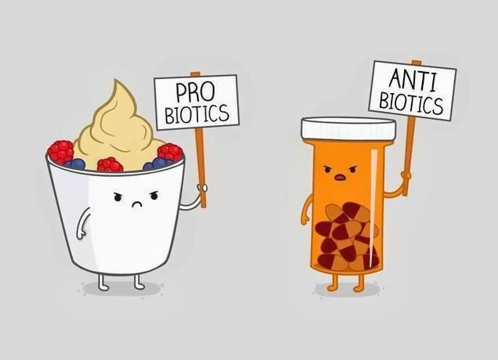
What can affect our gut bacteria?
3. Antibiotics
Can kill the good and bad bacteria
4. Environment
Exposes us to a variety of bacteria throughout our life
Notes:
Antibiotics are a type of medication commonly used to treat a variety of infections. Antibiotics work to kill the bad bacteria, but they also kill some of the good bacteria! Depending on how long you are on antibiotics for, it can take time for the good bacteria to grow back.
The environment that we live in may also affect our gut bacteria. Throughout our life we are exposed to a variety of good and bad bacteria that could impact the types of bacteria in the gut.

Slide 9
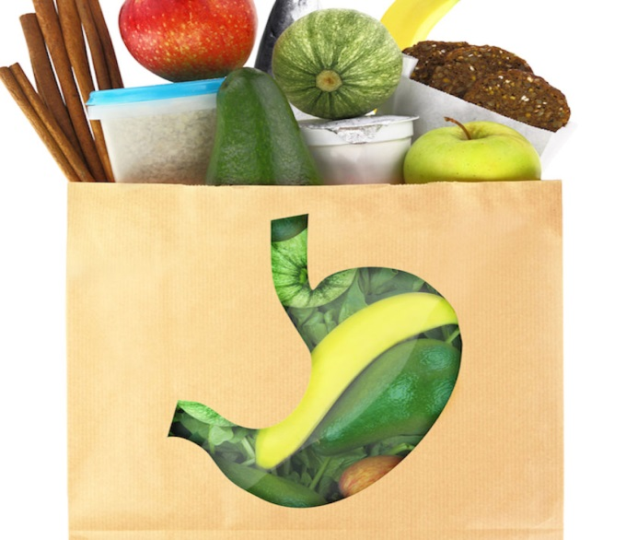
What can affect our gut bacteria?
5. DIET
What we eat impacts our gut bacteria and overall gut health
Food helps to increase the diversity, balance of bacteria in our gut… and so much more!
Probiotics
Prebiotics
Notes:
The focus today will be on diet, and how what we eat impacts our gut bacteria and overall gut health.
The food we eat helps to increase the diversity, balance of bacteria in our gut, and so much more.
Two components of food that are known to help keep the gut healthy are probiotics and prebiotics.

Slide 10
Probiotics
Probiotics are live, non-pathogenic microorganisms that are thought to be beneficial to the health of the host
Known benefits of probiotics:
  Helps with digestion
  Promotes regularity
  Improves nutrient absorption
  Helps keep a balance of “good” bacteria in the gut
Notes:
Probiotics are live, non-pathogenic (not dangerous) microorganisms that are thought to be beneficial to the health of the host (our bodies).
When we eat probiotics, they can help with our digestion, keep us regular, and add to the balance of good bacteria in the gut so there is less room for bad bacteria to grow

Slide 11
Probiotic Guidelines
In order for microorganisms to be considered a probiotic they must:
Be able to survive the digestion process
Not toxic
Remain alive during transport and storage
Have beneficial effects
Help balance gut microbiota
Help protect against bad bacteria
Notes:
There are specific guidelines for a microorganism to be called a probiotic. In order for microorganisms to be considered a probiotic they must:
Be able to survive the digestion process. In other words, when you eat the food with the probiotic, the bacteria must be able to make it all the way from your mouth, through your stomach and small intestine to your colon, where most of the other good bacteria live!
Not toxic (it won’t make you sick)
Remain alive during transport and storage. So that when the product is being moved to the store and to your house, the bacteria are still able to stay alive in amounts that are still going to be helpful to your body
Have beneficial effects
Help balance gut microbiota
Help protect against bad bacteria
All of these guidelines are in place to make sure that companies are following the rules when making a product

Slide 12

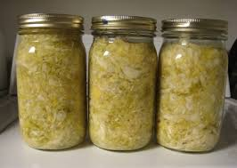
Probiotic Products
Probiotics come in a variety of forms:
  Supplements (Pills, Capsules, Powders)
  Added to food products
  Naturally occurring in food
    Fermented foods: use of yeast or bacteria
    to create flavor and preserve food
  NOTE: Probiotics must be taken regularly, since they do not grow in the gut
Notes:
We find probiotics in many different forms:
They are sold as supplements
Added to food products
And there are some foods that naturally contain bacteria that work very similar to probiotics. These are called fermented foods. They are also sometimes called probiotic foods. Fermentation happens when a bacteria or yeast breaks down the food product in an environment with no oxygen. As it breaks down the food, the bacteria usually produce an acid, which is why fermented foods taste sour, like sauerkraut or plain yogurt.
There are many different types of bacteria used as probiotics in supplements and added to food, read the label to know what type you are getting.
It is important to know that if you are taking probiotics in any form, you have to keep taking them regularly to maintain any benefits, since the probiotic bacteria do not keep growing in the gut.

Slide 13
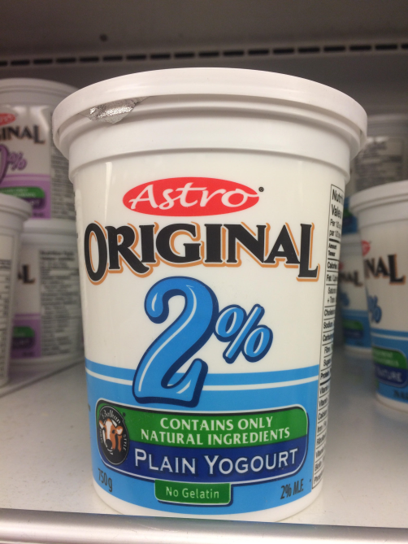
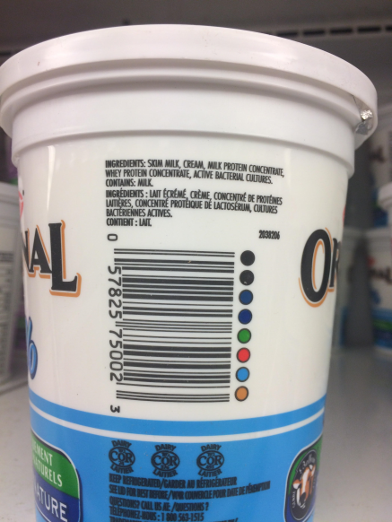
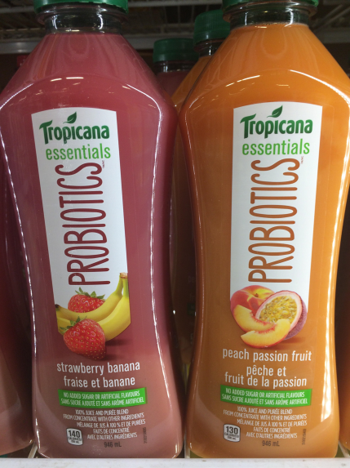
Foods Containing Live Bacteria
Naturally containing:
Sauerkraut
Kimchi
Kefir
Some types of pickles
Yogurt
Probiotics sometimes added to:
Yogurt
Juice
Gum
Milk
Ice cream
Chocolate
Notes:
As mentioned before, there are some foods that contain live bacteria that can work like probiotics, and are helpful to our gut health. These foods are all naturally fermented, and can contain many different types of bacteria.
Some examples include: Home made fermented products such as sauerkraut, and pickles. Some of the bacteria in these products survive all the way to the gut, and are helpful to our health like probiotics. Most of these products sold in stores are made with vinegar, are not naturally fermented and are processed at a very high heat so they do not contain any live good bacteria. Look for the words: live cultures on the ingredients label.
Also, not all fermented foods contain enough live bacteria to be helpful to our gut health.
** Fermented foods can offer many benefits, but were not researched in detail for the purpose of this presentation.
Specific probiotic bacteria are often added to foods as well such as: yogurt, juice and milk
Warning: pay attention to the amount of salt and sugar added to these products. While they do contain bacteria that are good for our gut health, they can often contain a lot of salt and sugar that is not good for our overall health!
Plain yogurt is a good choice of probiotic food because it has lots of nutrients that are healthy for our body (calcium, vitamin D) and it does not have added sugar flavoring. This way you can add your own fruit for flavor to control the amount of extra sugar.

Slide 14
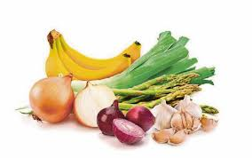
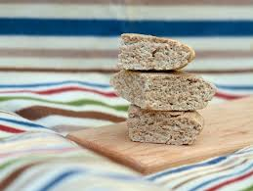
Prebiotics
A non-digestible food ingredient that helps the growth of good bacteria in the gut
Known benefits:
  Help feed good bacteria in the gut
  Help good bacteria grow and multiply
  Help with constipation
Notes:
Prebiotics on the other hand are non-digestible food ingredients that help the growth of good bacteria in the gut
They are also called the “food” for probiotics
It is known that the prebiotics in food help to feed good bacteria in the gut, which help good bacteria grow and multiply
Prebiotics can also help with constipation

Slide 15
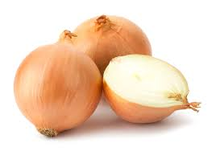
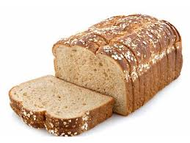
Foods Containing Prebiotics
Often found in high fibre foods
Foods such as:
  Whole grains
  Fruits and vegetables
    Ex. Onions, garlic, leeks, soybeans
Ingredients such as :
  Inulin
  Pectin
  Resistant starch
  Oligosaccharide (in breast milk)
Notes:
Prebiotics are found in high fibre foods, which is why they can help with constipation.
Prebiotics are also found in foods such as whole grain foods and fruits and vegetables like onions, garlic, leeks and soybeans
They are food components such as inulin, pectin, resistant starch, and oligosaccharides, which is the component in breast milk that helps to feed the good gut bacteria

Slide 16

Food, Pills, Capsules, Powders… What do I choose?
There is not enough research yet to say which form of probiotic is best
There is no recommended dose yet
Certain strains may help people with certain disease conditions (ex. IBS, IBD)
Everyone has a different gut microbiota, there is no guarantee that one type of probiotic will be as beneficial for everyone
Read labels to be aware of what you are consuming
Notes:
Unfortunately, there is not enough research to say which form of probiotic is best. There is also no specific recommended dose. What we do know is that you need at least 100 million colony forming units (cfu’s) per day.
What is known is that you have to take probiotics daily to keep them living in your gut.
If you would like to use probiotics to help treat a certain disease, such as IBS or IBD it is important to check which strain could help the most.
Remember, everyone has a different gut microbiota, so there is no guarantee that one type of probiotic will be as helpful for everyone.
It is important to always read the label so you can be aware of what you are putting into your body.

Slide 17

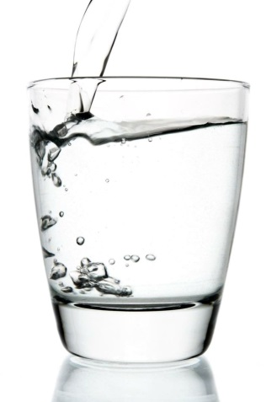
So, how do we keep our gut healthy?
Feed the “good” gut bacteria
  Eat high fibre foods: whole grain breads,
  pastas, cereals and rice
  Load up on veggies and fruit
  Breastfeed infants
Drink lots of water
Add in extra “good” bacteria
  Try incorporating a probiotic food each day
  Ex. Plain Yogurt
  Start Slow!
Notes:
So, after all of that, you are probably wondering what you can actually do to keep your gut healthy!
Feed the good gut bacteria, in other words, eat prebiotics, including high fibre foods. Not only do these foods help to feed the good gut bacteria, they also help to keep you regular. Breastfeeding is important to help feed the good bacteria in infant’s gut
Drink lots of water. As you increase your fibre intake it is important to also increase your water intake to help your body move the fibre through
Add in extra “good” bacteria. Eating a probiotic food each day such as yogurt can help keep your gut full of good bacteria, and keep the bad ones out!
Start Slow! Some types of probiotic bacteria create gas. If you are not used to eating probiotic foods or high fibre foods you may want to start with eating small amounts each day to let your body get used to the new bacteria.

Slide 18
For More Information…
Gut Microbiota
http://www.gutmicrobiotaforhealth.com/en/home/
http://cdhf.ca/en/staying-healthy/your-microbiota/section/about
http://loveyourtummy.org/
Probiotics/Prebiotics
http://cdhf.ca/en/staying-healthy/pre-probiotics/section/resources
http://cdhf.ca/bank/document_en/72understanding-probiotics-.pdf#zoom=100
http://cdhf.ca/en/videos/pre-and-probiotics
http://uat.eatrightontario.ca/en/Articles/Probiotics/prebiotics/Prebiotics.aspx
http://www.eatrightontario.ca/en/Articles/Digestion/The-Pros-of-Probiotics.aspx
Notes:
If you are interested in learning more about your gut microbiota and probiotics and prebiotics, these are a few links to some helpful websites!

Slide 19
Thank You!
Questions?

Slide 20
References
Azad, M. B., Konya, T., Maughan, H., Guttman, D. S., Field, C. J., Chari, R. S. ... & Kozyrskyj, A. L. (2013). Gut microbiota of healthy Canadian infants: profiles by mode of delivery and infant diet at 4 months. Canadian Medical Association Journal, 185(5), 385-394. doi: 10.1503/cmaj.121189.
Chilton, S. N., Burton, J. P. & Reid, G. (2015). Inclusion of fermented foods in food guides around the world. Nutrients, 7(1), 390-404. doi:10.3390/nu7010390
Clemente, J. C., Ursell, L. K., Wegener Parfrey, L. & Knight, R. (2012). The impact of the gut microbiota on human health, an integrative view. Cell, 148(6), 1258-1270.
Douglas, L.C. & Sanders, M. E. (2008). Probiotics and Prebiotics in Dietetics Practice. Journal of the American Dietetic Association, 108(3), 510-521. http://dx.doi.org/10.1016/j.jada.2007.12.009.
Huff, B. A. (2004). “Probiotics” might not be what they seem. Candadian Family Physician, 50, 583-7.
Krumbeck, J. A., Maldonado-Gomez, M. X., Ramer-Tait, A. E. & Hutkins, R. W. (2016). Prebiotics and synbiotics: dietary strategies for improving gut health. Current Opinion, 32(2), 110-119. doi: 10.1097/MOG.0000000000000249
Marco, M. L, Heeney, D., Binda, S., Cifelli, C. J., Cotter, P. D., Foligne, B. … & Hutkins, R. (2017). Health benefits of fermented foods: microbiota and beyond. Current Opinion in Biotechnology, 44, 94-102. https://doi-org.uml.idm.oclc.org/10.1016/j.copbio.2016.11.010
Practice Based Evidence in Nutrition (2016). Gastrointestinal system- Microbiota background. http://www.pennutrition.com/KnowledgePathway.aspx?kpid=24357&trid=25391&trcatid=38
Sanders, M. E., Guarner, F., Guerrant, R., Holt, P. R., Quigley, E. M., Sartor, R. B., Sherman, P. M. & Mayer, E. A. (2013). An update on the use and investigation of probiotics in health and disease. Gut, 62(5), 787-796. doi: 10.1136/gutjnl-2012-302504.
Tamang, J. P., Shin, D., Jung, S. & Chae, S. (2016). Functional properties of microorganisms in fermented foods. Fermented Foods, 7(578). doi: 10.3389/fmicb.2016.00578
Wallace, T. C., Guarner, F., Madsen, K., Cabana, M. D., Gibson, G., Hentges, E. and Sanders, M. E. (2011), Human gut microbiota and its relationship to health and disease. Nutrition Reviews, 69: 392–403. doi:10.1111/j.1753-4887.2011.00402.x

