Slide 1
Healthy Eating for Women with Pre-pregnancy Diabetes
ADI presentation
2016
Notes:
Today I will present on ‘Healthy Eating for Women with Pre-pregnancy Diabetes’.
The presentation will last about 15-20 minutes and then we will play a game called: ‘Who wants to be a Millionaire?’

Slide 2
Outline
What is diabetes?
Gestational diabetes vs. pre-pregnancy diabetes
Planning a healthy pregnancy
Risks for you and your baby
Healthy pregnancy tips
Healthy living after baby
Notes:
Here’s an outline of what we will talk about during today’s presentation.

Slide 3
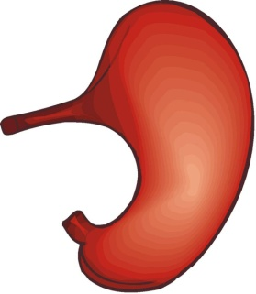
Digestion 101
When we eat foods that contain carbohydrates, our body turns them into sugar (glucose), which enter our blood
Blood
carbs
Stomach
Notes:
What foods contain carbohydrates?
-All grain products (bread, bannock, cereal, pasta, rice, muffins, wraps, etc)
-All fruit and fruit juices (including berries)
-Some vegetables (potatoes, sweet potatoes and corn)
-Milk, yogurt and ice cream
-Anything with added sugar (candies, pop, chocolate, cake, cookies, ketchup, plum sauce, 1000 island salad dressing, etc)
So when you eat foods that have carbohydrates such as bread, fruit, etc., they get broken down into glucose, which is a fancy word for sugar.
That sugar enters our blood and causes our blood sugar levels to go up.

Slide 4
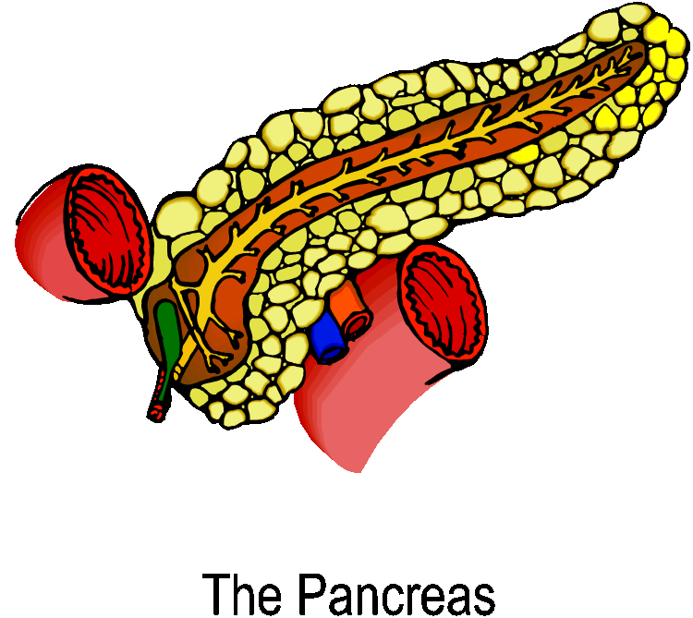
Digestion 101
When the sugar enters our blood, our pancreas releases insulin
Insulin acts as a key that allows the sugar to enter our cells
Cells
Insulin
Notes:
When we have high blood sugar levels, our brain sends a signal to the pancreas to start releasing insulin.
Insulin is a hormone that acts like a key and opens up the cells to allow the sugar in.
The cells can then use the blood sugar for energy to do their jobs.
Once the insulin opens the door and allows the sugar to enter our cells, we now have energy to do the things we need to do such as walking, going to work, etc.
Without insulin our body cannot correctly use the sugar we get from the food that we eat.

Slide 5
What is diabetes?
In type 1 diabetes, the pancreas does not make ANY insulin
In type 2 diabetes, the pancreas does not make enough insulin, or it’s not being used effectively
Cells
Insulin
Notes:
In people with Type 1 Diabetes the pancreas does not produce insulin, therefore, the sugar does not enter the cells and stays in the bloodstream which causes high blood sugar levels.
In type 2 diabetes not enough insulin is produced or the cells are resistant to it, therefore do not respond to the insulin and do not open to let all the glucose in. This results in the sugar being left in the bloodstream known as high blood sugar levels.
The longer someone is living with high blood sugar levels, the more likely they will develop complications related to diabetes. So it’s important to make sure our bodies get the insulin it needs to lower our blood sugar levels.

Slide 6
Diabetes
There are 3 different types of diabetes:
Type 1 diabetes
Uncommon in First Nations populations
Requires insulin for survival
Type 2 diabetes
Common in First Nations populations
Most are overweight or obese
Does not require insulin for survival
Gestational diabetes
Higher rates in First Nations populations
Only occurs during pregnancy
Notes:
Type 1 diabetes – it affects about 10% of those living with diabetes and cannot be prevented. It is generally diagnosed in children and youth and results when the body is not able to produce insulin.
Type 2 diabetes – it affects about 90% of those living with diabetes and can be delayed or prevented (through eating healthy and active living practices).
Gestational diabetes – Statistics say that gestational diabetes affects about 13% of pregnancies among Aboriginal women. However, this number may be much higher in some First Nations communities. Should a woman be diagnosed, her baby will not be born with diabetes. It will however increase her risk as well as her baby’s risk of future complications. Frequent follow-ups will be necessary to monitor the risk of developing diabetes in the future.

Slide 7
Gestational vs. pre-pregnancy diabetes
Gestational diabetes
Pre-pregnancy diabetes
Diabetes diagnosed during pregnancy and goes away after pregnancy
Type 1 or type 2 diabetes before pregnancy
Notes:
There are 2 different types of diabetes during pregnancy: gestational diabetes and pre-pregnancy diabetes.
Gestational diabetes and pre-pregnancy diabetes are NOT the same thing. We will focus most of this presentation on pre-pregnancy diabetes, but for this slide, we will look at the two different types of diabetes and compare them.
Gestational diabetes
Gestational diabetes is diagnosed at 24 to 28 weeks during pregnancy while the baby is growing and developing.
We don’t yet know exactly why some women develop gestational diabetes and others don’t.
During pregnancy the placenta produces high levels of other hormones, which impair the action of insulin in the body’s cells and causes blood sugar levels to go up. As the baby grows, the placenta produces more and more insulin-blocking hormones,
A pregnant woman’s insulin needs increase by 2-3 times due to her pregnancy and the baby’s needs.
To ensure that enough sugar stays in the mother’s blood to reach the baby, the normal response of these hormones blocks the action of the mother’s insulin in her body. Sometimes this is done too well and this is called gestational diabetes .
Pre-pregnancy diabetes:
The number of women with pre-pregnancy diabetes has increased in the past 10 years, because of the increase in number of people living with type 2 diabetes.
A woman who has diabetes should plan her pregnancy and it is best if she has good blood sugar control for at least 3-6 months before planning to get pregnant.
Most women do not know they are pregnant until the baby has been growing for up to 2-4 weeks.
In both cases, it is important for pregnant women to control her blood sugar levels.

Slide 8
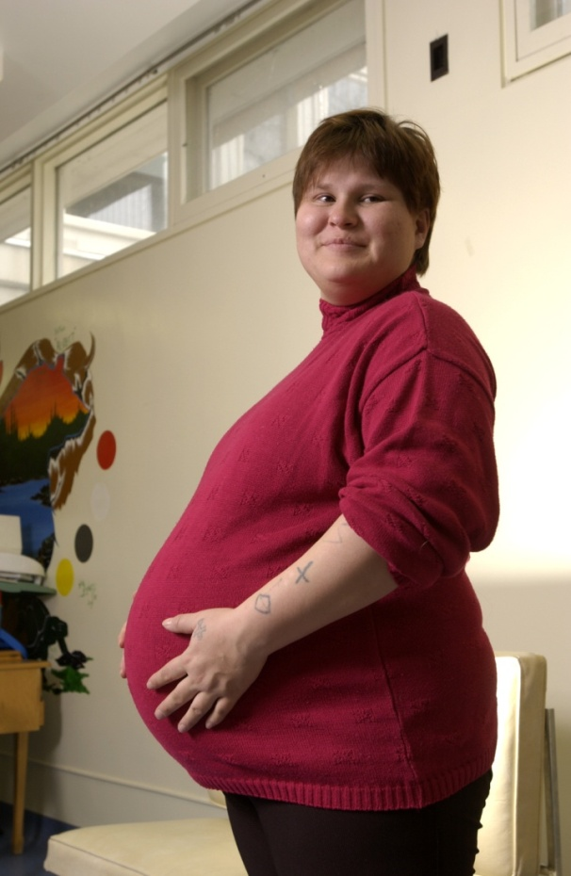
Planning a healthy pregnancy;
when you already have diabetes
Notes:
Planning your pregnancy gives you time to make healthy choices before you become pregnant and means you are able to choose a good time in your life to have a baby.
By planning your pregnancy you can reduce the risks to you and your baby.
It’s always important to plan a pregnancy, but even more so if you have type 1 or type 2 diabetes.

Slide 9
Planning a healthy pregnancy
If you had diabetes before you became pregnant, you need to:
Work with your community health nurse and doctor to learn to control your blood sugar levels and monitor your medications
Test your blood sugar levels regularly
Notes:
These things should be done at least 3-6 months before you start trying to get pregnant.

Slide 10
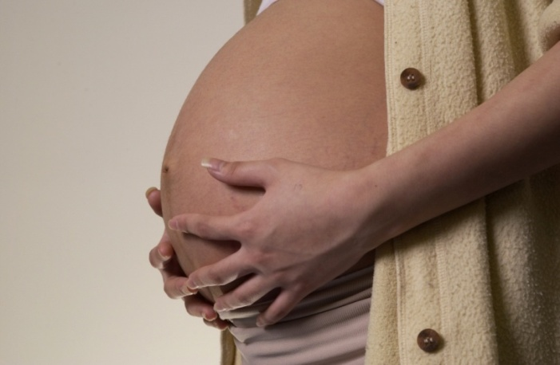
Planning a healthy pregnancy
If you had diabetes before you became pregnant, you need to:
Get screened for possible complications:
Blindness
High blood pressure
Chronic kidney disease
Heart disease
Notes:
Blindness (Retinopathy) – women with type 1 and type 2 diabetes should be seen by an eye doctor (optometrist) before conception, during the 1st trimester, as needed during pregnancy and within the first year postpartum.
If you have uncontrolled blood sugar levels during pregnancy (and up to 1 year after giving birth), you are at greater risk of blindness.
If you have pregnancy-induced high blood pressure or preeclampsia, you are at greater risk of blindness.
High blood pressure (Hypertension) -40-50% of women with type 1 and type 2 diabetes have high blood pressure during pregnancy. Women with type 2 diabetes tend to have chronic hypertension, whereas women with type 1 diabetes tend to have preeclampsia. Any type of hypertension is linked to negative outcomes. Some medications including calcium channel blockers are known to be safe during pregnancy.
Chronic kidney disease – women should be checked for kidney disease prior to conception. Kidney disease is associated with increased risk of maternal and fetal complications. ACE and ARBs should not be used during pregnancy.
Heart disease – Although rare, heart disease can occur in women of reproductive age with diabetes. This can lead to unhealthy outcomes for mom and baby. Women with heart disease should be seen regularly by her doctor or nurse.
All women with diabetes should be checked for diabetes related complications.
High blood sugar levels in the body can cause damage to vessels and nerves leading to serious complications such as high blood pressure, kidney disease, heart disease and blindness.

Slide 11
Planning a healthy pregnancy
If you had diabetes before you became pregnant, you need to:
Take a folic acid supplement
5 mg for at least 3 months before conception and until at least 12 week post conception
Notes:
You will notice that the recommendations of folic acid is much higher for women with pre-pregnancy diabetes than those who don’t have pre-pregnancy diabetes. The reason:
Many women with type 2 diabetes are overweight or obese, which is associated with:
Lower serum folate levels for the same intake
Lower intake of folate rich foods
Increased risk of neural tube defects
Therefore 5 mg will be more effective at reducing neural tube defects in this vulnerable population.
Folate is a B vitamin which is essential for normal development of the spine, brain and skull of the fetus and to prevent birth defects.

Slide 12
Risks of pre-pregnancy diabetes
Risks for mom
Risks for baby
Pregnancy loss
Increased chance of having a c-section
Worsening diabetes complications
Greater risk of low blood sugar levels
Higher risk for birth defects
Being a big baby
Higher risk of premature birth and complications
Greater risk for diabetes
Greater risk of sickness and health problems
Notes:
High blood sugar levels can cause problems for the both mom and her baby.
Risks for mom:
Pregnancy loss – such as still birth later on in pregnancy.
Nutrients and sugar are passed along from the mother’s bloodstream to the placenta. If the mother’s blood sugar levels are high, the extra sugar is passed on to the baby. Even though the baby can make more insulin as required, he/she can gain extra weight. This can result in labour being delayed or the baby may be too large for a vaginal delivery, making a caesarean section more likely.
Worsening of diabetes complications
Greater risk of low blood sugar levels, especially in the 1st trimester. Typically when women had a history of severe low blood sugar levels and hypoglycemia unawareness. Can also be because of the counter regulartory hormones reported in women with pre-pregnancy diabetes.
Risks for baby:
Higher chance of birth defects – Extra blood sugar and ketones pass through the placenta, causing harm to the baby.
The baby may be heavy, weighing more than 9 lbs. This may make the delivery more difficult for both mother and baby. For example:
The baby may have damage to her shoulders during birth
There may be a higher chance of having a ceasarean section birth.
There is a high risk of stillbirth
At birth the baby will have high levels of insulin in blood. Once her supply of sugar from her mother is cut off, she could have low blood sugar levels (within 1st 24 hrs) because the baby will be used to making lots of insulin in order to control his/her blood sugar levels. This could be harmful. Normal blood sugar levels can be restored when your baby is fed.
-Studies of women with pre-pregnancy diabetes continue to show higher rates of complications compared to the general population, including being born by c-section, preterm delivery, having high blood pressure, low blood calcium, jaundice (especially in premature babies), problems breathing normally, malformations and even death (CDA CPG, 2013; and Diabetes Quebec, 2004).

Slide 13
Good news!
Women who have pre-pregnancy diabetes can still have a healthy pregnancy
Even though a woman has diabetes during pregnancy, her baby will not be born with diabetes
Notes:
Having a mother with type 1 diabetes does not put a child at additional risk of developing diabetes.
Babies whose mothers have type 2 diabetes have a higher risk of getting diabetes later in life.

Slide 14
What can you do to have a healthy pregnancy?
Eat healthy foods
Gain a healthy amount of weight
Be physically active every day
Test your blood sugar levels regularly
Take insulin if needed
Notes:
Eat healthy foods:
A healthy diet is good for you and your family now and in the future. Enjoying foods from all four of the food groups and eating at regular times will play an important role in managing blood sugar levels and getting the best nutrition for you and your growing baby.
Gain a healthy amount of weight:
The amount of weight you gain will vary depending on your weight before your pregnancy. Weight loss is not recommended. Talk to your healthcare provider about appropriate gestational weight gain.
Gain the right amount of weight…. Do not lose weight
If you were underweight before you got pregnant, you should gain 28-40 lbs.
If you were of healthy weight before you got pregnant, you should gain 25-35 lbs.
If you were overweight before you got pregnant, you should gain 15-25 lbs.
If you were obese before you got pregnant, you should gain 11-20 lbs.
Be physically active every day, if possible:
-Regular physical activity can help control your blood sugar levels. It can help manage stress and prepare your body for labour, delivery & recovery.
-It can help gain an appropriate amount of weight. It may also make it easier to accept physical changes that go with pregnancy. Additionally, physical activity in pregnancy may help women maintain muscular and cardiovascular fitness, reduce the risk of pre-eclampsia, and decrease physical complaints like back pain.
-Try: gardening and house cleaning, walking, swimming and dancing. Start with 15 minutes at time and work towards 30 minutes. You should be able to talk while exercising.
-If you were active prior to your pregnancy you can continue to be active while replacing high impact exercises, such as jogging or aerobics, as your pregnancy progresses
If you were not active prior to pregnancy it’s never too late to get started! Start slowly and gradually increase.
Always talk to your doctor about physical activity during pregnancy
Take insulin, if needed:
Sometimes healthy eating and physical activity are not enough to manage blood sugar levels and you may need to take insulin. Insulin will help keep your blood sugar levels normal and will help to keep you and your baby in good health.

Slide 15
Healthy eating
There is no special ‘diabetes pregnancy’ diet
Eat a variety of foods from all four food groups
Vegetables and Fruit
Grain Products
Milk and Alternatives
Meat and Alternatives
Make healthy choices most of the time
Distribute carbohydrate foods throughout the day
Notes:
Pregnant women need to remember that they should be eating twice as healthy not twice as much!
Pregnant women should aim to have 3 meals and 2-3 snacks each day to meet the recommended servings from the four food groups in Eating Well with Canada’s Food Guide.
All foods can fit in moderation and women should eat a variety of food following Eating Well with Canada’s Food Guide.
Healthy choices most of the time include foods higher in fiber and lower in fat and sugar.
Distribute carbohydrate foods throughout the day, as carbohydrate foods turn into sugar in your body.

Slide 16
Folate, vitamin A
Iron, essential fats & protein
Folate, iron
Calcium, vitamin D
Notes:
Activity: Provide a copy of Eating Well with Canada’s Food Guide to the people attending your presentation.
Eat according to Eating Well with Canada’s Food Guide
The bottom line is: every food group is important and eating every food group will help your baby be healthier.
Vegetables and Fruit: (Green)
Pregnant women should aim for at least 7 servings of fruits and vegetables per day
Choose whole fruits and vegetables over juice to get the most nutrition out of your choices from this group.
Grain Products: (Yellow)
They give you iron and folate
Milk and Alternatives: (Blue)
It’s important to consume at least 2 servings of milk or milk alternatives daily to build the baby’s bones and teeth as well as to prevent osteoporosis for you
Meat and Alternatives: (Red)
You need at least 2 servings of meat and alternatives daily
One serving is 75 gram which is about 1 deck of card or the palm of a hand.
Iron found in meats is important to ensure healthy blood and help build the baby’s iron stores
Pregnant women should have at least 2 servings of fish each week for omega-3 fatty acids

Slide 17
The Plate Method
Notes:
Show plate and food models and how it would look for a meal.
Encourage all community members to have their plate look like this, including pregnant women.
Eat more vegetables. These are high in nutrients and low in calories.
Choose starchy foods such as whole grain breads and cereals, rice, noodles, or potatoes at every meal. Starchy foods are broken down into sugar that your body needs for energy. However, you should limit starchy choices to no more than ¼ of your plate at each meal.
Include fish, lean meats, low fat cheese, eggs, or vegetarian protein choices as part of your meal.
Have a glass or skim or 1% milk and a piece of fruit to complete your meal.

Slide 18
After your baby is born
To stay healthy:
Breastfeed
Eat healthy
Be active
Control your blood glucose levels
Be screened for possible diabetes complications
Manage your stress
Notes:
Breastfeeding your baby
There’s no reason why any woman who had diabetes should not breastfeed.
Breastfeeding helps to normalize your blood sugar levels
Breast milk may protect your baby from getting diabetes later in life
You may find it easier to lose weight after your baby is born if you breastfeed.
While you are breastfeeding, follow the same meal plan and activity schedule as for pregnancy.
Your after-delivery recovery will not be different than any other mother.
Your baby will not have diabetes after it is born.
Continue to monitor your blood sugar levels every day.
If you do not want to become pregnant right away, it is important to begin using protection as soon as possible after the birth of your baby.
Maintain contact with your diabetes health care team for follow up, screening for complications and counselling before any future pregnancies.
If you are overweight, it is important after your pregnancy to lose weight slowly until you are at a healthy weight for you.
A healthy eating plan following Eating Well with Canada’s Food Guide and regular physical activity is always important.

Slide 19
Thank you
Notes:
Do you have any questions about today’s presentation?
Are there other topics you’d like to hear about at future sessions? If so, please let me know.
Now, let’s play “Who wants to be a millionaire?”.

