Slide 1
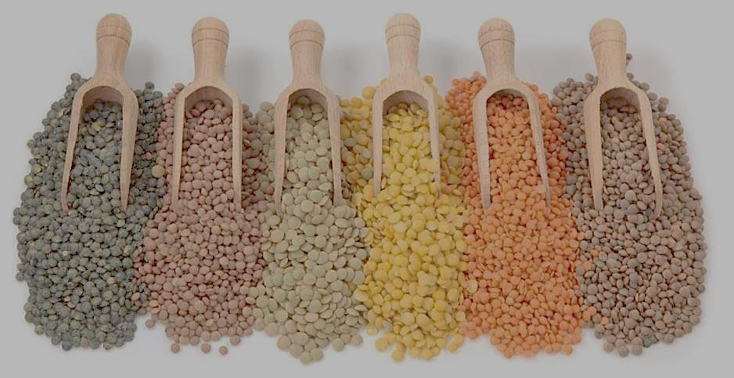
The Power of Pulses
ADI presentation
2016
Notes:
Today I will present on ‘The Power of Pulses’.
The presentation will last about 15-20 minutes and then we will play a game called: ‘Name That Pulse’.

Slide 2
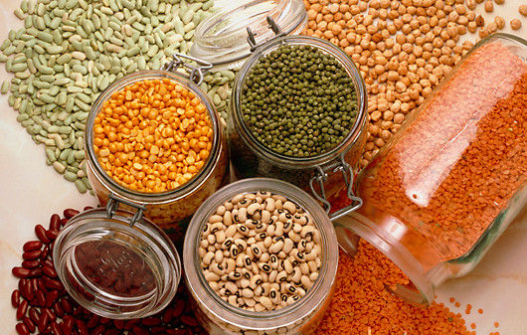
Outline
What are pulses?
Different types of pulses
Who should eat pulses?
Nutritional benefits of pulses
How to add more pulse to your diet
Pulses, pulses, the musical fruit
Cooking with pulses
Notes:
Here’s an outline of what we will talk about during today’s presentation.

Slide 3
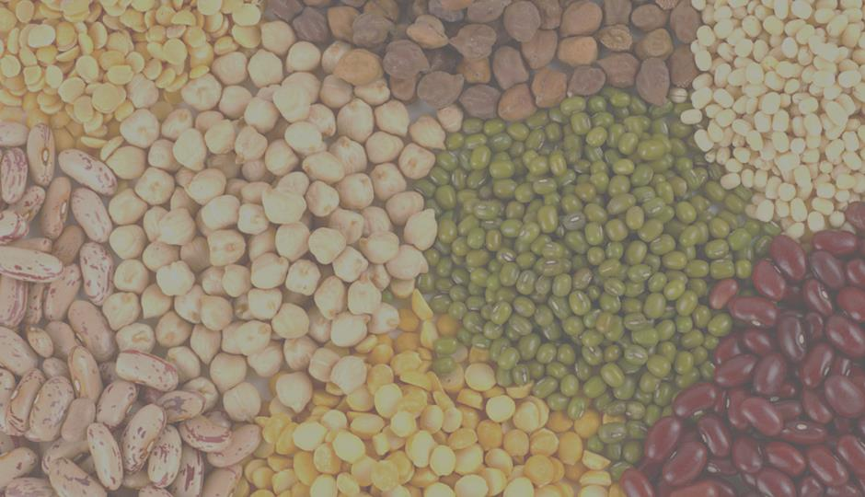
What are pulses?
‘Pulses’ refers only to the dried, edible seeds
Different shapes, sizes and colors
Consumed whole, split or ground
Pulses do not negatively affect the environment as much as meat does
Notes:
Pulses are part of the legume family, A legume (/ˈlɛɡjuːm/ or /ˌləˈɡjuːm/) is a plant or fruit/seed in the family Fabaceae (or Leguminosae). Legumes are grown agriculturally, primarily for their grain seed called pulse.
The term “pulse” refers only to the dried, edible seed. Dried peas, dried beans, lentils and chickpeas are the most common varieties of pulses. Pulses are very high in protein and fibre, and are low in fat.
Pulses do not include fresh green beans or peas, only dried. Although they are related to pulses because they are also edible seeds of podded plants, soy beans and peanut differ from pulses because they have a much higher fat content, whereas pulses contain virtually no fat.
Pulses come in a variety of shapes, sizes and colours and can be consumed in many forms including whole or split, ground in to flours or separated into different parts such as protein, fibre and starch.
As we will see in future slides, pulses are very high in nutrients and have been linked to improved health. As well, they are a unique food in their ability to reduce the environmental footprint of our grocery carts. Put it all together and these sensational seeds are a powerful food ingredient that can be used to deliver the results of healthy people and a healthy planet.

Slide 4
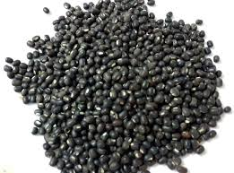
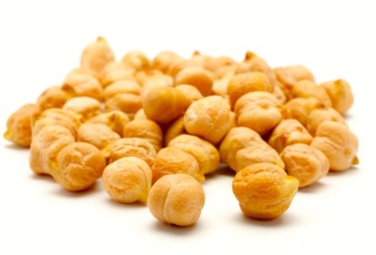
Different types of pulses
Split and whole dried peas
  Yellow peas
  Green peas
Lentils
  Green
  Red
Beans
  Red kidney
  Black
  Pinto
  Navy
Chickpeas
Notes:
There are many different types of pulses, which I’ve divided into 4 groups on this slide.
Split and whole dried peas (Yellow and green peas)
Lentils (Green and red)
Beans (Red kidney, black, pinto and navy)
Chickpeas

Slide 5

Who should eat pulses?
Everyone!
Notes:
Everyone can benefit from eating pulses. They are high in fiber, complex carbohydrates (the help with digestion, slow does the breakdown of food and therefore slow the release of sugars into the blood) and low in fat. These nutrients make pulses an important part of any healthy diet and can help maintain a healthy weight.
Pureed pulses can be an excellent food to give to your 6 month old baby once he or she is starting to eat solid foods.
Pulses have additional benefits for people who:
Are overweight
Have diabetes
Have high blood cholesterol levels
Tend to be constipated
Have celiac disease
Are vegetarian
Pulses are gluten-free and can be eaten by people with celiac disease. Pulses are great alternative to wheat-based products. They add fibre, protein, and many vitamins and minerals that may be lacking from a gluten-free diet.

Slide 6
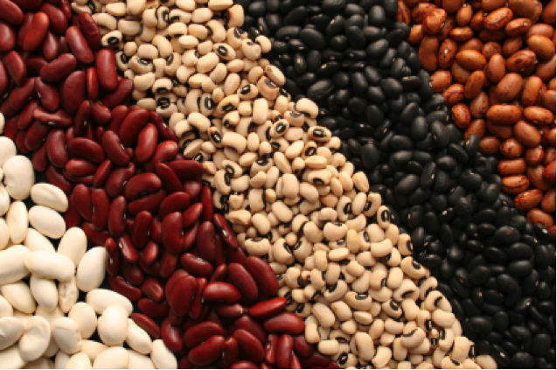
Nutritional benefits of pulses
Low in fat and saturated fat
High in fibre
Source of protein
High in of vitamins and minerals
Low glycemic index
PULSES CAN REDUCE LDL CHOLESTEROL
Notes:
The power of pulses is remarkable. They are a low fat and low saturated fat, (saturated fat is a fat that a person should have a minimal amount of in the diet, found mainly from animal sources, eg meat), a source of protein, and are high in fibre. They also have several vitamins and minerals including iron, potassium, folate and other B vitamins.
Fibre
Fibre includes all parts of plant foods that your body can't digest or absorb. Pulses are very high in fibre, containing both soluble and insoluble fibres. While soluble fibre helps to decrease blood cholesterol levels and control blood sugar levels, insoluble fibre helps with digestion and regularity. Most Canadians are not getting the recommended amount of fibre per day. The recommend daily intake of fibre is 38 g/day of total fibre for men and 25 g/day of total fibre for women. Eating just 125 mL (1/2 c.) of pulses per day provides 7 - 17 g of fibre. With their high fibre levels, pulses are a healthy food choice!
Make sure to drink enough water when adding high fibre foods like pulses to your diet. It is important to drink 6-8 glasses of water per day. If you start eating more pulses, it is important to drink water. Fibre helps to keep you regular but if you are not drinking enough water with the extra fibre, it can work the oppostie and actually cause constipation.
So just remember, more fibre = more water = good gut health
Protein
Pulses are somewhat unique as a plant food because in addition to high amount of fibre, pulses typically contain about twice the amount of protein found in whole grain cereals like wheat, oats, barley and rice. Blending pulses with cereals or nuts results in a better quality protein that contains all essential amino acids in appropriate amounts.
Vitamins and minerals
Pulses provide substantial amounts of vitamins and minerals including *iron, potassium, magnesium and zinc. Pulses are also particularly high in B vitamins including folate, thiamin and niacin.
*this is important for those who have low iron.
Low Glycemic Index
Pulses have a low glycemic index which means they do not cause a fast rise in blood sugar after eating. Most of the carbohydrates in pulses are fibre and starch that prevent blood sugars from rising quickly after a meal or snack. Studies have shown that eating pulses is a good way to manage blood sugar levels which is particularly important for people with diabetes.
Pulses Can Reduce “Bad” (LDL) Cholesterol – recent research shows that eating pulses for at least three weeks significantly reduces LDL-cholesterol levels, which can lower the risk of heart attack and stroke.
The average dose of pulses consumed in the studies was about ½ to ¾ cup of pulses/day. According to some research, pulse consumption lowered LDL-cholesterol levels by about 5%. This reduction translates to a 5 to 6% reduction in events like heart attack or stroke.
Many health organizations recommend eating pulses to maintain good health and prevent chronic diseases like diabetes, heart disease and cancer. Eating Well with Canada’s Food Guide states “Have meat alternatives such as beans and lentils often” and suggests that regularly choosing beans and other meat alternatives such as lentils can help minimize the amount of saturated fat in the diet.

Slide 7
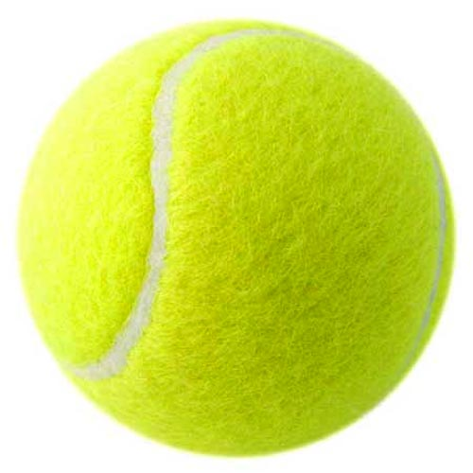
How many pulses should I eat?
Canada’s Food Guide recommends eating beans, lentils and peas often as an alternative to meat.
1 serving = ¾ cup (the size of a tennis ball)
Notes:
Pulses can be eaten every day. If you do not currently eat pulses often, start adding them to your diet gradually. Don’t forget to also drink more water☺
The next slide provides you with ideas on how to add more pulses to your diet.

Slide 8
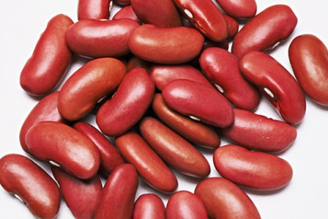
Add more pulse to your diet
Add them to soups, chilies, salads, pizzas, omelettes, burger, burritos and sandwiches
Add lentil and bean purees to your baked goods
Add pureed pulses to your spaghetti sauce
Make it part of your healthy snacks
  Hummus and crackers or vegetables
  Roasted chickpeas
Recipes:
http://www.pulsecanada.com/food-health/recipes
Notes:
There are many ways to add more pulse to your diet.
We’ve all seen pulses added to soups and chilies, which is great, but you can become more creative and add them to your salads (add chickpeas) pizzas, omelettes, burgers (add lentils), burritos (baked/mashed beans) and sandwiches.
Adding lentil and bean purees to your baked goods such as muffins, cookies and cakes are a great way to reduce the fat, increase the fibre and increase the protein in your diet.
Snacks like hummus and crackers pack a serious punch by combining pulses and cereal grains to increase fibre and protein
Mix canned, rinses and drained chickpeas with oil and spices (curry, garlic, cayenne) and bake at 400F for 30-50 minutes until crunchy.
Pulses are available as whole seeds and can also be turned into ingredients like flour, fibre, protein and starch.
You will be able to find a large variety of delicious pulse recipes online. Here’s an excellent website with tried, tested and true recipes. However, there are many excellent websites for recipes.
http://www.pulsecanada.com/food-health/recipes

Slide 9
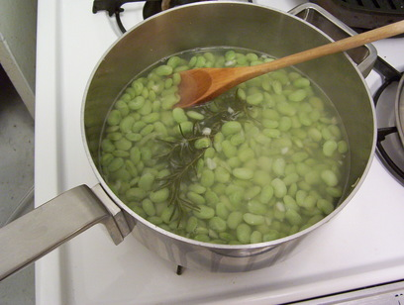
Using pulses
Cooking with canned pulses
Cooking with dried pulses
Soaking pulses
Pulse puree
Notes:
In the next few slides I will share with you the different ways you can use pulses to get the most nutrition in your diet.
These include:
Cooking with canned pulses
Cooking with dried pulses
How to soak dried pulses so that they can become edible
Making pulse puree to use for dips, spreads and some baked foods

Slide 10
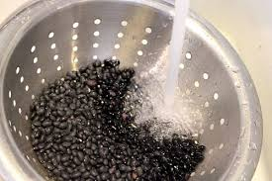
Cooking with canned pulses
Convenient
Ready-to-use
Always rinse and drain before using
Store in a cool, dry place
Notes:
Canned pulses are very convenient as they are pre-cooked and ready-to-use. They are available in most grocery stores, but tend to cost a bit more compared to dried pulses.
Always rinse and drain canned pulses before using them. When you do this, you will reduce the sodium (salt) by about 40% and the carbohydrates that cause gas in some individuals.
Canned pulses store well in cool, dry places. They may be stored up to one year.
You can eat them out of the can (mixed with rice, cheese and herbs), or add them to your favorite recipe – soup, stew or salad.

Slide 11
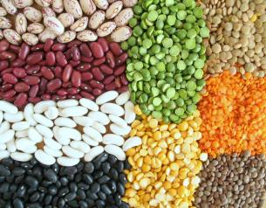
Cooking with dried pulses
Dry pulses will keep for years if they are stored in a tightly covered container and in a dark, cool and dry place
Best to use them within one year
Many dried pulses need to be soaked before you can use them in your recipe or eat them
Notes:
Dried pulses are readily available at most grocery stores. If you check and they are not in your local store in your community, go and talk to the manager and ask if they could bring some in.
When buying dried pulses look for seeds that are brightly colored and uniform in size with a smooth appearance. It’s best to use dried pulses within one year of buying them. However, they will keep for years if stored in a tightly covered container, in a cool, dark, dry place. The longer a pulse is stored, the dryer it becomes, which increases its cooking time.
Many dried pulses need to be soaked before you can use them in your recipe or eat them.
The next slide explains the different ways to soak pulses so that you can use them in your recipes.

Slide 12
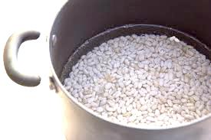
Soaking pulses
Long, cold soak or overnight
  Let stand for 12 hours or overnight in fridge
Quick soak
  Bring pulses and water to a boil in a pot
  Boil gently for 2 minutes
  Remove from heat, cover & let stand for 1 hr
Microwave soak
  Combine pulses and water in dish
  Cover and microwave for 10-15 minutes
  Let stand for 1 hour
Notes:
Dry beans, whole peas and chickpeas must be soaked because their skins do not readily absorb water.
Dry lentils and split peas do not need to be soaked. However, they must be rinsed before cooking.
For every 1 cup of pulses, soak with 3 cups of water. Whole peas can be soaked for 1-2 hours. Beans and whole chickpeas require longer soaking than whole peas.
Make sure your saucepan is big enough, as pulses double and triple in size during cooking.
Always discard the soaking water by putting pulses into a strainer and rinsing them well. This washes away the carbohydrates and sugars that cause gas.

Slide 13
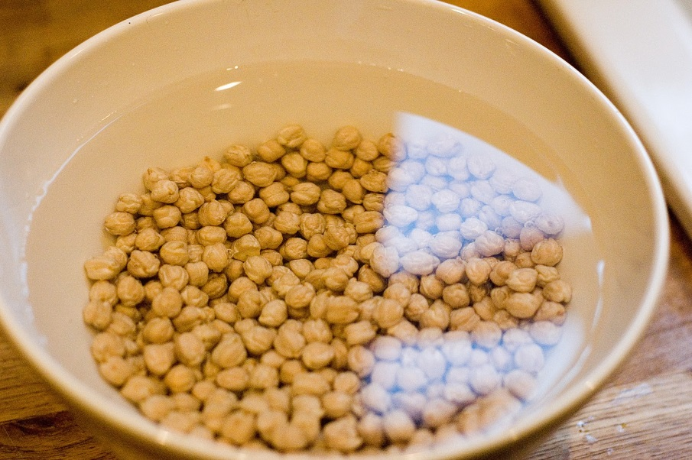
Soaking pulses
For every 1 cup of pulses, soak with 3 cups of water.
Whole peas can be soaked for 1-2 hours.
Beans and whole chickpeas require longer soaking than whole peas.

Slide 14

Pulses, pulses, the musical fruit
To cut down the discomfort from eating pulses:
  Eat small amounts of pulses
  Gradually increase your intake
  Drink lots of water
  Change the soaking water 1-2 times
  Do not use the soaking liquid to cook the pulses
  Cook pulses thoroughly
  Thoroughly rinse canned or pre-soaked pulses before cooking
Notes:
Some carbohydrates in pulses produce gas and bloating for some people. Eating pulses often allows your gut to adapt to the higher fibre and carbohydrates, decreasing these effects over time.
For those who find that pulses lead to gas and bloating, here are some easy things that you can do to significantly reduce the digestive discomfort that can occur from eating pulses.
Cook pulses thoroughly as undercooked starch is harder to digest.

Slide 15
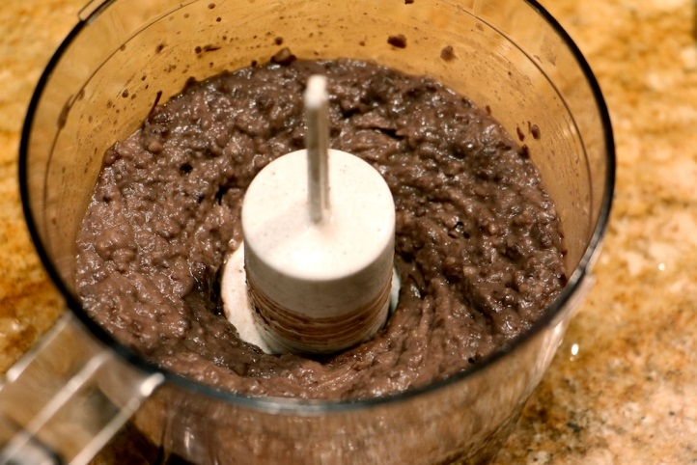
How to make pulse puree
Place cooked or rinsed and drained canned pulses into a food processor
For each cup of pulses, put ¼ cup of water
Blend to make a smooth puree, with a consistency like canned pumpkin
If needed, add additional water
Use in recipe immediately, or freeze
Notes:
Purees are useful for dips, spreads and some baked foods.
Purees can be frozen in plastic bags and kept for several months in the freezer.

Slide 16
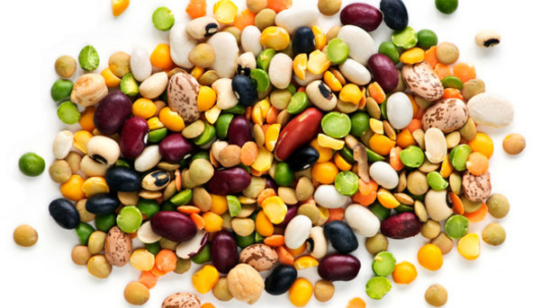
Thank you
Notes:
Do you have any questions about today’s presentation?
Are there other topics you’d like to hear about at future sessions? If so, please let me know.
Now, let’s play “Name That Pulse” game.

