Slide 1
WHICH HAS MORE FAT?
ADI activity

Slide 2
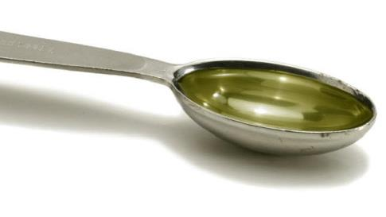
REVIEW:
Each teaspoon of fat
= 4 grams of fat
= 36 calories!

Slide 3
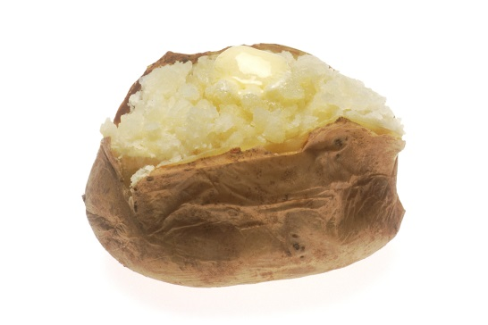
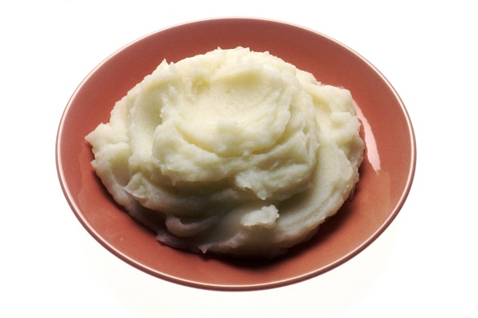
WHICH HAS MORE FAT?
1 Baked potato
0 teaspoons
Mashed potato (1/2 cup made with whole milk and butter)
1 ¼ teaspoons

Slide 4
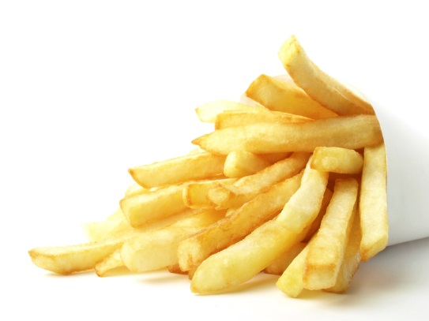
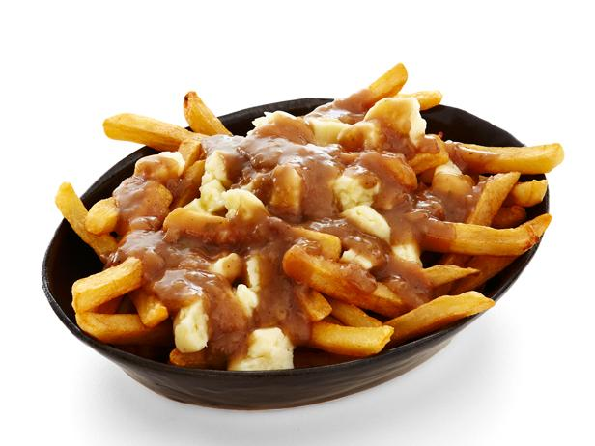
WHICH HAS MORE FAT?
20 French fries
2 ½ teaspoons
Poutine (20 fries, 75 ml gravy and 80 ml cheese)
6 teaspoons
Notes:
6 teaspoon of fat = 24 grams of fat = 216 calories (of fat only… there will also be calories from the carbs and protein in the poutine!)

Slide 5
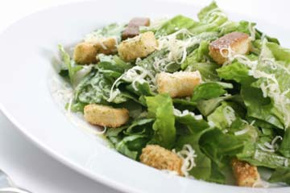
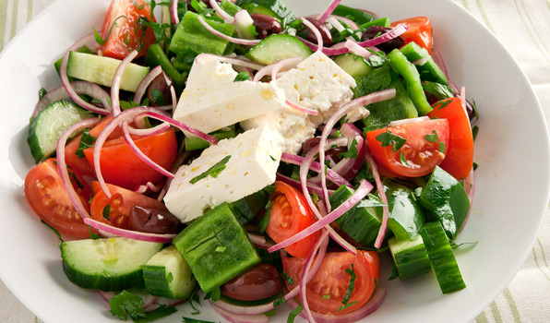
WHICH HAS MORE FAT?
2 cups of Ceasar salad
5 ½ teaspoons
2 cups of Greek salad
3 teaspoons

Slide 6
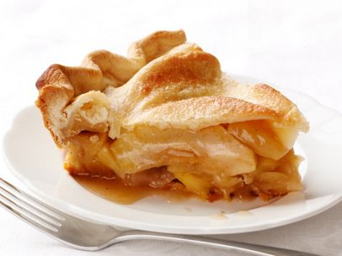
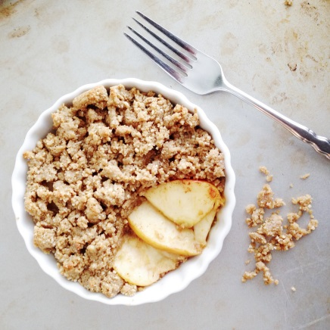
WHICH HAS MORE FAT?
1/8 Apple pie
3 ½ teaspoons
Apple crisp (1 1/3 cup)
1 teaspoon

Slide 7
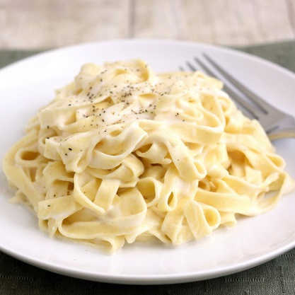
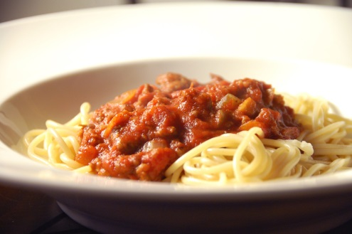
WHICH HAS MORE FAT?
1 cup of spaghetti with tomato meat sauce
2 ½ teaspoons
1 cup of fettucuini alfredo
4 teaspoons

Slide 8
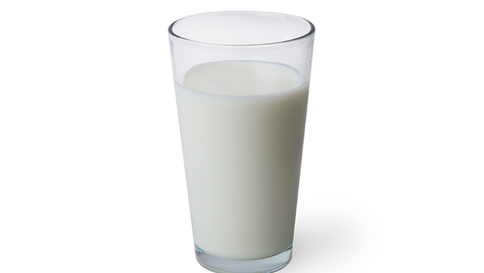
WHICH HAS MORE FAT?
1 cup skim milk
0 teaspoons
1 cup whole milk
2 teaspoons

Slide 9
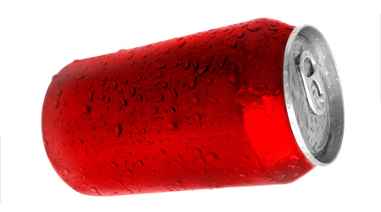
WHICH HAS MORE FAT?
1 can of pop
0 teaspoons
1 commercial french vanilla cappuccino (286 ml)
2 teaspoons

Slide 10
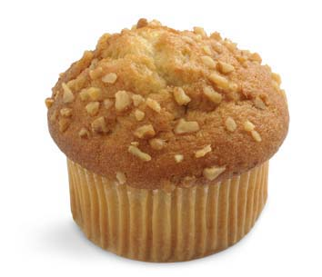
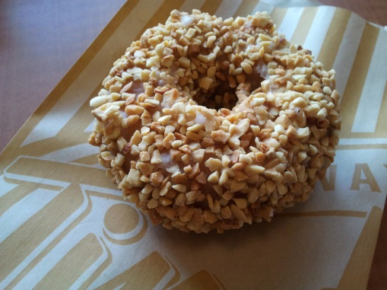
WHICH HAS MORE FAT?
1 chocolate peanut crunch donut (74 g)
4 ¼ teaspoons
1 banana nut muffin (115 g)
4 ½ teaspoons

Slide 11
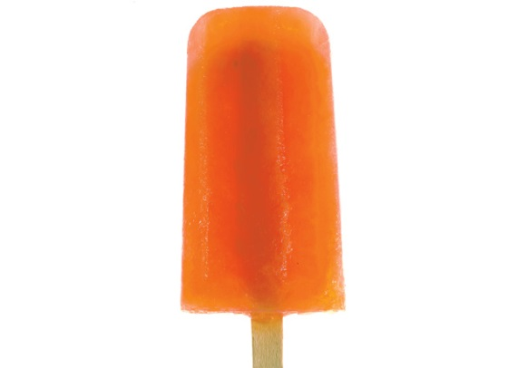
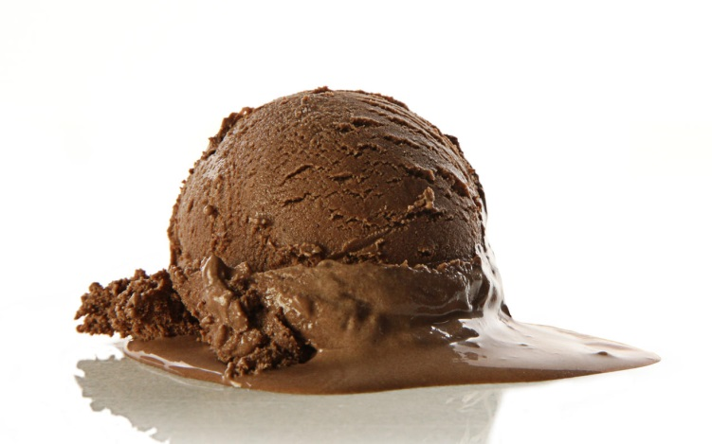
WHICH HAS MORE FAT?
1 popsicle (75 g)
0 teaspoons
½ cup chocolate ice cream
2 teaspoons

Slide 12
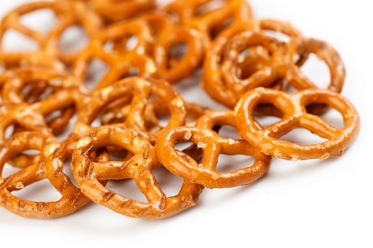
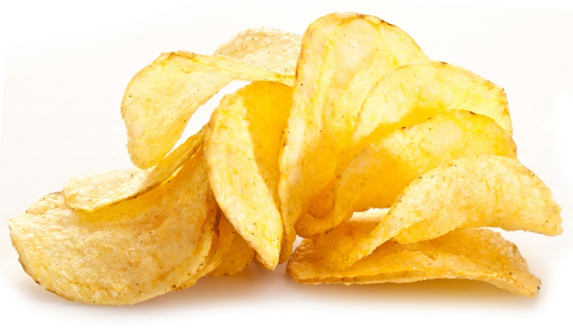
WHICH HAS MORE FAT?
20 potato chips
2 teaspoons
20 pretzels
0 teaspoons

