Slide 1
Which food has more fibre?
ADI activity

Slide 2
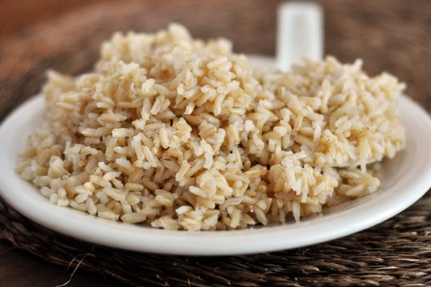
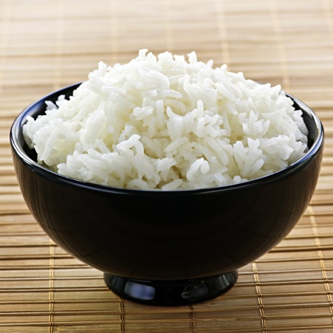
Which food has more fibre?
1 cup of brown rice
1 cup of white rice
3.1 grams of fibre
0.9 grams of fibre
Notes:
Brown rice.
1 cup of brown rice = 3.1 grams of fibre
1 cup of white rice = 0.9 grams of fibre

Slide 3
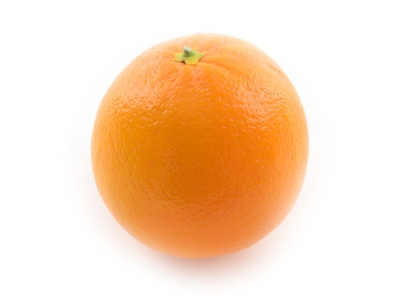
Which food has more fibre?
1 cup of orange juice
1 orange
1 gram of fibre
3.1 grams of fibre
Notes:
1 orange.
1 orange = 3.1 grams of fibre
1 cup of orange juice = 1 gram of fibre

Slide 4
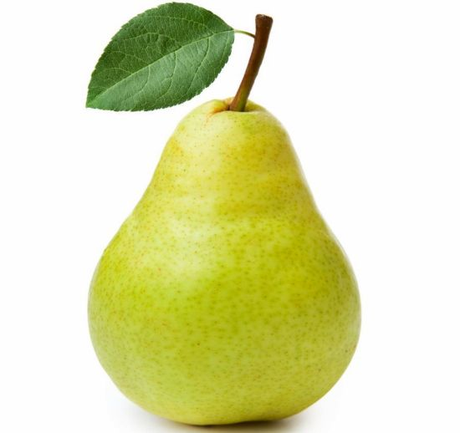
Which food has more fibre?
1 banana
1 pear
1.9 grams of fibre
5.1 grams of fibre
Notes:
1 pear.
1 pear (with skin) = 5.1 grams of fibre
1 banana = 1.9 grams of fibre

Slide 5
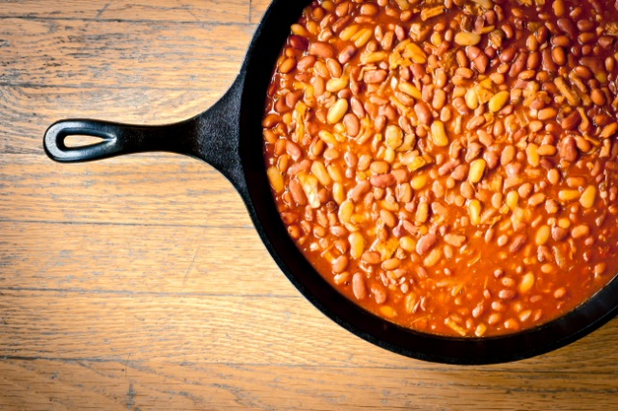
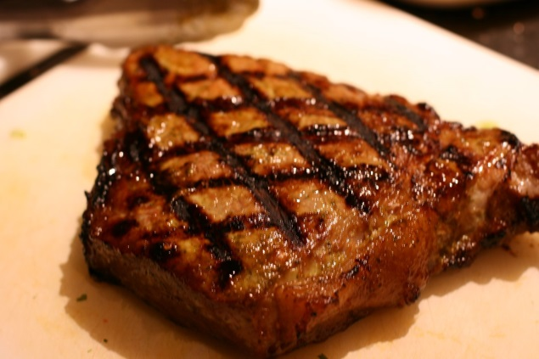
Which food has more fibre?
1 cup of pork and beans
3 oz of steak
14.7 grams of fibre
0 grams of fibre
Notes:
1 cup of pork and beans
1 cup of pork and beans = 14.7 grams of fibre
3 oz of steak = 0 grams of fibre

Slide 6
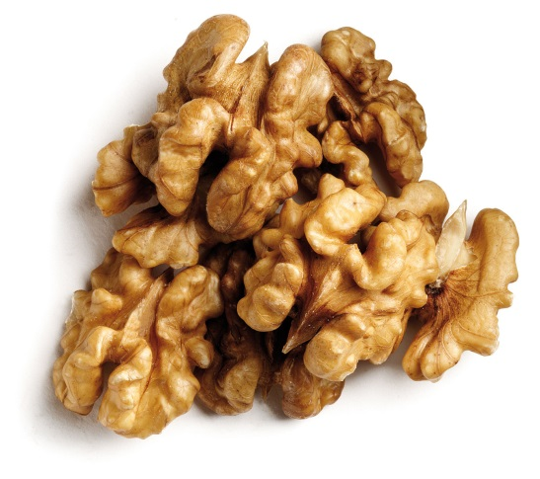
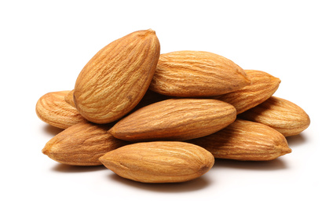
Which food has more fibre?
½ cup of walnuts
½ cup of almonds
8.2 grams of fibre
2.5 grams of fibre
Notes:
½ cup of almonds
½ cup of walnuts = 2.5 grams of fibre
½ cup of almonds = 8.2 grams of fibre

Slide 7
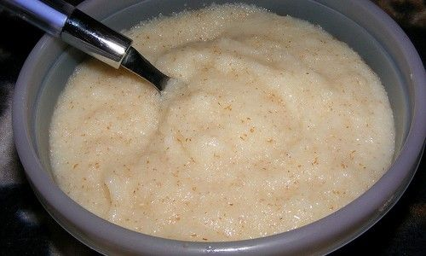
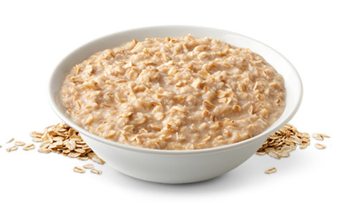
Which food has more fibre?
¾ cup of cream of wheat
¾ cup of oatmeal
0.7 grams of fibre
2.7 grams of fibre
Notes:
Oatmeal
¾ cup of cream of wheat = 0.7 grams of fibre
¾ cup of oatmeal = 2.7 grams of fibre

Slide 8
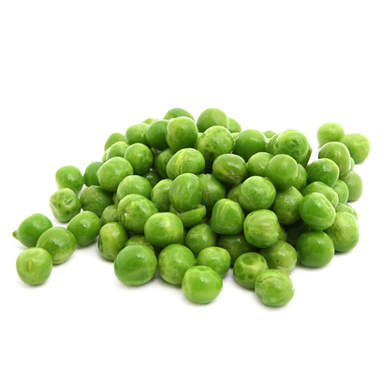
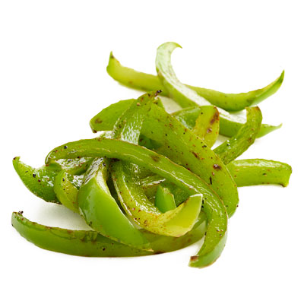
Which food has more fibre?
½ cup of cooked peas
½ cup of cooked green pepper
5.7 grams of fibre
1.1 grams of fibre
Notes:
Peas
½ cup of cooked peas = 5.7 grams of fibre
½ cup of cooked green pepper = 1.1 grams of fibre

Slide 9
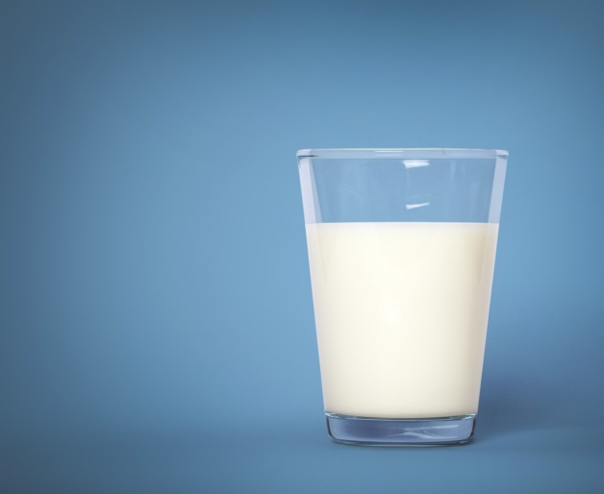
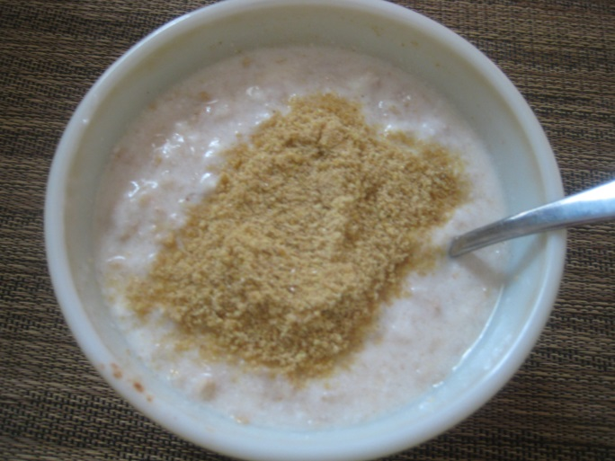
Which food has more fibre?
1 cup of milk
½ cup of yogurt with ¼ cup of flax seed
0 grams of fibre
6.1 grams of fibre
Notes:
Yogurt and flax seed.
1 cup of milk = 0 grams of fibre
½ cup of yogurt with ¼ cup of flax seed = 6.1 grams of fibre

Slide 10
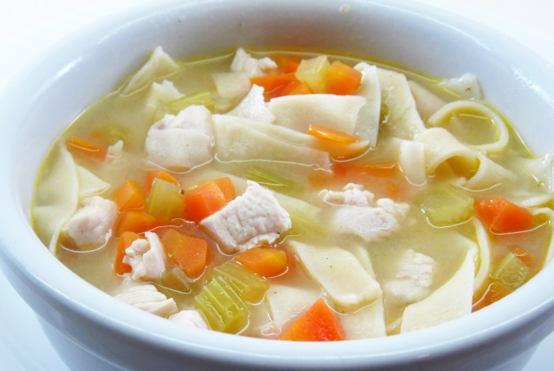
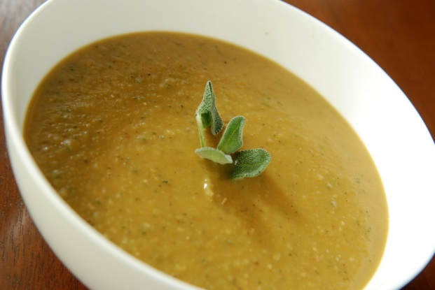
Which food has more fibre?
1 cup of split pea soup
1 cup of chicken noodle soup
4.5 grams of fibre
0.4 grams of fibre
Notes:
1 cup of split pea soup
1 cup of split pea soup = 4.5 grams of fibre
1 cup of chicken noodle soup = 0.4 grams of fibre

