Slide 1
What’s in Your Breakfast?
ADI Activity

Slide 2
What did you eat for
breakfast today?
Notes:
Everyone take out a piece of paper and write down what you ate for breakfast today or what you ate up to now today.
Did you have anything to eat up to now? If not, when were you planning on eating?
Give participants 3-5 minutes to write down what they ate for breakfast.

Slide 3
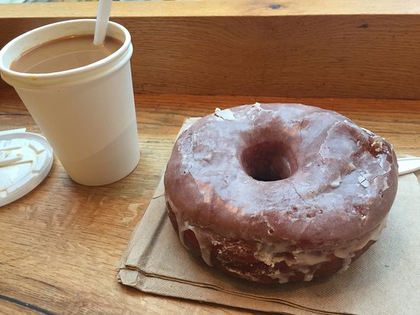
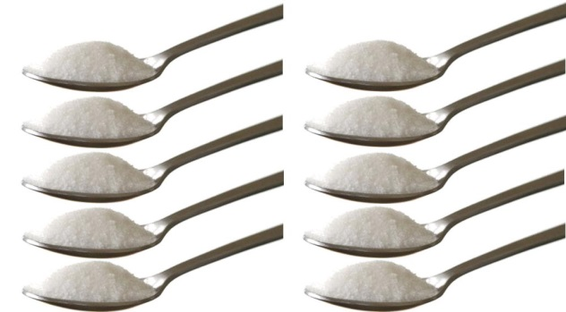
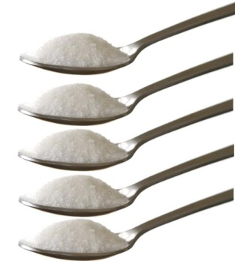
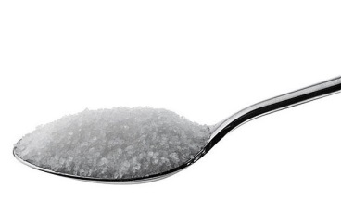
Breakfast #1
Large coffee, double-double
1 doughnut
Lots of calories, fat and
16 teaspoons of sugar
No fibre, vitamins or minerals
How many food groups?
0
Notes:
Let’s take a look at some typical breakfasts and see if they are considered healthy.
The World Health Organization recommends no more than 12 tsp of added sugar per day, but that we would benefit if we were to eat no more than 6 added tsp per day.
Coffee – 30 grams of sugar; 14 grams of fat and 270 calories.

Slide 4
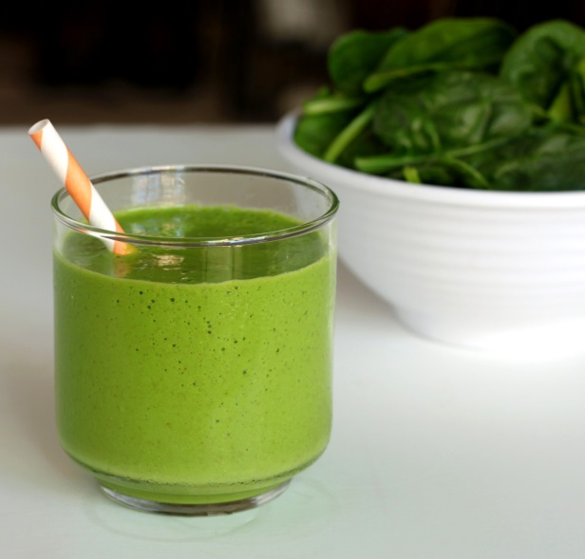
Healthy Breakfast #1
Healthy fruit smoothie
Made with fresh or frozen fruit, plain yogurt, milk and spinach.
The nutrients will vary
Lots of vegetables and fruit = vitamins, minerals, phytochemicals and will keep you healthy!
How many food groups?
2
Notes:
Have it with a whole wheat toast and you’ll have 3 food groups served for this breakfast.

Slide 5
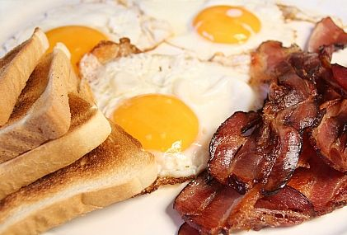
Breakfast #2
3 eggs
5 slices of bacon
2 slices of white bread with butter
Large coffee, double-double
Lots of calories, saturated fat and
16.5 tsp of fat
No fibre, very little vitamins or minerals
How many food groups?
2
Notes:
82 grams of fat = 16.5 tsp of fat
You only need 2-3 servings of meat and alternatives per day (2 for females and 3 for males). 3 eggs = 1.5 servings. Therefore almost all the servings for females and ½ of the amount of servings for males.
While white bread is listed on the food guide, the food guide also makes the recommendation that at least ½ of our servings should be whole grain each day. White bread (and other ‘white’ grain products) are not healthy choices.

Slide 6
Healthy breakfast #2
2 egg omelet with 1 cup worth of peppers, mushrooms and onions
1 slice whole wheat bread
Black coffee
1 apple
This breakfast will give you energy and lots of nutrients to keep you going!
How many food groups?
3

Slide 7
Breakfast #3
3 pancakes with butter and syrup
Large coffee, double-double
Lots of calories, sugar and fat.
No fibre, very little vitamins and minerals
How many food groups?
1
Notes:
Pancakes – 519 calories; 90 grams of carbs; 15 grams of fat
Coffee – 30 grams of sugar; 14 grams of fat and 270 calories.

Slide 8
Healthy breakfast #3
2 whole grain pancakes
2 Tbsp plain yogurt
½ cup raspberries
1 cup of black tea
This breakfast provides you with fibre, calcium, lots of vitamins, minerals and phytochemicals!
How many food groups?
3

Slide 9
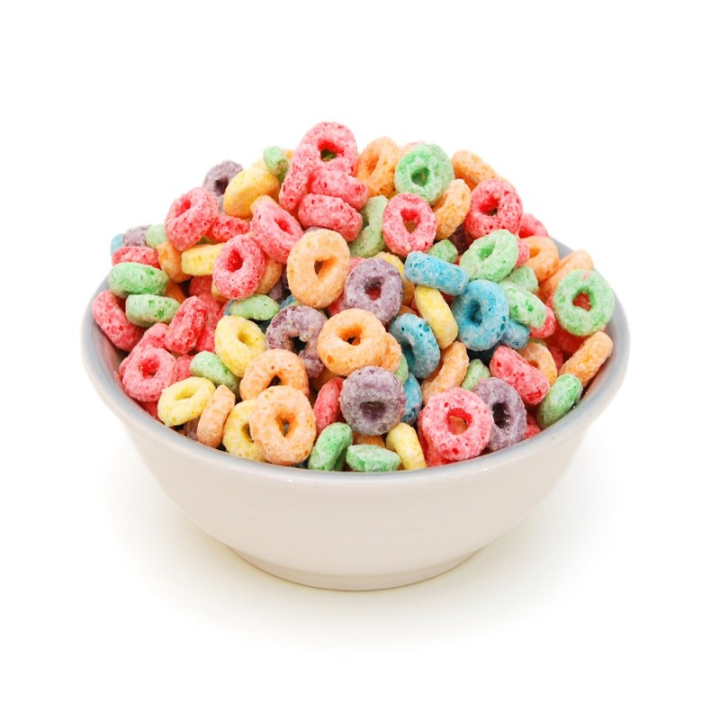
Breakfast #4
2 Pop tarts
1.5 cups of Fruity Os with milk
1 bottle of orange unsweetened juice
35 tsp of sugar!
How many food groups?
2
Notes:
Pop tarts – 68 grams carbs; 14 grams of fat
Fruity Os - 28 grams of sugar (8 tsp) – first ingredient on the ingredient list is sugar!
Bottle of juice = 500 ml = 46 grams of sugar/10 tsp sugar
Food groups:
-vegetables and fruit, but it’s not the best quality of vegetable and fruit servings.
-milk and alternatives

Slide 10
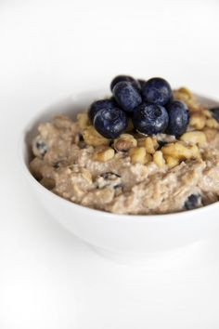
Healthy Breakfast #4
Steel cut oatmeal
1% milk
½ cup blueberries (fresh or frozen)
Fresh walnuts
Cinnamon
Lots of fibre, phytochemicals and antioxidants!
Lots of taste!
How many food groups?
4

Slide 11
It’s time to share
Who would like to share what they had for breakfast today?
Would you consider this a healthy breakfast?
How could you make it healthier?
Notes:
Ask other participants to share their suggestions on how to make this breakfast healthier.
Does it include vegetables and fruit?
Could/would you realistically eat the healthier breakfast?

