Slide 1
Whole, Unprocessed Foods
2018
Notes:
Today I will present on ‘Whole Foods’.
The presentation will last about 15-20 minutes and then we will do an activity called:

Slide 2
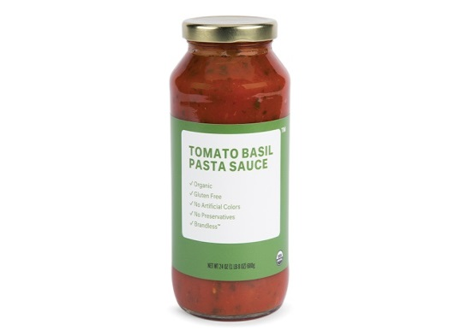
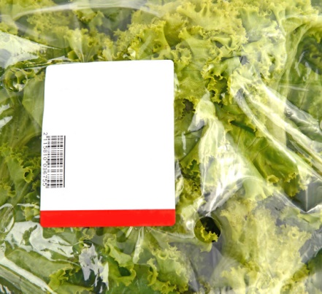
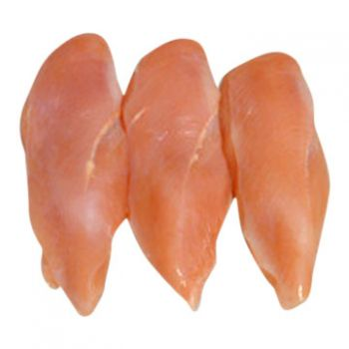
A question for you….
Which of the following foods are whole, unprocessed foods?
Tomato sauce
Prewashed, precut salad
Boneless, skinless chicken breast
Notes:
Answer: They are all processed.

Slide 3
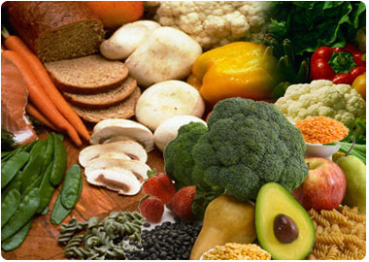
Outline
Whole, unprocessed foods
Processed foods
Minimally
Moderately
Ultra
Health implications
Activity
Where and how to incorporate whole, unprocessed foods in your diet
Notes:
Today we will talk about….

Slide 4
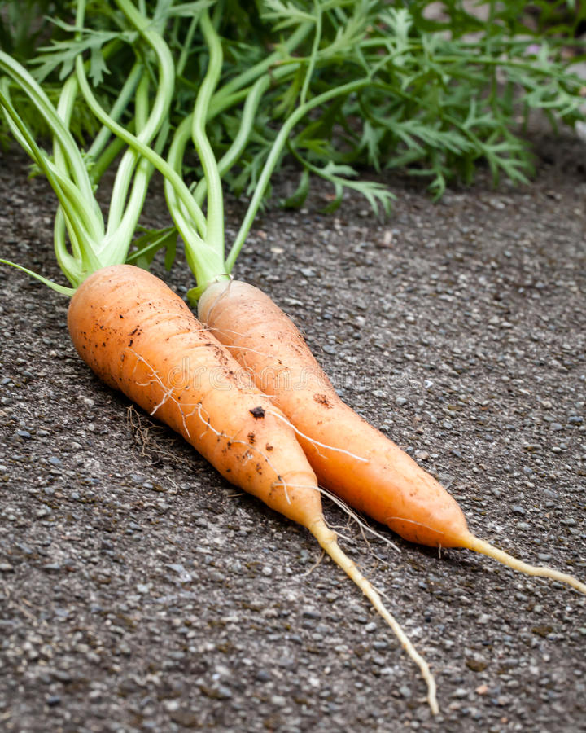
What Are Whole, Unprocessed Foods?
Closest to their natural state
Mostly untouched by chemicals, processing or preservatives
Typically healthier options
They maintain their vitamins,
minerals and nutrients
Notes:
Whole foods are those closest to their natural state.
They've been mostly untouched by chemicals, processing or preservatives.
Whole foods also tend to be rich in vitamins, minerals and nutrients also known as micronutrients. A diet rich in whole foods boosts your health by offering up multiple nutrients that work together in their most natural forms.

Slide 5
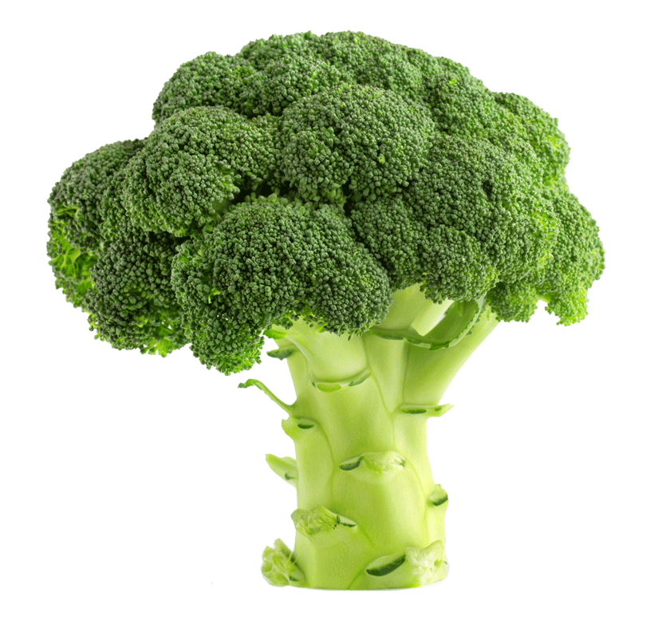
Examples of Whole, Unprocessed Foods
Vegetables
Fruit
Pulses
Black beans, white beans, kidney beans, lentils, chickpeas, split peas
Whole grains
Millet, quinoa, barley, rice, wheat berry, oats
Nuts
Almonds, walnuts, cashews, pistachio
Seeds
Pumpkin, chia, flax, sesame and sunflower seeds
Notes:
Vegetables and Fruit –
Fresh fruits and vegetables are unprocessed foods. Other than being picked from the plant and washed, they are ready to eat. When you enter the grocery store, you often encounter the produce section first. This is where you will find the majority of your unprocessed fruits and vegetables. Frozen and canned fruits and vegetables are processed to some degree in order to increase shelf life, but they could still be a healthy choice.
Vegetables and fruit tend to be rich in phytochemicals, antioxidants, vitamins, minerals, fiber and healthy fats that help to fight against disease.
Phytochemicals are the natural compounds in plants that give plants their color and many health benefits.
When you eat a diet mostly made up of whole unprocessed foods it means that you are eating mostly foods packed with vitamins, minerals and other nutrients (also known as micronutrients).
Eating a diet high in micronutrients improves health for your body and decreases food cravings since your body is getting all the nutrients it needs from the healthy foods. Less food cravings leads to eating less calories and helps to achieve and maintain a healthy body weight for you.

Slide 6
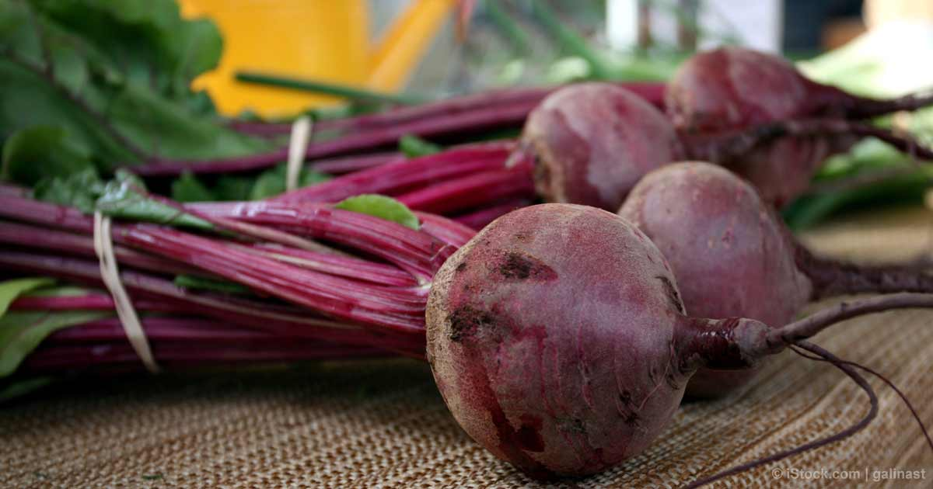
When it comes to nutrition, the whole is greater than the sum of the individual parts.
Notes:
You need to eat the whole foods to get the most beneficial effect from foods and to get the benefits of the nutrients. It is best to eat whole foods rather than to take supplements.
When thinking about nutrition, we have to think about getting the right amount of nutrients – not too little and not too much. We should follow nature’s lead and eat the foods in their whole, unprocessed package as much as possible. This has the perfect amount and balance of nutrients that our bodies and minds need.
Getting too much of a nutrient through supplement can be toxic. Eating a healthy, whole foods diet does not lead to toxicity of nutrients of any kind.
FOOD IS NEVER A SINGLE NUTRIENT: IT IS MADE UP OF A PACKAGE OF NUTRIENTS AND SUBSTANCES.
For example, beets are high in immune-boosting vitamin C, fiber, and essential minerals like potassium (essential for healthy nerve and muscle function) and manganese (which is good for your bones, liver, kidneys, and pancreas). Beets also contain the B vitamin folate, which helps reduce the risk of birth defects. Beets are a unique source of betaine, a nutrient that helps protects cells, proteins, and enzymes from environmental stress. It's also known to help fight inflammation, protect internal organs, improve vascular risk factors, enhance performance, and likely help prevent numerous chronic diseases. Beets are known to help fight certain cancers, lowers your blood pressure and helps to purify your blood and liver. You get that when you eat the whole beet. It’s very hard/impossible to get those benefits from supplements.

Slide 7
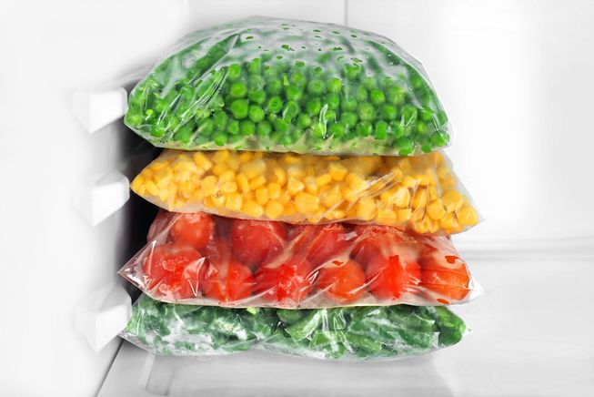
What are Processed Foods?
Foods that have been altered from its raw state:
Cooked
Dried
Frozen
Canned
Pasteurized
Ingredients removed or added
Texture
Taste
Preservation
Notes:
Foods that have had any deliberate changes made to it before it is ready to be eaten
The way humans produce and consume foods has dramatically changed over time.
Dietitians of Canada looked that the change in what foods consumers purchased between 1938 and 2011.
Not surprisingly, during the time studied (1938-2011) there has been:
-a significant decrease in the amount of unprocessed/minimally processed foods purchased; (34.3% to 25.6%)
-a significant decrease in the amount of ingredients purchased to make meals at home and (37% to 12%)
-a significant increase in ultra processed foods purchased (28.7% to 61.7%)
After the United States population, Canadians are now the second largest buyers of ultra processed foods and drinks in the world.

Slide 8
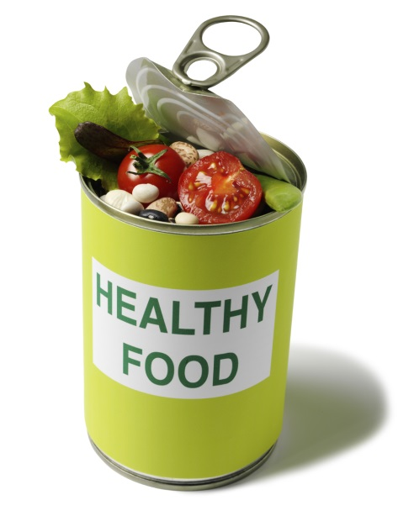
Are processed foods healthy?
Can I include processed foods in my diet and still be healthy?
Notes:
They can be healthy and yes you can include them in your diet.
It is difficult, if not impossible, for the average Canadian to eat a completely unprocessed diet
Some processed foods are healthy.
Processing foods enables food to be stored as a reserve against times of shortage to increase food security (to ensure that sufficient food is available and that essential nutrients are eaten throughout the year).
It enables crops to be sold out of season when prices are higher.
Therefore it helps to make the foods more durable and portable.
However, eating too much processed foods, or many ultra processed foods can lead to health problems.

Slide 9
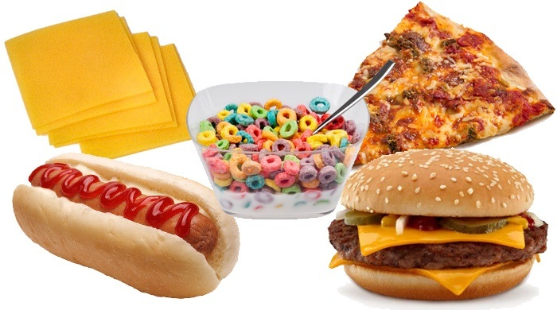
Different Levels of Processed Foods
Minimally/unprocessed
Moderately
Ultra
Notes:
There are different levels of processed foods – minimally/unprocessed; moderately and ultra processed foods.
We will take a look at each of these different levels in more detail.

Slide 10
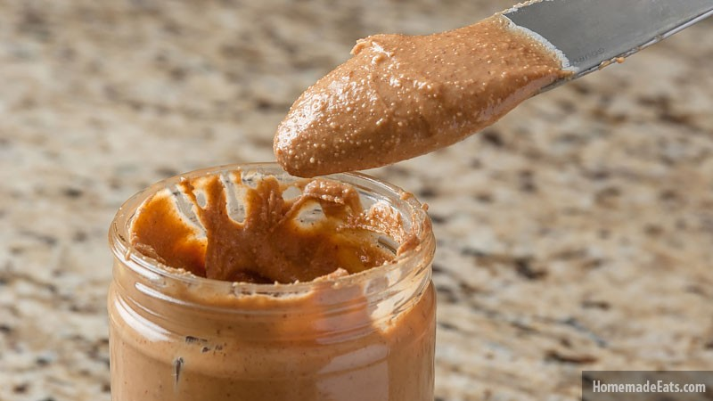
Minimally Processed Foods
As a general rule, minimally processed foods are healthier options
Fewer synthetic additives
Less sugar, salt and fat
Minimal – think of two or less additives
Cut carrots
Rolled oats
Natural peanut or almond butter
Notes:
Whole, or minimally processed foods, in great variety, are the basis for diets that are nutritionally balanced, delicious, culturally appropriate, and supportive of socially and environmentally sustainable food systems. They are the basis of healthy dishes and meals.
Variety means foods of all types – cereals, legumes, roots, tubers, vegetables, fruits, nuts, milk, eggs, meat – and diversity within each type – such as beans and lentils, rice and corn, potato and cassava, tomatoes and squash, orange, banana, chicken and fish.
Synthetic – made by chemical synthesis, especially to imitate a natural product.
Unprocessed or minimally processed foods include fresh, dried, or frozen vegetables, grains, legumes, fruits, meats, fish, eggs, and milk.

Slide 11
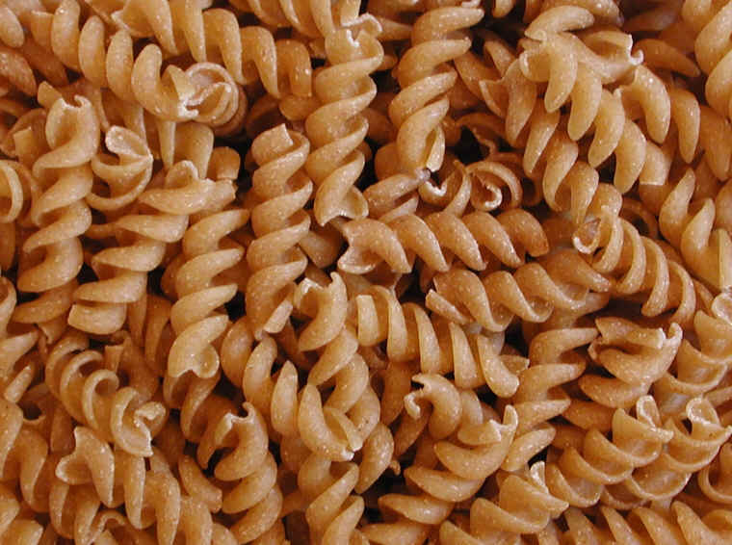
Moderately Processed Foods
Raw foods have been changed
Whole grains to bread, cereal, pasta crackers
Sweet potatoes peeled, seasoned, shaped into fries
Can be part of a healthy diet, but try to minimize ingredient number
Notes:
Many times the ingredients and methods used in the manufacturing of processed foods unfavorably alter the nutritional composition of the foods from which they are derived.
In small amounts, processed foods can be used as ingredients in dishes and meals based on natural or minimally processed foods.
Limit the number of ingredients found on the label and limit any foods that include ingredients that you do not recognize.

Slide 12
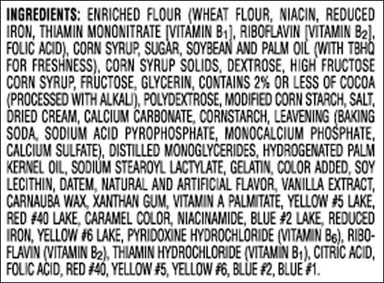
Ultra Processed Foods
Many ingredients added
Additives, sweeteners, sugar, fat, salt
Many ingredients removed
Germ, fibre
Pre-cooked or otherwise prepared
Often they offer lots of energy with little nutrients = empty calories
Nutritionally poor
Long ingredient list
Notes:
Wheat berry has germ and fibre removed leaving high starch carbs
Because of their ingredients, highly processed foods are nutritionally unbalanced. As a result of their formulation and presentation, they tend to be consumed in excess, and displace whole or minimally processed foods. Their means of production, distribution, marketing, and consumption can damage culture, social life and the environment.
Typically, the longer the ingredient list is and the more unfamiliar the ingredients are, the more processing was involved to make the food.

Slide 13
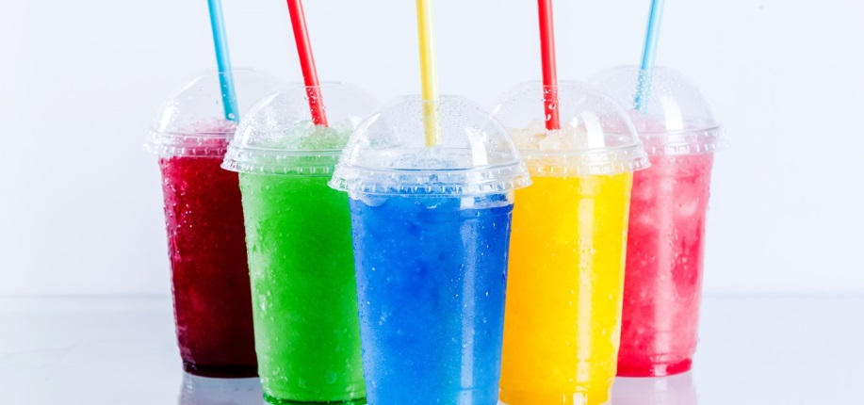
Examples of Ultra Processed Foods
Cookies, cakes, donuts
Prepared dinners (frozen, boxed)
Energy or granola bars
Candy
Sugary cereals
Deli meat
Pop
Salty, fatty packaged snacks (chips)
Instant noodles
Notes:
When many of us talk and think about processed foods we often think about the ultra processed foods such as these.

Slide 14
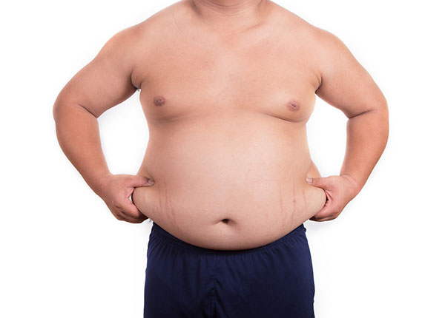
Health Implications of Eating a High Ultra Processed Foods Diet
Obesity
Diabetes
Stroke and heart disease
High blood pressure, high blood fats
Other potential health implications:
Cancer
Gluten sensitivity
Food coloring sensitivity/allergy
Notes:
There is much research that supports the fact that eating a diet high in ultra processed foods contributes to obesity, diabetes, stroke, heart disease, high blood pressure and high blood fats.
Up to 80 per cent of premature deaths from heart disease and stroke can be prevented by eating healthy diets and being physically active
There is much talk (but less research on) the impact that a high ultra processed foods diet has on risk of developing certain types of cancer, food sensitivities and food allergies.
However, overall we know that eating a diet high in ultra processed foods is not healthy.

Slide 15
Are processed foods healthy?
Can I include processed foods in my diet and still be healthy?
Notes:
Healthy diets are mainly made up of freshly prepared dishes and meals prepared from unprocessed or minimally processed foods, together with processed culinary ingredients and some processed foods. They include only small amounts of ultra-processed foods.
The Heart and Stroke Foundation of Canada defines healthy eating as being based on freshly prepared dishes and meals, and avoidance of highly processed foods:
A healthy balanced diet includes a variety of vegetables and fruit, whole grains or alternatives and proteins from various sources. These protein sources can include beans, lentils, nuts, lower fat dairy or dairy alternatives (i.e. fortified soy milk, etc.), lean meats, poultry, and fish. A healthy balanced diet does not include highly processed and highly refined foods, confectionaries, sugary drinks, processed meats and snack foods.

Slide 16
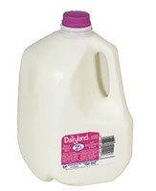
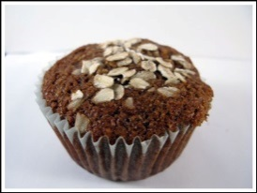
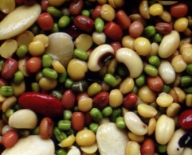
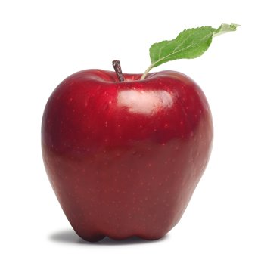
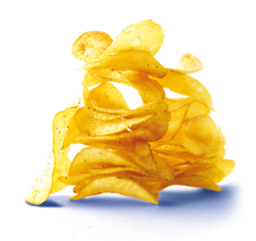
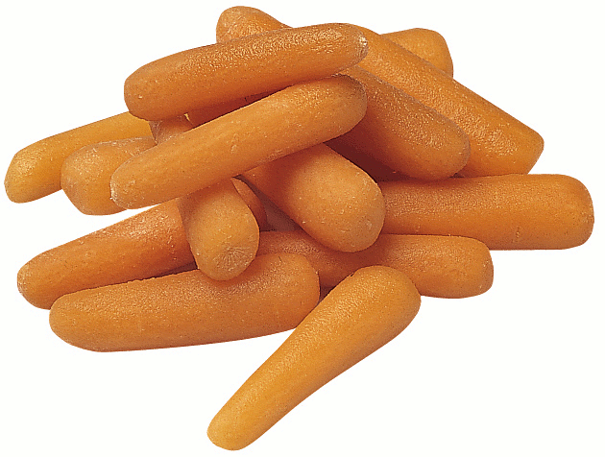
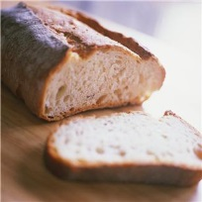
ACTIVITY: Unprocessed vs. Ultra Processed Foods
Unprocessed Foods Ultra Processed Foods
Notes:
Think about foods lying on a continuum
Unprocessed on one end ultra processed on another
We will look at different groups of food. I want you to place the foods in order starting with the least processed to the most processed.

Slide 17
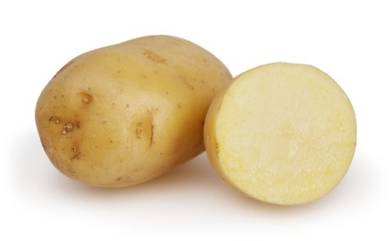
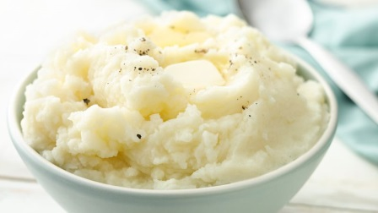
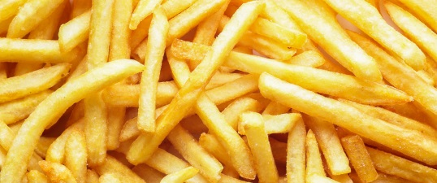
Vegetables
Place the following foods in order starting with the least processed to the most
French Fries
Potato
Mashed potatoes
Unprocessed Foods Ultra Processed Foods
Notes:
Answer:
1. Potato
2. Mashed potatoes
3. French fries

Slide 18
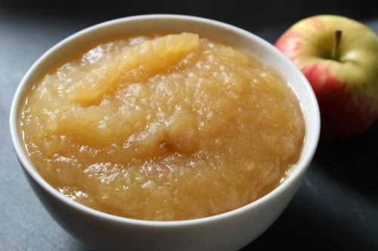
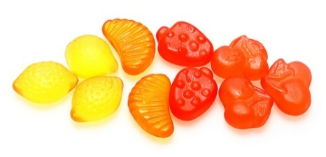
Fruit
Place the following foods in order starting with the least processed to the most
Apple
Fruit gummy snacks
Apple sauce
Unprocessed Foods Ultra Processed Foods
Notes:
Answer:
1. Apple
2. Apple sauce
3. Fruit gummy snacks

Slide 19
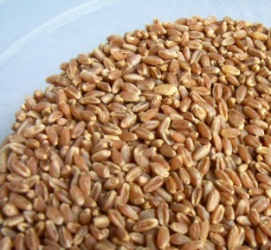
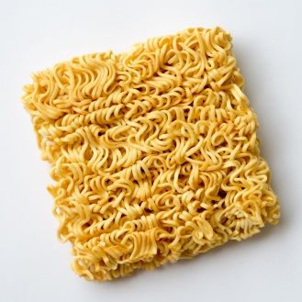
Grain Products
Place the following foods in order starting with the least processed to the most
Wheat berry
Pasta
Instant noodles
Unprocessed Foods Ultra Processed Foods
Notes:
Most grains undergo some type of processing before arriving on the grocery store shelf. Whole grains are the ones that have been processed the least. They contain the entire kernel, including the endosperm, the germ and the bran. Even when whole grains are crushed, cracked or flaked, they still contain the same proportion of germ, endosperm and bran.
Answer:
Wheat berry (whole wheat kernel made up of germ, bran and endosperm)
Pasta
Instant noodles

Slide 20
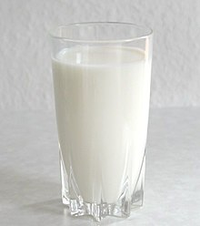
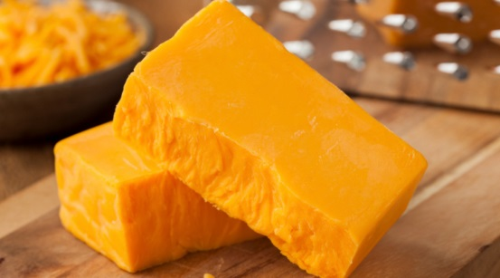
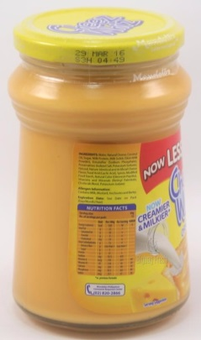
Milk Products
Place the following foods in order starting with the least processed to the most
Milk
Cheese spread
Cheddar cheese
Unprocessed Foods Ultra Processed Foods
Notes:
Answer:
Milk
Cheddar cheese
Cheese spread

Slide 21
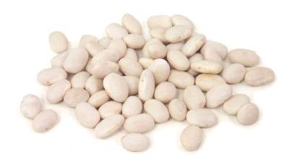
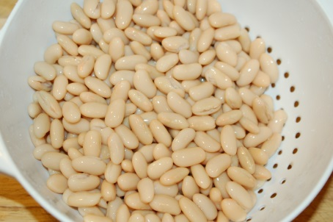
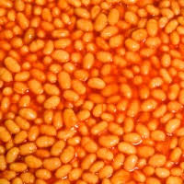
Meat Alternatives
Place the following foods in order starting with the least processed to the most
Canned pork and beans
Canned white beans
Dried white beans
Unprocessed Foods Ultra Processed Foods
Notes:
Answer:
Dried white beans
Canned white beans
Canned pork and beans

Slide 22
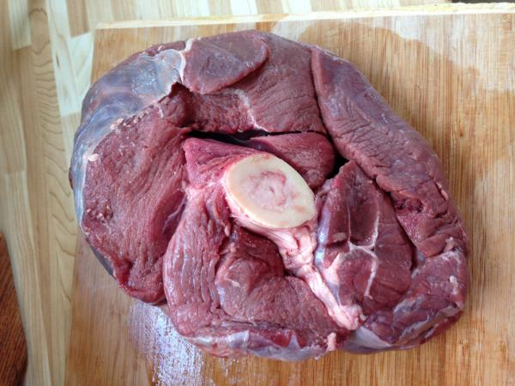
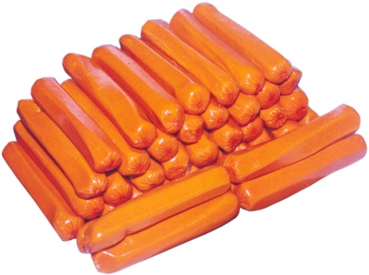
Animal Protein
Place the following foods in order starting with the least processed to the most
Hotdog
Moose meat
Boneless, skinless chicken breast
Unprocessed Foods Ultra Processed Foods
Notes:
Answer:
Moose meat
Boneless, skinless chicken breast
Hotdog

Slide 23
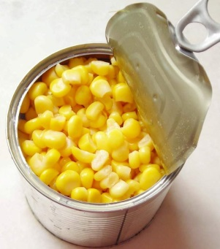
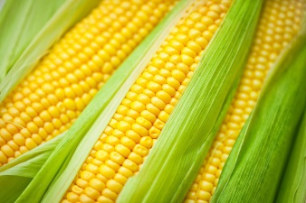
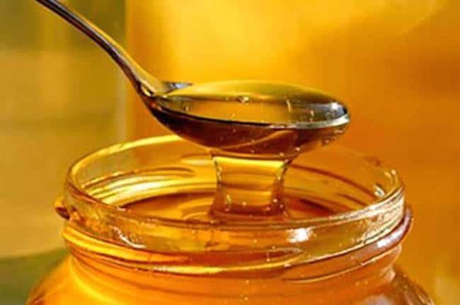
Other Foods
Place the following foods in order starting with the least processed to the most
Corn on the cob
Corn syrup
Canned corn
Unprocessed Foods Ultra Processed Foods
Notes:
Answer:
Corn on the cob
Canned corn
Corn syrup

Slide 24
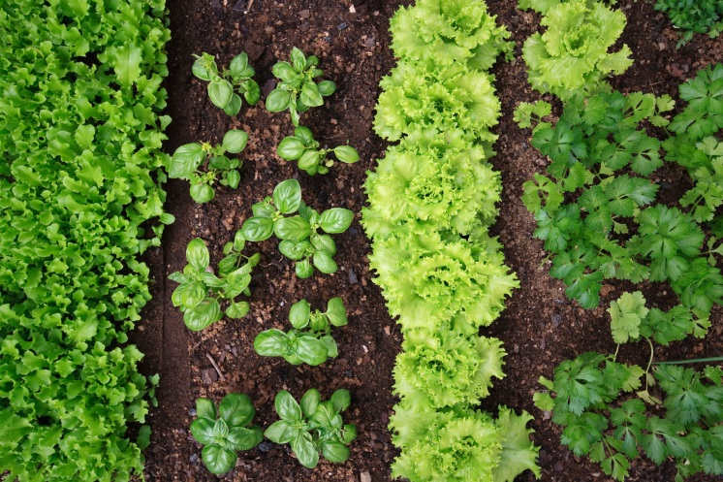
Where Can You Find Whole, Unprocessed Foods?
In your garden
On the land
In the lakes
On the farms
In the sky
At the produce aisle of your grocery store
Many times whole, unprocessed foods do not have Nutrition Facts information
Notes:
Typically, you find whole foods at the perimeter of the store. These include plant products, including fresh fruits and vegetables, as well as whole grains, plain dairy, eggs, meats and fish. Craft an unprocessed meal plan using these ingredients and minimal processed foods from the center aisles of the store

Slide 25
Tips on How to Eat More Whole, Unprocessed Foods
Change your physical environment
Make unprocessed foods available
Limit ultra processed foods
Change your social environment
Get family, friends and co-workers on board
Find friends/support groups on social media
Prepare more home cooked meals
Notes:
Change your physical environment:
Have lots of unprocessed foods available at home and at work and limit the amount of processed foods available.
Change your social environment:
Get your friends, family and co-workers on board. They may also want to eat healthier and may need your support as much as you want theirs.
Perhaps nobody wants the unhealthy foods at work, but they always seem to make their way there. Once unhealthy foods are in front of us, they are very hard to resist.
In small communities it could be hard to find other community members who also want to change their ways of eating, but most of us have access to the internet, where there are endless amounts of social-media groups. These groups can be a great support to you as you try to improve your eating habits – either focussing on eating more unprocessed foods, or otherwise.
Strategy: groom your physical and social environment to support your goal.
When you change your physical and social environment to make it more supportive you do not have to rely as much on willpower.
If you are trying to quit smoking you are likely not going to buy a pack of cigarette and hope that you have the willpower not to smoke them.
Make healthy changes as easy on you as possible. Help make the healthy choice the easy choice.
Do everything you can during the first few weeks of eating differently to make it easy on yourself to choose healthy foods and inconvenient to choose unhealthy foods.
Prepare home cooked meals:
It is very challenging to eat less processed foods if you do not know how to cook.
Host/attend cooking classes in your community. When doing so, focus on healthy recipes. If you do not currently have cooking skills see if there is someone in the community that you can partner with to help you with healthy cooking classes. You can also ask the FNIHB dietitians to come teach you how to offer healthy cooking classes.
Prepare more home cooked meals
Scrambled eggs with cut up veggies
Fish, brown rice, steamed vegetables with fruit

Slide 26
“The secret to change is to focus all of your energy, not on fighting the old, but on building the new”
Notes:
Instead of thinking about not having processed foods and focusing on all the foods you will NOT have now, think of what your new way of eating will include and how you can learn to love this new way of eating.
Know that the longer you make healthy choices, the easier it will become.

Slide 27
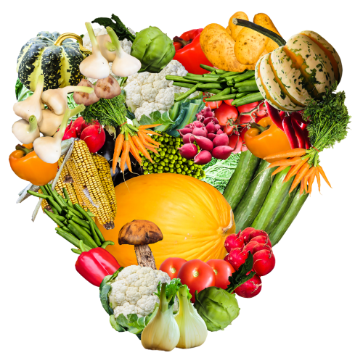
Thank you
Notes:
Do you have any questions about today’s presentation?
Are there other topics you’d like to hear about at future sessions? If so, please let me know.

