Slide 1
Continuous Glucose Monitors (CGM)
Kayla Perry, RD CDE Diabetes Integration Project
First Nations Health and Social Secretariat of Manitoba

Slide 2
What is a CGM
CGM’s available, comparison and coverage
Agenda
Dexcom G6 Demonstration
Case Study, Review Dexcom Reports

Slide 3
What is a CGM?
Notes:
Presenter
2023-01-24 20:46:42
--------------------------------------------
Who has heard of CGM before? Raise your virtual hand if you have.
A continuous glucose monitor is a type of monitor to check sugars however instead of checking sugar in the blood it checks interstitial fluid sugar. It is a monitor that is worn on the back of the arm or the stomach for multiple days and can continuously check these sugars and transmits to an app or reader to constantly tell you where your sugars are at.

Slide 4
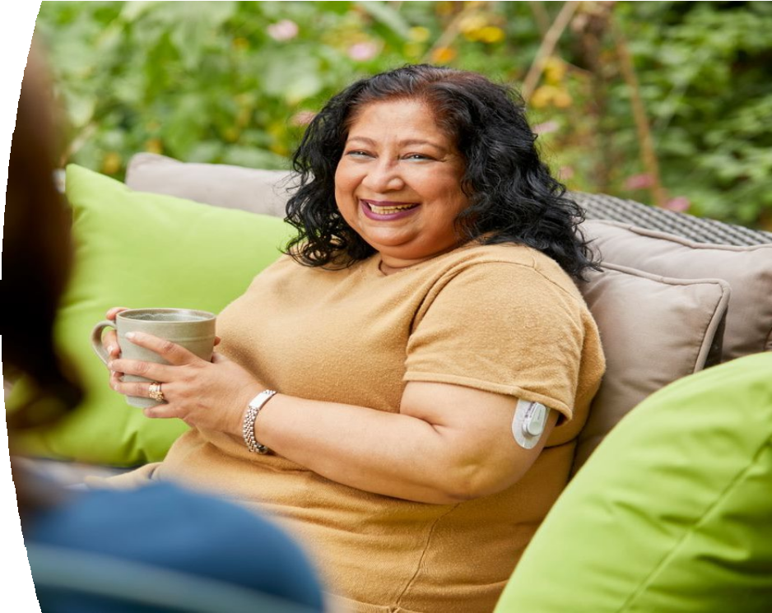
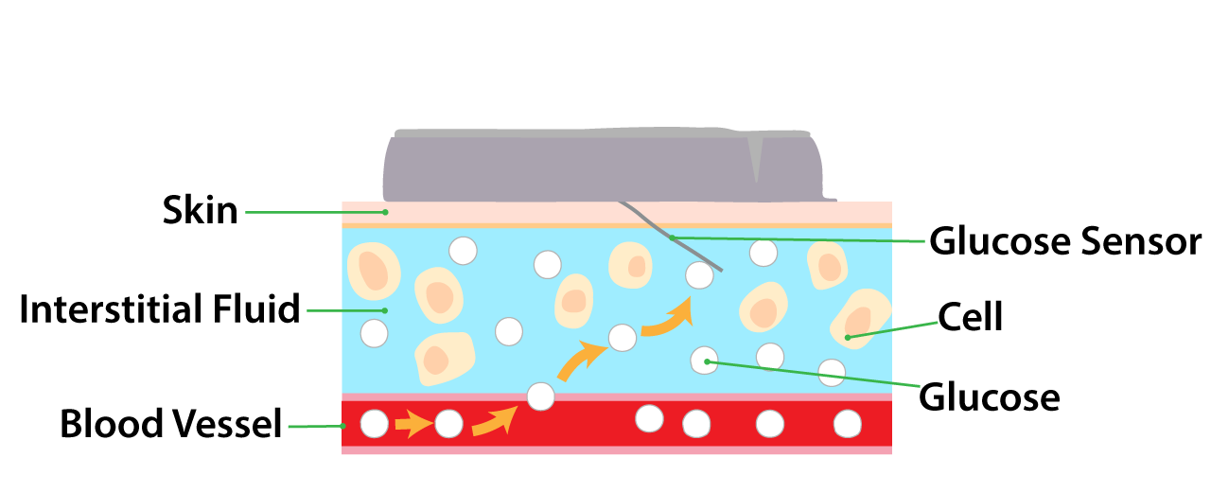
What is a Glucose Sensor?
LBL022299 Rev001
A small wearable device that measures interstitial glucose concentration continuously
CGM, continuous glucose monitoring. Choice of sensor sites: Ages 18 and older: Insert in belly or back of upper arms. Ages 2-17 years: insert in belly or upper buttocks. Images for illustration purposes only.

Slide 5
New Glucose Monitoring Terms¹
LBL022035 Rev001
CBG
isCGM
rtCGM
Capillary Blood Glucose
Intermittently Scanned Continuous Glucose Monitoring
Real-time Continuous Glucose Monitoring
Measures glucose in capillary blood using fingersticks
Measures interstitial fluid glucose via intermittent scan of sensing device
Measures interstitial glucose via sensing device that is continuously transmitting data to device with real time display for viewing at any time
CBG, capillary blood glucose; isCGM, intermittently scanned continuous glucose monitoring, RT-CGM, real-time continuous glucose monitoring.
¹ Cheng A, Feig DS, Ho J and Siemens R. Can J Diabetes. 2021; 45: 580-587.

Slide 6
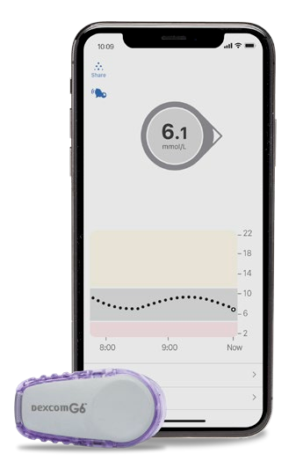
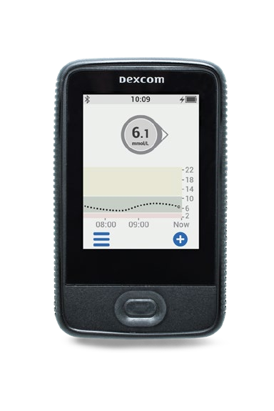
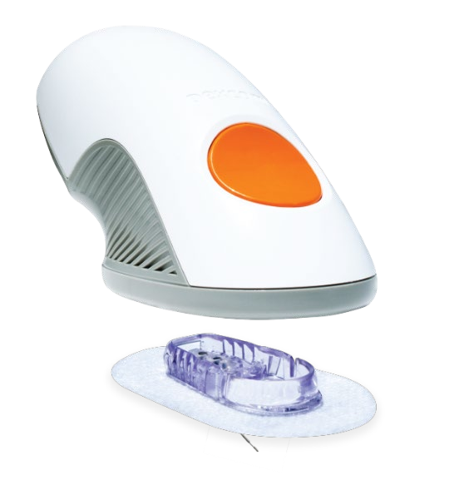
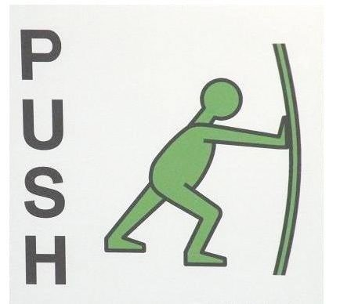
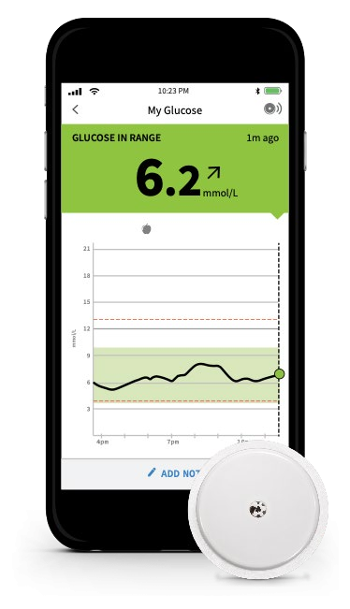
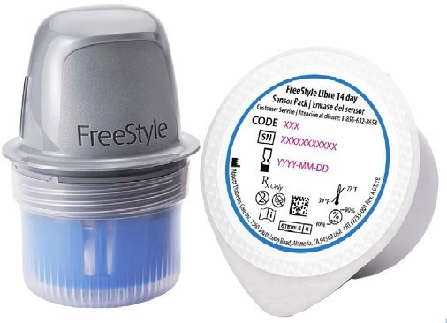
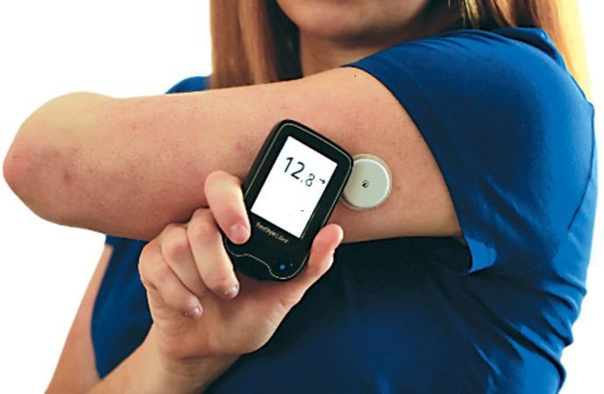
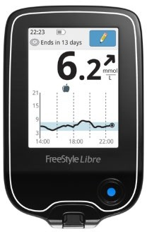
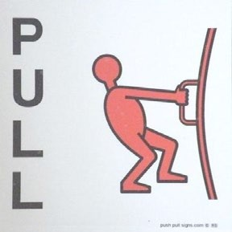
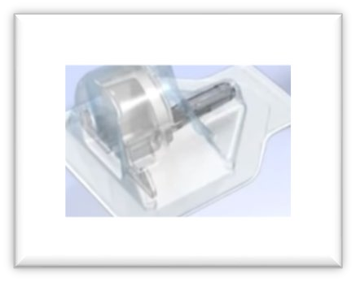
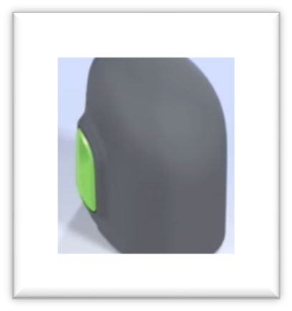
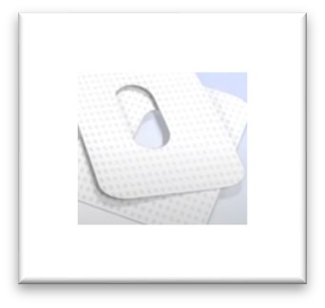
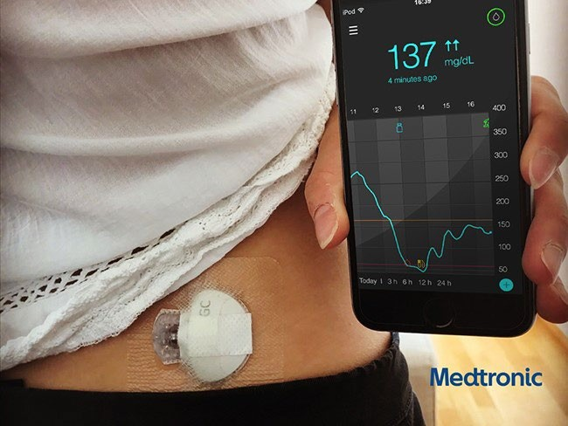
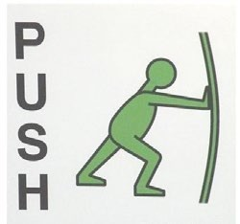
GLUCOSE SENSORS IN CANADA¹⁻⁴
LBL022395 Rev001
ZERO fingerstick calibration
Dexcom G6^{1,2}
FreeStyle Libre 1 and 2³
Medtronic Guardian Connect ⁴
1. Dexcom G6 Using Your G6 Guide. https://www.dexcom.com/en-CA/downloadsandguides/search . Dexcom G6 readings can be used to make diabetes treatment decisions when taking up to a maximum acetaminophen dose of 1,000mg every 6 hours. Taking a higher dose may affect the G6 readings. 2. For a list of Dexcom G6 compatible devices, please visit https://www.dexcom.com/en-CA/compatibility/select. Use of the smart watch requires the Dexcom G6 App on a compatible smartphone. 3. FreeStyle Libre https://www.freestyle.abbott/ca/en/products/libre.html 4. Guardian™ Connect https://www.medtronic.com/ca-en/diabetes/home/products/cgm-systems/guardian-connect.html

Slide 7
Coverage
Brand | NIHB Coverage | MB Health/Pharmacare | Private Insurance
Dexcom G6 | Covered for Children aged 2-19 on intensive insulin regimen Covered for some Adults on Basal/Bolus Insulin with Medical Justification* | Covered for people with Type 1 Diabetes age 25 years and younger | Website says most private insurance companies cover it
Freestyle Libre | Not Covered by NIHB | Covered for people with Type 1 Diabetes age 25 years and younger | Website says most private insurance companies cover it
Medtronic Guardian Connect | Not Covered by NIHB | Covered for people with Type 1 Diabetes age 25 years and younger | Website says CGM is a standard benefit for many insurance providers and your coverage could vary depending on your plan.

Slide 8
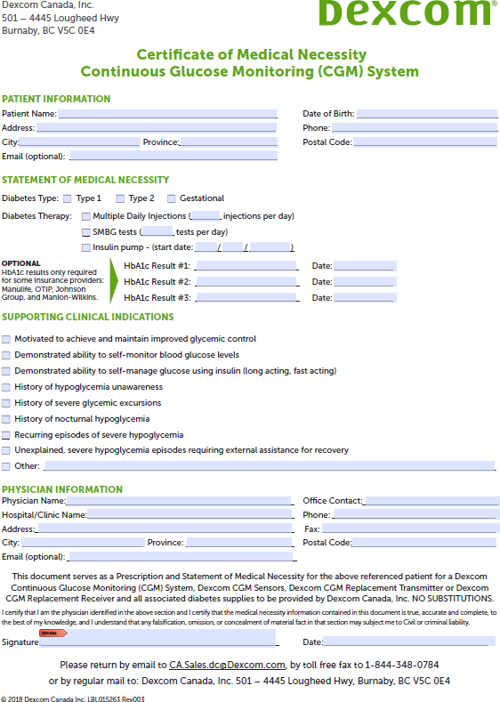
Example of Certificate of Medical Necessity
Notes:
Presenter
2023-01-24 20:46:45
--------------------------------------------
Sorry it might not be very easy to see but this is the form that physicians need to fill out in order for clients to be considered for NIHB coverage for a Dexcom monitor. They need to be on both types of insulin and have some evidence of any of these listed under supporting clinical indications such as history of hypoglycemia unawareness. I have filled these out and sent to the doctors to then read and sign if they agree so that it is an easier quicker process for them. However the process to get coverage through NIHB is typically a lengthy one and doesn’t always mean they will get covered.

Slide 9
Comparison of Features
Dexcom G6 | Freestyle Libre 2
Uses rtCGM | Uses isGGM
Uses Bluetooth for continuous readings | Must scan sensor with reader at least every 8 hours
Sensor lasts 10 days | Sensor lasts 14 days
Low and High alerts | Low and High alerts
Easy to use app | Easy to use app
Adding in personal comments on BG levels limited | Can make personal comments on BG levels
Can share data with healthcare provider and caregivers easily | Can share data with healthcare provider and caregivers easily
Costs $115.65/sensor or $346.94/30 days | Costs $105/sensor or $210/28 days
Receiver available if don’t have a smart phone | Reader available if don’t have a smart phone

Slide 10
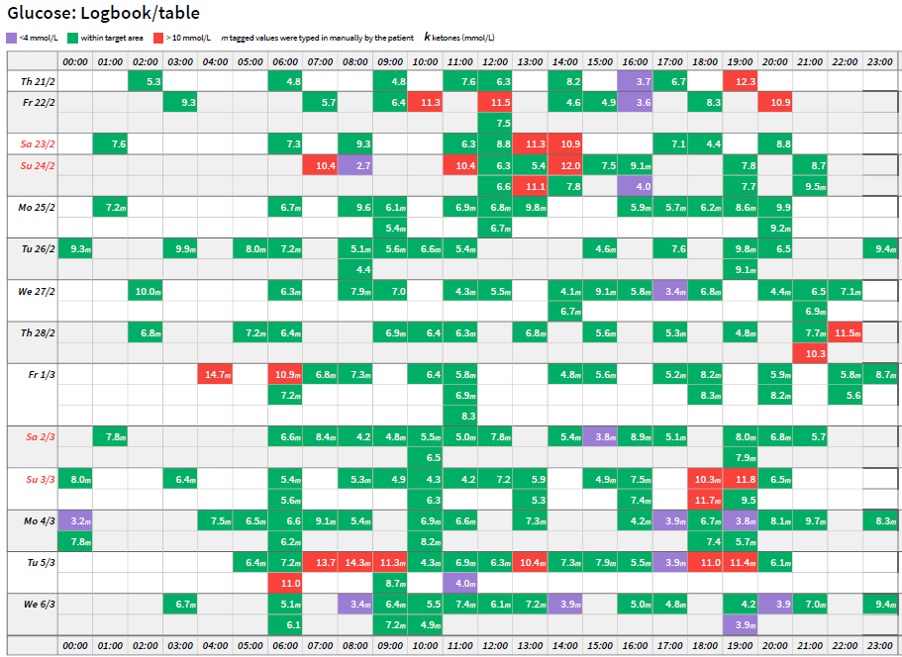
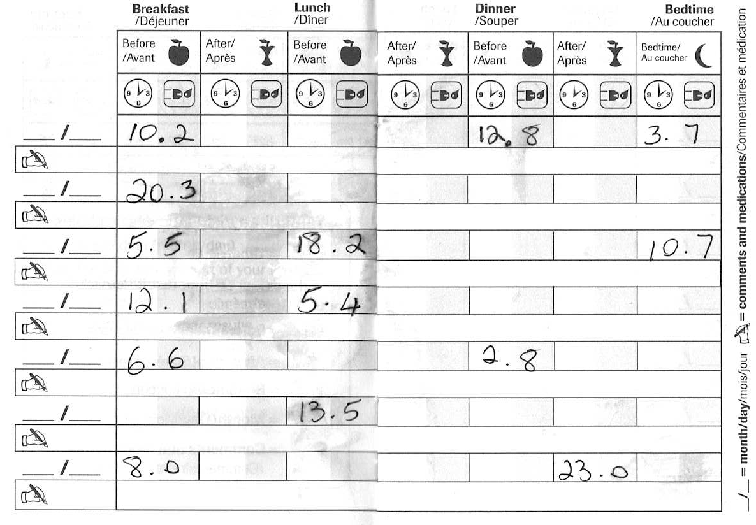
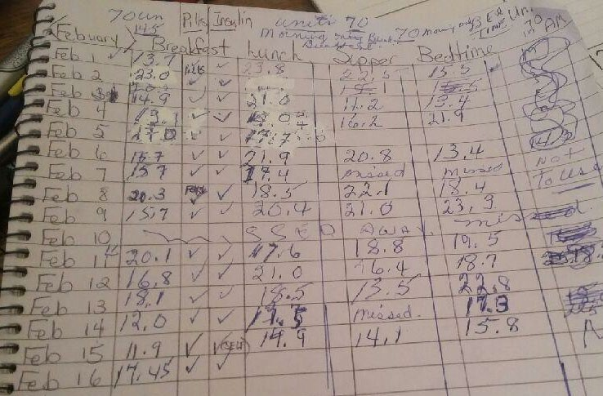
A1C 976.208%
LBL021284 Rev001
Testing Blood Sugars before CGM
A1C, hemoglobin A1C. Images are for illustrative purpose only.
Notes:
Presenter
2023-01-24 20:46:46
-------------------------------------------- ANIMATED SLIDE
Some of our patients keep their DM at the forefront every day, monitor their BG around the clock, are very self-sufficient with DM self-management, and are able to avoid extended periods of hypo and hyperglycemia.
The reality for most patients in our practices is that their glycemic control fluctuates enormously. And while the average mean glucose estimated via an A1C may be slightly above target, they may actually experience significant hypo and hyperglycemia daily. There are also many that cannot cope with the burden of monitoring their BG around the clock and thinking about DM all day. Their logbook may look like something like this third case.
As clinicians we are often unsure how to best assist them with dm self-management and improve their glycemic control

Slide 11
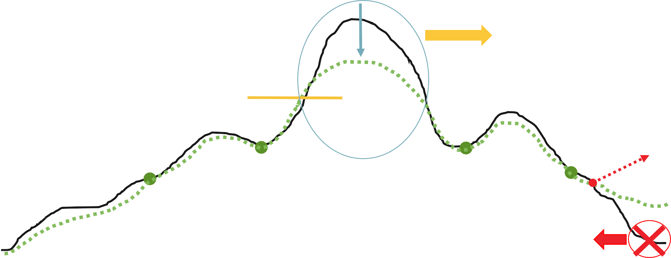
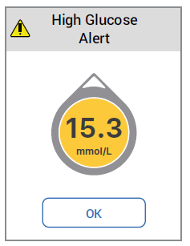
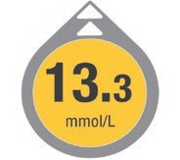
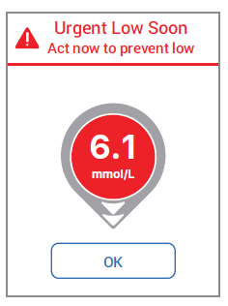
Modernization of Glucose Monitoring
LBL021448 Rev001
Glucose Meter → Glucose Sensor
18.0
→ Alerts that drive action¹
Hyperglycemia¹
Long-term micro- and macr complications, increased costs
ovascular
14.0
Glucose (mmol/L)
10.0
4.0
Hypoglycemia¹ Dizziness/nausea, blurred vision, sleep disturbances, ER visits, hospitalization, worry, fear, under-management
12 AM
4 AM
8 AM
12 PM 4 PM
Time (Hours)
8 PM
12 AM
Images are for illustrative purpose only.
1. Cappon G, Vettoretti M, Sparacino G, Facchinetti A. Diabetes Metab J. 2019;43(4):383-397.
LBL021195 Rev001
Notes:
Presenter
2023-01-24 20:46:46
--------------------------------------------
We don’t have to wait until a meal or a symptomatic event to make a change to management
This graph shows that with a glucose meter all you may see is the very high BG of about 16 mmol/L (blue circled), but with a CGM it can tell you which direction the sugars are trending to and will deliver an alert when it reaches a certain level so that you can make a change to manage and prevent the high and low BG.

Slide 12
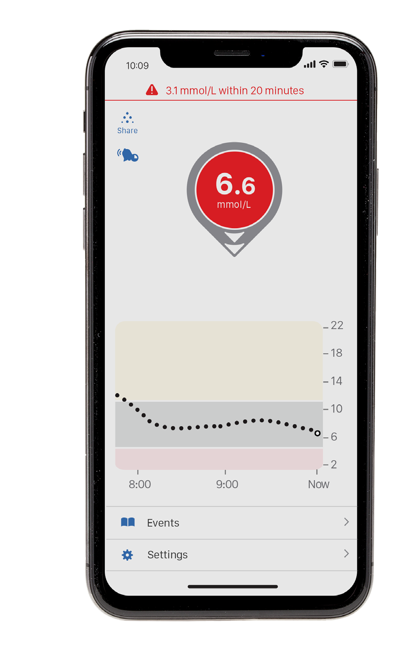
How is a Predictive Low Alert Designed to Work¹?
LBL021448 Rev001
Available with Dexcom G6, Freestyle Libre2 and Medtronic Guardian Connect
7 PM
8 PM
Now
Glucose
Urgent Low Soon Alert:
predicts < 3.1 mmol/L within 20-minutes
Treated Untreated
Images are for illustrative purpose only.
1. Wadwa P. et al. Diabetes Technology and Therapeutics 2018;20(6):395-402
Notes:
Presenter
2023-01-24 20:46:47
--------------------------------------------
This is an example of the Dexcom as it says it predicts lows within 20 minutes however the Libre and Medtronic do have low alerts as well but the time may be different. The Medtronic website says theirs predicts 60 minutes before.
- Allows for change to basal rate or consumption of a smaller low treatment Help avoid rebound highs and time lost due to hypoglycemia

Slide 13
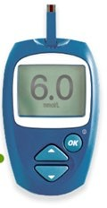
Am I comfortable starting this important presentation ?
LBL022035 Rev001
Am I good to go for a walk?
A Number is Seldom Enough information
What should I do before going to sleep?
Am I ready to go to work?

Slide 14
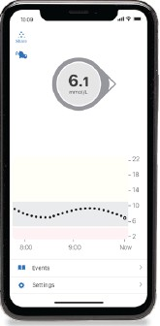
Am I comfortable starting this important presentation ?
LBL022035 Rev001
Am I good to go for a walk?
A Number is Seldom Enough information
What should I do before going to sleep?
Am I ready to go to work?
Notes:
Presenter
2023-01-24 20:46:47
--------------------------------------------
With the app, it shows arrow trends so with this one although It also says 6.1 like the meter, it shows an arrow going forward meaning it should continue in the normal range, therefore it is easier for the client to make those decisions and feel comfortable with the decision. Context is important

Slide 15
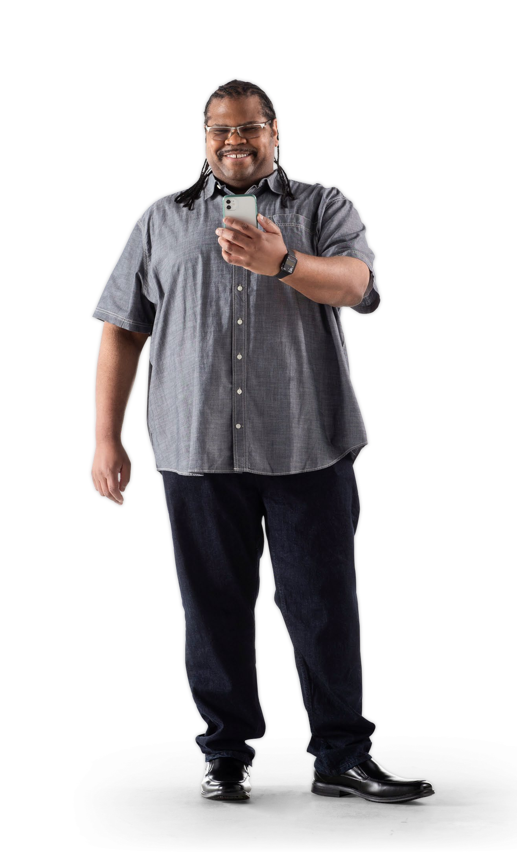
Patient Benefits of CGM
LBL021448 Rev001
Provides more complete picture of glucose trends
Continuous and timely feedback on nutrition, activity, and insulin requirements to help make informed diabetes treatment decisions
More confidence with insulin adjustments
No routine fingersticks*
Actionable alerts
Various high and low alerts available
Reduced fears of hypoglycemia (care givers and patient)
Remote monitoring†
Ability to share glucose data with up to 10 followers
*Fingersticks required for diabetes treatment decisions if symptoms or expectations do not match readings. Treatment decisions should be made using readings from the Dexcom G6 and not the Follow App. †Separate Dexcom Follow app required.
CGM, real-time continuous glucose monitoring

Slide 16
Who would benefit most from CGM?
People on Intensive Insulin Therapy (Basal/Bolus)
Those experiencing frequent hypoglycemia
Those experiencing hypoglycemia unawareness
Large amount of glucose variability – lots of highs and lows

Slide 17
Challenges of CGM
Digital Divide
Learning curve
Expensive if can’t get coverage
Possible information overload

Slide 18
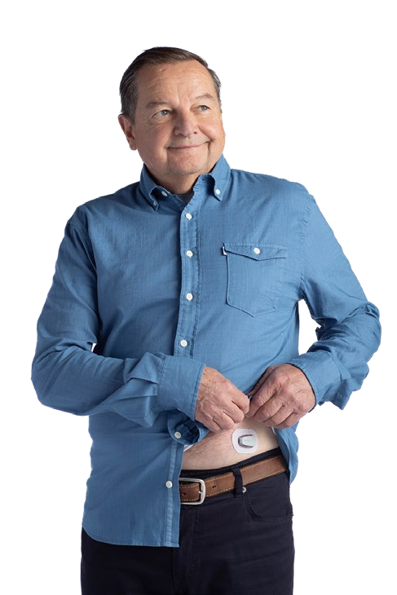
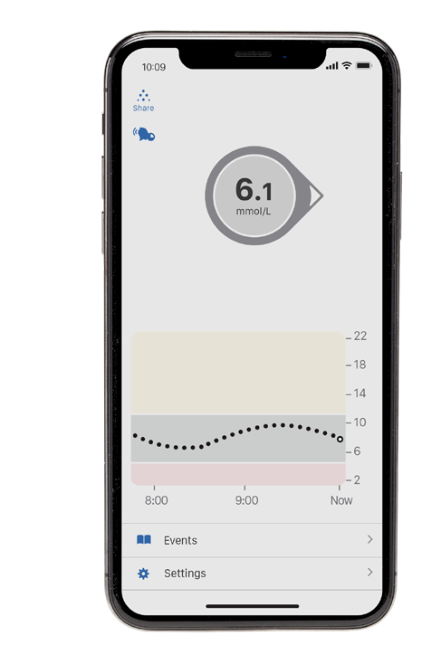
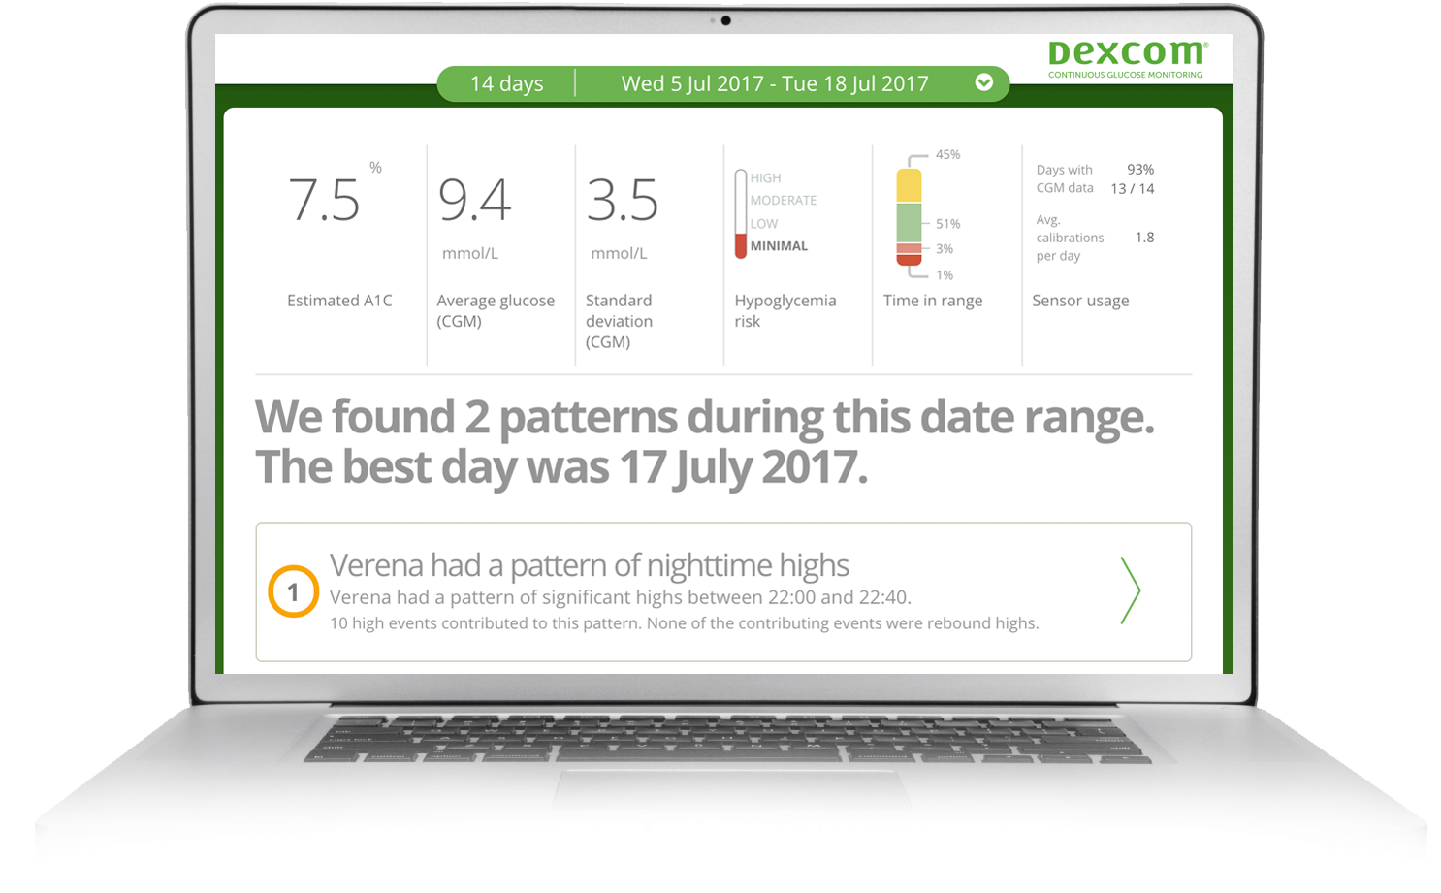
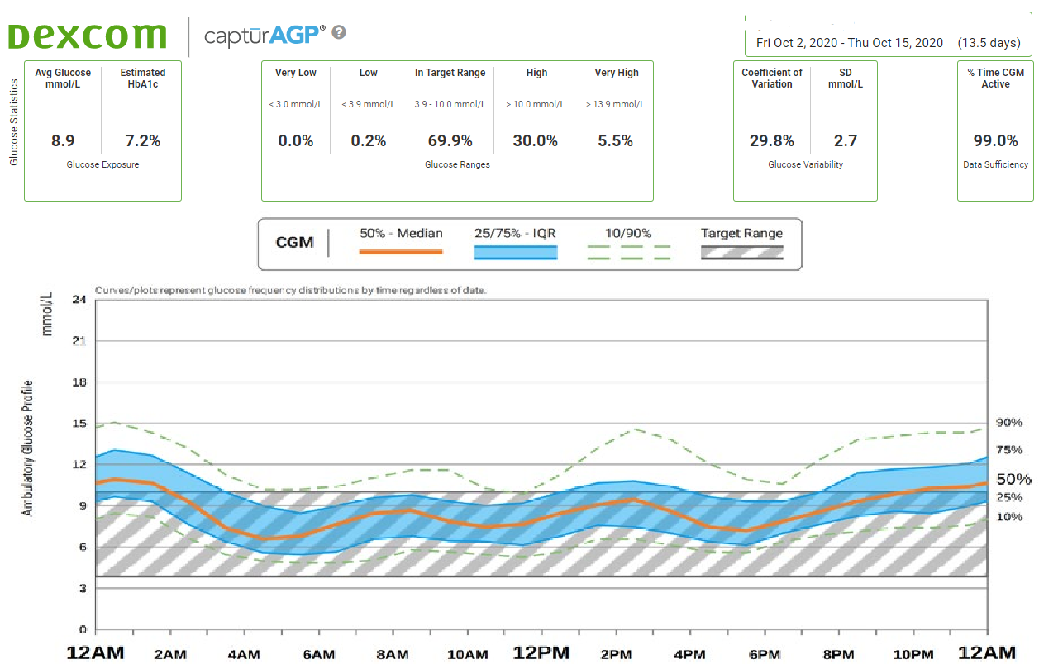
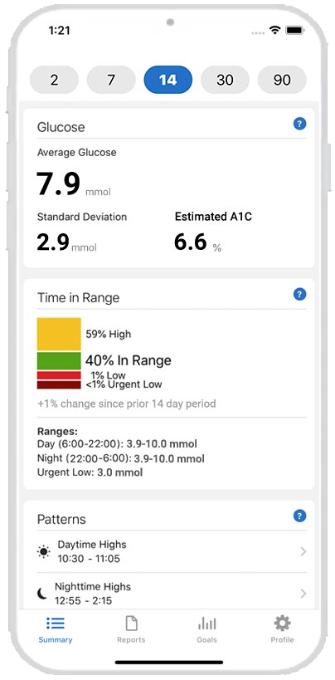
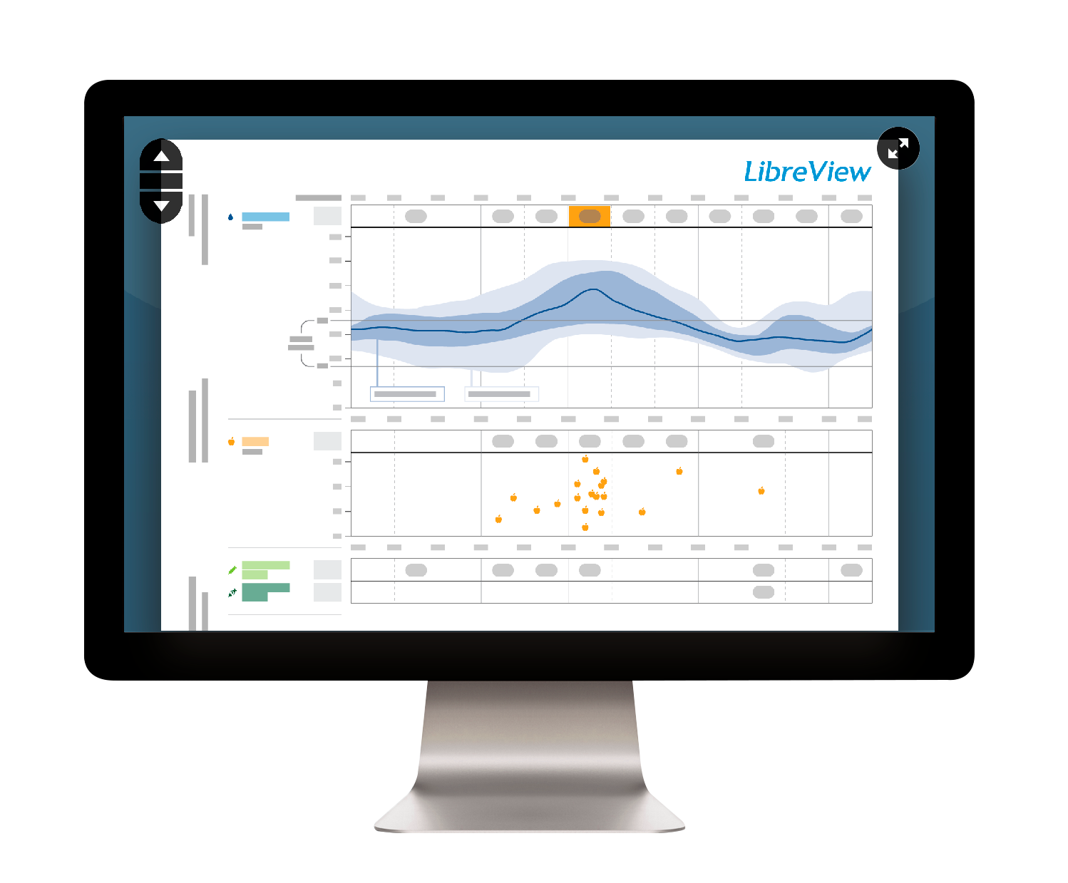
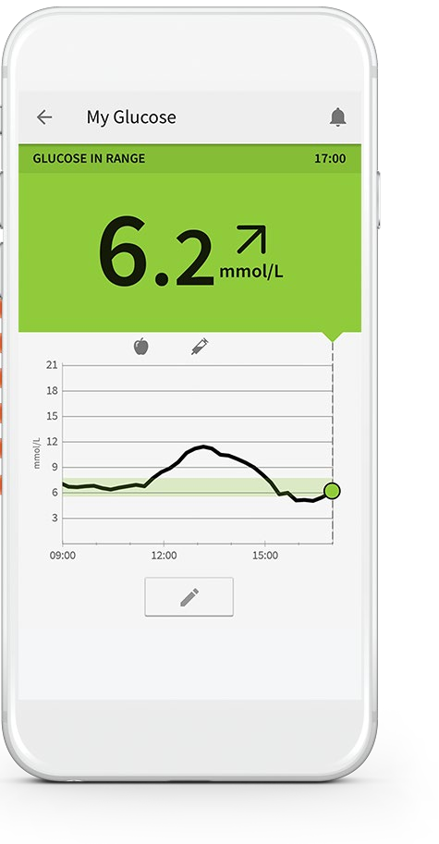
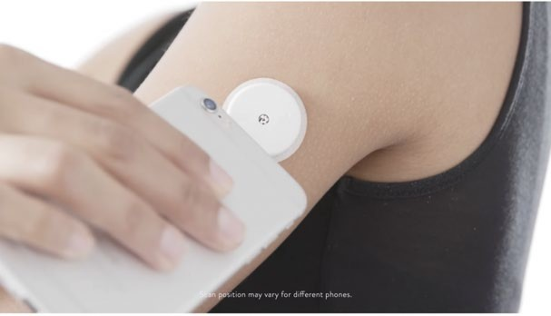
CGM DEVICES PROVIDE EASY ACCESS TO CLOUD-BASED SENSOR GLUCOSE DATA
LBL022519 Rev001
Dexcom G6
CLARITY
Legend
Bluetooth Internet
Freestyle Libre
LibreView
Images for illustration purposes only.

Slide 19
Can this technology help me help my patients?
LBL022299 Rev001
Notes:
Presenter
2023-01-24 20:46:51
--------------------------------------------

Slide 20
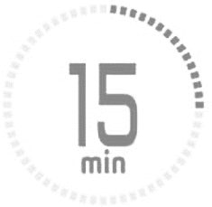
WHAT ARE THE TARGETS¹?
LBL022299 Rev001
13.9 mmol/L
< 5 % of day
< 72 minutes
TAR
10.0 mmol/L
< 25% of day
< 6 hours
1 % of the day
3.9 - 10.0
mmol/L
TIR
Time in range
70% of day
17 hours
< 4 % of day
< 1 % of day
< 1 hour
< 15 minutes
TBR
< 3.9 mmol/L
< 3.0 mmol/L
¹Battelino T et al. Diabetes Care. 2019; 42(8): 1593-1603. and Cheng A, Feig DS, Ho J and Siemens R. Can J Diabetes. 2021; 45: 580-587.
Notes:
Presenter
2023-01-24 20:46:51
--------------------------------------------
For T1DM and T2DM

Slide 21
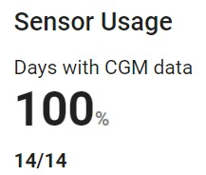
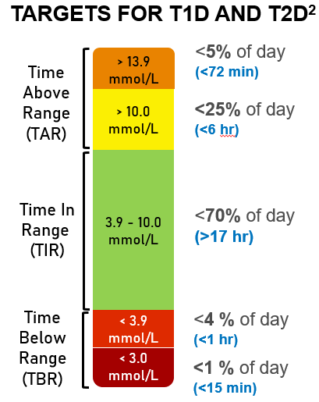
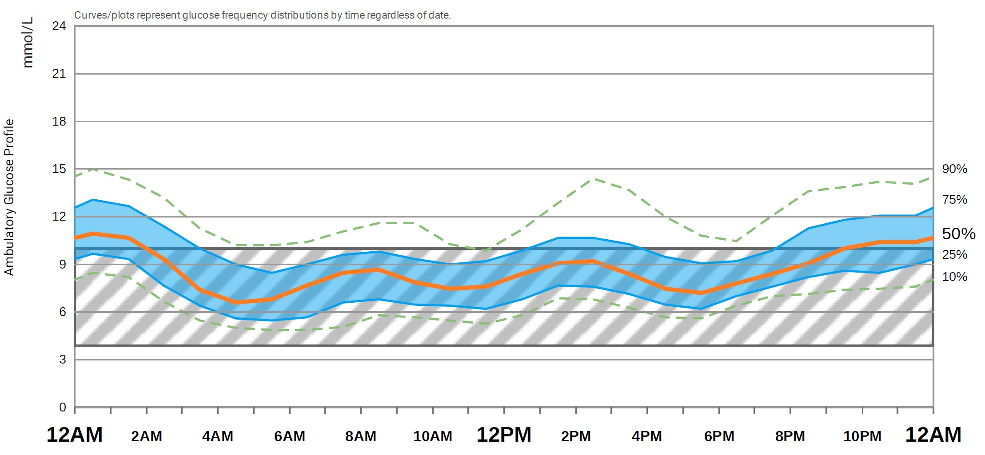
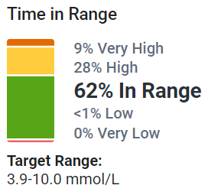
2. WHERE IS ACTION NEEDED?¹
LBL022299 Rev001
1. IS ACTION NEEDED?¹
Target Range:
3.9-10.0mmol/L
Target Range:
3.9-10.0mmol/L
3. PLAN?¹
Images for illustration purposes only.
Beck RW, Bergenstal RM. Diabetes Spectrum. 2021; 34(2):102-108
Cheng AYY, Feig DS, Ho J, et al. CJD. 2021; 45(7):580-587
Notes:
Presenter
2023-01-24 20:46:52
-------------------------------------------- ANIMATED SLIDE

Slide 22
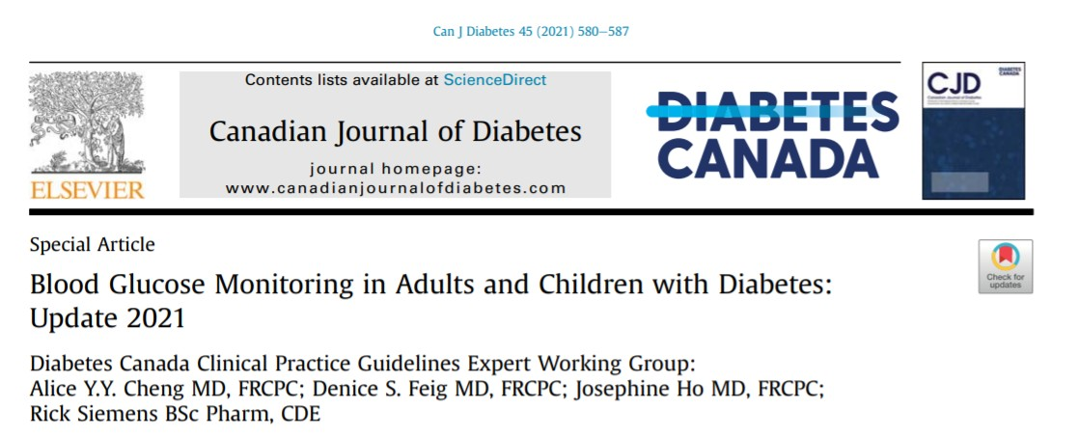
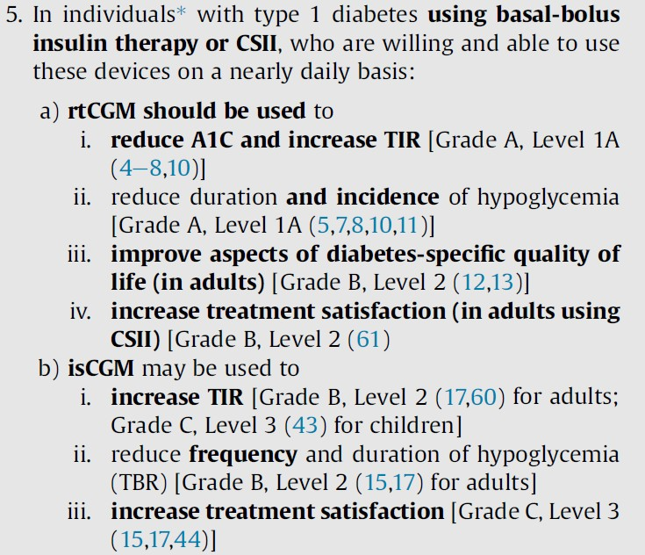
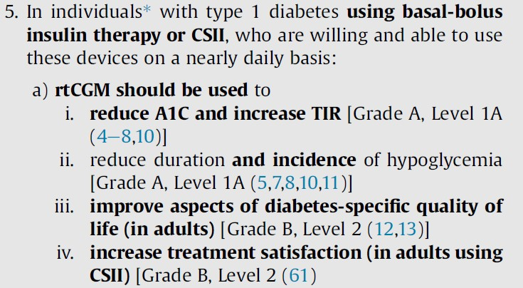
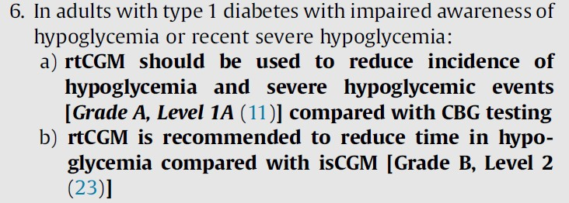
Blood Glucose Monitoring in Adults and Children with Diabetes: Update 2021
LBL022063 Rev001
Cheng AYY, Feig DS, Ho J, et al. Blood glucose monitoring in adults and children with diabetes: Update 2021. CJD. 2021; 45(7):580-587
Notes:
Presenter
2023-01-24 20:46:53
--------------------------------------------
Animated slide

Slide 23
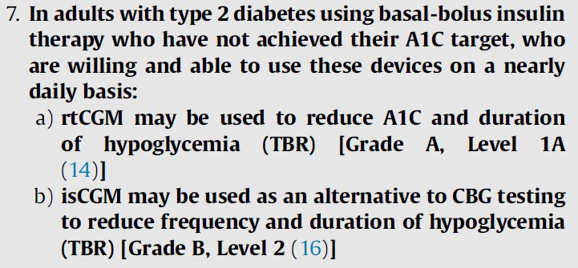
Blood Glucose Monitoring in Adults and Children with Diabetes: Update 2021
LBL022063 Rev001

Slide 24
Dexcom G6 Demonstration

Slide 25
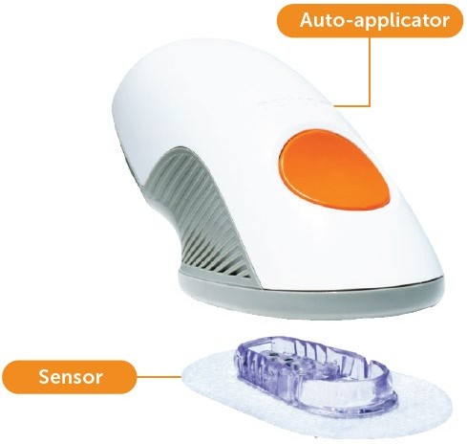
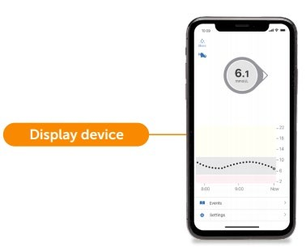
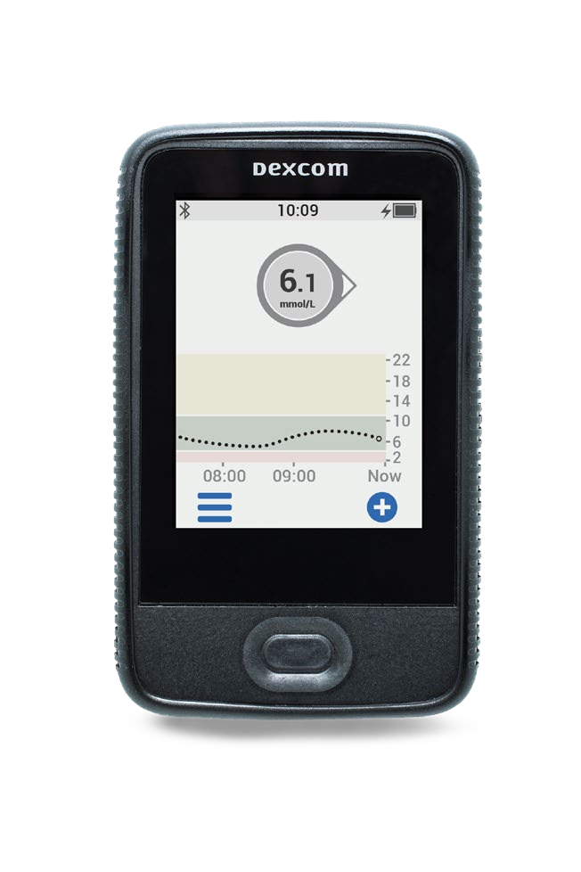
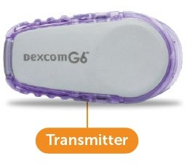
COMPONENTS OF THE DEXCOM G6 rtCGM SYSTEM
LBL022519 Rev001
The simple to use auto- applicator easily inserts a small sensor just beneath the skin with one touch.
A display device‡ continuously shows current glucose value, speed and direction of change.
The sensor measures glucose levels from just underneath the skin*.
The transmitter fastens on top of the sensor and wirelessly sends data to a receiver† or compatible smart device‡ loaded with the Dexcom G6 app.
rtCGM, real-time continuous glucose monitoring. * If glucose alerts and readings from the Dexcom G6 do not match symptoms or expectations, use a blood glucose meter to make diabetes treatment decisions. ‡ For a list of compatible smart devices, visit dexcom.com/compatibility. Images are for illustrative purpose only.

Slide 26
G6 SENSOR AND TRANSMITTER INSERTION

Slide 27
Case Study

Slide 28
Sam
LBL022299 Rev001
57 year old with Type 2 diabetes x 10 years
Recent labs:
HbA1C: 8.1%
eGFR 60
ACR 2.2
LDL 1.64
Vitals:
BP 129/83 HR: 84
BMI 32
10%
9%
HbA1C %
8%
7%
6%
Rx:
Lifestyle changes?
Metformin 1g bid
Semaglutide 1mg weekly
Degludec 48u qhs
Atorvastatin 20mg daily
Perindopril 8mg daily
Empagliflozin d/c (recurrent UTIs)
What do we recommend?
Increase basal insulin?
Add rapid insulin?
Try SGLT-2
inhibitor again?
Start rtCGM?
GLP-1 RA, glucagon-like peptide 1 receptor agonist; CGM, Continuous glucose monitoring
Notes:
Presenter
2023-01-24 20:46:58
-------------------------------------------- ANIMATED SLIDE
Is there any evidence to support initiating rtCGM?

Slide 29
Sam Starts a Glucose Sensor
LBL022299 Rev001
Sam can see the results of his efforts and take action between health care visits
9.3 mmol/L
7.6%
Images provided for illustration purposes only. List of compatible devices available at https://www.dexcom.com/en-CA/compatibility.
CLARITY is available in over 20 languages: Dansk, Deutsch, English, Español, Français, Français (CA), Italiano, Magyar, Nederlands, Norsk (bokmål), Polski, Português,
Slovenčina, Slovenščina, Suomi, Svenska, Türkçe, Čeština, תירבע, ﺔﯾﺑرﻌﻟا, 한국어.
Notes:
Presenter
2023-01-24 20:47:00
-------------------------------------------- ANIMATED SLIDE

Slide 30
THE EVOLUTION OF DIABETES VISITS
LBL022299 Rev001
BEFORE
NOW
Images provided for illustration purposes only.
Notes:
Presenter
2023-01-24 20:47:00
-------------------------------------------- ANIMATED SLIDE

Slide 31
Dexcom Reports on Clairty

Slide 32
How can you help clients?
1
Tell them about CGM options available
2
Help them get set up with a free trial if eligible
3
Offer for sensor and receiver to be mailed to your work if mailing options limited
4
Offer to help put the sensor on and set up app
5
Connect them with supports to help decipher data if needed
Notes:
Presenter
2023-01-24 20:47:01
--------------------------------------------
#2 – show screenshot of the Dexcom free trial #3 – Explain hard to get reciever
Open Dialogue #4:
Would you feel comfortable helping folks put on the sensor and set up the app on their phones If not, what would make your more comfortable doing this?
If not, is there someone in your community who can help with putting sensors on?
#5 If your one of the DIP communities you can contact me; but otherwise you can contact the diabetes educator that visits your community or call the company supports

Slide 33
Dexcom G6 Free Trial
Only for those with diabetes who are taking insulin
Free Continuous Glucose Monitor - Dexcom G6 Trial | Dexcom Canada

Slide 34
Summary
LBL022299 Rev001
1
Evidence support the use of rtCGM in insulin-requiring diabetes
2
By receiving real-time feedback on their glucose levels, patients tend to act and implement behaviour changes on their own in between visits
3
CGM can simplify diabetes care by providing quick access to glucose data and help identify glucose trends and improvement opportunities in a visual and intuitive way.
Notes:
Presenter
2023-01-24 20:47:01
-------------------------------------------- ANIMATED SLIDE

Slide 35
Support Contact Information
Kayla Perry
431-277-6225
kperry@fnhssm.com
Dexcom G6
Dexcom CARE team 1-844-832-1810 (Option 4)
Freestyle Libre
Abbot: 1-888-205-8296

