Slide 1
Basic Foot CARE for Community Workers

Slide 2
Diabetes affects our Feet
Foot problems are very common in people with Diabetes because it causes nerve damage and poor circulation to the legs and feet.
They are less likely to feel an injury to the foot
Untreated foot injuries can quickly become infected and are more difficult to heal and can lead to serious complications

Slide 3
Skin conditions
What are we Looking for when looking at feet?
-Skin integrity (cuts, cracks, blisters, sores, ulcers, rashes, scratches, calluses, corns (thickened skin, scars)
Color: new redness, bruising, discoloration (pallor, or darkening)
swelling
Temperature: warm/cool to touch
dryness/moisture
Hair (top of toes)
Numbness/tingling
Changes in shape
Notes:
Calluses and corns are caused by friction, rubbing, improperly fitting shoes
Redness and warmth are signs of infectiion

Slide 4
Nails
Nails, are they?:
deformed (thick, fungal, rams horns, etc.)
discolored (yellow, red, purple)
improperly cut
Absent
ingrown

Slide 5
Deformities
Are there changes in shape of feet/toes?
Bunions
Hammer toes
Claw toes
Charcot Foot
From previous injury (screws, pins, swelling)
spurs

Slide 6
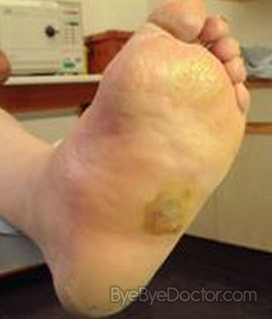
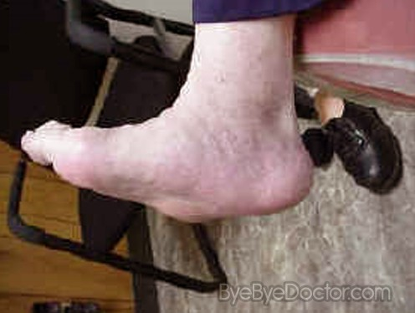
Charcot Foot

Slide 7
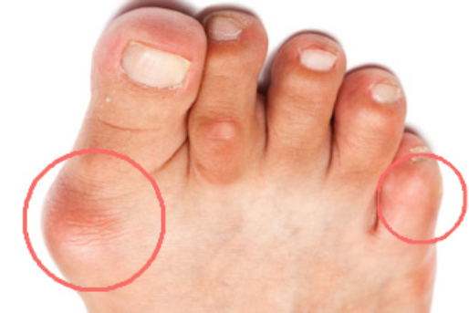
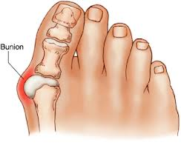
Bunions
Caused by:
big toe pushing against 2nd toe, making joint of big toe bigger and sticks out.
Wearing shoes with small toe box
Can be painful

Slide 8
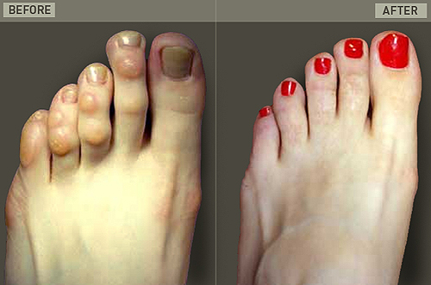
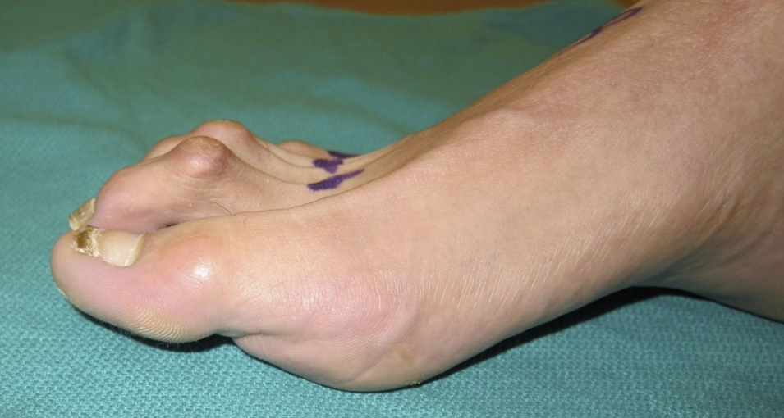
Hammer toes
Causes of hammer toes include:
shoes that don’t fit properly
foot injuries,
bunions and
rheumatoid arthritis.
Notes:
2nd photo: picture before and after surgery for hammer toe-toes were shortened.

Slide 9
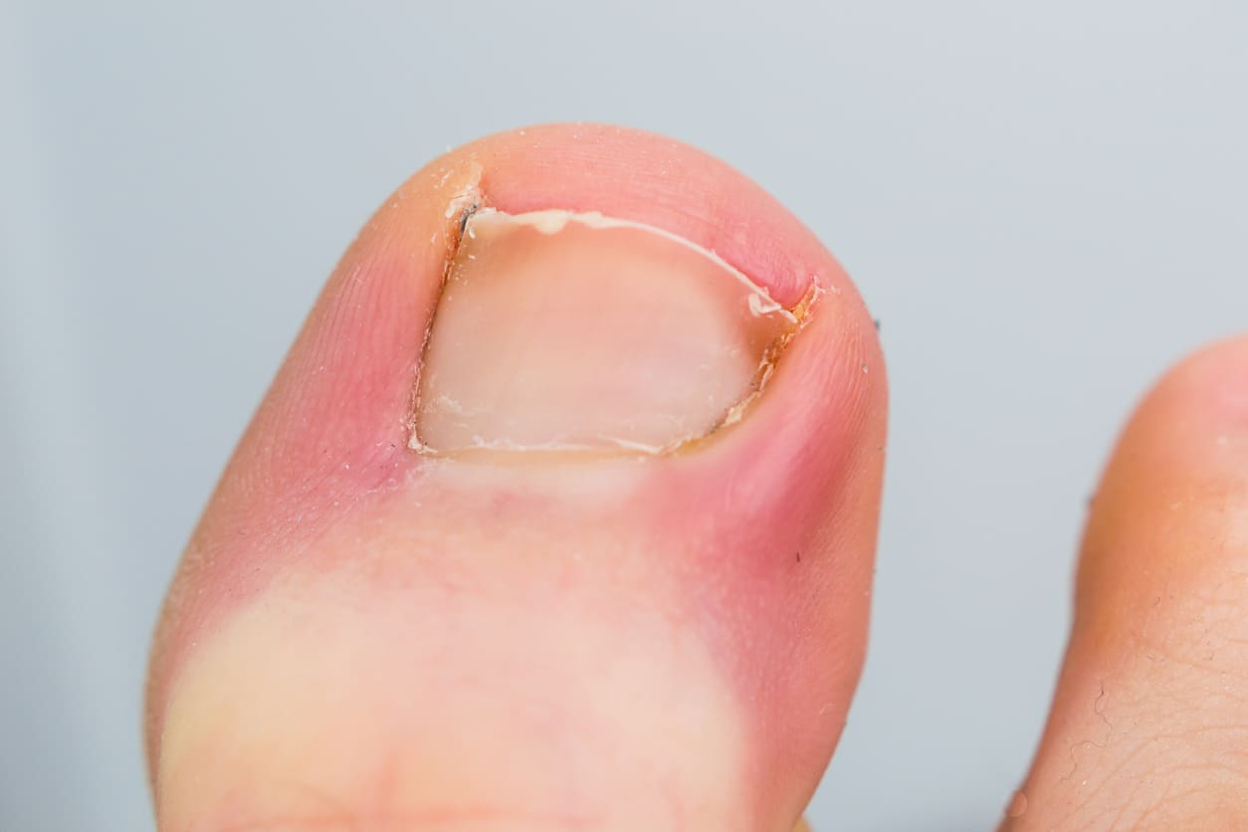
Ingrown toenail
Pain, redness, or swelling around a toenail could mean you have an ingrown toenail—a leading cause of diabetic foot infections and amputations.

Slide 10
Potential causes of foot problems
Footwear-poor fitting shoes
Diabetes-poorly controlled blood sugars
Nerve damage-lose sensation to feet
Poor circulation-cardiac problems, atherosclerosis (hardening of the arteries)
Hypertension
Smoking(causes damage to small blood vessels)

Slide 11
Why check the feet?
Complications of Diabetes?
If the blood glucose levels are not well controlled, high blood glucose levels over time can damage the nerves and blood vessels to the feet, heart, brain, kidneys, eyes, .
Foot problems can develop quickly and become very serious.
75% of clients with Diabetes have not had their feet examined by a health professional
Notes:
Hgb A1C blood tubes demo

Slide 12
Foot complications
Damage to the nervous system = Loss of Sensation
A person with loss of feeling to their lower limbs (legs/feet) may not feel skin damage or minor injury caused by a foreign body in the shoe
Breakdown of the skin of the foot and sores can develop quickly
Damage to blood vessels = make it difficult to heal these wounds.

Slide 13
Foot Care Tips
Encourage clients to examine feet daily
Use water based moisturizer with no alcohol or perfumes
Do not use lotions between toes, dry very well between the toes
Use acrylic or wool socks
Cut toenails straight across, do not cut into corners
Wear shoes and socks at all times, even inside to protect the feet
Buy proper fitting shoes (buy at end of the day)
Test water temperature before bathing (like for baby)
Exercise (walk) to promote circulation to feet

Slide 14
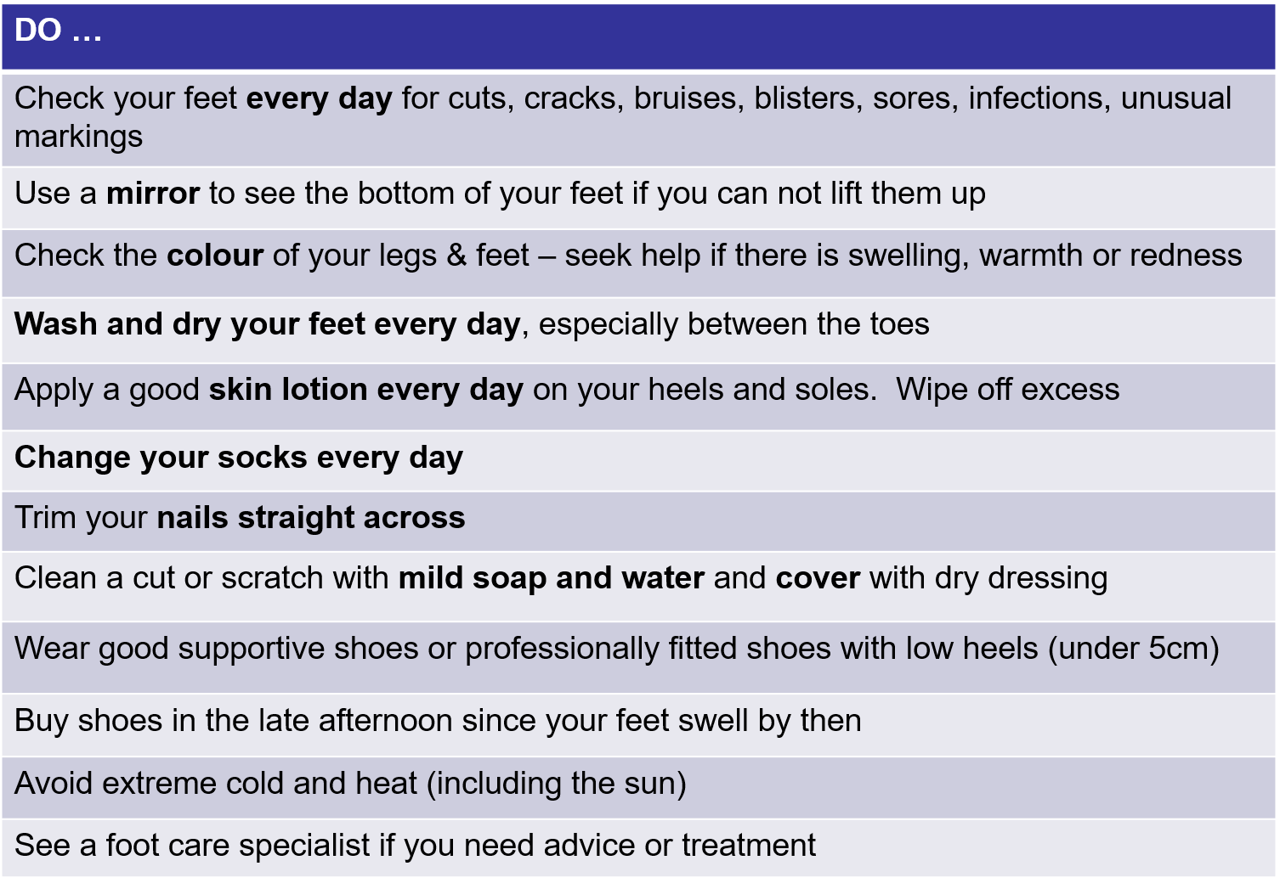
Questions?..........
Foot Care in The Community

Slide 16
Pointers for community ADI/Health Program Workers
It is important to encourage people with Diabetes to check their feet, there may be reasons that client is unable to provide proper care of their own feet, including:
poor vision
decreased range of motion (age, obesity, other conditions),
Little or no assistance and resources at home (ie. Water for proper hygiene, clean socks, etc.)
lack of foot care education and resources

Slide 17
Foot Health is Everyone’s Responsibility
You do not have to be a Certified Foot Care Nurse to :
-look at client’s feet and to identify foot problems
-report foot problems to Health Care Providers
-Prevention far outweighs the implications of no foot care (severe infections, amputations)

Slide 18
No such thing as a silly question!
QUESTIONS:

