Slide 1
Carbohydrates
Notes:
Hi Everyone and welcome to today’s session on Carbohydrates.
My name is __________________.

Slide 2
Objectives
By the end of the presentation you will:
- Learn what is a carbohydrate
- Understand what foods contain carbohydrates and those with no carbohydrates
- The benefits of fibre for blood sugar control
- What glycemic index is, how it works and how to choose foods with a lower glycemic index
- How to read and understand food labels
Notes:
Today we will learn about what a carbohydrate is, the types of carbohydrates, foods with carbohydrates and those with no carbohydrates, the benefits of fibre for blood sugar control, what glycemic index is, how it works and how to choose foods with a lower glycemic index and how to read and understand food labels.

Slide 3
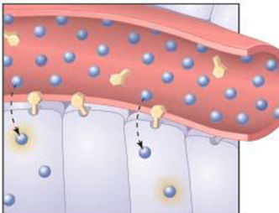
Should I avoid carbohydrates?
NO – carbohydrates provide your body, brain and cells with energy
- like fuel for a vehicle
Notes:
Some people with diabetes might ask if they should completely avoid all carbohydrates in their diet. The answer is no. This is because carbohydrates are one of the body’s main energy sources. Carbohydrates provide your body, brain and cells with energy to do the activities you do each day.
You can as it think of carbohydrates as fuel for the body, just as you would gas for a car. If your car is low on gas, you need to refuel to keep driving otherwise it will not run. The body is different from a car because it needs 3 types of fuel or energy to run well. The fuel our bodies need are carbohydrates, fat and protein. We can make sure that we get all 3 types of energy each day by using the balanced food plate at mealtimes to guide our food choices.

Slide 4
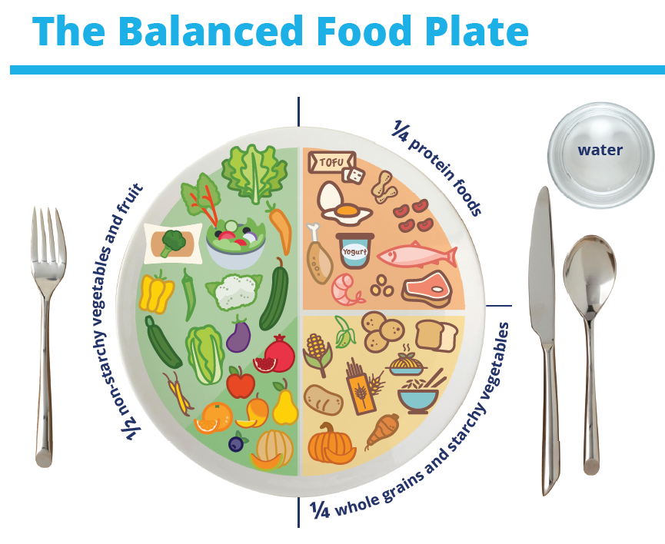
Why talk about carbohydrates?
Notes:
We are talking about carbohydrates today because ensuring meals are balanced and include the right amount of carbohydrates is important to healthy eating and managing blood sugars.
You can use your plate to build a nutritious meal!
Fill ½ your plate with non-starchy vegetables and fruit. Include a variety of vegetables such as dark leafy greens, broccoli, cucumber, carrot, zucchini, cauliflower, or bell pepper. Include a small portion of fruit such as 1 cup of berries, or a small apple with your meal or as a snack.
Fill ¼ of your plate with protein foods such as kidney beans, split peas, lentils, soy products like tofu or tempeh, eggs, chicken, turkey, lean cuts of beef or pork, nuts and seeds, fish and shellfish, and low-fat dairy products. Choose vegetable proteins more often.
Fill ¼ of your plate with whole grains and starchy vegetables such as pasta, oats, brown rice, quinoa, barley, bulgur, potato, sweet potato or corn.
Link to resource: https://guidelines.diabetes.ca/docs/patient-resources/The_Balanced_Food_Plate_EN.pdf

Slide 5
Macronutrient Distribution (% Total Energy)
 | Carbohydrates | Protein | Fat
% of total energy | 45-60% | 15-20% (or 1-1.5g /kg BW) | 20-35%
Calories per gram | 4 | 4 | 9
Grams for 2000 calorie/day | 225-300 | 75-100 | 44-78
BW = body weight
Notes:
This table shows the recommended amount of all calorie sources, from carbohydrates, protein and fat. As you can see, it is
recommended that about half of your total calories should come from carbohydrate sources (45-60%). This would be 225-
300g of carbohydrates for people who eat a 2000 calorie/day diet.
5

Slide 6
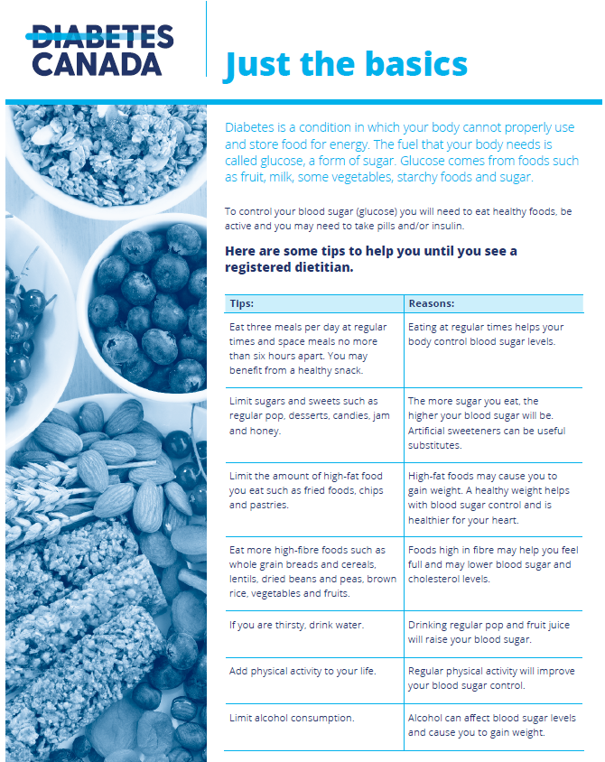
Just The Basics
Eat 3 meals per day no more than 6 hours apart.
Limit obvious sugars, sweets, and high fat food.
Eat more high fibre foods.
If you are thirsty, drink water.
Add physical activity to your life.
Limit alcohol consumption
Notes:
To control your blood sugar you can follow these tips to get started:
Eat 3 meals per day no more than 6 hours apart because because eating at regular times helps your body control blood sugar levels.
Limit obvious sugars, sweets, and high fat food because the more sugar you eat, the higher your blood sugar will be. Eating high fat foods like fried foods or chips may cause you to gain weight and a healthy weight can help with blood sugar control.
Eat more high fibre foods. Eating high fibre foods can help you feel full and may lower blood sugar and cholesterol levels
If you are thirsty, drink water. If you drink juice or regular pop instead, this will raise you blood sugar.
Add physical activity to your life. Physical activity can improve blood sugar.
Limit alcohol consumption. Alcohol can affect blood sugar levels and cause you to gain weight.
Today we will focus the recommendations that focus on carbohydrates such as limiting obvious sugars, and sweets and eating high fibre foods. We will review some tools you can use to make healthier food choices.
Link to resource: https://www.diabetes.ca/DiabetesCanadaWebsite/media/Managing-My-Diabetes/Tools%20and%20Resources/just-the-basics.pdf?ext=.pdf

Slide 7
Avoid the roller coaster….
Notes:
The reason we are focusing on carbohydrates today is because what you eat can impact your blood sugar. If you skip meals and eat high amounts of sugars and sweets, this can cause your blood sugar levels to look like a rollercoaster!
Balanced eating such as eating at regular meals each day, limiting sugars and sweets and eating more fibre foods, can help keep your blood sugar stable.

Slide 8
What is a carbohydrate?
Carbohydrates are the sugars found in different foods that break down into sugar in the body
Carbohydrates are the body's main source of energy
There are simple carbohydrates (pop, chocolate bars, donuts) will affect your blood sugars fast
There are more complex carbohydrates (some vegetables, whole grain foods, beans and legumes) that will affect your blood sugars slowly
Notes:
Lets discuss what a carbohydrate is. They are the sugars found in different foods that break down into sugar or glucose in the body. Carbohydrates are the body’s main source of energy. There are simple carbohydrates that will affect you blood sugars fast. Examples are pop, chocolate and donuts for example. There are also complex carbohydrates that will affect your blood sugar slowly. Examples can include some vegetables, whole grain foods, beans and legumes.

Slide 9
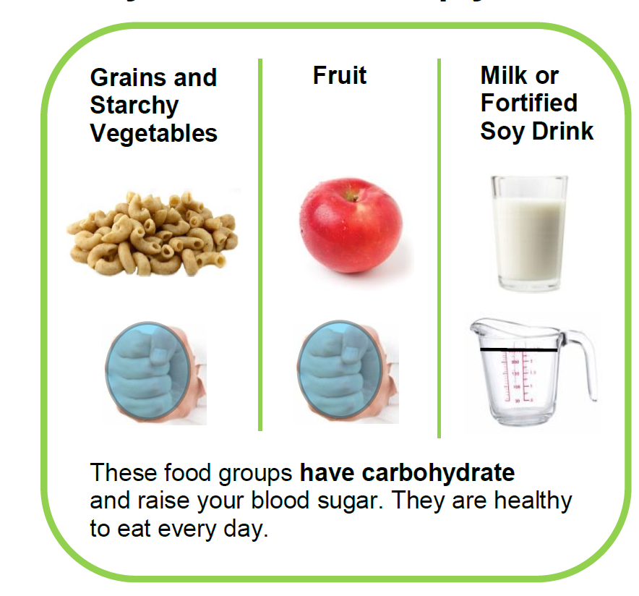
Foods with carbohydrates
Notes:
These are the foods that have carbohydrates and raise your blood sugar. They are healthy to eat every day.
This includes grains and starchy vegetables, fruit and milk or fortified soy drink. Choose an amount the size of your fist for grains or starches, or fruit.
For milk or fortified soy drink, drink up to 1 cup (250ml) of low-fat milk at a mealtime.

Slide 10
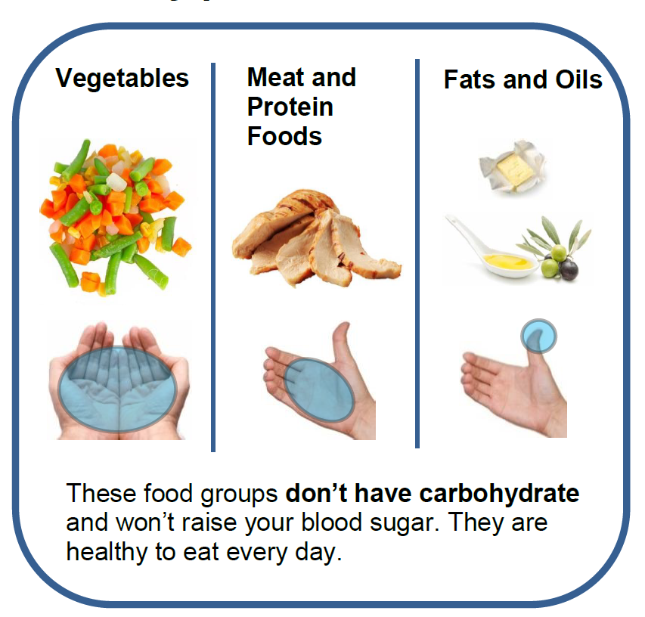
Foods without carbohydrates
Notes:
These are the foods that don’t have carbohydrates and won’t raise your blood sugar. They are healthy to eat every day.
This includes vegetables, meat and protein foods, and fats and oils.
For vegetables, aim to choose as much as you can hold in both hands.
For meat and protein foods, choose an amount the size of the palm of your hand and the thickness of your little finger.
Limit fat to an amount the size of the tip of your thumb.

Slide 11
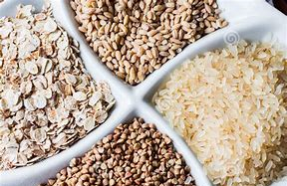
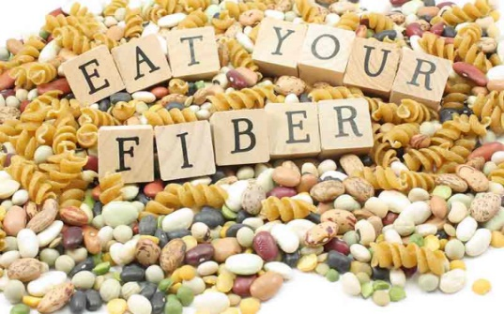
There are 3 types of carbohydrates:
Sugar
Starch
Fibre
Notes:
There are 3 types of carbohydrates sugar, starch and fibre.

Slide 12
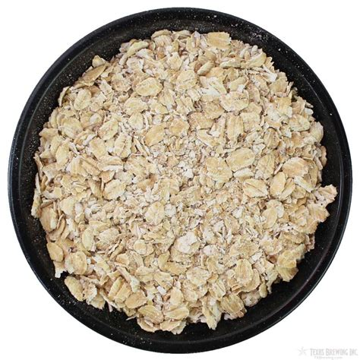
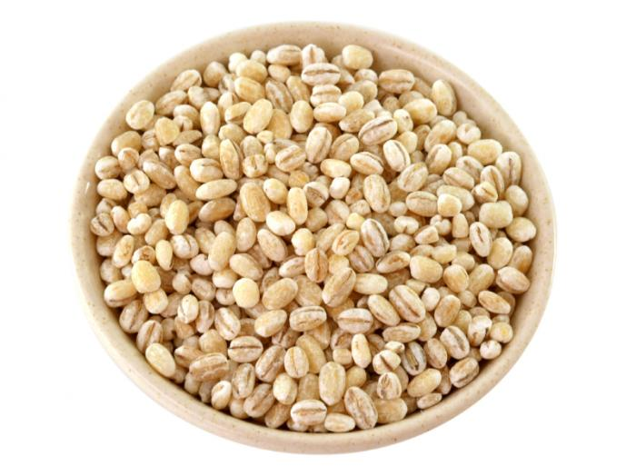
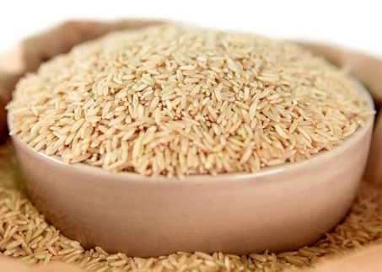
Starch
Starch is a form of a complex carbohydrate
Starchy vegetables like peas, corn, lima beans, kidney beans, black eyed peas, and split peas
‘Grains’ like oats, barley, and rice
Notes:
Starch is a form of a complex carbohydrate. Starches are made up of individual sugar units. Some examples are starchy vegetables like peas, corn as well as beans and peas like lima beans, kidney beans and split peas. Grains like oats, barley and rice are also a type of starch.

Slide 13
A ‘Grain’ consists of 3 parts:
Bran-hard, outer shell of the grain. It provides the most fibre and most of the vitamins and minerals
Germ-small nutrient core, packed with nutrients including essential fatty acids and vitamin E
Endosperm-soft, centre of the grain, contains the starch.
Notes:
Let’s talk more about grains. A grain consists of 3 parts.
The bran is the hard outer shell of the grain. It provides the most fibre, vitamins and minerals.
The germ is a small nutrient core that is packed with nutrients including essential fatty acids and vitamin E.
The endosperm which is the soft, centre of the grain that contains the starch.

Slide 14
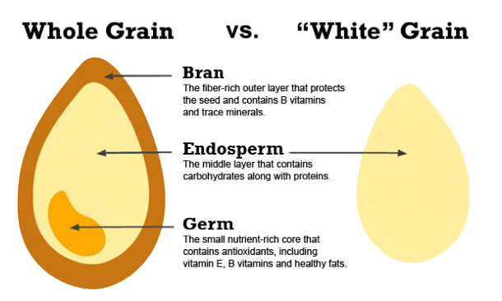
Notes:
Let’s compare a whole grain to a “white grain”.
As you can see on the left, the whole grain has all three parts of the grain, the bran, endosperm and germ. This means it has lots of fibre, vitamins and healthy fats.
When we compare the whole grain to a “white grain” on the right, the white grain only has the endosperm. It does not have the bran and germ that are rich in fibre, vitamins and healthy fats. These are lost during the refining process.
When it is recommended to have more whole grains, it is because these foods have more vitamins, fibre and healthy fats that are needed for a healthy diet.

Slide 15
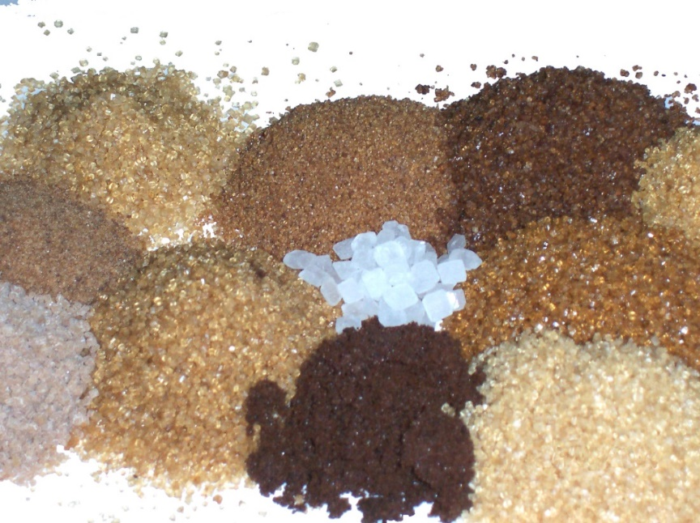
Sugar
Sometimes referred to as simple or fast-acting carbohydrate
There are 2 main types of sugar:
a) Naturally occurring sugar
b) Added sugar
Notes:
The second type of carbohydrate is sugar. It is sometimes called a simple or fast-acting carbohydrate. There are 2 mains types of sugar; Naturally occurring sugar and added sugar.

Slide 16
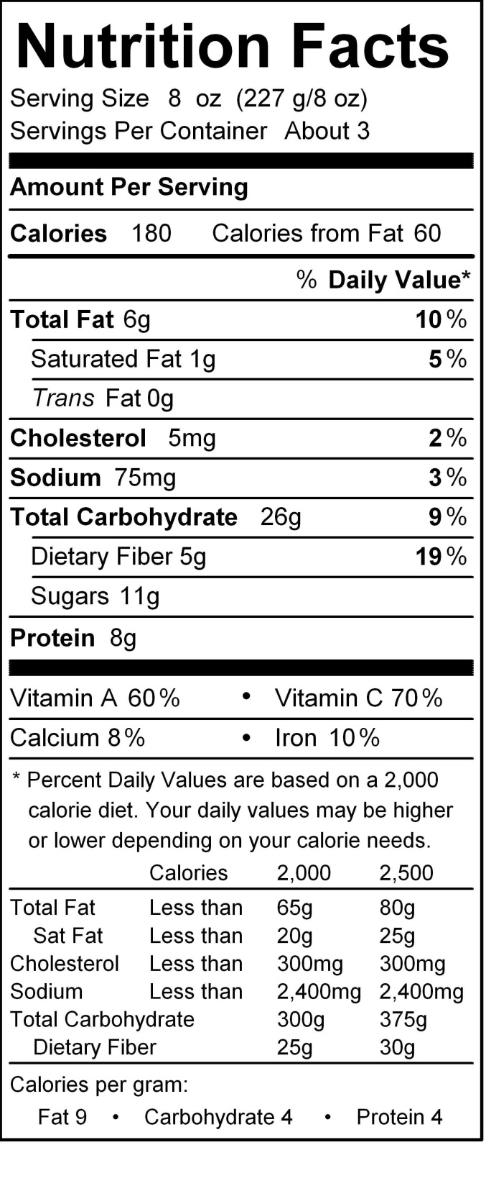
a) Naturally Occurring Sugars: found in foods
like milk or fruits
b) Added Sugars: added during processing
such as sugar added to make cookies, or
added to canned fruit to make the syrup.
On the Nutrition Facts label,
the number of sugar in grams includes BOTH
added and natural sugars
Notes:
Naturally occurring sugars are found in foods like milk or fruit.
Added sugars are added during processing such as sugar added to make cookies or sugar added to canned fruit to make the syrup.
On a nutrition facts label, the number of sugar in grams includes both added and natural sugars.

Slide 17
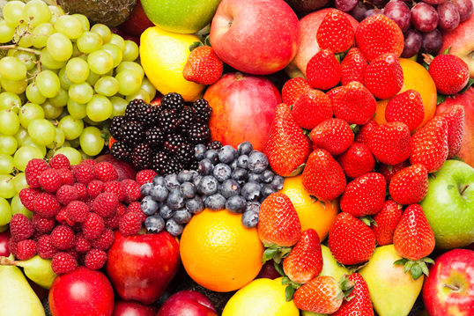
There are many different names for sugar
Some common ones: table sugar, brown sugar, molasses, honey, beet sugar, cane sugar, confectioner’s sugar, powdered sugar, raw/rock sugar, maple sugar, high fructose corn syrup, agave nectar and sugar cane syrup
Fruit sugar is known as fructose
Milk sugar is known as lactose
Notes:
There are may different names for sugar. Some common ones are table sugar, brown sugar, molasses, honey, beet sugar, cane sugar, confectioner’s sugar, powdered sugar, raw/rock sugar, maple sugar, high fructose corn syrup, agave nectar and sugar cane syrup.
Fruit sugar is known as fructose. Milk sugar is known as lactose.

Slide 18
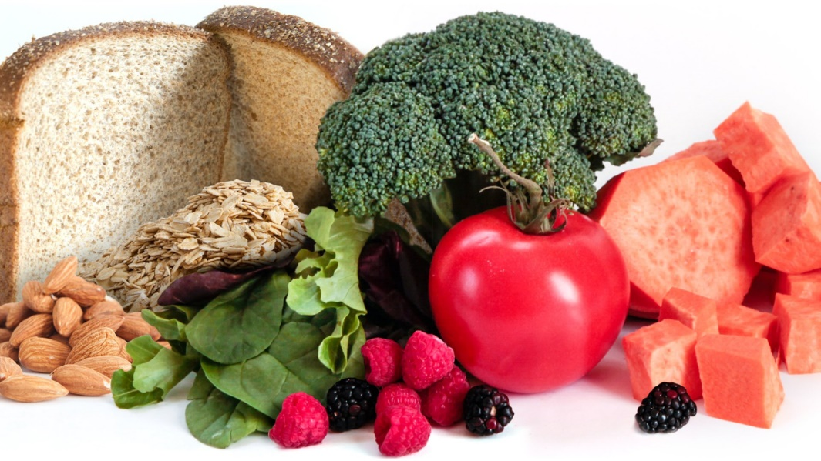
Fiber
Comes from plant based foods
No fibre in animal products such as milk, eggs, meat, poultry, & fish
Indigestible part of plant foods: includes fruits, vegetables, whole grains, nuts and legumes
When you eat these foods, most passes through the intestines and is not digested
Does not affect blood sugars
Notes:
The third type of carbohydrate is fibre. It comes from plant foods. There is no fibre in animal products such as milk, eggs, meat, poultry, and fish. Fibre is the indigestible part of plant foods and can be found in fruits, vegetables, whole grains, nuts and legumes.
When you eat these foods, most passes through the intestines and cannot be digested or absorbed and does not affect blood sugars.

Slide 19
For good health, adults with diabetes should aim to eat:
30-50 grams of fiber
per day
Notes:
For good health, adults with diabetes should aim to eat 30-50 grams of fiber per day.

Slide 20
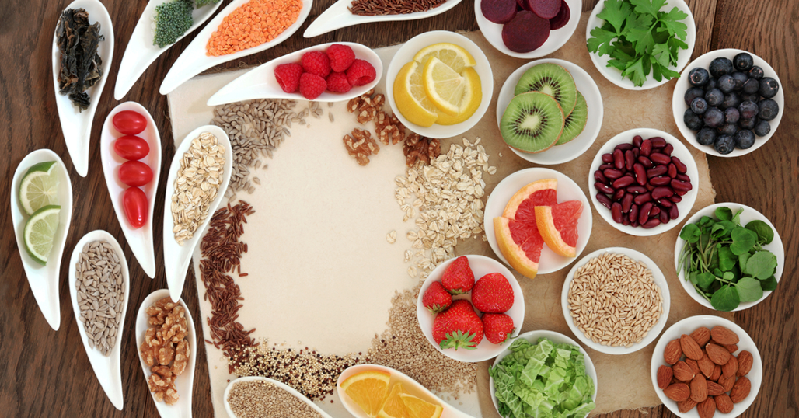
Benefits of Fibre
Fibre helps keep you regular and reduces constipation, but it is also has other benefits.
Fibre can help you:
Control your blood glucose levels
Lower your blood cholesterol levels, which also lowers your risk of diabetes and heart disease
Achieve and maintain a healthy weight, which lowers your risk of diabetes
Feel fuller longer
Promote your heart health
Lower your risk of some types of cancer
Foods with soluble fibre are especially helpful. These foods help slow the glucose being absorbed into your blood. Soluble fibre is found in foods like oats, legumes (beans, peas and lentils), barley, eggplant and okra.
Notes:
There are many benefits of fibre. Fibre helps keep you regular and reduces constipation.
It can also help you control your blood glucose level, lower your blood cholesterol levels, which also lowers your risk of diabetes and heart disease.
Achieve and maintain a healthy weight, which lowers your risk of diabetes.
Help you feel fuller longer.
Promote your heart health.
Lower your risk of some types of cancer.
Foods with soluble fibre are especially helpful. These foods help slow the glucose being absorbed into your blood. Soluble fibre is found in foods like oats, legumes (beans, peas and lentils), barley, eggplant and okra for example.

Slide 21
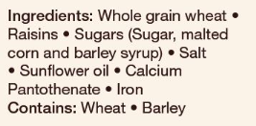
Sources of Fibre
Beans and legumes- Black beans, kidney beans, chickpeas, white beans and lentils
Fruits and vegetables- especially those with edible skin (eg. apples, berries, peaches, carrots, broccoli, beans)
Whole grains such as:
Whole wheat pasta
Whole grains cereal- look for those with 3 grams of fibre or more per
serving (whole, wheat, wheat bran, oats in ingredient list)
Whole grain bread- one slice should have at least 3 grams of fibre per serving (whole grain in ingredient list)
Nuts & seeds- try different kinds, peanuts, almonds and walnuts are a good source of fibre
Notes:
Sources of fibre are:
Beans and legumes, like black beans, kidney beans, chickpeas, white beans and lentils
Fruits and vegetables- especially those with edible skin (eg. apples, berries, peaches, carrots, broccoli, beans)
Whole grains such as:
Whole wheat pasta
Whole grains cereal- look for those with 3 grams of fibre or more per serving (whole, wheat, wheat bran, oats in ingredient list)
Whole grain bread- for example, one slice should have at least 3 grams of fibre per serving ( look for the works whole grain in ingredient list)
Nuts & seeds- try differrent kinds like peanuts, almonds and walnuts are a good source of fibre
Link to resource, Foods with Fibre:
https://www.albertahealthservices.ca/assets/info/nutrition/if-nfs-foods-with-fibre.pdf

Slide 22
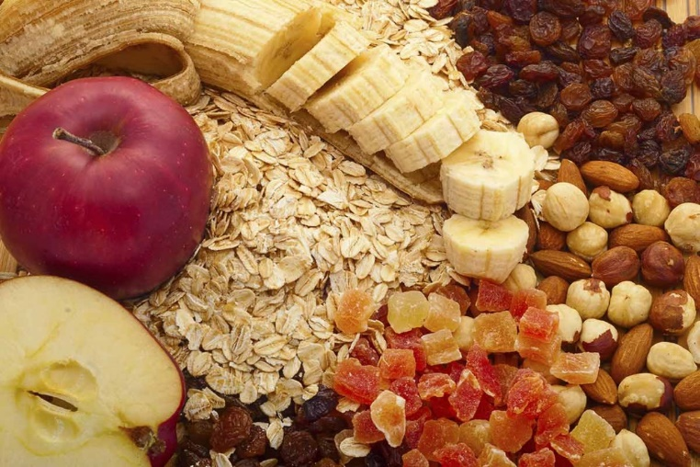
Remember when adding more fibre to your meals:
It is important to increase fibre SLOWLY.
If you increase fibre intake too fast, may cause upset stomach, bloating and/or constipation
Be sure to also increase water intake at the same time. You should try to drink 6-8 cups of water each day
Notes:
When you are increasing the amount of fibre in your diet, if is important to increase fibre slowly. If you increase your fibre intake too fast, this can may cause upset stomach, bloating and/or constipation.
Also be sure to increase your water intake at the same time. Aim for 6-8 cups of water each day.

Slide 23
Carbohydrate Quiz!

Slide 24
The 3 types of Carbohydrates are:
Sugar, Protein and Fat
Sugar, Fibre and Starch
Sugar, Splenda and Starch
Answer: Sugar, Fibre and Starch

Slide 25
Which of the following is correct?
Sugar is a carbohydrate
Starch is made up of individual sugar units
Starch and sugar are carbohydrates
Starch is first digested into individual sugar units before it is absorbed into the bloodstream
All of the above
All of the answers are correct. However the best answer is "All of the above". Both sugar and starch are carbohydrates. Starch is broken down into individual sugar units in the intestines. The individual sugar units are small enough to be transported across the intestinal wall into the blood stream.

Slide 26
Carbohydrates are found in what foods?
Starch, fruit, milk, starchy vegetables
Cheese, steak, chicken
Olive oil, butter, fish
Answer: A, Starch, fruit, milk, and starchy vegetables contain carbohydrate. Cheese, steak, chicken, and fish are types of protein, while olive oil and butter are types of fat.

Slide 27
How much carbohydrate do you need each day?
10% of your daily calories
45-60% of your daily calories
90% of your daily calories
About half (45-60%) of your calories each day come from carbohydrates. This is the case whether you have diabetes or do not have diabetes. The exact amount of carbohydrates you need each day depends on your calorie goals, activity level and personal preferences. Your registered dietitian can help choose a carbohydrate goal and daily meal plan that keeps your food, medication and physical activity in mind.

Slide 28
Why are whole grains higher in fibre when compared to a “white grain”?
Answer: Whole grains have the bran which is high in fibre and the “white grain” does not.

Slide 29
Fibre helps to:
Control your blood glucose levels
Lower your blood cholesterol levels, which also lowers your risk of diabetes and heart disease
Achieve and maintain a healthy weight, which lowers your risk of diabetes
Lower your risk of some types of cancer
All of the above
All of the above are benefits of fibre. In addition to keeping bowel movements regular, fibre can help you control your blood glucose levels, lower your blood cholesterol levels, which also lowers your risk of diabetes and heart disease, achieve and maintain a healthy weight, which lowers your risk of diabetes, feel fuller longer, promote your heart health, lower your risk of some types of cancers.

Slide 30
Which of the following is NOT a source of fibre:
Beans and legumes
Fruits and vegetables
Whole wheat pasta
Eggs
Answer: Eggs

Slide 31
True or False?
It is important to increase fibre intake slowly while also increasing water intake. If you increase fibre intake too fast, this may cause upset stomach, bloating and/or constipation.
Answer: True

Slide 32
Glycemic Index (GI)- What is it?
A scale that ranks carbohydrate-rich foods based on how much they raise blood sugar levels after eaten or drank.
It helps you know how much these foods raise blood sugar
Some carbohydrate foods raise blood sugar more than others
Foods with high GI increase blood sugar higher and faster than foods with low GI
Lower GI foods may help you:
• decrease risk of type 2 diabetes and its complications
• decrease risk of heart disease and stroke
• feel full longer
• maintain or lose weight
Notes:
Glycemic index is another tool you can use when meal planning.
It is a scale that ranks carbohydrate-rich foods based on how much they raise blood sugar levels after eaten or drank. The glycemic index scale is out of 100.
It helps you know how much these foods raise blood sugar
Some carbohydrate foods raise blood sugar more than others
Foods with high glycemic index increase blood sugar higher and faster than foods with a low glycemic index
Lower GI foods may help you:
• decrease risk of type 2 diabetes and its complications
• decrease risk of heart disease and stroke
• feel full longer
• maintain or lose weight

Slide 33
Glycemic Index- How it works
There are 3 categories:
Red= Stop and think: High glycemic index foods are rated 70 and above.
Yellow = Caution: Medium glycemic index foods are 56 to 69.
Green = GO: Low glycemic index foods are 55 or less.
Notes:
There are three glycemic index categories.
Red= Stop and think: These are high glycemic index foods. They are rated 70 and above. Choose these foods least often. Foods in the high GI category can be swapped with foods in the medium and/or low GI category to lower GI.
Yellow = Caution: These are medium glycemic index foods. They are rated 56 to 69. Choose these foods less often.
Green = GO: These are low glycemic index foods. They are rated 55 or less. Choose these foods most often.

Slide 34
How to use Glycemic Index as a Tool
Enjoy vegetables, fruits, and milk products with meals. These generally have a low GI
Plan meals using medium and low GI grains or starches. Examples on handout and next slide
Limit intake of foods with a high GI and aim to find lower GI replacements
Mix lower GI foods with higher GI foods.
Swap half of your higher GI starch food serving with beans, lentils or chickpeas. For example, instead of having 1 cup of cooked short grain rice, have ½ cup of cooked rice mixed with ½ cup of black beans.
Notes:
You can use glycemic index as a tool when meal planning. You can do this by enjoying vegetables, fruit and milk products with meals. These generally have a low glycemic index.
Plan meals using medium and low glycemic index grains or starches more often. Examples can be found on the handout (linked below) and on the next slide.
Limit intake of foods with a high glycemic index and aim to find lower glycemic index replacements.
Mix lower glycemic index foods with higher glycemic index foods.
Swap half of your higher GI starch food serving with beans, lentils or chickpeas. For example, instead of having 1 cup of cooked short grain rice, have ½ cup of cooked rice mixed with ½ cup of black beans.
Link to Resource:
https://guidelines.diabetes.ca/docs/patient-resources/glycemic-index-food-guide.pdf

Slide 35
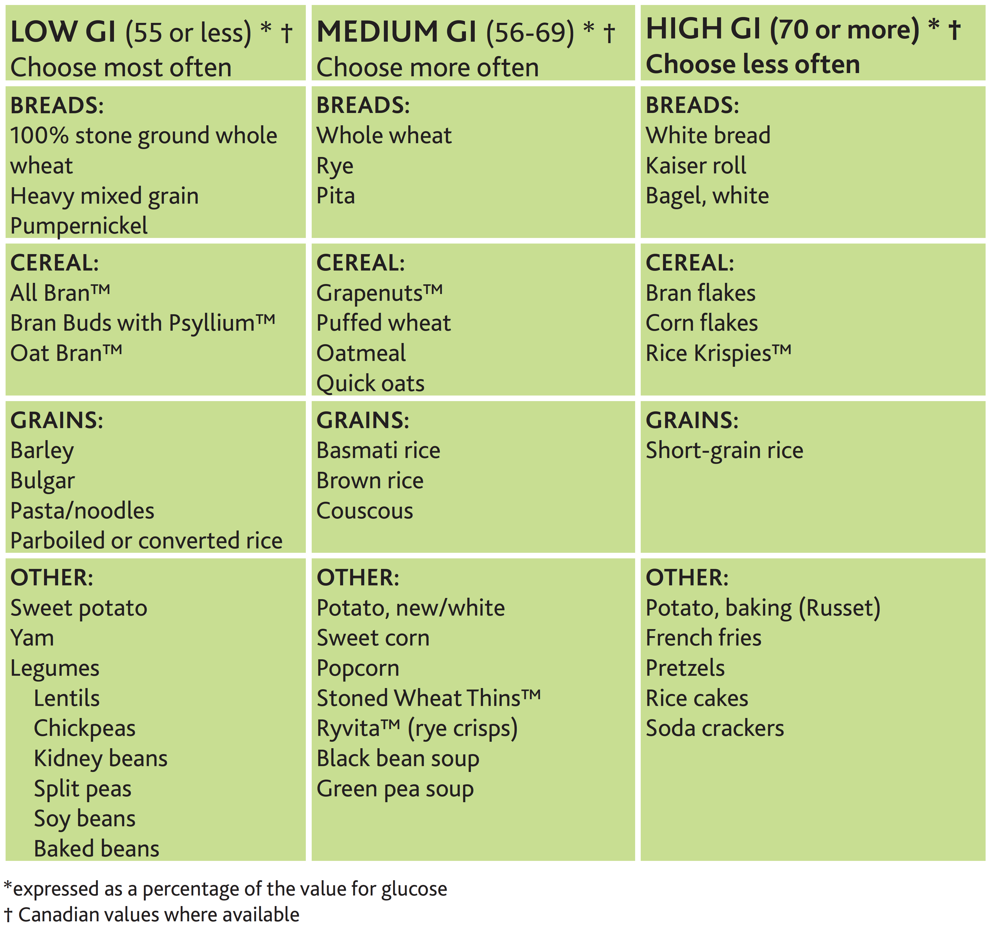
Choose low glycemic index carbohydrates
Notes:
When looking at this table or the handout, you can see the three glycemic index categories, low, medium and
high. When meal planning, think about how you can choose foods within the low and/or medium category more
often to lower the glycemic index of your meal.
35

Slide 36
How to Read Food Labels
1. Look at serving size and compare it to the amount of food being eaten
2. Carbohydrate includes starch, sugars, and fibre (starch is not listed but included in total carbohydrate)
3. Fibre can be subtracted from total carbohydrate because it does not raise blood sugar (ie. 36g carbohydrate – 6g fibre= 30g carbohydrate)
Notes:
Finally we will review how to read food labels and how figure out the net carbohydrate amount. The net carbohydrate amount is the amount of carbohydrate that your body can digest and use for energy.
First you want to look at the serving size and compare it to the amount of food being eaten. All the information listed within the nutrition facts table below will be based on the serving size listed.
Next, look for carbohydrate. The amount listed beside the work carbohydrate includes the total amount of starch, sugars, and fibre (starch is not listed but included in total carbohydrate).
Next, we subtract fibre from the total carbohydrate amount. This is because fibre is not digested and does not raise blood sugar. In this case, we take the total amount of carbohydrate which is 36g carbohydrate and minus 6g of fibre, to equal a net carbohydrate about of 30g.
Note to ADI worker: at this time, you can read and compare food labels with the group to test their knowledge. Give each participant a food label and ask them to figure out the net carbohydrate amount. Have participants share their result with the group.
In addition, you can also complete the cereal slayer activity on the next slide.

Slide 37
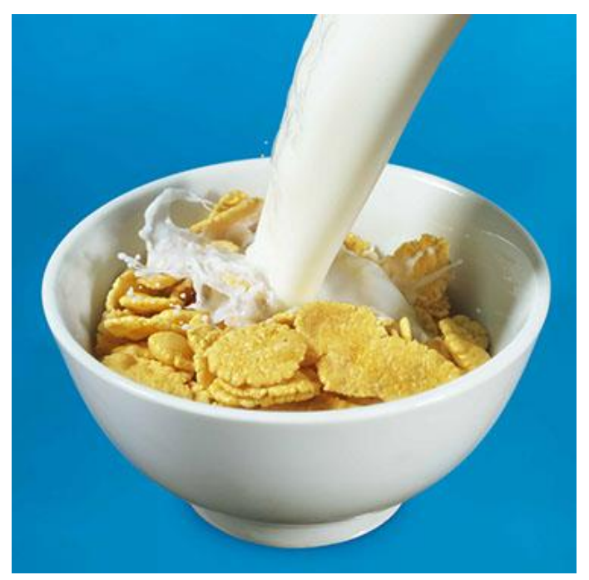
Cereal Slayer Activity
Notes:
Cereal Slayer activity can be found here:
https://www.albertahealthservices.ca/assets/info/nutrition/if-nfs-nutrition-activities-classroom.pdf
Note to ADI worker: Each food label within the Cereal Slayer activity guide can be placed on the walls throughout the room to get participants up and moving. Read the instructions to the cereal slayer activity in the guide linked below so participants know how to complete.
Go over the answers together as a group once everyone has completed the activity.

