Slide 1
Healthy Eating for Women with Gestational Diabetes
Telehealth 2022
Notes:
Today I will present on ‘Healthy Eating for Women with Gestational Diabetes.

Slide 2
Outline
Gestational diabetes vs. pre-pregnancy diabetes
Screening for gestational diabetes
Risk factors for gestational diabetes
Risks for mom and baby
Healthy pregnancy tips
Healthy living after baby
Notes:
Here’s an outline of what I will cover in today’s presentation.

Slide 3
Gestational vs. pre-pregnancy diabetes
Gestational diabetes
Pre-pregnancy diabetes
Diabetes diagnosed during pregnancy and goes away after pregnancy
Type 1 or type 2 diabetes before pregnancy
Notes:
There are 2 different types of diabetes during pregnancy: gestational diabetes and pre-pregnancy diabetes.
Gestational diabetes and pre-pregnancy diabetes are NOT the same thing. Most of the presentation will focus on gestational diabetes, but for this slide, we will look at the two different types of diabetes and compare them.
Gestational diabetes
Gestational diabetes is when a woman has high blood sugar levels during her pregnancy. Their body uses insulin to move sugar from the blood to the cells for energy. Normally the pancreas produces enough insulin to be able to move sugar out of our blood and into our cells for energy. But with gestational diabetes, the body does not produce enough insulin to handle the effects of a growing baby and changing hormone levels. When your body does not produce enough insulin, blood sugar levels will rise.
We don’t know why some women develop gestational diabetes but there are risk factors that put women at a higher risk for it (we will talk more about risk factors).
Anywhere between 3 – 20% of all pregnant women develop gestational diabetes.
Pre-pregnancy diabetes:
Is when a woman already has diabetes before becoming pregnant. The number of women with pre-pregnancy diabetes has increased in the past 10 years, because of the increase in number of people living with type 2 diabetes.
A woman who has diabetes should plan her pregnancy and it is best if she has good blood sugar control for at least 3-6 months before planning to get pregnant.
Most women do not know they are pregnant until the baby has been growing for up to 2-4 weeks.
With both gestational diabetes and pre-pregnancy diabetes, it is important for pregnant women to control their blood sugar levels.

Slide 4
Screening for gestational diabetes
All pregnant women should be tested for gestational diabetes between 24-28 weeks of pregnancy
Women who are high risk for undiagnosed type 2 diabetes should be screened at less than 20 weeks (in their 1st trimester)
Women who test negative during the first trimester should still be tested again in both the 2nd and 3rd trimester
Notes:
Gestational diabetes is diagnosed at 24 to 28 weeks during pregnancy while the baby is growing and developing.
Indigenous women and women with multiple risk factors should be tested during the 1st trimester, then again during the second and third trimesters, if the first test is negative.
If blood sugar level after 1 hour of taking the sugary drink is greater or equal to: 11.1 mmol/L the woman is diagnosed with gestational diabetes
If blood sugar level is between 7.8 – 11.0 mmol/L they will have to take a second sugary drink to confirm gestational diabetes.
There is an online screening tool at Diabetes Canada | Clinical Practice Guidelines - GDM

Slide 5
Risk factors for gestational diabetes
High risk groups include Indigenous, Asian, Hispanic, African
Having had gestational diabetes in the past
Given birth to a baby who weighs more than 9 lbs
35 years old or older
Obese
Having a parent, brother or sister with type 2 diabetes
Notes:
Certain women are at greater risk of developing gestational diabetes.
Please note, that women may have all these risk factors and NOT develop gestational diabetes, or they may not have any of these risk factors and develop it. These are only risk factors and will not dictate whether or not women will develop gestational diabetes.

Slide 6
Risks for mom and baby
Risks for mom
Having a difficult labour and delivery
Increased chance of having a caesarean section
Risk of getting type 2 diabetes later in life
Risks for baby
Gaining too much weight
Hard labour on baby if the baby is large
Long-term risk for obesity and type 2 diabetes
Notes:
Possible gestational diabetes implications for mom include:
She’s considered a high risk pregnancy and will require more monitoring
Frequent blood sugar testing
Greater chance of early delivery
High risk of future gestational diabetes and type 2 diabetes
Possible gestational diabetes implications for baby include:
If moms blood sugar levels are left untreated this could mean high blood sugar levels for baby. This increases the risk that baby will be born weighing more than 9 lbs. This can make for a more difficult delivery and may increase the need for a C-section
Increased risk of baby becoming overweight and greater risk for type 2 diabetes later in life

Slide 7
Good News!
Women who have gestational diabetes can still have a healthy pregnancy
If a woman has gestational diabetes during pregnancy, her baby will not be born with diabetes
Notes:
If a woman develops gestational diabetes they can still have a healthy pregnancy. This can be achieved by keeping blood sugar levels normal through healthy food choices, staying active, having a healthy weight gain, managing stress and in some cases women with gestational diabetes may need to use insulin to manage their blood sugar levels.

Slide 8
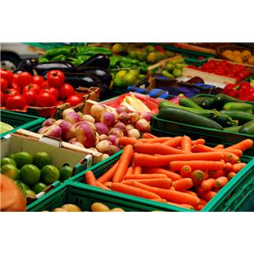
What women can you do to have a healthy pregnancy?
Eat healthy foods
Gain a healthy amount of weight
Be physically active every day
Test their blood sugar levels regularly
Take insulin if needed
Notes:
Eat healthy foods:
We will discuss in more detail but eating healthy is good for mom, baby and the entire family. Enjoying a variety of foods and eating at regular times will play an important role in managing blood sugar levels and getting the best nutrition for mom and growing baby.
Gain a healthy amount of weight:
The amount of weight women gain will vary depending on their weight before pregnancy. Weight loss is not recommended. Women should talk to their healthcare provider about appropriate gestational weight gain.
Gain the right amount of weight…. Do not lose weight
If they were underweight before they were pregnant, weight gain should be around 28-40 lbs.
If they were at a healthy weight before they got pregnant, weight gain should be around 25-35 lbs.
If they were overweight before they got pregnant, they should gain around 15-25 lbs.
If they were obese before they got pregnant, they should gain around 11-20 lbs.
Be physically active every day, if possible:
-Regular physical activity can help control blood sugar levels. It can help manage stress and prepare a woman’s body for labour, delivery & recovery.
-It can help gain an appropriate amount of weight. It may also make it easier to accept physical changes that go with pregnancy. Additionally, physical activity in pregnancy may help women maintain muscular and cardiovascular fitness, reduce the risk of pre-eclampsia, and decrease physical complaints like back pain.
- Some exercises to recommend: gardening and house cleaning, walking, swimming and dancing. Encourage them to start slow (15 minutes at time and work towards 30 minutes). They should be able to talk while exercising.
-If mom was active prior to her pregnancy she can continue to be active but should replace high impact exercises, such as jogging or aerobics, as their pregnancy progresses
If mom was not active prior to pregnancy it’s never too late to get started! Start slowly and gradually increase.
Always encourage women to talk to their health care provider about physical activity during pregnancy
Take insulin if needed:
Sometimes healthy eating and physical activity are not enough to manage blood sugar levels and woman may need to take insulin. Insulin will help keep their blood sugar levels normal and will help to keep mom and baby in good health.

Slide 9
Healthy Eating
There is no special ‘diabetes pregnancy’ diet
Eat a variety of foods from Canada’s Food Guide
Eat a little more food each day than you normally would
Make healthy choices most of the time
Distribute carbohydrate foods throughout the day
Choose low glycemic index foods more often
Include protein foods at each meal
Notes:
Eat a variety of foods from Canada’s Food Guide everyday. We will talk more about the food guide in the next slide
Eat a little more food each day than you normally would: During your second and third trimesters, you need more calories to support the growth of your baby. You need just a little more food each day, such as an extra snack or small meal.
Pregnant women need to remember that they should be eating twice as healthy not twice as much!
Examples of an extra snacks:
1 medium fruit + piece of cheese
Hummus dip and vegetables
½ peanut butter sandwich + glass of milk
Healthy choices most of the time include foods higher in fiber and lower in fat and sugar most of the time so that mom and baby are getting the most nutrition out of what they eat and drink.
Distribute carbohydrate foods throughout the day Pregnant women with gestational diabetes can help manage their blood sugars by spreading their food intake over 3 meals and 2 snacks each day . Choose low glycemic index foods more often
Include protein foods at each meal and snack. Protein doesn’t raise blood sugars. It can help keep your blood sugar from rising too high after you eat.

Slide 10
Notes:
Follow guidelines outlined in Canada’s Food Guide
Have plenty of vegetables and fruit:
Meals should be mostly vegetables and fruit, they should make up ½ of your plate. Eat a variety of vegetables and fruit everyday. This can include fresh, frozen or canned. They all count. Choose frozen vegetable or fruit with no added sugar, seasonings and those with no sauces or breading. If choosing canned, choose those with less salt and sugar or rinse them under cool water to remove some of the salt and sugar. When you have a meal is most of your plate vegetables and fruit? If not, think about what changes you can make to start moving towards this.
Eat the skin on fruits and vegetables whenever possible, this will increase the amount of fibre mom is eating. Eating more fibre helps to regulate blood sugar levels.
Choose lower glycemic index foods more often (next slide will show the chart of lower glycemic index foods)
Choose whole fruits and vegetables over juice to get the most nutrition out of your choices from this group and to decrease the impact on blood sugar levels.
Choose whole grain foods:
A ¼ of the plate should be grains (This could include pasta, rice, bread) and the focus is still on whole grain foods. Some foods may look like a whole grain because they are darker in color you should check the ingredient list and look for the word “whole grain”.
Choosing whole wheat foods more often will help mom get more fibre and again fibre helps to regulate blood sugar levels
Again choose grains that are low in glycemic index
Eat protein foods:
A ¼ of the plate should be protein foods. Choose plant based proteins (beans, lentils, nuts, seeds) more often. Protein foods also include: eggs, low fat meats, fish, chicken and low fat cheese and milk.
Make water your drink of choice:
Choose water more often. Sugary drinks will make your blood sugars go up and they do not provide any nutrition. Sugary drinks include: soft drinks like coca cola, 7up, root beer; fruit flavoured drinks like fruit cocktails and tropical fruit punches; flavoured water with added sugar, sport and energy drinks, drink mixes like iced tea and Tang and slushies and 100% fruit juice. Fruit juice is high in sugar and we should be eat whole fruits instead of drinking the juice!
1 8oz glass = 1 cup of apple juice is made from about 4 apples!
Other healthy drink options:
- white milk (not flavoured milks like chocolate, strawberry, banana etc.).
- fortified milk alternatives (for example, unsweetened fortified soy or almond beverages)

Slide 11
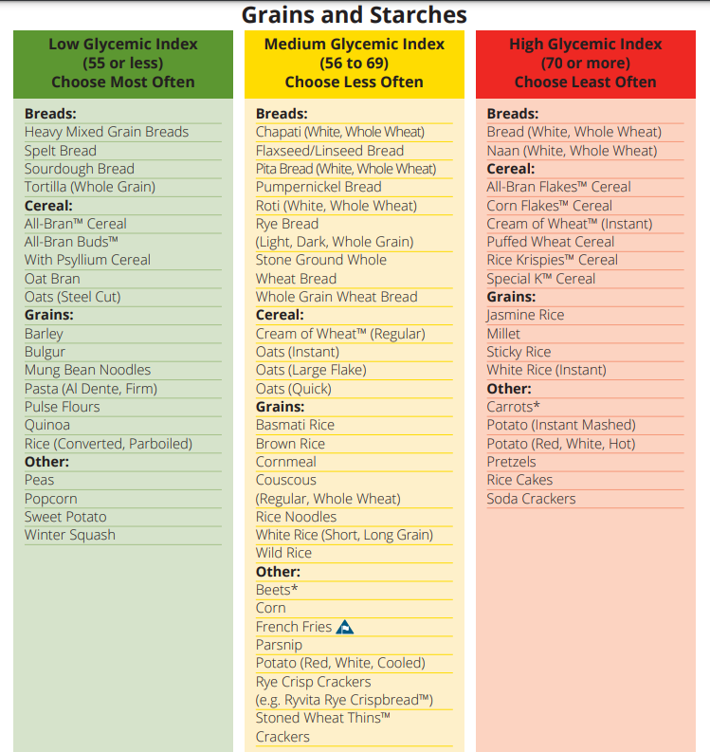
Glycemic Index
Scale that ranks a food/drink by how much it raises blood sugar after eaten or drank
Foods with a high glycemic index raise blood sugar higher and faster than foods with a low glycemic index
Notes:
The glycemic index is a scale that ranks a carbohydrate-containing food or drink by how much it raises blood sugar levels after it is eaten or drank. Foods with a high glycemic index increase blood sugar higher and faster than foods with a low glycemic index.
Choose food and drinks in the medium or low glycemic index category most often to help control blood sugar.
More information on glycemic index in foods can be found at the Diabetes Canada website.
https://www.diabetes.ca/DiabetesCanadaWebsite/media/Managing-My-Diabetes/Tools%20and%20Resources/glycemic-index-food-guide.pdf?ext=.pdf

Slide 12
After baby is born
Breastfeed immediately after birth
Get screened for type 2 diabetes between 6 weeks and 6 months after baby is born
Get screened for type 2 diabetes when planning another pregnancy
Get screened for type 2 diabetes every 3 years
Eat healthy
Be active
Notes:
Breastfeeding baby immediately after birth and for at least 4 months
There’s no reason why any woman who had diabetes should not breastfeed
Breastfeeding helps to normalize your blood sugar levels
Breast milk may protect baby from getting diabetes later in life
Mom may find it easier to lose weight after baby is born if they breastfeed
While mom is breastfeeding they can follow the same healthy eating guidelines and activity schedule as for pregnancy.
Screen for type 2 diabetes between 6 weeks and 6 months after the baby is born.
To reduce the risk of developing diabetes:
Eat healthy and be active
Be screened regularly – every 3 years
Be screened for type 2 diabetes when planning another pregnancy

Slide 13
Thank you!
Notes:
Do you have any questions about today’s presentation?
I am going to show you a few of the resources you can use:
Nutrition Screening that is used by CPNP
Resource page (see)

