Slide 1
Hypoglycemia (low blood sugar)

Slide 2
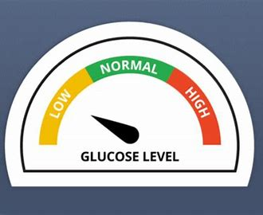
If you have diabetes, it’s important to know the signs of low blood sugar so you can treat it quickly. Learning the full range of symptoms for each stage of hypoglycemia is a great place to start.

Slide 3
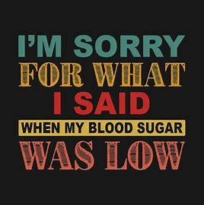
What is Hypoglycemia?
When the amount of blood glucose
(sugar in your blood) has dropped
below your target range (less than
4 mmol/L).
Hypoglycemia is also known as low blood sugar.

Slide 4
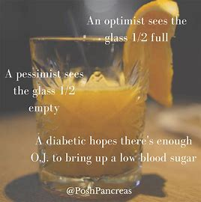
People who control their diabetes with certain medications—especially insulin—can experience hypoglycemia because taking more insulin than you need can cause blood sugar levels to fall too low. Hypoglycemia can also be caused by not eating enough or exercising harder than usual.
There are a number of signs of hypoglycemia, and its seriousness can range from mild to moderate to severe.

Slide 5
Types of symptoms
There are two types of symptoms: Neurogenic (autonomic) & Neuroglycopenic.
What does neurogenic mean? caused by, controlled by, or arising in the nervous system.
What does neuroglycopenic mean? a shortage of glucose (glycopenia) in the brain, usually due to hypoglycemia.

Slide 6
Symptoms of hypoglycemia
Neurogenic (autonomic) |  | Neuroglycopenic
Trembling | Hunger | Difficulty Concentrating | Confusion
Palpitations | Nausea | Weakness | Drowsiness
Sweating | Tingling | Vision changes | Difficulty speaking
Anxiety |  | Headache/Dizziness | Mood Swings

Slide 7
Severity of Hypoglycemia
Mild
MODERATE
SEVERE
Autonomic symptoms are present. The individual is able to self-treat.
Autonomic and neuroglycopenic symptoms are present. The individual is able to self-treat.
Individual requires assistance of another person. Unconsciousness may occur. PG is typically <2.8 mmol/L.
If you experience mild or moderate hypoglycemia, you will likely be able to manage the episode yourself.

Slide 8
Severe hypoglycemia
Typically, blood sugar levels fall below 2.8 mmol/L during a severe episode and the person may show some or all of the signs of mild and moderate hypoglycemia. In addition, they may lose consciousness or have seizures. In rare cases, severe hypoglycemia can be life-threatening.

Slide 9
What causes Hypoglycemia?
More physical activity than usual
Not eating on time
Eating less than you should have
The effects of drinking alcohol
Taking too much medication

Slide 10
If you are experiencing the signs of a low blood sugar level, check your blood sugar immediately. If you don’t have your meter with you, treat the symptoms
anyway. It is better to be safe.
How to treat Hypoglycemia?

Slide 11
Eat or drink a fast-acting carbohydrate (15 grams):
15 mL (1 tablespoon) of honey (do not use for children less than 1 year old)
15 mL (1 tBSP) or
3 packets of sugar dissolved in water
6 LifeSavers® (1 = 2.5 g of carbohydrate)
15 g of glucose in the form of glucose tablets
150 mL (2/3 cup) of juice or regular soft drink

Slide 12
Wait 15 minutes, then check your blood sugar again. If it is still low:
Treat again; wait 15 minutes, check your blood sugar.
Continue these steps until your blood sugar is above 4
When your blood sugar is above 4:
If your next meal is more than one hour away, or you are going to be active,
eat a snack, such as half of a sandwich or cheese and crackers (something
with 15 grams of carbohydrate and a protein source
Wait 40 minutes after treating a low blood sugar before driving
Think about why your blood sugar went low and make the necessary changes to avoid low blood sugar again.
Make sure you always wear your MedicAlert® identification, and talk to your doctor or diabetes educator about prevention and emergency treatment for severe low blood sugar

Slide 13
Hypoglycemia in School
Cognitive Effects of High or Low Blood Glucose (Sugar) Levels:
Hypoglycemia (low blood sugar) and hyperglycemia (high blood sugar) may affect
mood and behaviour and a student’s ability to learn and to participate in school activities as well as lead to emergency situations, if left untreated. Students with diabetes will learn and perform best when their blood sugar levels are within the target range outlined by their health care providers and indicated in the student’s
ICP. Blood sugar levels below or above this range can be associated with a decline in
cognitive performance and ability. In order for a student with diabetes to learn and
demonstrate their knowledge of a subject, including writing exams and performing other tasks for credit, blood sugar levels should be within their target range. If not, then an alternate time to redo or complete the activity should be provided
Individual Care Plan (ICP)

Slide 14
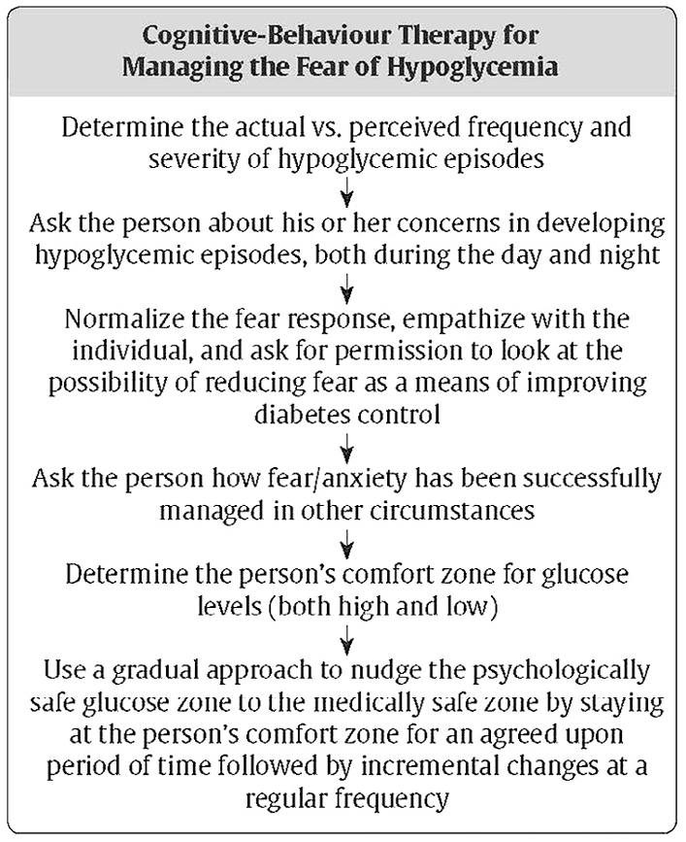
Resources
Diabetes Canada
https://www.diabetes.ca/

