Slide 1
Mindful Eating
Jessica Almeida, RD
Community Nutritionist
First Nations & Inuit Health Branch (FNIHB)
Indigenous Services Canada (ISC)
Notes:
Today I will present on ‘Mindful Eating’
This presentation will be about 30 minutes and then we will do an activity called Tasting Mindfulness

Slide 2
Outline
Mindless eating
Mindfulness
Mindful eating
Benefits
Hunger vs Craving
Suggestions
Activity
Notes:
--First we are going to look at mindless eating and what some studies have shown.
--Then look into mindfulness, how it’s related mindful eating and why it’s important.
--We will identify the difference between hunger and cravings,
--Then discuss a few suggestions on how you can incorporate mindful eating into your every day.
--Next we will look at practical changes you can make to your environment to support healthier eating.
--We will then finish with an activity.

Slide 3
Mindful Breathing
A 3-Minute Body Scan Meditation to Cultivate Mindfulness
A brief mindfulness meditation practice to relax your body and focus your mind
This could be considered a 3-minute meditation too
Notes:
Read the script

Slide 4
Have you ever….
Eaten because it’s meal time?
Hurried down a meal as you run to the next activity?
Eaten straight out of the bag?
Eaten while distracted?
Eaten the last dry, old chocolate chip cookie?
Eaten because the food is in front of you?
Eaten because you’re bored, lonely, emotional?
Forgotten what your last meal was?
Notes:
Have you ever….
-Eaten because it’s meal time, even if you’re not hungry?
-Hurried down a meal as you run to the next activity?
-Eaten straight out of the bag or container instead of portioning out a serving?
-Eaten because the food is in front of you?
-Eaten while distracted by your phone, TV, work, a book?
-Eaten the last dry, old chocolate chip cookie even though it tasted like cardboard?
-Eaten because you’re bored, lonely or emotional?
-Forgotten what your last meal was because you barely took time to enjoy it?
I’m sure we can all relate to this … it’s called mindless eating. Did you know that we make over 200 decisions PER DAY around food and many of these decisions are made on autopilot? We eat, don’t eat, overeat without really thinking about it. These decisions affect our health: physical, mental, emotional. A lot of our food decisions are heavily influenced by signals and cues around us that tell us to eat

Slide 5
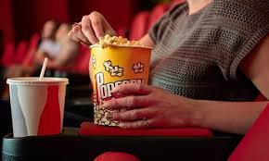
Mindless Eating
Stale Popcorn Study
Free stale popcorn, two sizes
Large bucket participants ate 53% more
→ The larger the container, the more people will eat
When do you stop eating?
French: based on internal cues
ex: hunger (stopped when not hungry)
Americans: based on external cues
ex: empty plate, tv show over,
emtpy beverage
Notes:
First, Let’s take a look at mindless eating. A lot of very interesting research has been conducted about how our environment causes us to eat mindlessly. For example, a study was performed in response to people’s comments that they eat depending on how hungry they are and how good the food tastes. Participants were invited right after lunch to watch a movie at a theatre. Participants were given free popcorn in two different sized containers: medium and large. The popcorn was stale – 5 days old. One participant said it tasted like “eating Styrofoam packing peanuts”. After the movie ended, left over popcorn was measured and it was found that individuals with the large bucket ate 53% more popcorn than those with the medium bucket – that’s equal to 21 more dips into the bucket. Clearly it was not the yummy taste of the popcorn (super stale) that drew people to eat or their hunger (as it was right after lunch) but the presence of the food and the size of the popcorn bucket. The larger the container, the more people ate.
Other research found that French people reported they usually stopped eating when they no longer felt hungry, an internal cue.
Americans on the other hand said they stopped eating when they ran out of a beverage, when their plate was empty, or when the TV show had ended. They relied on external cues. Interestingly enough, in France, a meal is a cultural experience and can take up to 2 hours.
→ In North America, eating tends to be a race and is often completed within 15 minutes. However, it takes the 20 minutes for your body to tell your brain that it is full!

Slide 6
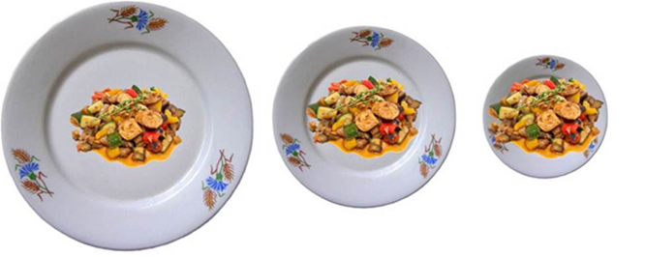
Size Matters
Bigger package = more eating
Glass shape affects amount consumed
Tall skinny glasses look more full than short wide glasses
Size of serving bowls, serving spoons and dishes affect how much is consumed
Bigger plate = more eating
Notes:
It has been found that the size of packages, plates, glasses and serving bowls makes a difference on how much food we consume.
In one study it was found that people who got large packages of pasta, sauce and meat typically prepared 23% more than those who received medium sized packages
Glass shape is also important. Imagine you have 2 different glasses: one is tall and skinny and the other is short and wide. When pouring an equal amount of liquid into both glasses, the tall one will look more full than the short one. If you don’t fill your glass full and you’re going to ‘eyeball’ an half cup, you’ll tend to pour 30% more into a wide glass than into a skinny tall glass.
Additionally, the use of big dishes and big spoons often cause overconsumption. People who were given a large bowl and a large scoop served themselves 57% more ice cream than individuals who got a smaller bowl and a smaller scoop. The reality is that we do often eat with our eyes. Regardless of how big the bowl is, we think it has to meet a certain level of fullness.
In the last 20 years, the size of dinner plates has significantly increased, which has led to more food being added to plates because everyone wants to eat from a full plate.
So we see that size of dishes really does matter.

Slide 7
Mindfulness
Non-judgmental
Focused on acceptance
Includes sensory thoughts, experiences, emotions
Includes the external environment
Being fully aware of the moment
“Awareness that arises from paying attention, on purpose, in the present moment, nonjudgmentally.”
J. Kabat-Zinn
Notes:
No one is immune to the environmental cues around us and the power of convenience. However, since what we eat is such a major contributor to our health and happiness, there are some things that can be done to counter our world of ‘convenience’ and regain control over how and what we eat!
Where do we start? By being mindful. The concept of mindfulness actually stems from principles found in Buddhism.
Mindfulness focuses on a non-judgmental means of acceptance. To be mindful means to examine internal motivations such as thoughts and emotions. It involves slowing down. It also includes the external environment and our response to it.
Mindfulness involves being fully aware of the moment – mentally, physically, emotionally - and being present therein, without judging it or reacting to it.
One quote states that mindfulness is: “the awareness that arises from paying attention, on purpose, in the present moment, nonjudgmentally”

Slide 8
Mindful Eating
Be in-the-Moment
Observe your body
Notice all the senses, tastes, smells, and textures
Notice physical reactions, thoughts, feelings
Acknowledge responses to food without judgment
Be aware of what triggers you to start or stop eating
Recognize the interconnectedness of the earth
Notes:
Mindful eating takes the principles of mindfulness and applies it to food and the 200+ food related decisions we make daily.
There are several basic principles that are important for mindful eating:
Be in the moment: be fully present in the moment and eat without distractions
Observe your body, paying close attention to what it is telling you: rumbling stomach, low energy, stressed, emotional,…
Notice all the sense, tastes, smells and textures of the food being eaten. Take time to enjoy. Notice the physical reaction to the food you eat as well as your thoughts and feelings.
Acknowledge these reactions, thoughts and feelings without judgment
Be aware of what triggers you to start or stop eating
Be aware of how your food choices impact other people and the environment

Slide 9
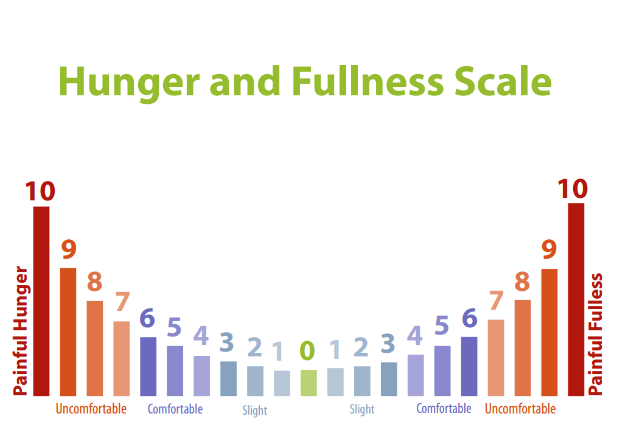
Notes:
Couple of Questions: (See handout)
--How do you know you’re hungry? (answers: hangry, tired, empty…)
--How do you know you’re full, what does fullness feel like? (lack of desire to eat…)
→ Where are you on this scale right now?
--Where are you usually on this scale when you decide to eat a meal?
--Where are you on this scale when you decide to stop eating your meal?
And if you don’t know whether you are full or not…. A great thing to ask yourself if you are unsure is:
→ Do I feel comfortable now or would I feel better if I ate some more?

Slide 10
True Hunger
How to tell you’re actually hungry
Physical signs
Desire to eat doesn’t go away
Desire for food intensifies over time
Even a non-favourite food sounds good
Most people need to eat approximately every 4 hours
Energy and mood
Do not ignore true hunger
Notes:
One major component of mindful eating is learning to eat in response to your body’s hunger cues. But have you ever struggled with knowing how to identify hunger?
Hunger can be identified by physical signs such as your stomach rumbling or feeling emptiness in your stomach, dizziness/fatigue, lack of concentration,…
If you’re actually hungry, the desire to eat won’t go away, and it’ll increase over time
If you’re hungry, you’ll be willing to eat foods that aren’t just your favorite
Most people need to eat approximately every 4 hours to maintain their energy levels throughout the day and to help balance their mood.
It’s important not to ignore true hunger as that’s your body’s way of telling you it’s ready for food!

Slide 11
Cravings
No physical hunger “pains”
Thought of eating goes away when distracted
Emotions related to eating
You want something specific: crunchy, salty, sweet
What am I really hungering for?
Notes:
Now that we know that hunger is, let’s move on to cravings.
--What are cravings? It’s when your mind and mouth are telling you to eat, not your stomach.
--In cravings there are no physical hunger ‘pains’ and the thought of eating goes away when you are distracted.
--Cravings are usually connected with some form of emotional attachment to the food. When you are craving, you likely want to eat something specific: crunchy, salty or sweet, often because you think the food will satisfy you.
An important question to ask yourself is: what are you really hungering for? Is it food, or is it something else?
In order to address this you need to take a step back from the kitchen, breath and actually thinking about what you need/want.
Cravings are normal, but it’s important to learn to relate mindfully to them so that you can recognize them and their messages.

Slide 12
Benefits of Mindful Eating
Builds a healthier relationship with food
Better weight control
No need to ‘diet’ ever again
Better prevention and management of health-related conditions
More satisfaction from eating
Engaged in a healthy food system
Become more introspective
Notes:
Why is it important to be a mindful eater?
As North Americans, we have generally become out of touch with our bodies, what we need, what’s best for us, the environment.
By eating mindfully we learn to build a healthier relationship with food and eat in response to our body’s cues. This allows for better control over weight and prevention and management of health-related conditions.
Our bodies are smart – they know what they need. Slowing down allows us to gain more satisfaction from eating and makes us more aware and engaged in how our food decisions impact the world around us – we not only become responsible eaters but also increasingly introspective individuals

Slide 13
.
Notes:
Read Benefits on slide:
Another great benefit (similar to # 4) Is that when we eat away from distractions (like sitting at the computer or watching TV, on your cell phone) AND while eating mindfully is that it makes our bodies calm and focused. Any deep breathing exercise will also help with this.
So when our bodies and nervous system are calm, our hormones adrenalin and cortisol are in check and allowing our digestive enzymes to do their job, to break down food.
However, if we are stressed out or eating at the computer quickly trying meet a deadline, or we are upset… the state of our nervous system, might flip the switch to “fight or flight” and then all the body’s resources like our digestive enzymes will stop being secreted or released into where it needs to go to properly break down food.
If our bodies do not break down food properly… it can lead to so many health issues. For example: Indigestion & IBS (which is stated is related to stress).
Also when we are not breaking down our food optimally, our bodies won’t absorb all the important nutrients from food, such as vitamins and minerals.
Improved Relationship between the nervous system and optimal digestion & absorption of food

Slide 14
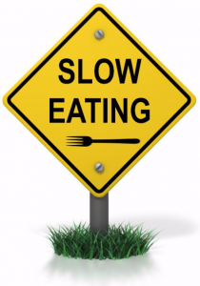
Suggestions to Try
Eat slower – try and take 20 minutes to eat
Chew slowly
Pause
Learn to listen to your body
Ask yourself: is this physical or emotional hunger?
Remove distractions
Practice deep breathing before eating
Turn on your senses
Consider your food’s lifecycle
Notes:
Here are a few suggestions of things you can try in order to become a more mindful eater:
Sit down and slow down while you’re eating; give your body those 20 minutes it needs to signal the brain that it’s full. Chew your food slowly, pause in between bites, take smaller fork-fulls.
Learn to listen to your body and recognize when you’re feeling physical hunger vs eating for other reasons
Eat free of distractions; whether that be your phone, TV, or your job, be fully there, preferably at a table, enjoying your meal
When you eat, turn on your senses! Pay attention to color, aroma, flavour, texture
Being mindful involves learning to appreciate where your food comes from, how it was grown and how it gets to you. As you think about this, you may very well start to change how/what you choose to buy

Slide 15
Remember…
There is no right or wrong way to eat
Every person is unique
Acknowledge that perfection isn’t necessary
Enjoy and appreciate your food
Small changes have a big impact
Now is the time
Notes:
Remember,
There is no right or wrong way to eat but rather varying degrees of awareness when eating. Every person is unique and their eating experience will be as well.
No one is perfect; we all eat for reasons other than hunger at times … and that’s okay. Be patient with yourself
Food is meant to be enjoyed – take time to enjoy it! Be thankful for your food; gratitude increases satisfaction.
Small changes made to your eating environment can have a big impact on your health
There is no better time than now to start to listen to your body and take good care of yourself
As you gain awareness you may start to notice that you’re building a new relationship with food, one where you notice emotional triggers, where you start to taste food in a new way, where you are in control of your eating, rather than your eating being in control of you

Slide 16
Questions? Now… Activity Time
“Wherever you are, be all there.”
Jim Elliot
Notes:
Are there any questions?
Now we will do our activity

Slide 17
References
The Center for Mindful Eating
www.tcme.org
Today’s Dietitian
Mindful Eating in Nutrition Counseling for Eating Behaviours: What Research Suggest
Mindless Eating
Brian Wansink, 2006
Mindful Eating Dietitian: Megrette Fletcher M.ED, RD, CDE
Megrette.com

Slide 18
Activity Time
Notes:
We are now going to do a mindful eating exercise called Tasting Mindfulness. Everyone will receive a piece of chocolate. I would ask that you not eat it but wait for the exercise to begin

Slide 19
Tasting Mindfulness
Holding
Seeing
Touching
Smelling
Placing
Tasting
Swallowing
Following
Notes:
Everyone should now have a piece of chocolate and be seated comfortably. I am going to walk you through a series of steps to mindfully eat your chocolate. I will ask you some questions, but they are simply intended to guide your thoughts. There will be opportunity to share at the end.
So let’s begin by taking a deep breath and relaxing.
--(Holding): I want you to take the chocolate and place it in the palm of your hand. Focus on it, imagining you’ve never seen anything like it
--(Seeing): Now take time to really see the chocolate. Let your eyes explore every part of it: shape, texture, color. Look at the highlights where the light shines, the darker hollows, the folds and ridges, and any asymmetries or unique features. Be aware of your intention to begin eating
--(Touching): Next, close your eyes and touch the chocolate. What does it feel like?
--(Smelling): hold the chocolate below your nose and take a deep whiff; take note of all the aromas. Is your mouth watering?
--(Placing): Now slowly bring the chocolate up to your lips, noticing how your hand/arm know exactly how and where to position it. Gently place the chocolate on your tongue and leave it there. Spend a few moments exploring the taste and sensation of having it in your mouth
--(Tasting): When you are ready, slowly begin eating the chocolate. Move it around in your mouth, chew it. Notice the changes in taste, texture. What part of your tongue is experiencing the taste?
--(Swallowing): Try and identify the first intention to swallow. When you feel ready, swallow the chocolate. Focus on the sensations
--(Following): Try to follow the chocolate as it moves down into your stomach. Notice any lingering tastes or sensations. Sense how your body as a whole is feeling.
→Take a deep breath

Slide 20
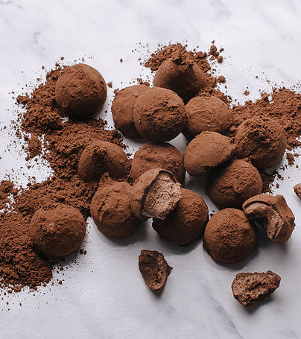
Let’s Discuss!
Notes:
What did you notice during this exercise?
Did your mind wander?
How did this experience compare to how you normally eat chocolate?
How do you think these principles might apply to eating or other areas of your life?

Slide 21
Thank you

