Slide 1
Heart Health Part 1: How Diabetes Harms Blood Vessels
Notes:
Updated by: Nadine Erickson, RN BN Nerickson@tribalhealth.ca
Phone: 1-204-627-1500
Resources:
Manitoba Centre for Health Policy, Type 2 Diabetes in Manitoba. Wpg, MB. Autumn 2020.
Heart and Stroke Foundation of Canada - www.Heartandstroke.ca
Canadian Hypertension Education Program - www.hypertension.ca
Diabetes Canada - www.diabetes.ca
Merck Manual, Consumer version – www.merckmanuals.com
A Resource Guide to Type 2 Diabetes in Your Community (Tribal Diabetes Coordinator and Diabetes Canada collaboration).
Manitoba First Nations Diabetes Leadership Council - www.mfndlc.ca
Karen Graham: The Complete Diabetes Guide (2011).
Canadian Medical Association Journal, Sept. 19, 2016.
Diabetes rates for First Nations people is 3-5 times higher than non- First Nations people.
FNs people tend to develop diabetes at younger ages and have chronic health complications at a younger age than the general population.
The age at which young people are receiving a diagnosis of diabetes is getting younger and younger.
FNs people develop diabetes complications (ie: heart attack, stroke, kidney injury) much earlier in age, at higher rates than the non-FN population.
FN people frequently have poorly controlled high blood pressure & diabetes, compared to non FN people with T2DM.
People with Diabetes are 3x more likely to die of heart disease.
People with Diabetes are more likely to develop heart disease at a younger age.
You can still live a healthy life with diabetes (and high blood pressure), this will help decrease your chance of suffering complications.

Slide 2
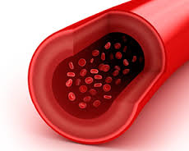
Every part of our body needs to have good blood flow
Good Blood Flow
Notes:
-Every cell in our body needs an oxygen supply to stay alive and function properly.
-Blood gives every cell oxygen and food to stay alive.
-If blood flow is decreased complications can happen.
-Diabetes can harm our blood vessels.
-That is why diabetes complications can happen in almost all parts of the body.
For example:
-Decreased or blocked blood flow to the heart can cause a heart attack.
-Decreased or blocked blood flow to the brain can cause a stroke.
-Decreased or blocked blood flow to the kidneys can cause kidney damage, which might need dialysis.
-Decreased or blocked blood flow to the nerves can cause pain in your legs or feet; numbness / tingling or loss of feeling in your hands or feet; erectile dysfunction

Slide 3
Anatomy of a Blood Vessel
Notes:
Blood vessels are made up of 3 main layers, The tunica intima, tunica media, and tunica externa.
The capillary network are the fine vessels that feed the cells, 1 red blood cell wide.
The capillary fine network supplies the blood to the nerve and muscle networks, especially in our eyes, kidneys, and nervous system.
When blood is thick (has too much sugar), it puts pressure on the large vessels, and slowly destroys the fine capillary network.

Slide 4
High Blood Sugar = Thicker Blood
A1C = <5.7%
A1C = >6.5%
Notes:
-For a person living with Diabetes, if they have high blood sugar levels, their blood is thicker.
-Thicker blood decreases blood flow to the fine capillary networks.
-Thicker blood damages the fine blood vessels, and causes strain on the large blood vessels.
-Thicker blood makes the heart work harder to pump the blood around our body.
-Thicker blood causes our Blood pressure to go up.
A1C is a blood reading that tells you if your diabetes is under control.
A1C is linked to Blood Sugar, but gives a more accurate picture of control over the last several (3) months.
An A1C of 5.6% or less tells you your diabetes is under control.
An A1C higher than 7% tells you your diabetes is not under control. You might need more medication or pay closer attention to the self management behaviours that can help control your A1C level.
Activity:
If you have blood glucose wands you can show how the high glucose stick flow if thicker.

Slide 5
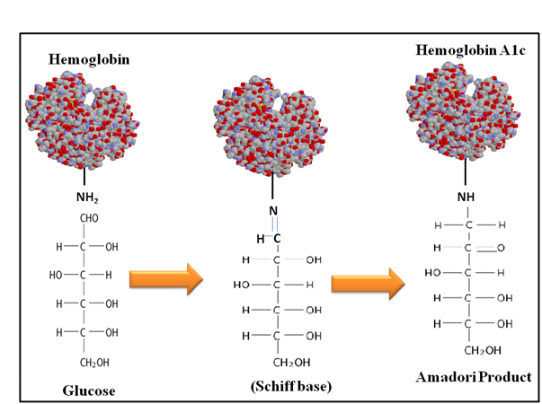
Hemoglobin A1c
Notes:
This is the name of the lab test that is used for measuring “A1c” or Hemoglobin A1c.
The red blood cell carries oxygen, but it also carries sugars.
The blood test then measures the percentage of HgA1c as a measure of glucose in the blood, as an average, over a 3 month period.

Slide 6
What’s HbA1c?
Hemoglobin A1c is a blood level that reflects a person’s average glucose control over the last 3 months.
Monitors how well you’ve been controlling your blood glucose
If HbA1c is higher than 6.5% = dx: diabetes
The higher the A1c, the greater the risk of complications from thick blood
Notes:
From “Manitoba Centre for Health Policy, Type 2 Diabetes in Manitoba”. Autumn 2020. University of Manitoba Rady faculty of Health Sciences and First Nations Health and Social Secretariat of Manitoba”
Key Findings (Page 70-72, figures 6.1-6.3):
1) Out of all people with T2DM, in FN communities, there was a higher percentage of people with high sugars compared to the general population.
2) More people who were FN AND T2DM, tended to have higher A1C values, meaning they had poorer control of their sugars.
3) “The average HbA1c levels were higher than recommended (higher than 7%) among 73.36% of First Nation Manitobans with type 2 diabetes and 59.74% of all other Manitobans with T2DM”

Slide 7
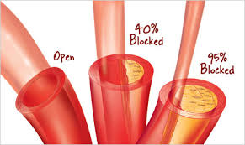
Many years of having high blood sugars will harm blood vessels.
Notes:
-Harm to the blood vessels occurs slowly overtime.
-As we age, our blood vessels naturally become less elastic and thicker, this is a normal part of aging.
-When a person living with diabetes ages, they are at higher risk to have poor blood flow because diabetes affects the quality of the capillary network, and the stretchiness of the blood vessel walls.
-Both of these pictures show the progress from a normal blood vessel with good blood flow…to a partly (40%) blocked vessel….to a blood vessel that is 95% blocked (by either cholesterol or thick sugary blood)
-How long does it take to move from partly (40%) blocked to 95% blocked?
Some people have a pre-disposition to it: genetics for high cholesterol, sensitive blood sugars – we can’t control this
What we can control: types of food we eat, amount of food, our activity levels, our mindset towards healthy daily living
DATA: Aug 2020- In all studies “First Nation Manitobans with T2DM made up a larger proportion of the population with high HbA1c levels compared to all other Manitobans with T2DM”.
What this means overall, is that FN people will have a higher rate of chronic health conditions related to DM2 complications, shorter lifespans, and have a greater burden of economic and health hardships.

Slide 8
Heartandstroke.ca says:
Uncontrolled Diabetes makes it harder for our blood to flow.
Notes:
-Thick, sugary blood can cause high blood pressure, because the fluid is thick.
-high body weight creates more work on the heart (more cells to supply out to, the pump stays the same size)
-high cholesterol causes buildups inside the blood vessels, (like grease in the kitchen sink pipes), blocks blood flow

Slide 9
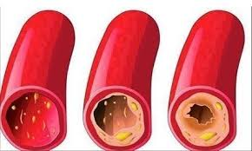
Diabetes & Blood Flow
High blood sugar causes our blood to be thicker, this leads to strain on the vein.
Cholesterol forms plaque on the inside of vessels, making them narrow and blocked
The small blood vessels experience damage first, then the larger vessels. The small vessels burst and scar and can’t provide blood to the end places that need it
Notes:
-Diabetes affects blood flow and our blood vessels.
-Blood vessel walls get thicker, which makes our Blood Pressure go up.
-Blood vessels become coated with fat (cholesterol), this makes the blood vessels more narrow, which also makes our BP go up.
-Every part of our body needs good blood flow.
-If any part of our body has less blood flow, it will be affected.
-Areas that experience damage first might be peripheral areas (fingertips, toes, eyes, sex organs)
-Organ damage occurs later (blindness, loss of limbs, decreased kidney function)
-the vessels themselves can fail, causing a stroke, bleed, or heart failure

Slide 10
We are born with healthy blood vessels and good blood flow.
Notes:
(The Complete Diabetes Guide, 2011, Author Karen Graham)
1. Healthy young blood vessels are clean inside and the blood flows freely.
Our blood vessels are elastic (three layers of muscle) and can easily stretch to pump more blood quickly when we exercise.

Slide 11
Age and some diseases makes it harder for our blood to flow.
Good
Blood
Flow
Poor
Blood Flow
Aging
Blood Flow
Diabetes
High BP
Cholesterol
Notes:
(The Complete Diabetes Guide, 2011, Author Karen Graham)
1. Healthy young blood vessels are clean inside and the blood flows freely.
Our blood vessels are elastic and can easily stretch to pump more blood quickly when we exercise.
2.
-As we get older, the walls of our blood vessels thicken, harden and become less elastic.
-Fatty deposits build up under the inner lining of the blood vessels.
-This is called, “Hardening of the arteries”.
-The heart has to work harder to pump the blood through.
-Blood pressure often goes up.
3. From many years of having high blood sugar and high blood pressure, the inner wall of the blood vessel weakens.
-Sometimes a blob of fat or a blood clot can form and travel in your blood vessel, it can get stuck and totally block a blood vessel.

Slide 12
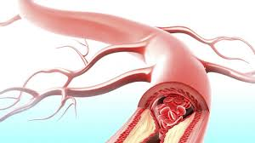
Poor blood flow can lead to a blocked blood vessel
Block
Notes:
-Over many years, aging and diseases like diabetes, high blood pressure, and having too much fat and cholesterol in our blood can lead to our blood vessels getting more blocked.
-Often there are no signs or symptoms that the blockage is present or getting worse.
-When a blood vessel is completely blocked (100%), then any tissue beyond the block does not receive oxygen or nutrients and dies.
-Regular bloodwork can monitor cholesterol levels, and different heart enzyme levels to see if you are at higher risk.
-Various medical tests can monitor how well your blood, blood vessels, and heart muscles are doing.

Slide 13
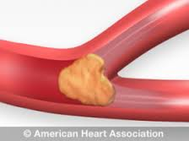
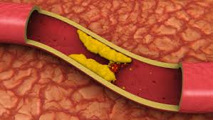
If a blood vessel gets blocked…what happens?
It depends on where the blockage happens.
Notes:
-Both of these pictures shows what a blocked blood vessel looks like.
-When a blood vessel is blocked, areas beyond the block are not able to receive oxygen and nutrition from the blood.
-Without oxygen and nutrition from the blood, cells begin to die within minutes of the blockage.
-Tissue death is Painful!!! That’s why it is important to not ignore pain

Slide 14
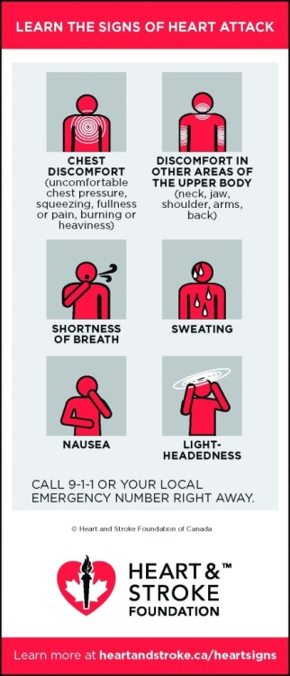
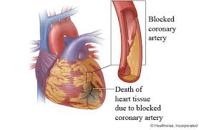
Blocked blood flow to the Heart = Heart Attack
Notes:
-If the blockage occurs in one of the heart vessels, a part of the heart tissue dies, this is called a heart attack.
-If only a small blood vessel is blocked in the heart, only a small amount of heart tissue will die and the person having the heart attack is more likely to survive the heart attack.
-If one of the larger blood vessels in the heart is blocked, then a larger amount of heart tissue will die and the person having the heart attack is more likely to die from the heart attack.
-Nerves in our body also need a good blood supply. If nerves do not get a good supply of blood, then the nerves are damaged. In people that have had diabetes for a long time, the nerves can be so damaged that they may not experience the pain that is usually associated with a heart attack.
-Everyone should know the common signs of a heart attack:
Chest pain or discomfort
Discomfort in other areas of the upper body (neck, jaw, shoulder, arms, back)
Shortness of breath
Sweating
Nausea & Light-headedness

Slide 15
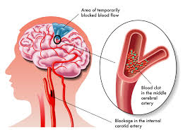
Blocked blood flow to the Brain = Stroke
Notes:
-If the blood flow to part of the brain is cut off, the brain tissue beyond the blockage dies, this is called a stroke.
-In the picture you can see 2 different blockages: 1- is a blockage in a blood vessel in the neck; 2-is a blockage in the brain. Both of these blockages will cause a Stroke.
-Sometimes people will have something called a ‘mini-stroke’ or a ‘TIA’ (Transient Ischemic Attack’. In this situation a blockage occurs, but it only lasts a few seconds or minutes. These ‘mini-strokes’ tend not to cause long term damage, because the brain tissue did not die. If someone has a ‘mini-stroke’, it is important to get them to a health care provider, since this is a warning sign that the person is at high risk of having a stroke.
-Learn the signs of stroke: FAST (as listed above).
-If a person is having any of the signs of a stroke, they need to seek the help of a health care professional immediately.
-An Aneurism is where the blood vessel bursts, damage depends on where it occurs, size of the blood loss/bruising, and the ability for the bleed to stop. Immediate medical emergency!

Slide 16
Blocked / ↓ blood flow to the leg= Slow Healing
-Numbness, tingling,
decreased sensation
-Unable to heal
-High risk for infection
-Higher risk for amputation
Notes:
-The picture shows normal blood flow to the leg (on the left hand side) and blocked or decreased blood flow to the leg on right hand side.
-Because damage to the blood vessels usually occurs slowly over time, people living with diabetes usually notice things like numbness and tingling or decreased sensation first.
-Decreased blood flow is also part of the reason that sores on the legs and feet are slow to heal for people living with diabetes.
-When a sore is slow to heal and there is poor blood flow the area is at increased risk for infection.
-When infection and poor blood flow are present, there is a higher risk for amputation.

Slide 17
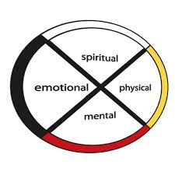
Self-management: Diabetes What can you do to promote good blood flow?
Cut your risk of heart attack and stroke in half by following the self-management steps.
Don’t smoke
Be active everyday
Eat a healthy diet
Maintain a healthy body weight
Stay connected to family and friends
See your health care professional regularly
Know your numbers: A1C, BP, Cholesterol
Take your medication as directed
Notes:
-Don’t smoke:
Smoking has a negative effect on our blood vessels, it makes them harder for blood to flow through.
Smoking increases blood pressure, which increases your risk for heart attack and stroke as well as other complications of diabetes.
Smoking also makes it harder for medication to work the way it suppose to.
If you need help quitting smoking, ask your health care professional about help that is available.
It is never too late to stop smoking.
Cut your risk of heart attack and stroke by 50% after 1 year of quitting smoking.
-Be active everyday:
Aim for 30 minutes of exercise per day. Exercise helps to keep our blood flowing and lowers our blood pressure.
Include resistance type exercise 3 times per week (ie. Weight lifting, rowing), this is especially important for people with diabetes.
-Eat a healthy diet:
Eat lots of fruit and vegetables and drink plenty of water. Follow Canada’s food guide, this will help you plan meals that will give you energy and be healthy for your body.
-Maintain a healthy body weight:
It is very difficult to lose weight, especially as we get older. Make a plan not to gain weight, this is a success in itself. Ask your health care worker to help you to determine a healthy weight for you.
-Stay connected to family and friends:
Take a holistic approach to your health, remember to stay connected to the people that bring meaning to your life.
Everyone needs Purpose, Meaning, Love and Belonging in their life.
These connections help balance stress.
-See your health care professional regularly:
Diabetes is a complicated disease.
Diabetes generally becomes more difficult to control over time.
It is important to have a positive relationship with your health care team.
A person with diabetes is at greater risk for developing high BP, problems with their cholesterol, and depression.
Know your numbers:
Know what your A1C target (goal) number is and how to get to your goal ≤7%.
Know what your target (goal) Blood Pressure is and how to get to your goal <130/80
Know what your target (goal) Cholesterol number is and how to get to your goal (Bad cholesterol (LDL) ≤2.
-Take your medication as directed:
Medications don’t work if you don’t take them.
Your health care team can help you understand why it is important to take your medication.

Slide 18
Medicine Wheel Management
Spirit – whatever your connection is, don’t ignore it. All life is sacred…
Physical – your body is your temple of your spirit…
Emotional – stress or illness can alter blood sugars. How do you feel?
Mental – do you have strong emotions connected to certain foods? Smells? Behaviours? Insight helps positive change.

Slide 19
Summary
High blood sugar first harms our blood vessels and then our organs.
People with diabetes are at high risk for blood vessel problems that can lead to heart attack and stroke.
Managing your diabetes will improve your life.
Know your numbers: A1C; BP; Cholesterol

