Slide 1
Heart Health Part 2: Diabetes and High Blood Pressure
Notes:
Updated 2023, by Nadine Erickson, RN BN Nerickson@tribalhealth.ca
Resources:
Heart and Stroke Foundation – www.heartandstroke.ca
Canadian Hypertension Education Program - www.hypertension.ca
Diabetes Canada - www.diabetes.ca
Karen Graham: The Complete Diabetes Guide (2011).
Manitoba Centre for Health Policy – Type 2 Diabetes in Manitoba, Aug 2020
Diabetes rates for First Nations people is 3-5 times higher than non- First Nations people.
FNs people tend to develop diabetes at younger ages and have more complications.
FN people frequently have poorly controlled high blood pressure & diabetes.
FNs people also develop diabetic related chronic health complications much earlier.
Having both diabetes and high blood pressure increases your risk further for heart attack and stroke.
You can still live a healthy life with diabetes and high blood pressure, good management of both will help decrease your chance of suffering complications.

Slide 2
Heartandstroke.ca says:
Notes:
-Thick, sugary blood can cause high blood pressure, because the fluid is thick.
-high body weight creates more work on the heart (more cells to supply out to, the pump stays the same size)
-high cholesterol causes buildups inside the blood vessels, (like grease in the kitchen sink pipes), blocks blood flow

Slide 3
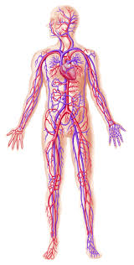
Many ppl w Diabetes also have Hypertension
Hyper= “too high, too much”
Tension= “the state of being stretched tight”
Diabetes and High Blood Pressure both increase tension in our vein walls.
Notes:
-Diabetes and High Blood Pressure are both long term diseases.
-In most people, Diabetes can be managed but it cannot be cured.
The same is true for High Blood Pressure, it can be managed but it cannot be cured.
-Good management will help support the best quality of life for you and your family.

Slide 4
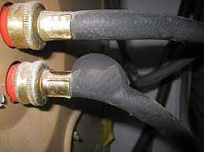
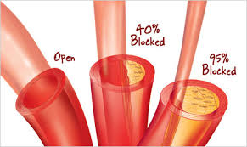
Over time, Diabetes and High Blood Pressure harm our blood vessels
Notes:
-Harm to the blood vessels occurs slowly overtime.
-As we age, our blood vessels naturally become less elastic and thicker, this is a normal part of aging.
-When a person living with diabetes ages, they are at higher risk to have poor blood flow because diabetes affects the blood vessels.
-Both of these pictures show the progress from a normal blood vessel with good blood flow…to a partly (40%) blocked vessel….to a blood vessel that is 95% blocked.
-How long does it take to move from partly (40%) blocked to 95% blocked?
It depends on a number of factors, like age, genetics, smoking history, if you are overweight / obese, nutrition level, activity level, if you are able to control your blood sugar level and blood pressure.

Slide 5
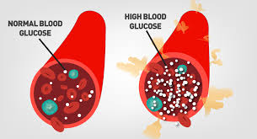
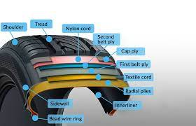
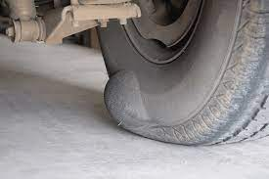
“under pressure”
Notes:
-This picture shows how high blood glucose can contribute to high blood pressure.
-You can have High Blood Pressure without having Diabetes, but the prevention strategy is the same.
-For reference, tires are built in multiple layers like a vein or an artery. Wear and tear, and pressure too high, can cause structural weakening and then failure in the walls.

Slide 6
Decreased blood flow leads to complications
Eyes
Head / Brain
Heart
Stomach
Kidneys
Fingers
Sex organs
Feet
Notes:
-When a person lives with Diabetes, the effect of the disease on their blood vessels makes them at risk for complications.
-Most people living with Diabetes also have High Blood Pressure. Diabetes and High Blood Pressure harm blood vessels making it harder for the blood to flow.
Activity: Have the group talk about complications that they have experienced or they might know others have experienced.
-Try to guess the complication that is linked to each area on the picture:
Eyes: Decreased vision, blindness
Head / Brain: Stroke or ‘mini stroke’
Heart: Heart Attack
Stomach: Stomach upset like diarrhea or constipation
Kidney: Kidney disease which might lead to dialysis
Fingers: Numbness / tingling, decreased sensation
Sex organs: Erectile dysfunction for men; decreased fertility for women.
Feet: Numbness / tingling, decreased sensation, cracked dry skin, sores that are slow to heal, infections, amputation.
-

Slide 7
Decreased blood flow leads to complications
Eyes -Blindness
Head / Brain- Stroke
Heart- Heart Attack
Stomach-Diarrhea / Constipation
Kidneys- Kidney Failure
Fingers- Numbness / tingling
Sex organs- Erectile Dysfunction / fertility
Feet-Numbness / tingling; sores; decreased healing; amputation
Notes:
-Having Diabetes and High Blood Pressure increases risk for complications and the complications can begin earlier.
-Some of the complications are reversible. For example numbness and tingling can improve if diabetes and high blood pressure are managed.
-Some complications are permanent. For example, once a heart attack or stroke have occurred, you cannot undo them. However, there are rehab programs that will help bring the person to achieve the best quality of life living with their complication.
-Disease management is also important to avoid other complications, including a second heart attack or stroke or any of the other listed complications.
Activity: Have the group talk about complications that they have experienced or they might know others have experienced.
-Try to guess the complication that is linked to each area on the picture:
Eyes: Decreased vision, blindness
Head / Brain: Stroke or ‘mini stroke’
Heart: Heart Attack
Stomach: Stomach upset like diarrhea or constipation
Kidney: Kidney disease which might lead to dialysis
Fingers: Numbness / tingling, decreased sensation
Sex organs: Erectile dysfunction for men; decreased fertility for women.
Feet: Numbness / tingling, decreased sensation, cracked dry skin, sores that are slow to heal, infections, amputation.
-

Slide 8
Retinal screening
Diabetes Canada guidelines recommends people with T2DM get Retinopathy done by an Opthalmologist every 1-2 years (Aug 2020)

Slide 9
Complication: myocardial infarction
These are heart attacks caused by:1- blockage, 2-poor artery wall function,3- split artery layers, 4-no oxygen supply for other reasons
(other reasons are related to electrical conduction system)

Slide 10
The Gut – Brain Axis
“You are what you eat…”
Notes:
The stomach, and the large and small intestines, are rich in blood (and lymph) vessels for the purpose of integrating nutrition and getting rid of waste.
As the fine blood vessel network gets damaged, gut motility can be altered, and nutrition absorption can get reduced.
Gut motility – how well everything moves through membranes, can result in diarrhea or constipation changes
Poor nutrient availability, and poor nutrient absorption can make you feel worse.
The guts tend to get more sensitive with age.

Slide 11
Notes:
https://www.patiadiabetes.com/en/type-2-diabetes-hypertension-and-kidney-disease/
Kidneys are at risk of damage from diabetes and hypertension, as kidneys rely on a superfine

Slide 12
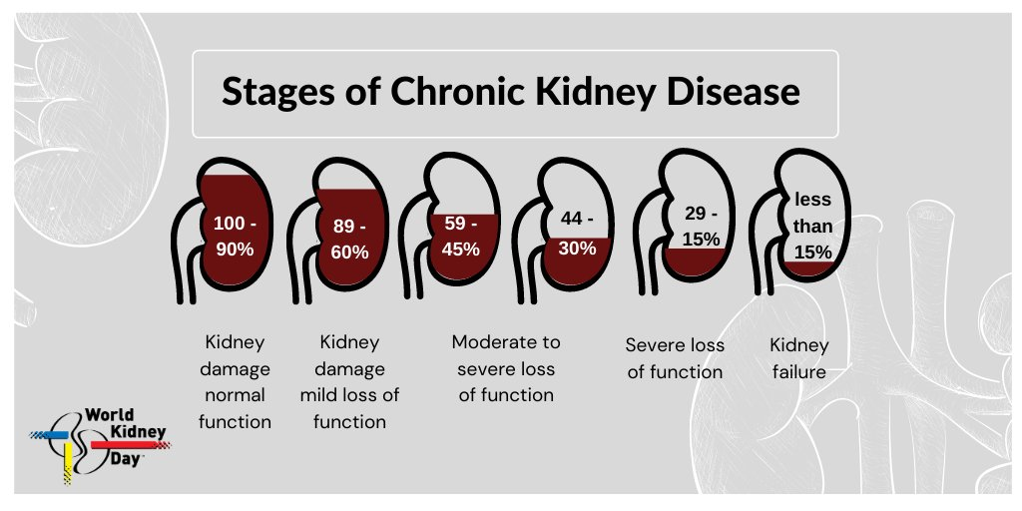
Kidneys: water filter system
Notes:
Keywords: Chronic Kidney Disease, Glomerular Filtration Rate
https://kidney.ca/Kidney-Health/Newly-Diagnosed/What-is-Kidney-Disease
https://www.ckdpathway.ca/

Slide 13
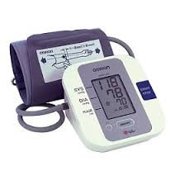
High Blood Pressure
Early hypertension has no signs or symptoms.
The only way to know if you have hypertension is to check your blood pressure
Notes:
-You can get your BP check at the nursing station / health centre.
-You can also check your BP at a store that has a BP machine (ie. Shoppers Drug Mart; Walmart).
-You can also check your BP with a home BP machine.
https://hypertension.ca/hypertension-and-you/about-hypertension/what-is-high-blood-pressure/ has a 10 min video on ‘Blood Pressure Basics”

Slide 14
Where should I check my BP?
At the nursing station / health centre by a health care professional.
At a store with a BP machine (ie. Walmart).
At home with a home BP machine.
Any of the above
Notes:
Correct Answer: D Any of the Above
Any of these locations is a good place to start to get your BP checked.
-Make sure you follow up with a health care professional if you have a high BP reading:
At or above 140/90 for a person that does not have diabetes;
Or a BP reading of 130 / 80 or above for a person with diabetes.
-Different machines have some variation, just know if you’re using different machines.

Slide 15
How will I know if I have High BP?
A Blood Pressure reading is made up of 2 values, the systolic and diastolic readings .
Systolic
Diastolic
Top pressure on vein walls_______
Relaxed pressure on vein walls
120
70
Notes:
-Activity: Get the participants to make a fist.
Ask the participants to tighten their fist- This represents the Systolic number of the BP reading.
Systolic = blood vessels under pressure when the heart beats
Ask the participants to loosen their fist- This represents the Diastolic number of the BP reading.
Diastolic = blood vessels when relaxed in between beats
-Both of these numbers are important.
-If a person does not have diabetes their BP should be less than 140 / 90. This means the top number should be less than 140 AND the bottom number should be less than 90.
-If a person has diabetes their Blood Pressure should be less than 130 / 80. This means the top number should be less than 130 AND the bottom number should be less than 80.
-If your blood pressure is high it is important to see your health care provider.
-The home care worker in your community has a BP machine that can be signed out, so you can check your BP at home for 1 week. Check your BP in the morning and again in the evening. Write the numbers down and show them to your health care professional.

Slide 16
How will I know if I have High BP?
Person without Diabetes
150
90
If the top number is 150 or higher
Or
If the bottom number is 90 or higher
Person with Diabetes
135
85
If the top number is 135 or higher
Or
If the bottom number is 85 or higher
Notes:
-Ideal Blood Pressure: 120/70

Slide 17
What else can increase blood pressure?
Alcohol – high in sugar and causes a spike in BP during withdrawal
Nicotine – causes a spike in BP after each cig
Caffiene – staying ‘wired’
Stimulant meds/drugs
SALT (sodium, NaCl)
Allergies (histamines)
Stress! – the higher the stress load, the higher the BP
Emotional trauma…
Illness
Anything that triggers “fight, flight, freeze”

Slide 18
Is this hypertension or something else?
Male, age 30, suffering from depression following the death of his son.
He does not have diabetes.
BP 150
90
What are his options?
Female, age 30, developed diabetes during her last pregnancy and was just told she has Type 2 Diabetes.
BP 130
85
Is this a concern? Why?
Notes:
Male, age 30 with depression, no diabetes.
Yes- he has high BP, his reading is above 140 / 90.
He needs to see a health care professional for further assessment.
Reminder: People with Depression are at higher risk for developing Diabetes and High BP, there could be several contributing reasons.
He should have an health assessment done for both physical risks and emotional state.
Get a full set of vital signs and record it.
He can be referred for Bloodwork, a doctor or nurse practitioner appointment, and Mental Health support.
Female age 30 with diabetes.
Yes- Her BP reading is above 130/80 (even though only one number is above) she needs to see a health care professional for further assessment.
Reminder: When a women has diabetes during her pregnancy, she is at increased risk of developing Type 2 Diabetes later on.
Gestational diabetes can also cause big babies = greater risk during delivery. Pregnant women are also at high risk of developing hypertension as the pregnancy goes on.
The children of a mom that had diabetes during her pregnancy are also at greater risk for developing diabetes in their lifetime.
Glucose control/hypertension needs to monitored throughout pregnancy for safety reasons.

Slide 19
“I have high blood pressure, I am on medication. What should my BP be?” Target / Goal
Person without Diabetes
Target / Goal:
Less than 135
80
Person with Diabetes
Target / Goal:
Less than 130
80
Notes:
-You need to know your numbers.
-Write down your BP number. Know what it is and what it should be (Target / Goal).
-The medical provider will consider: age, genetic risk, cardiovascular risk, and diabetic risk
-For a person living with Diabetes, their BP target or goal, is less because they are at higher risk for blood vessel damage and complications like heart attack, stroke, kidney disease, etc.
-BP medication should be taken as regularly as possible.
-Hypertension is a life long condition, it can be managed with lifestyle changes, but it will not go away.
-The better the long-term management, the less the chance of developing long term problems.

Slide 20
Regular Health Screening
Everyone should have their blood pressure checked at least once a year, including children aged 3 and up.
Random blood sugar check – finger poke
Urinalysis –checks kidneys and for some germs
Blood tests: CBC (K, Na, Creatinine), fasting glucose, HgA1c (or A1c). Liver and cardiovascular panel - Cholesterol, LDL, HDL, and triglycerides (fats). STBBI (outbreak of syphilis, HIV, HCV)
Notes:
Ensure people with diabetes are screened for high blood pressure (hypertension).
-Diagnosis of high BP in diabetes: BP greater or equal to 130/80 (confirmed within one month.
-Assess BP at all appropriate health care visits. Encourage everyone to write their BP down and keep this information in their wallet.
-Regular BP checks help guide BP medication and lifestyle changes.
-Every person should know their numbers and if they are at Target☺
-NEW in 2016- Children aged 3 and up need regular BP checks. Children today are more likely to be overweight or obese. Activity levels are down and nutrition may not be ideal. All of these facts make children at risk for high blood pressure and diabetes.
Encourage parents to ask to have their children’s BP checked☺

Slide 21
Hypertensive? Build your care team!
Notes:
*Note: bloodletting is an abandoned medical practice*
Care Team:
-friend or family
-your health workers at Health Centre
-your nurses
-your physician or nurse practitioner
-your pharmacist
-whoever prepares your food
-mental health support
-physical health support

Slide 22
HTN health monitoring
1.urinalysis
2. bloodwork
3. standard 12 lead ECG
4.Medication efficacy (how good its working)
5. Monitor for Target Organ Damage: keeps an eye on the Heart, blood vessels, eyes (retinas), Peripheral Arteries, and Kidneys
Notes:
From www.hypertension.ca
2020-2022 Hypertension Highlights, A Practical Guide informed by the Hypertension Canada Guidelines for the
Prevention, Diagnosis, Risk Assessment, and Treatment of Hypertension, Hypertension Canada.

Slide 23
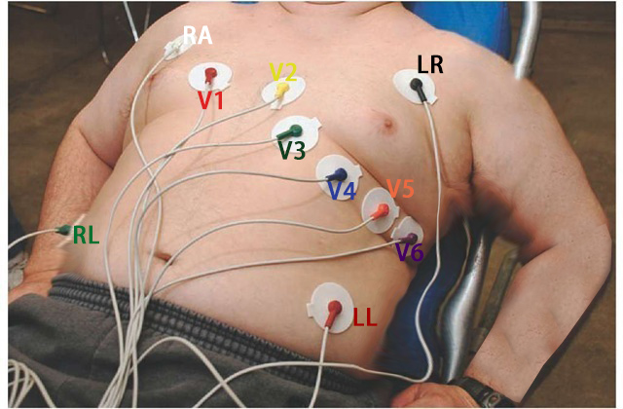
12 Lead ElectroCardioGram
Notes:
Easy test, longest part is applying the stickers for the monitors.
Takes a snapshot of the electrical conduction system for the heart, this will also show any damaged areas, as the nerve conduction will be poorer in the damaged area of the heart.

Slide 24
Self-management: Diabetes & High BP
Cut your risk of heart attack and stroke in half by following the self-management steps.
Don’t smoke
Be active everyday
Eat a healthy diet
Maintain a healthy body weight
Stay connected to family and friends
See your care team regularly
Know your numbers: A1C, BP, Cholesterol
Take your medication as directed
Reduce Salt intake
Reduce alcohol and substance use
Notes:
-Don’t smoke:
Smoking has a negative effect on our blood vessels, it makes them harder for blood to flow through.
Smoking increases BP, which increases your risk for heart attack and stroke as well as other complications of diabetes.
Smoking also makes it harder for medication to work the way it suppose to.
If you need help quitting smoking, ask your health care professional about help that is available.
It is never too late to stop smoking.
Cut your risk of heart attack and stroke by 50% after 1 year of quitting smoking.
-Be active everyday:
Aim for 30 minutes of exercise per day. Exercise helps to keep our blood flowing and lowers our blood pressure.
Include resistance type exercise 3 times per week (ie. Weight lifting, rowing), this is especially important for people with diabetes.
-Eat a healthy diet:
Eat lots of fruit and vegetables and drink plenty of water. Follow Canada’s food guide, this will help you plan meals that will give you energy and be healthy for your body.
-Maintain a healthy body weight:
It is very difficult to lose weight, especially as we get older. Make a plan not to gain weight, this is a success in itself. Ask your health care worker to help you to determine a healthy weight for you.
-Stay connected to family and friends:
Take a holistic approach to your health, remember to stay connected to the people that bring meaning to your life.
Everyone needs Love, Purpose, Meaning, and Belonging in their life.
-See your “personalized Care Team” regularly:
Diabetes is a complicated disease.
Diabetes generally becomes more difficult to control over time.
It is important to have good communication with your health care team.
They need your knowledge to help make good medical decisions.
Know your numbers:
Know what your A1C target (goal) number is and how to get to your goal ≤7%.
Know what your target (goal) Blood Pressure is and how to get to your goal <130/80
Know what your target (goal) Cholesterol number is and how to get to your goal (Bad cholesterol (LDL) ≤2.
-Take your medication as directed:
Medications don’t work if you don’t take them.
Your health care team can help you understand why it is important to take your medication.
Most people with Diabetes and High BP will need 3 or 4 BP medications to control their BP.
They might also need 1 – 2 medications to control their cholesterol levels, 3-4 medications to control their BP and of course 2-3 medications for their diabetes.
Reduce your Salt / Sodium Intake:
Eat fewer processed canned and instant foods
Choose fresh foods more often
Limit salted snack foods such as nuts, chips or popcorn
Do not add salt to home cooking, use spices instead
Take the salt shaker off the table
Choose lower slat options (label reading)
Limit Alcohol:
Excess alcohol intake is associated with the development / worsening of hypertension.
It also erodes stomach and gut lining, increasing chances of ulcers and stomach bleeds.
It aggravates nearly ALL chronic medical conditions.
It aggravates allergies, arthritis, and speeds aging.
Limit alcohol consumption to no more than 2 standard drinks per week.
Or have none.
Encourage home BP checks.
Home BP readings tell us a lot about how the person is dealing with their BP.
Home BP readings can confirm dx; improve control; encourage people to take their medication.
Write your BP readings down.
Take your BP at home throughout the day for a 7 day period.
It is also good to log down diet and general activities for the same period, to scan for other environmental/diet contributors.
Share the readings to your health care professional.

Slide 25
Summary
Many people with diabetes also have hypertension.
Having diabetes and hypertension increases your risk of cardiovascular complications like heart attack and stroke.
Creating your care team, and learning lifestyle changes to improve blood pressure, can help you live happier, longer.
Know your numbers: A1C; BP; Cholesterol
What you can control: diet, sleep, exercise

