Slide 1
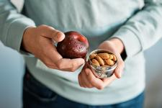
Healthy Snacking
Notes:
Today I will present on Health Snacking.
The presentation will last about 15-20 minutes and then we will do an activity.
Before we get started, ask participants to complete the “pre-test”. Allow about 5 minutes to complete.

Slide 2
Outline
Why healthy snacks can be good for you
Tips to practice healthy snacking
Healthy snack ideas and resources
Activity – What’s in your snack and how can you make it healthier?
Your turn to try!
Notes:
Here’s an outline of what we will talk about during today’s presentation.
We will discuss why healthy snacks can be good for you, tips to practice healthy snacking, we will go over some healthy snack ideas and resources, then we will do an activity and create our own healthy snack using your feast bundle.

Slide 3
Why healthy snacks can be good for you
Healthy snacks can:
keep you energized
help support good health
provide important nutrients
help satisfy your hunger between mealtimes
Do I need snacks?
Young children can benefit from snacks as they have small stomachs and may have trouble eating all of the foods they need at mealtime
Adults may choose snacks if there’s a long time in between their meals
Notes:
Healthy snacks can be an important part of your daily eating habits.
Eating healthy snacks can:
-keep you energized throughout the day
-help support good health
-provide important nutrients
-help satisfy your hunger between mealtimes
You might be wondering if you need to include snacks as a part of your daily eating habits.
Young children can benefit from snacks as they have small stomachs and may have trouble eating all of the foods they need at mealtime
Adults may choose snacks if there’s a long time in between their meals.

Slide 4
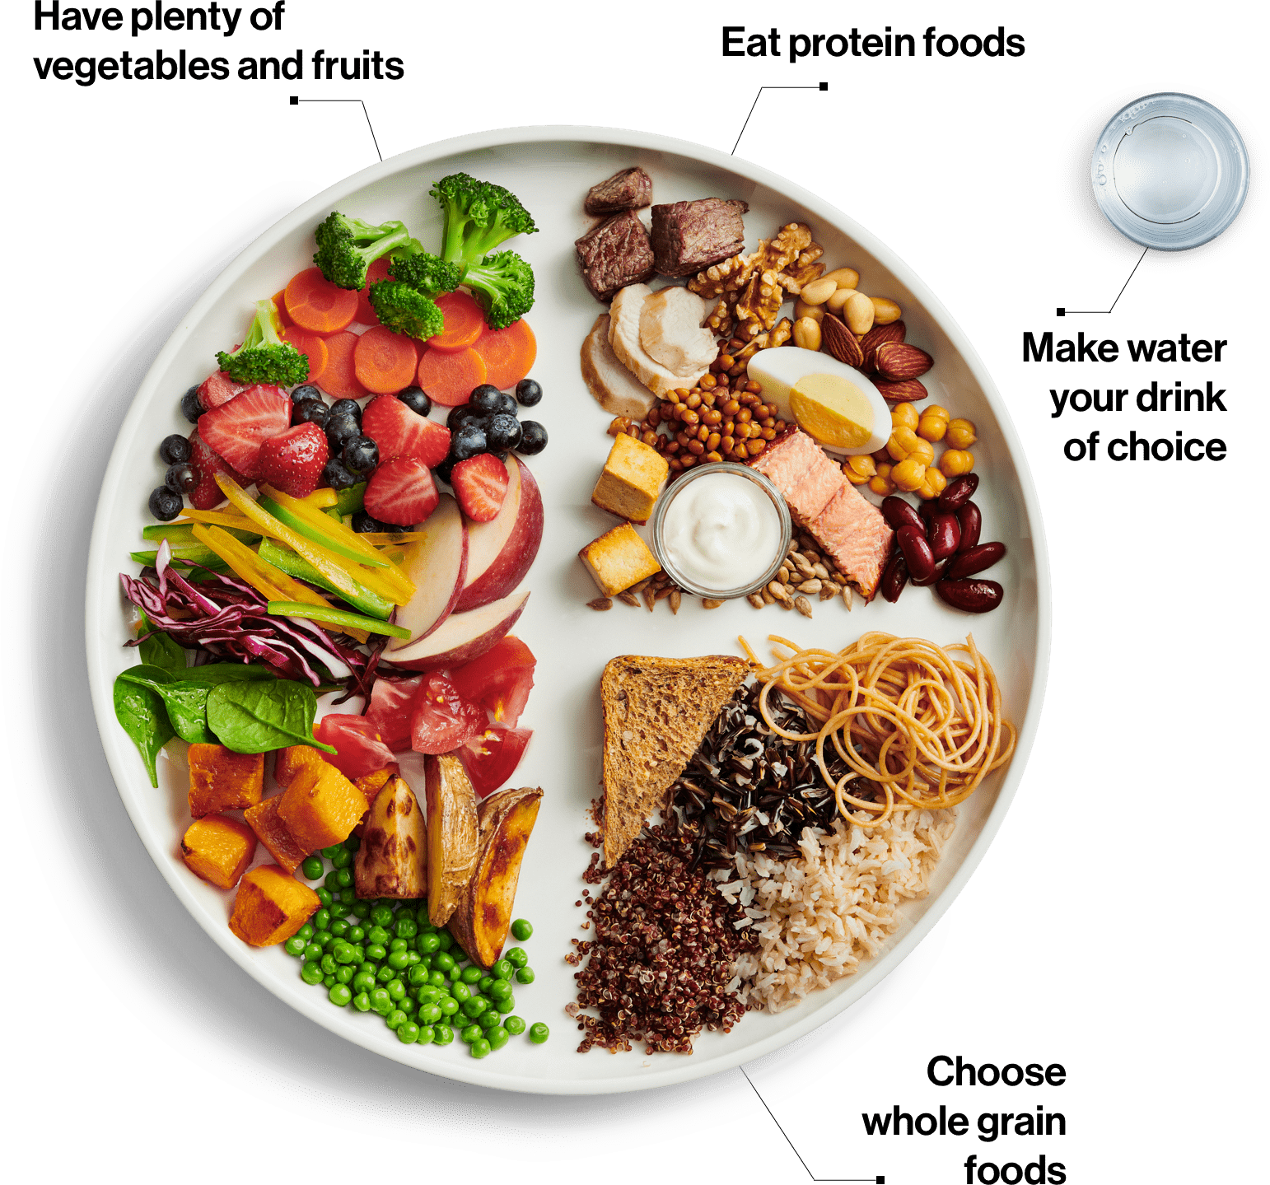
Snacking Tips
Choose healthy snack foods by selecting vegetables, fruits, whole grains and protein foods when planning meals/snacks
Notes:
The first snacking tip is to choose healthy snack foods by selecting vegetables, fruits, whole grains and protein foods when planning meals/snacks. You can use Canada’s Food Guide plate as a guide to build a nutritious meals and snacks!
When planning meals it is suggested to:
Fill ½ your plate with vegetables and fruit. Vegetables and fruits are an important part of a healthy eating pattern. Eating a variety of vegetables and fruits may lower your risk of heart disease. Vegetables and fruits have important nutrients such as:
fibre
vitamins
Minerals
Fill ¼ of your plate with protein foods. Protein foods, including plant-based protein foods, are an important part of healthy eating. Include foods such as beans, lentils, nuts, seeds, lean meats, wild game, poultry, fish, shellfish, eggs, lower fat milk and lower fat dairy products.
Fill ¼ of your plate with whole grains foods. Whole grain foods are a healthier choice than refined grains because whole grain foods include all parts of the grain. Refined grains have some parts of the grain removed during processing.
Whole grain foods have more fibre than refined grains. Eating foods higher in fibre can help lower your risk of:
stroke
colon cancer
heart disease
type 2 diabetes
Examples include whole grain bread, pasta, oats, brown or wild rice, quinoa, and barley to name a few.
Canada’s Food guide also suggests making water your drink of choice. There are a lot of drink choices available. Many choices have a lot of:
calories
sodium
sugars
saturated fat
Make water your drink of choice instead.
Drinking water is:
important for your health
a great way to quench your thirst
a way to stay hydrated without calories
We can also use this plate as a guide to planning snacks as well.

Slide 5
How to use Canada’s Food Guide to build a snack
https://www.youtube.com/watch?v=Zj1w42_WhpE
Notes:
In this video are a few examples as to how to build a healthy snack using Canada’s food guide plate.

Slide 6
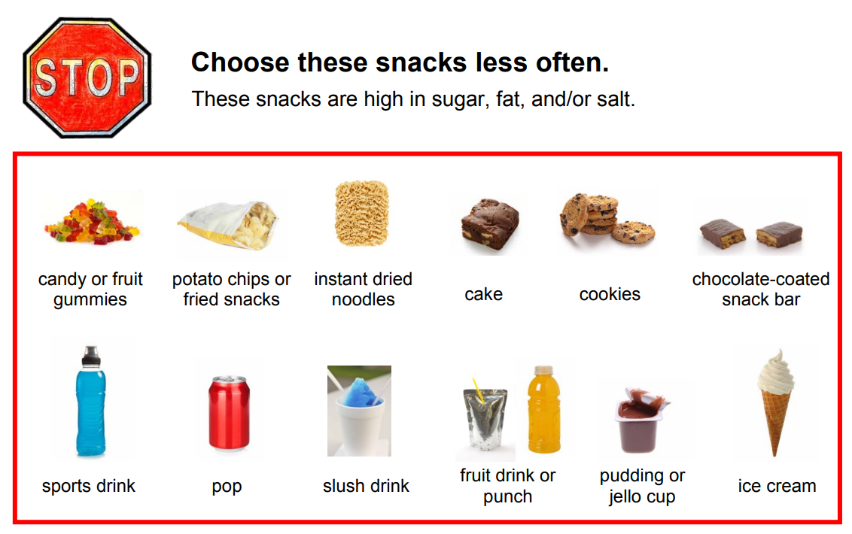
Snacking Tips
Limit foods such as candy, pop, fruit juice, fruit drinks, and chips. They are higher in sugar, saturated fat, or salt, and are not part of Canada’s Food Guide.
You may hear people call these types of foods “sometimes” foods or foods to have in moderation.
Notes:
The next tip is to limit foods such as candy, pop, fruit juice, fruit drinks, and chips. These foods are higher in sugar, saturated fat, or salt, and are not part of Canada’s Food Guide.
You may hear people call these types of foods “sometimes” foods, because it is recommended that these snack foods eaten less often, or in moderation.

Slide 7
Notes:
Instead, look to choose foods that are part of Canada’s food guide such as vegetables, fruits, whole grains and protein foods. Aim to build snacks using these foods more often. You may hear some people call these foods “everyday” foods.

Slide 8
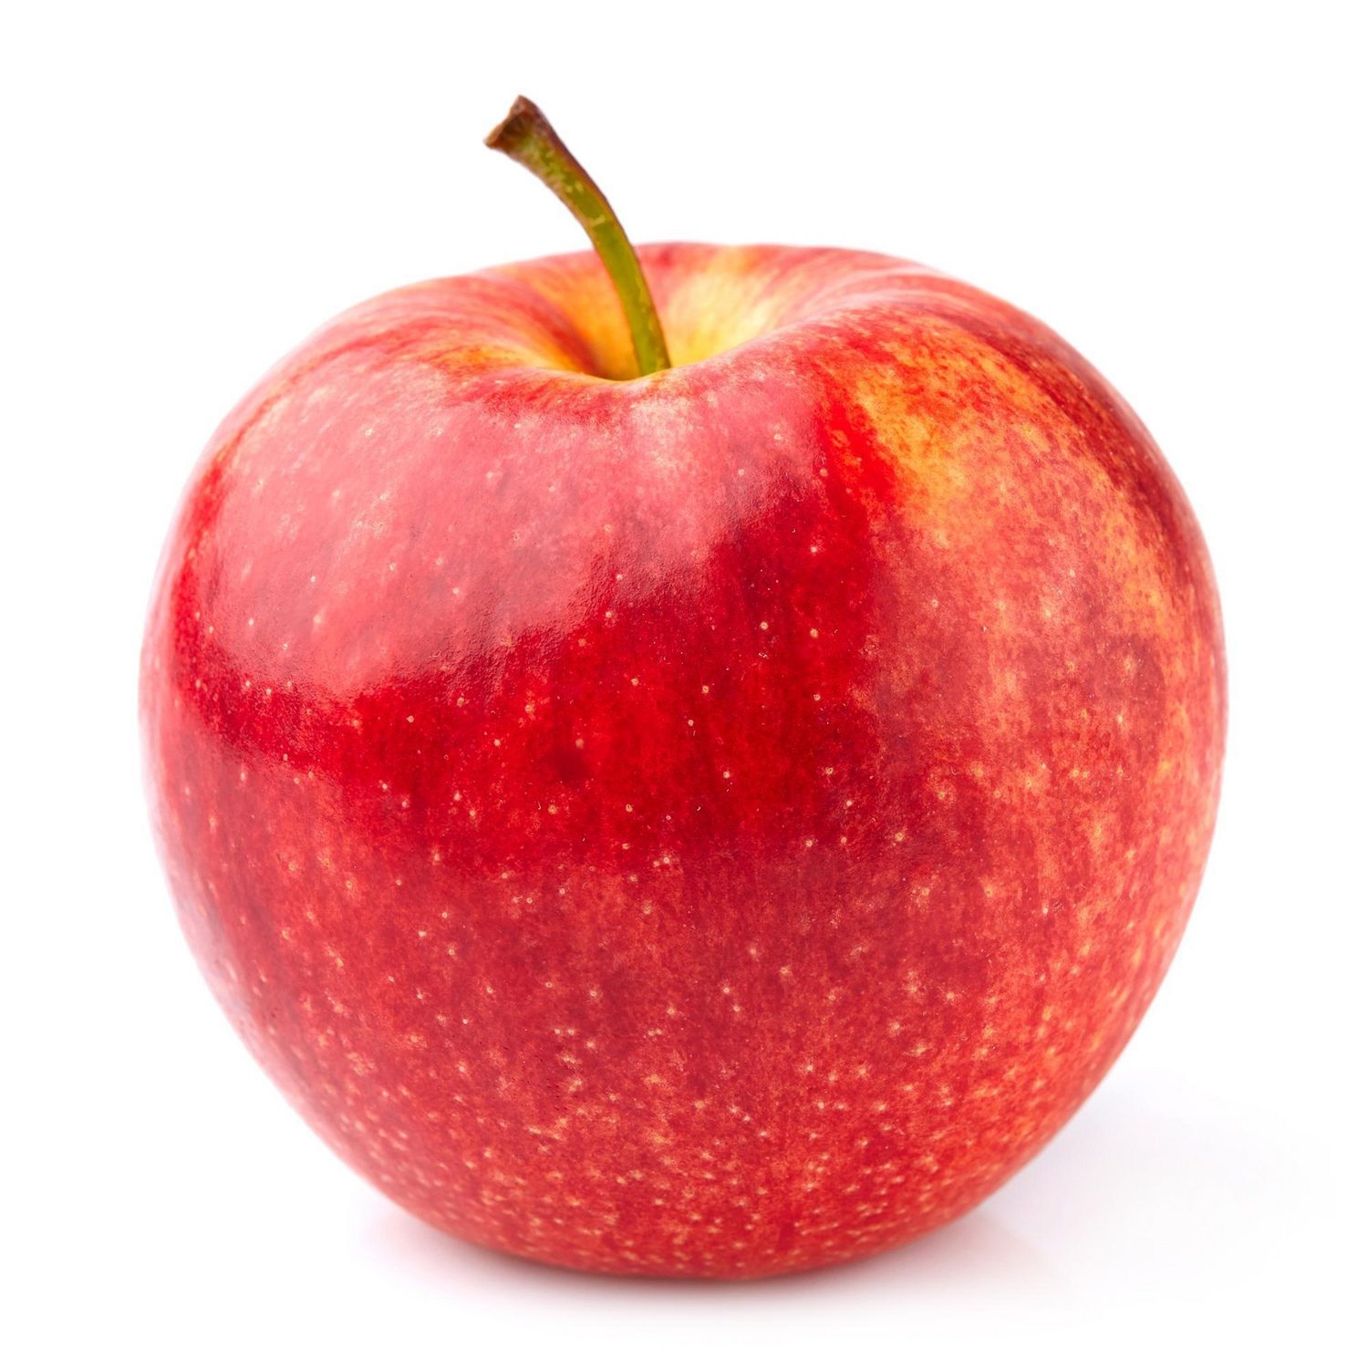
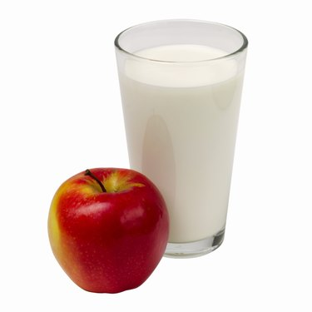
Snacking Tips
Size Matters!
The size of your snack may depend on your age, activity level, and how long it is until your next meal.
A small snack can be something as simple as vegetables and dip or a piece of fruit.
A larger snack may include 2 or more foods from Canada’s Food Guide.
Notes:
The size of your snack matters. The size you your snack can depend on your age, activity level, and how long it is until your next meal. For example, if you are very active, you might need a larger snack to meet your energy needs. If you are a bit hungry but you plan to eat a meal in the next 1-2 hours, you might have a smaller snack to tide you over until your next meal.
-A small snack can be something as simple as vegetables and dip or a piece of fruit.
-A larger snack may include 2 or more foods from Canada’s Food Guide.

Slide 9
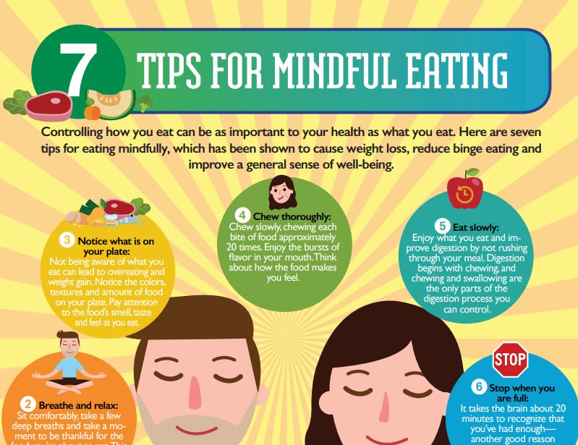
Snacking Tips
Eat your snacks mindfully
Eat your snacks slowly and without distractions, such as watching TV.
Choose small portions. Serve a small amount for your snack and try not to eat directly from large containers.
Eat snacks when you feel hungry, and not just out of routine or when you feel:
tired
bored
emotional
Too much snacking can lead you to eat more than you need.
Notes:
When eating a snack, be sure to practice mindful eating. Being mindful of your eating habits means being aware of:
how you eat
why you eat
what you eat
when you eat
where you eat
how much you eat
Being mindful while eating can help you:
make healthier choices more often
make positive changes to routine eating behaviours
be more conscious of the food you eat and your eating habits
create a sense of awareness around your every day eating decisions
reconnect to the eating experience by creating an awareness of your:
feelings
thoughts
emotions
Behaviours
Eat your snacks slowly and without distractions such as watching TV or driving. This can allow you to focus in the meal, the taste, smell texture and how your feeling as your eating.
Choose small portions. Snacks are usually smaller portions than what you might normally have at a meal.
Service a small amount of your snack and try not to eat directly from large containers as you might find yourself eating more, or eating until you finish the container.
Think about why you are about to eat. Eat snacks when you feel hungry and not just out of routine or when you feel tired, bored or emotional. Too much snacking can lead you to eat more than your body might need.
For more tips and information on mindful eating, feel free to print a copy of the poster on mindful eating shown on the slide which is linked below:
https://www.workstride.org/wp-content/uploads/2019/10/DigOnlyClient-Johns_Hopkins_Work_Stride_MindfulEatingInfographic.pdf

Slide 10
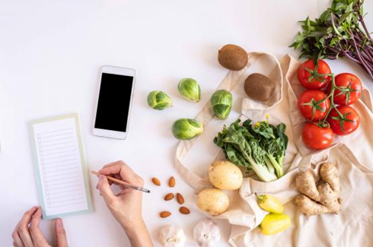
Snacking Tips
Prepared in Advance
Chop extra vegetables when cooking so you’ll have some for snacks.
Make muffins or homemade granola bars and store them in the freezer.
Hard-cook eggs on the weekend. They will keep for a week in the fridge with the shell on.
Make your own trail mix. Take whole grain cereal and nuts and seeds and toss them together.
Notes:
Meal planning and preparing snacks in advance can help to make sure you have healthy snacks available but can also save you time:
Some tips to prepare snacks in advance include:
Chopping extra vegetables when cooking so you’ll have some for snacks.
Making muffins or homemade granola bars and storing them in the freezer.
Hard-cook eggs on the weekend. They will keep for a week in the fridge with the shell on.
Making your own trail mix. Take whole grain cereal and nuts and seeds and toss them together.
Cut up vegetables and fruit, and store them in plastic containers in the fridge for easy ‘grab and go’ snacking.

Slide 11
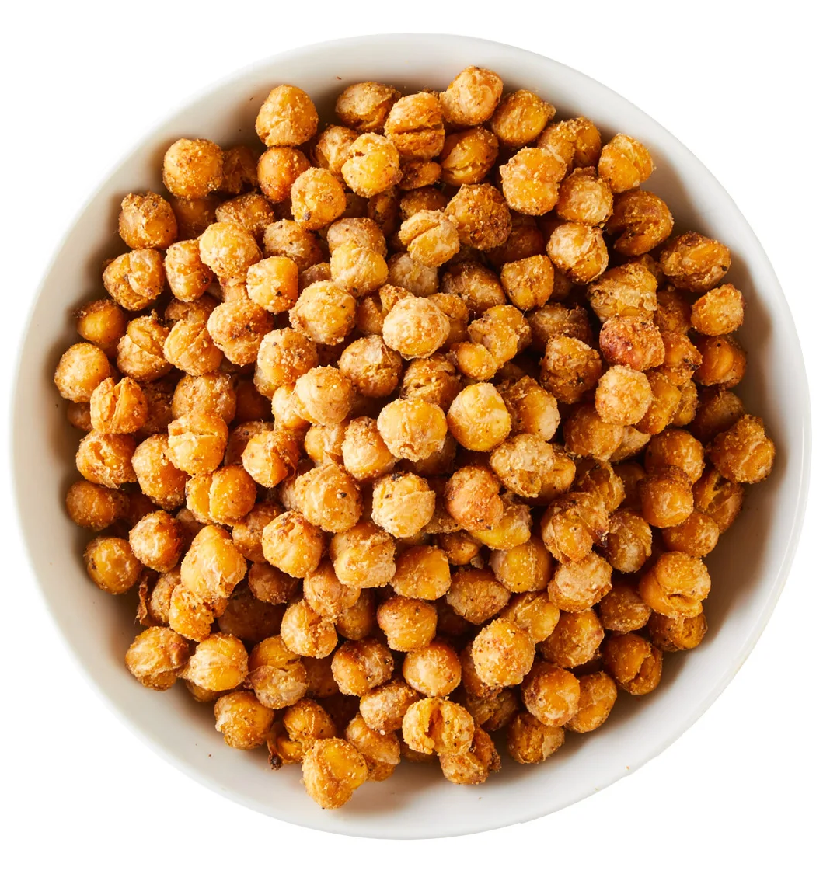
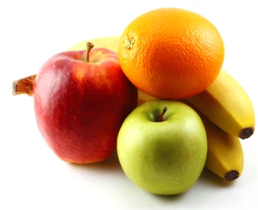
Healthy Snack Ideas
Travel friendly options you can bring in your bag:
roasted chickpeas or nuts such as almonds, cashews, soy nuts or peanuts can be kept in your bag for when you feel hungry
keep cut up vegetables such as carrots, cucumbers, celery and peppers in the fridge and bring along in a reusable container
oranges, bananas and apples are examples of fruit that come in their own natural packaging that makes them easy to transport
Notes:
Next we will go through some healthy snack ideas. Here are some Travel friendly options you can bring in your bag:
roasted chickpeas or nuts such as almonds, cashews, soy nuts or peanuts can be kept in your bag for when you feel hungry
keep cut up vegetables such as carrots, cucumbers, celery and peppers in the fridge and bring along in a reusable container
oranges, bananas and apples are examples of fruit that come in their own natural packaging that makes them easy to transport

Slide 12
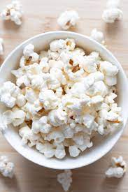
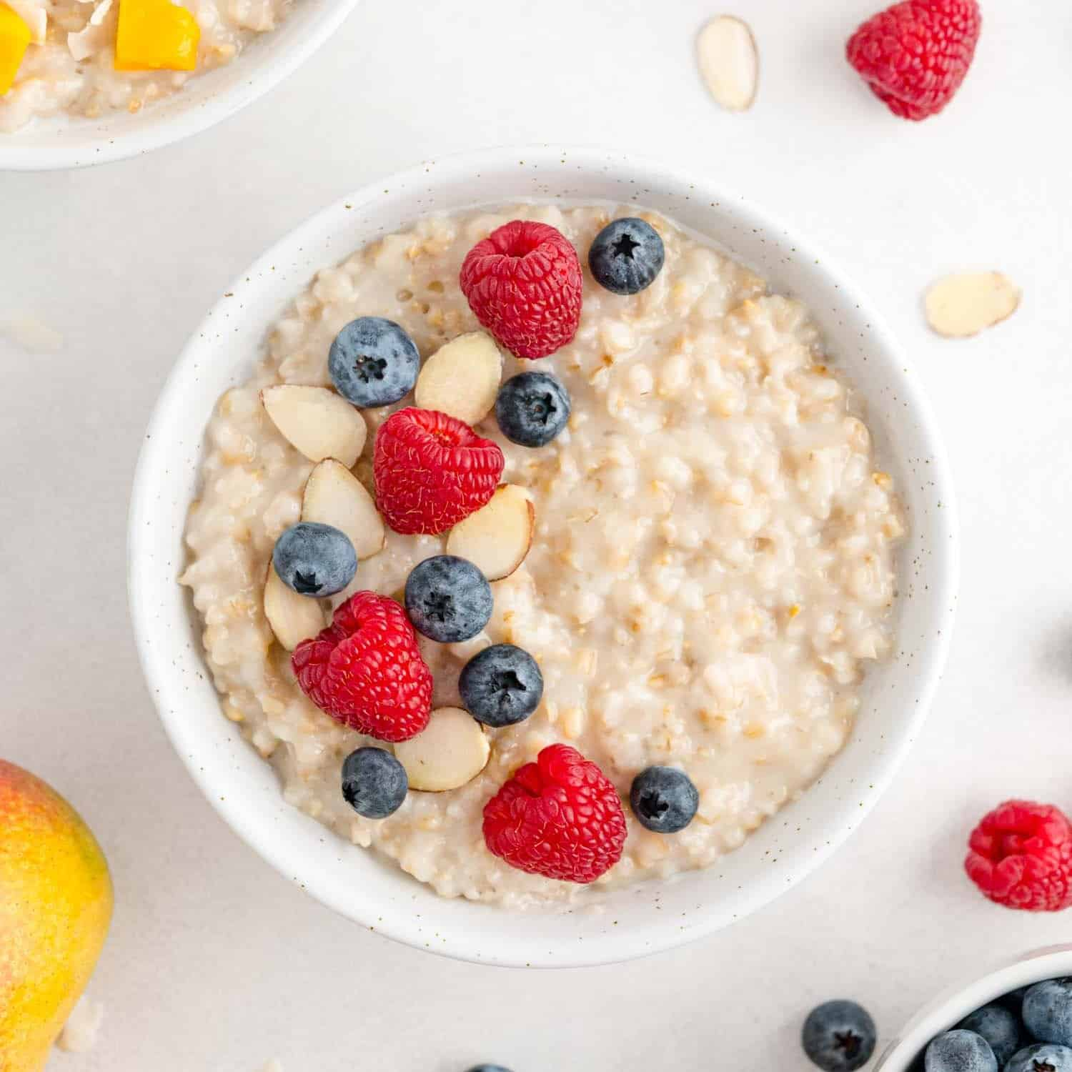
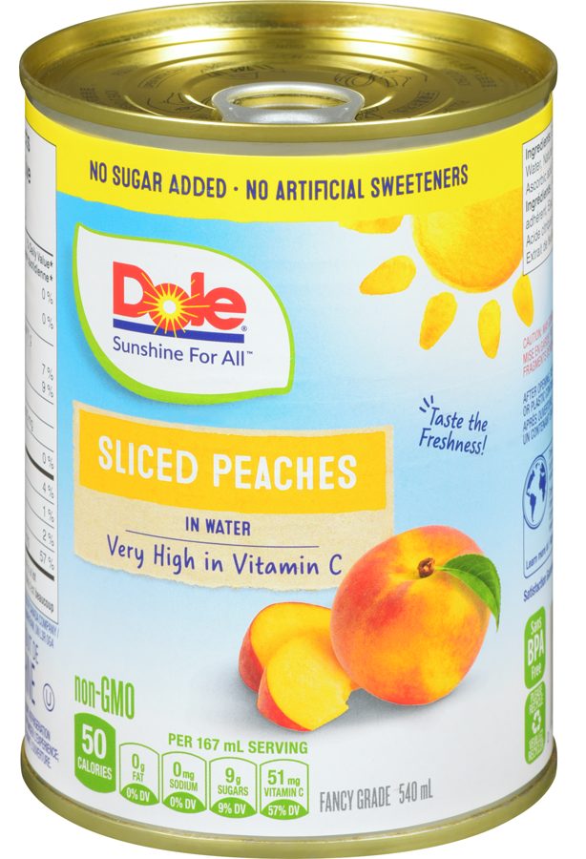
Healthy Snack Ideas
For work and school try:
apples
oatmeal
nut butter
canned fruit
canned tuna
plain popcorn
whole grain crackers
nuts, pumpkin or sunflower seeds
Make sure to keep snacks like lower fat yogurt or lower fat cheese in the fridge or in a cooler bag with an ice pack.
Notes:
For work and school you could try snacks such as:
apples
oatmeal
nut butter
canned fruit
canned tuna
plain popcorn
whole grain crackers
nuts, pumpkin or sunflower seeds
Make sure to keep snacks like lower fat yogurt or lower fat cheese in the fridge or in a cooler bag with an ice pack.

Slide 13
Healthy Snack Ideas
Try these snack ideas at home:
whole grain toast with nut butter and banana
green leafy salad with orange sections and almonds
lower fat yogurt topped with frozen berries and walnuts
lower fat cheese and whole grain crackers with cherry tomatoes
sliced cucumber and red pepper with hummus or lower fat yogurt dip
whole grain crackers topped with lower fat cottage cheese and peach slices
whole grain English muffin topped with apple slices and melted lower fat cheese
whole grain cereal with fruit slices and milk or unsweetened fortified plant-based beverage
Notes:
Try these snack ideas at home:
whole grain toast with nut butter and banana
green leafy salad with orange sections and almonds
lower fat yogurt topped with frozen berries and walnuts
lower fat cheese and whole grain crackers with cherry tomatoes
sliced cucumber and red pepper with hummus or lower fat yogurt dip
whole grain crackers topped with lower fat cottage cheese and peach slices
whole grain English muffin topped with apple slices and melted lower fat cheese
whole grain cereal with fruit slices and milk or unsweetened fortified plant-based beverage

Slide 14
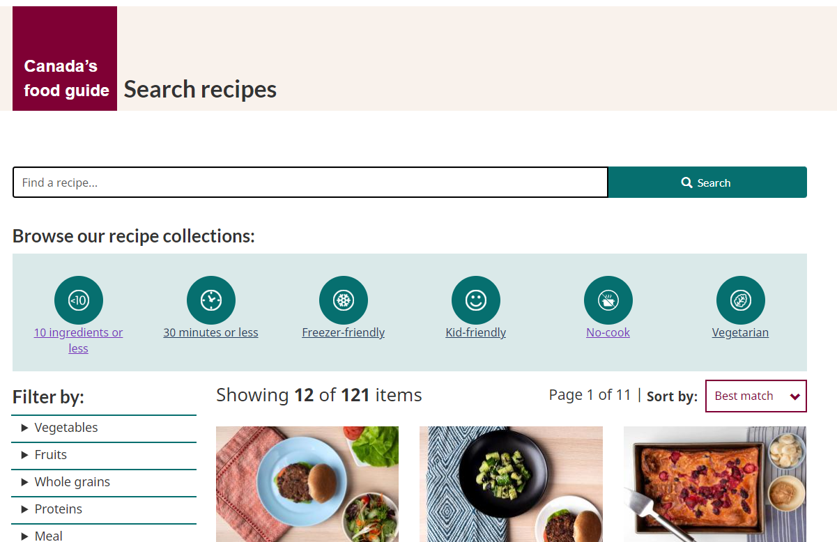
Resources
https://food-guide.canada.ca/en/recipes/
Notes:
You can go through each of these links and show participants how to navigate through each, or allow them to explore on their own.

Slide 15
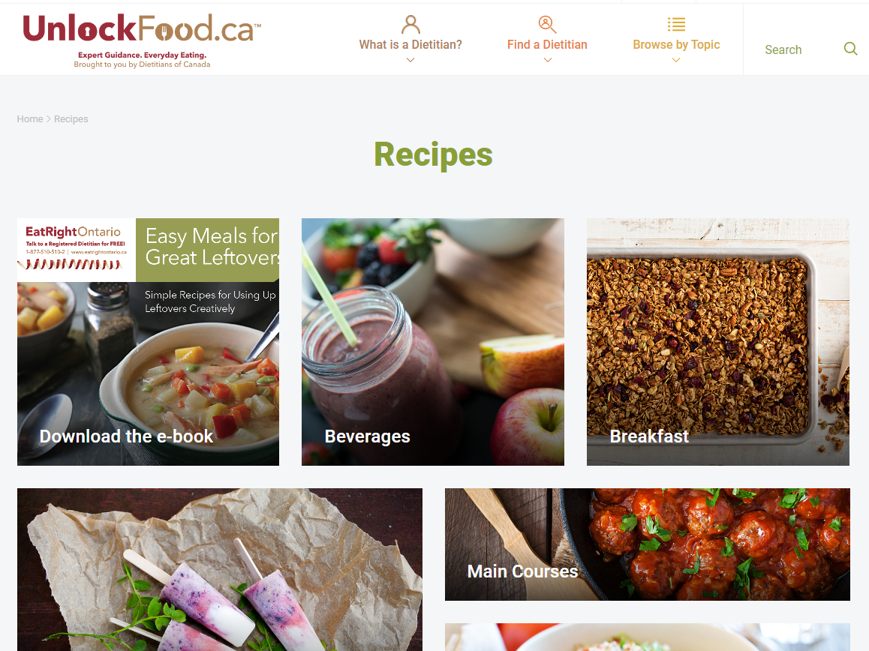
Resources
https://www.unlockfood.ca/en/Recipes.aspx

Slide 16
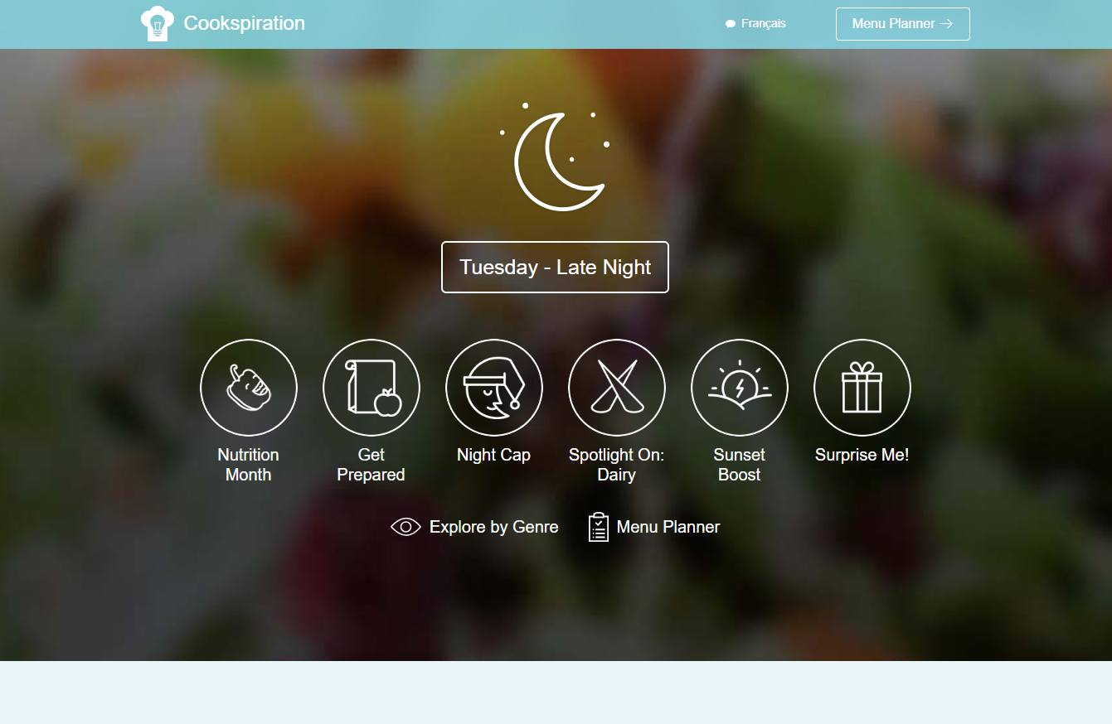
Resources
https://www.cookspiration.com/

Slide 17
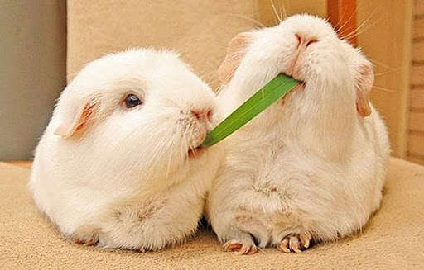
It’s time to share
Who would like to share what they wrote down for their 2 snacks before the presentation?
How could you make it healthier?
Do you have any snack tips that you can share with the group?
Notes:
Ask participants to complete post test at this time. Allow about 5 minutes to complete.
Once you’ve given participants time to complete the post test, as if any one would like to share the 2 snacks that they listed before this presentation. Ask how they could make the snack healthier?
As the group is they have any other snack tips that they would like to share with the group to facilitate discussion.

Slide 18
Activity: Snacker Says
Designate a “snacker” who will shout out types of snacks (i.e. Snacker says eat an apple)
Everyone stand in a straight line at one end of the room
Designate a finish line at the other end of the room
If an “everyday” snack is mentioned, take one step forward
If a “sometimes” snack is mentioned, remain still! If you take a step forward, them you go back to the beginning point
First person to cross the finish line wins!
Notes:
Similar to “Simon Says”. Will need a large open space to play.
Approximate time needed for activity: 20 minutes
Instructions:
• Have the participants stand in a straight line (side by side a few feet apart).
• Call the names of “everyday” and “sometimes” snacks.
• When an “everyday” snack is mentioned, the participants take one step forward.
• When a “sometimes” snack is mentioned the participants remain still. If a participant still takes a step forward, they go back to the beginning point.
• For example, if the leader says "Snacker says eat an apple," the participants take one step. If the leader says, "Snacker says, eat a chocolate bar," the participants don't move and if they do they must go back to the beginning and start again.
• The first participants to cross the finish line becomes wins and becomes the next “Snacker” if you wish to play another round.
Ideas for snacks are below, however snacker can come up with their own too!
“Everyday” Snacks
Grapes
Bananas
Raw veggies
Apples
Milk
Cheese and Crackers
Peanut Butter Sanwich
Fruit Smoothie
Yogurt
Cereal
“Sometimes” Snacks
Candy
Chocolate
Potato Chips
Kool-aid
Donut
Ice cream
Milkshake
Slurpee
Cheese Puffs

Slide 19
Activity: Food Guide Game
How to Play:
The objective of the game is for participants to learn which sections on the Canada’s Food Guide plate foods belong.
Divide participants into groups (maximum of 6 per group).
Have each group stand by or around the copy of the food guide with the pieces of paper
around it.
Each group receives a bag filled with “food items”(can be food picture cards or empty food packages).
Participants go through each “food item” and place each item on the appropriate piece of paper that represents the places on the food guide plate. NOTE: “Other Foods or Sometimes foods” and “Combination Foods” can be placed off to the side, not on one of the pieces of paper.
Once the foods have all been classified, discuss foods that were difficult to categorize or foods in the “Other/Sometimes foods” and “Combination” categories.
Notes:
This is a second activity that helps participants put their knowledge to the test as it related to categorizing foods within the food guide plate. Further instructions can be found in the resource page included with this presentation.
You can complete one activity or the other, or both if you wish!

Slide 20
Questions?

