Slide 1
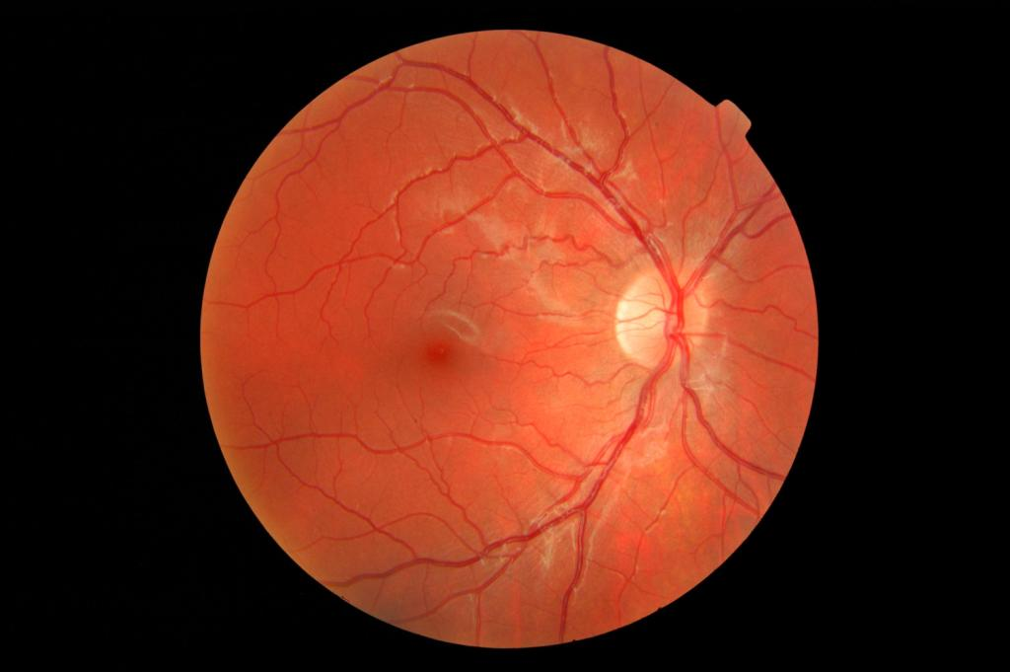
MANITOBA RETINAL SCREENING VISION PROGRAM
NORTHERN REGIONAL HEALTH AUTHORITY
Last updated June 2023

Slide 2
Land Acknowledgement
The Northern Regional Health Authority acknowledges that we are situated on Treaty 5, 6, and 10 Territory and that Manitoba is located on the traditional and ancestral lands of the Anishinaabeg, Anishininew, Denesuline, Nehethowuk, Ininiwak, Nêhiyawak Nations. We acknowledge that Manitoba is situated on the homeland of the Red River Métis. We respect waters, land, histories, language and cultures of First Nations, Métis and Inuit whose presence enriches Canadian society.
We respect and acknowledge that we are all connected through the Spirit and Intent of Treaties and Treaty Making and remain committed to working in collaboration and partnership that will encompass equity, justice, truth and reconciliation. The term “Indigenous” means First Nations, Métis, and Inuit inclusively. We acknowledge the unique status of Indigenous Peoples in Manitoba and Canada.

Slide 3
WHAT IS RETINAL SCREENING?
Retinal Screening is a way to check for early signs of eye disease that affect the back of the eye (Diabetic retinopathy).
Retinal Screening can be done by:
An experienced eye care professional through retinal photographs taken by a retinal screening nurse.
An ophthalmologist or optometrist through a dilated eye exam.

Slide 4
The MANITOBA RETINAL SCREENING VISION PROGRAM
A program has been established to:
Increase access to retinal screening in northern communities; and
Prevent vision loss from the complications of diabetes.
The Regional Eye Care Outreach Nurse (RECON) visits communities in Northern Manitoba to assess general visual health and take photographs of the retina (Teleophthalmology).

Slide 5
The MANITOBA RETINAL SCREENING VISION PROGRAM
Benefits of the MRSVP include:
Improved access to retinal screening in the North
Travel to specialists in Winnipeg is reduced and will only be required if disease is suspected or present
Reduced wait time for treatment
Reduction in cost for both the client and FNIH
Notes:
Example Cross Lake 53 people screened estimate cost per person $1000
Two Retinal screening nurse estimated cost approx $3000

Slide 6
REFERRAL PROCEDURE TO MRSVP
Referrals are accepted by clients (self refer), Care Provider, and ADI worker. Walk-ins are also welcome if fitting with appointment templates (otherwise will be added to wait list)
Completed referral forms should be faxed to:
Thompson Primary Health Care Center at (204) 778-1741
The Pas Primary Health Care Center at (204) 627-8285
Omgomiizwin Health Services (204) 774-8919 (OHS Office Wpg) or 1-855-938-3286 (secure email to fax: retinal screening nurses direct)

Slide 7
Referral Forms
The Pas referral form can be found on Accuro under the referral section and in community at the Nursing Station.
Thompson referral form can be found in community at the Nursing Station.
Omgomiizwin-Health Services Diabetic Retinal Screening Program referral form can be found on Accuro under referrals or in community at the Nursing Station.

Slide 8
NRHA The Pas Referral Form

Slide 9
Thompson referral form-community

Slide 10
Omgomiizwin-Health Services Diabetic Retinal Screening Program Referral Form

Slide 11
DIABETES AND EYE DISEASE
The risk of developing an eye disease is higher for people living with diabetes.
The signs of eye disease can stay hidden for years.
Some of the complications of diabetes, can be prevented or delayed by working towards blood sugar, blood pressure and cholesterol control as well as smoking cessation.
Notes:
Regular eye exams can help to identify eye disease at an early stage to prevent visions loss
food choices, physical activity and medication important to achieve blood sugar, blood pressure and blood cholesterol control.

Slide 12
DIABETES AND EYE DISEASE
Diabetic retinopathy- Damage to small blood vessels inside the lining at the back of the eye, called the retina
Macular degeneration- Breakdown of the central part of the retina and hence central and fine vision
Cataract- Clouding of the lens in the eye
Glaucoma- Disease that damages the optic nerve

Slide 13
WHAT ARE THE SYMPTOMS OF DIABETIC RETINOPATHY?
There are often no symptoms of diabetic retinopathy until the condition becomes more serious. Noticeable changes may include:
Decrease in vision or vision loss
Dark/ gray patches in vision
Blurred vision
Notes:
Tell your doctor or health professional right away if you notice any changes in your vision.

Slide 14
No Diabetic Retinopathy

Slide 15
Early Stages of Diabetic Retinopathy

Slide 16
Later Stages of Diabetic Retinopathy

Slide 17
Final Stages of Diabetic Retinopathy

Slide 18
HOW OFTEN SHOULD RETINAL SCREENING BE PERFOMED?
The 2018 Canadian Diabetes Association screening guidelines:
For Type 1 diabetes: Five years after diagnosis in individuals older than 15 years of age and follow up assessments every year.
For Type 2 diabetes: At time of diagnosis and follow up every 1-2 years if no or minimal retinopathy is present. If more severe retinopathy is found, clients may then be referred to an Ophthalmologist for assessment and/or treatment.
Notes:
Regular retinal screening for people living with diabetes can help prevent vision loss.
If retinopathy is present screening intervals may be sooner.
-Challenge in outlying communities to connect with client when rescreen is due

Slide 19
WHAT HAPPENS AT RETINAL SCREENING?
THE RECON will:
Ask questions about eye health and test visual acuity
Eye drops are administered (to dilate the pupil) and measure the inner eye pressure (IOP)
Retinal photographs are taken using a retinal screening camera (stereoscopic color fundus photographs in 7 standard fields (Gold Standard; approx. 12 pictures per eye)
The photographs are packaged and uploaded onto a Secure Diagnostic Imaging Site and will be accessed by the retinal specialist who will check for signs of eye disease and provide recommendations for follow up care.
Appointments can be up to 1 hour long

Slide 20
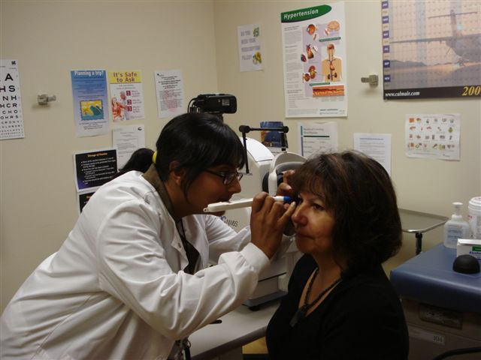
Notes:
Tonometry

Slide 21
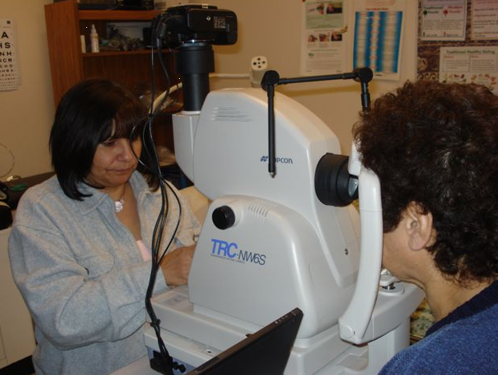
Notes:
Fundus Photos

Slide 22
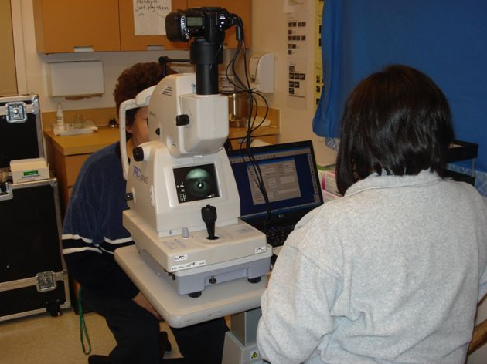

Slide 23
NORMAL RETINA

Slide 24
Mild to Moderate Non-Proliferative Diabetic Retinopathy
Notes:
Treatment generally blood glucose control

Slide 25
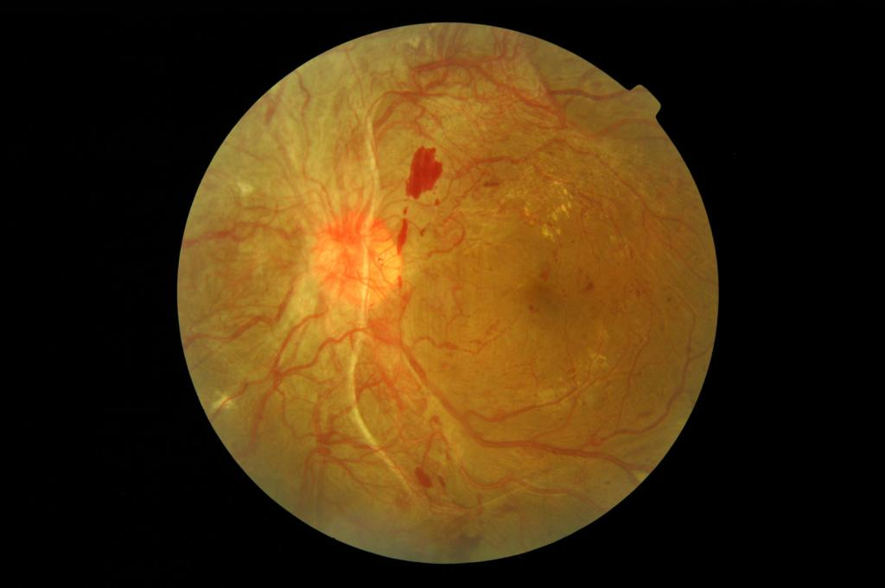
Severe Proliferative Diabetic Retinopathy
Notes:
Laser photocoagulation or a vitrectomy

Slide 26
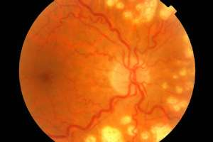
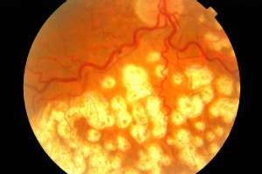
LASER TREATMENT IMAGES
Notes:
Laser treatment, also can perform ocular injections

Slide 27
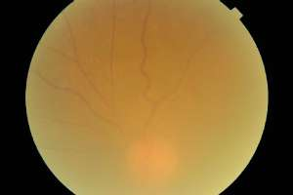
Cataract

Slide 28
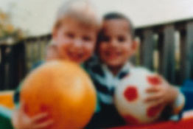
Cataract

Slide 29
Ways to Keep Good Eye Health
Blood sugar levels: regular monitoring and management within healthy range (Hgb A1C ≤7%)
Blood pressure and cholesterol: within normal range
Smoking cessation and reduction to exposure of second-hand smoke
Regular eye exams with retinal screening
Wearing glasses or contact lenses as prescribed
Seek immediate medical attention if any noticeable changes in vision (examples: veil vision, extreme eye pain, flashes of light in peripheral vision, floaters that suddenly increase in size or quantity, nausea/vomiting, excessive tearing)

Slide 30
Working Together for the North
The Misericordia Health Centre - Eye Care Centre of Excellence (Winnipeg Regional Health Authority) is the program lead.
Other partners include
First Nations and Inuit Health (FNIHB)
Diabetes Integration Project (DIP)
Manitoba Health and Healthy Living
TeleCARE & Telehealth
Northern Health Region (NHR)
Regional Diabetes Programs (RDP)
Canadian National Institution for the Blind (CNIB)
Ongomiizwin Health Services
Health Canada
Capital Health Team Teleophthalmology (Edmonton)

Slide 31
CNIB
CNIB is an important community resource for people with vision loss and blindness.
CNIB can assist with practical training to stay active and independent, answer questions about fading vision and provide suggestions for good quality of life.
There is no cost to people who need CNIB support.
Contact 1-800-552-4893 or visit cnib.ca.
Notes:
Please contact us directly or through a doctor, family, or friend.
Not everyone who comes to CNIB is totally blind. In fact 9 out of 10 people CNIB assists have some vision. CNIB offers specialized programs/services for people of all ages and their families.

Slide 32
OTHER SUPPORTS
DIP-Diabetes Integration Program: Provide Point of Care testing and education for people with diabetes. For more information call 204-942-9400
Diabetes Education Resource for Children and Adolescents (DERCA) Tel: (204) 787-3011 http://www.hsc.mb.ca
TeleCARE is a free, confidential telephone service that connects Manitobans with a registered nurse to prevent and self-manage any chronic disease call (204)-788-8688 or 1-866-204-3737
Program for patients with type 2 Diabetes (Aboriginal Diabetes Initiative)

Slide 33
Successful Retinal Screening Clinics
Factors to success:
Attendance at clinics (adhering to booking criteria, reminder phone calls, medical van arrangement).
Patient charts readily available upon arrival (less time spent looking for client charts).
Contact the Regional Eye Care Outreach nurses if any questions arise at any time.
Notes:
Appointment time can be decreased by ½ if information is present
ADI worker can assist with recruitment & support retinal screen nurse as we are visitors in the community; the ADI workers know the community and the clients.

Slide 34
Challenges
Accommodations (limited space at nursing stations for 2 screening nurses)
Weather (flight delay/cancellation, road conditions, temperature policies).
Technology and equipment challenges
Narrow time frame clinic is offered in communities
Community Events

Slide 35
Travel is individualized for each community, considerations include:
Funding - Funding for program is provided by MB Health and First Nation Inuit Health
Population of people with diabetes in community
Availability of screening nurses
MRSVP is a program designed to help provide eye care in the north for client’s living with diabetes. It is not the only eye care available.
Other options for clients:
Appointment can be booked at Thompson Primary Health Care or The Pas Primary Health Care with the RECON if the client is travelling for another medical appointment or personal trip.
See an Optometrist for a dilated eye exam in community, Thompson, The Pas or Winnipeg.
If a client is connected with an Ophthalmologist (eye specialist) they may not need to be seen by retinal screening (they are getting more appropriate eye care than what MRSVP can provide)

Slide 36
NRHA East Communities
1. Brochet
2. Cross Lake
3. Gillam (Fox Lake)
4. God’s River
5. God’s Lake Narrows
6. Ilford
7. Lac Brochet
8. Leaf Rapids
9. Lynn Lake
10. Nelson House
11. Oxford House
12. Pikwitonei
13. Tadoule Lake
14. Thicket Portage
15. Thompson
16. Shamattawa
17. South Indian Lake
18. Split Lake
19. Wabowden
20. York Landing

Slide 37
NRHA West Communites
The Pas, OCN and area
Flin Flon and area
Snow Lake
Cormorant
Moose Lake
Easterville
Grand Rapids

Slide 38
Omgomiizwin Health Services Communities
Berens River
Bloodvein River
Garden Hill
Little Grand Rapids
Norway House
Pauingassi
Poplar River
Red Sucker Lake
St. Theresa Point
Wasagamack

Slide 39
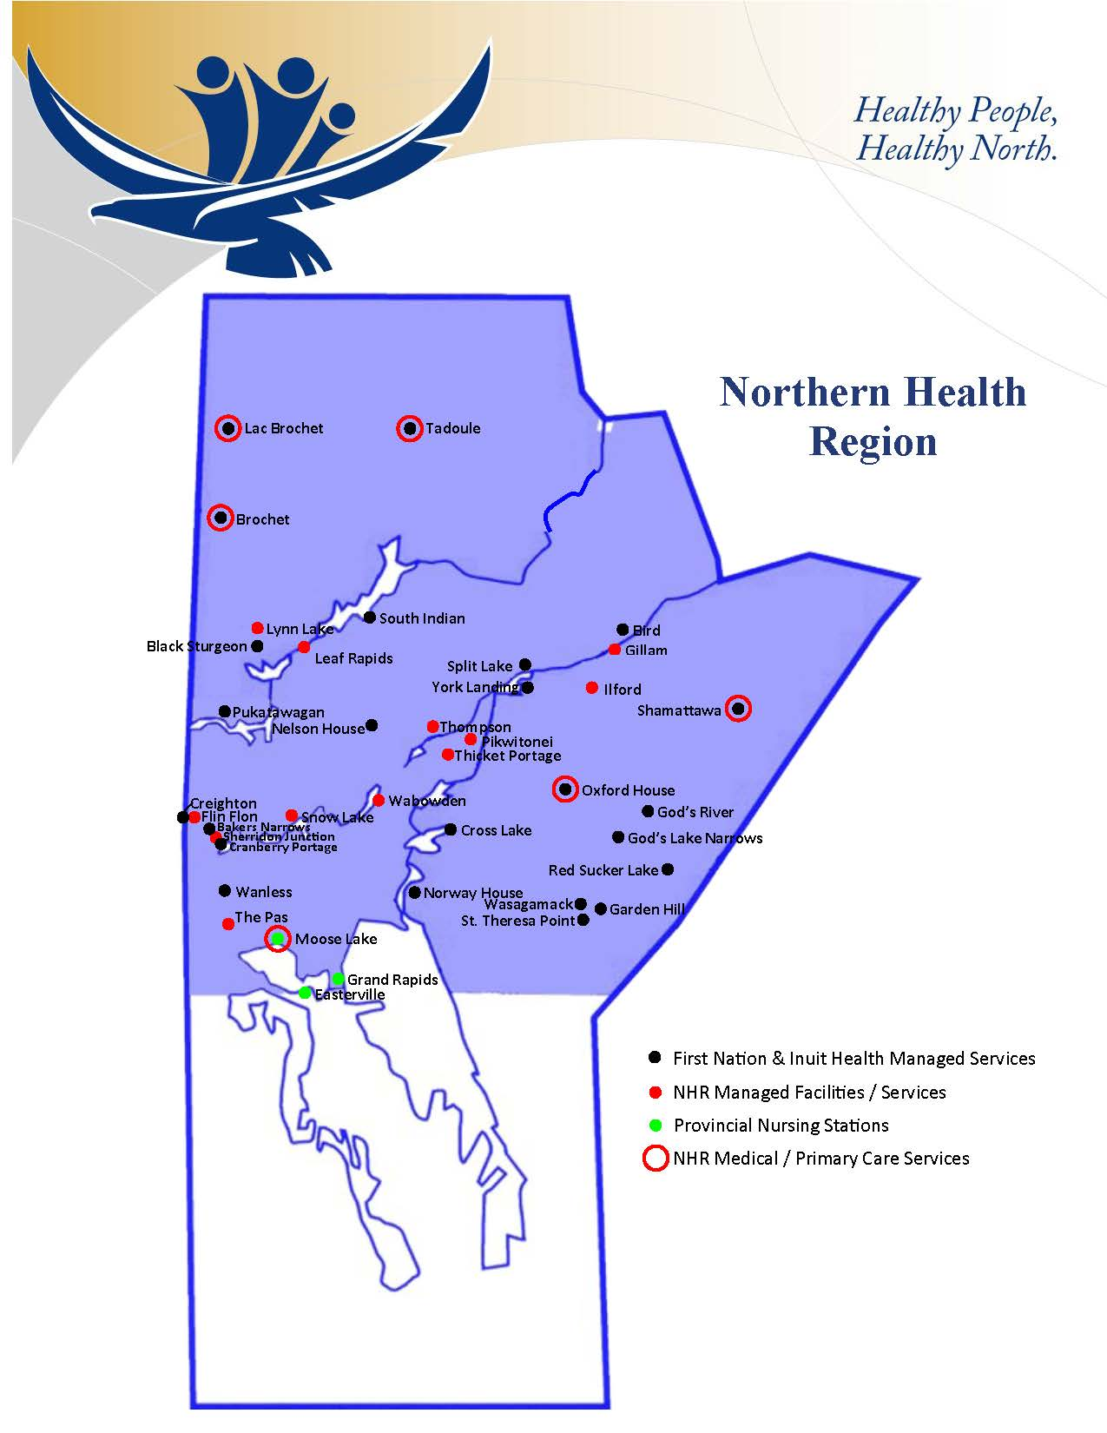

Slide 40
Questions?

