Slide 1
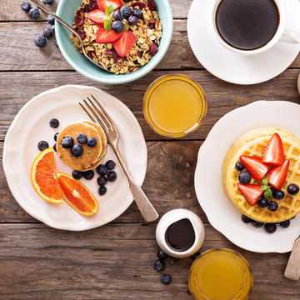
Eating Breakfast
2023
Notes:
Today I will present on ‘Eating Breakfast’.
The presentation will last about 15-20 minutes and then we will do an activity called: “What’s in your breakfast?”

Slide 2
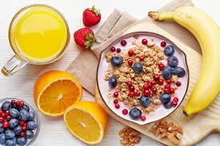
Outline
Reasons to eat breakfast
Making time for breakfast
Breakfasts high in nutrients, vitamins and minerals
Healthy breakfast idea and recipes
It’s your time to share…
Activity – What’s in your breakfast and how can you make it healthier?
Notes:
Here’s an outline of what we will talk about during today’s presentation.

Slide 3
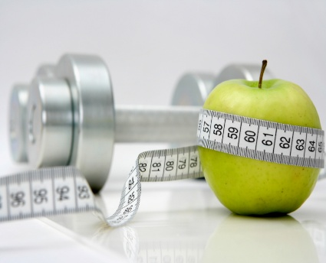
Reasons to Eat Breakfast
Helps to control weight
Helps to control blood glucose levels
Improved concentration and performance
Improved Encourages you to make healthy food choices all day
Notes:
You’ve heard it said many times: Breakfast really is the most important meal of the day. Not only does it give you energy to start a new day, but breakfast is linked to many health benefits, including weight and blood glucose control, improved concentration, improved performance as well as encourages you to make healthier choices for the rest of the day. We will talk about these benefits in more details during this presentation.

Slide 4
Helps to Control Weight
Breakfast eaters tend to weigh less than breakfast skippers
Eating breakfast ‘breaks the fast’
Eating breakfast may increase your metabolism
Eating breakfast can reduce hunger throughout the day
Notes:
Many studies, in both adults and children, have shown that breakfast eaters tend to weigh less than breakfast skippers. It's worth noting that most studies linking breakfast to weight loss looked at a healthy breakfast containing protein and/or whole grains -- not meals loaded with fat and calories such as bacon, donuts and croissants.
May increase your metabolism
Why does eating breakfast help to control weight? unsure, but one theory suggests that eating breakfast increases your metabolism - Experts note that lean muscle mass is more metabolically active, and thus helps with weight management. Breakfast gives you the right nutrition and fuel for your body to start your day. Skipping breakfast would make you go without food for twelve hours or more, making your metabolism slower and slower.
According to this theory, the body also start storing food when food becomes available.
Eating a healthy breakfast can reduce hunger throughout the day, and help people make better food choices at lunch, dinner and in between meals. While it might seem you could save calories by skipping breakfast, this is not an effective strategy. Typically, hunger gets the best of breakfast-skippers, and they eat more at lunch and throughout the day.

Slide 5
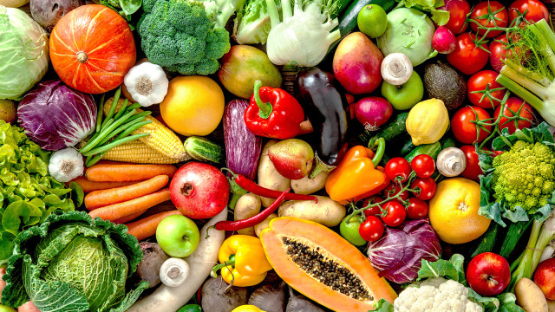
Helps to Control Blood Glucose Levels
Eating at regular times helps your body control blood glucose levels
Eating breakfast is important for people living with diabetes.
A person gets better glycemic control when the carbohydrates are spread out throughout the day
Notes:
Skipping breakfast increase your body's insulin response
This, in turn, increases fat storage.
Breakfast is a very important meal to eat and it is especially important for people with diabetes to eat breakfast. For someone on insulin, if there's no food on board, that person runs the risk of hypoglycemia. Even if you use fast-acting insulin to cover carbs, you shouldn't avoid breakfast. Research shows that there's much better glycemic control when a person's carbohydrates are spread out throughout the day.

Slide 6
Improved Concentration and Performance
When you eat breakfast, you :
Increase your mental clarity and creative power
Are better able to learn, recall information, problem solve and perform recognition tasks
Become physically stronger
Will have more energy
You may become happier
Notes:
Some research has found a correlation between eating a healthy breakfast and our ability to learn, recall memory, and performing recognition tasks. Therefore, a healthy breakfast can actually make you smarter. In children we know that eating breakfast will increase their performance in school and lead to higher grades.
I know for myself when I am hungry I have difficulty concentrating. I tend to focus on my hunger and cannot focus on the task at hand.
Become physically stronger - People who eat breakfast are more likely to become physically stronger including having more strength and endurance compared to the person who does not eat breakfast. Eating breakfast will give you more energy and will make your body run like a well oiled machine.
Eating breakfast makes you happy as it boosts your levels of serotonin in your blood, a neurotransmitter responsible for balancing your mood, appetite, and sleep.
A recent study on over 200,000 people in South Korea found that skipping breakfast increases your risk of depression by up to 43%.

Slide 7
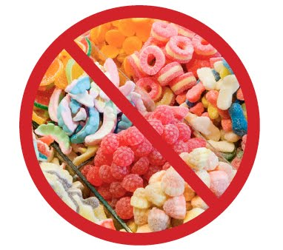
Encourages You to Make Healthy Choices All Day
When you eat breakfast you are:
Are more likely to exercise
Less likely to choose junk food
More likely to choose healthy food choices
More likely to include micronutrients (vitamins, minerals and phytochemicals) in your diet
Notes:
People who eat breakfast tend to be healthier overall including are more likely to exercise throughout the day, less likely to choose junk food and more likely to choose healthy food choices. This makes sense right? I know this to be true for myself. When I get on the right track with a healthy breakfast, I’m more inspired and motivated for the rest of the day to make better choices. Therefore eating breakfast gets me on track to make healthy choices all day. It seems as though when I start the day off on a healthy note that I am more likely to keep making healthy choices.
People who typically eat breakfast tend to incorporate more micronutrients in their diet.

Slide 8
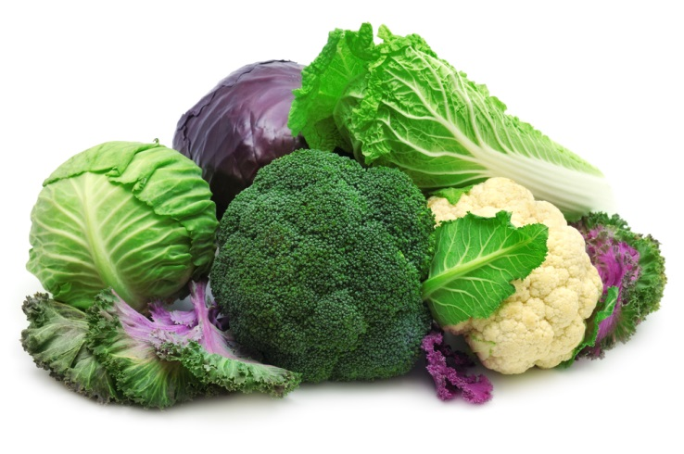
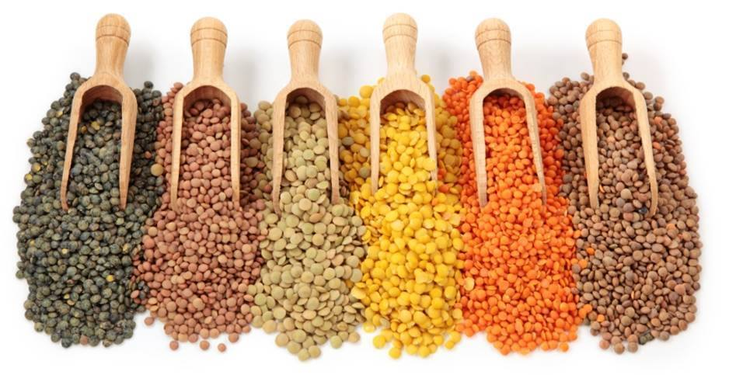
Micronutrients
Micronutrients are vitamins, essential minerals and phytochemicals found in the foods we eat
They contain no calories
For overall health and to prevent and manage diseases it is essential to eat foods packed with micronutrients
Vegetables, pulses, beans, seeds, nuts, fruit and berries are high in micronutrients
Notes:
Micronutrients is where the magic happens.
They provide the nutrients that heal the body.
Micronutrients are made up of 14 vitamins and 16 essential minerals, which are known to be vital to human health
Eating a healthy diet means that you need to eat foods packed with micronutrients.
Eating a diet high in micronutrients improves health for your body and decreases food cravings since your body is getting all the nutrients it needs from the healthy foods. Less food cravings leads to eating less calories and helps to achieve and maintain a healthy body weight for you.
When you eat more foods that have a high-nutrient density and fewer foods with a low-nutrient density, your health will dramatically improve.
Eat mostly high-nutrient foods and your body will age slower and is armed to prevent and reverse common diseases.

Slide 9
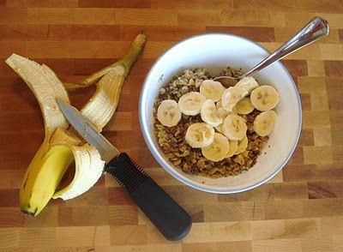
Making Time for Breakfast
Many say they do not have time for breakfast
You need to make time for yourself
Make your breakfast the night before
Choose quick and healthy breakfast options
Breakfast does not need to be a sit-down meal
Notes:
The main problem in the morning is that many people feel that they are always in a rush. We want the convenience, affordability and shelf life of processed foods.
However, it is crucial in order to become and stay healthy that you take time for yourself and your health. That not only includes getting plenty of sleep and physical activity, but also eating healthy foods regularly.
Would your car perform efficiently if you decided you didn't have time to fill it with gas? Would your bicycle work if you decided you didn't have time to fill the tires with air?
Make time for yourself. YOU are the best person to take care of you. Taking just 10 minutes of time in the morning for fueling your body with goodness is such an important start to your healthy day.
If you are really rushed in the morning, prepare your breakfast the night before and have it waiting in the fridge for you. You can also prepare a healthy soup full of vegetables in the slow cooker over night and have it ready for when you wake up in the morning.
A healthy breakfast does not need to be time consuming and complicating. There are many quick and healthy breakfast ideas that I will share with you in upcoming slides.

Slide 10
Listen to Your Body
Breakfast does not need to happen first thing in the morning
If you are hungry, eat
If you are not hungry, do not eat
Notes:
Many people are not hungry as soon as they wake up. If that is how you are, no worries. You do not need to eat breakfast as soon as you wake up. It’s important to eat in the morning, but perhaps for you it happens 2 hours after you wake up. It’s important that when you do eat that it’s something that is nutritious and that includes many micronutrients (vitamins, minerals and phytochemicals).
Cielle and Maxie – Cielle is hungry first thing in the morning and Maxie isn’t hungry until 1-2 hours after she wakes up.
It is also important that you avoid high sugar, highly processed foods for breakfast.

Slide 11
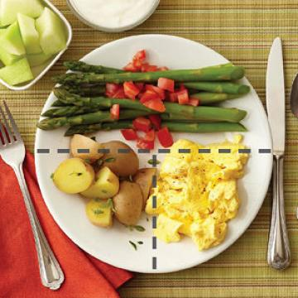
Choose a Healthy Breakfast
High in micronutrients
Follow Eating Well with Canada’s Food Guide
Make sure ½ your plate is filled with vegetables
Change the tradition – include vegetables in your breakfast
Limit high sugar, highly processed foods
Notes:
A healthy breakfast should contain a variety of foods, including lots of vegetables, fruit, pulses, beans, whole grains, and lean protein.
Follow Eating Well with Canada’s Food Guide and make sure that you include at least 3 of the 4 food groups at breakfast and ALWAYS vegetables and fruit.
Emphasize vegetables during your breakfast. The plate approach recommends that ½ your plate be filled with vegetables, ¼ with meat and alternatives (proteins) and ¼ with starches (grains, potatoes or corn).
You should plan for a healthy well balanced breakfast with plenty of nutritious food like vegetables, fruit, and whole grains, and you will be ready to take to take on the day. Avoid foods high in sugar because they give you a quick boost of sugar which falls rapidly. Further, eating too much sugar provides you with calories, but no nutrients and can lead to weight gain if eaten in excess. Also limit highly processed foods.
Eat whole, unprocessed foods at all meals, including breakfast.
Breakfast foods tend to be highly processed. According to one study, breakfast cereals in North America targeted at kids have 40% more sugar than those targeted to adults. In one study, only 5.5% of breakfast cereals for kids met the ‘low sugar’ guidelines. According to this study 73% of children eat sugary cereal regularly.
Therefore, if you are choosing a cereal for breakfast, choose one that has less than 4 g of sugar per serving.

Slide 12
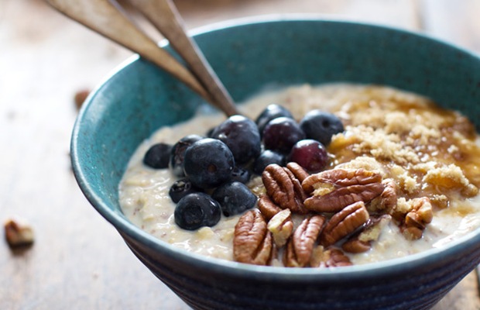
Healthy Breakfast Ideas & Recipes
Healthy smoothies
Steel cut oats with walnuts, blueberries & cinnamon
No-cook strawberry oatmeal
Avocado or hummus spread on whole grain bread
Left over salad with chickpeas, or black beans
Hard-boiled egg and an orange
Stir fried veggies with beans
Notes:
Even if you think you don’t have time to eat breakfast, there are endless grab-and-go options that are delicious. Some quick and healthy choices include:
Smoothies – Make your own smoothies using any fruit you have, plain yogurt, milk and spinach. The spinach has very little taste, but will add a beautiful green color to your smoothie, plus many vitamins (vitamin A, B, C, folate), minerals (calcium, iron, potassium), phytochemicals (found in plants shown to be disease fighting and health promoting) and antioxidants (reduces our risk of developing certain types of cancer).
Steel cut oats – cook them in a large pot the evening before. It can last for a few days in the fridge.
No cook strawberry oatmeal - put ½ cup of steel cut oats, or old fashioned oats with ½ cup milk in a portable cup. Let soak overnight in the fridge. In the morning add strawberries and enjoy!

Slide 13
More Breakfast Ideas and Recipes
Banana nut lettuce wraps
Banana burrito
Homemade pork and beans in the slow cooker
Homemade lentil and vegetable soup
A veggie omelet and a piece of whole-wheat toast
Be creative with your breakfast!
Notes:
And more healthy and quick breakfast ideas….
Banana nut lettuce wraps – spread 1 tsp of peanut butter on a leaf of lettuce. Lay a few banana slices on the peanut butter and roll up like a burrito.
Banana burrito – spread 2-4 tsp of peanut butter on a whole wheat tortilla wrap. Lay a few banana slices on the peanut butter and roll up like a burrito.
Do you have a slow cooker? If so, prepare your favorite recipe of pork and beans the night before and have it cooking while you sleep. You will wake up to a house that smells delicious and a healthy breakfast ready to be eaten.
Don’t feel like you have to stick to traditional breakfast food choices. Be creative with your breakfast. Choose healthy foods that you want to eat.
Quinoa – a seed, but called mother of all grains. Very high in protein, fibre, vitamins and low in GI.
Chia – high in fibre, vitamin, Omega 3, protein, antioxidants and minerals.

Slide 14
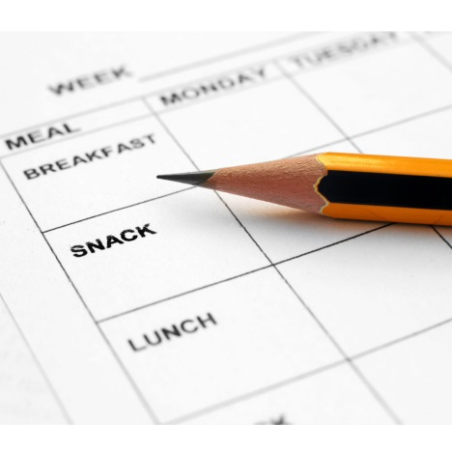
What did you eat for
breakfast today?
Notes:
Everyone take out a piece of paper and write down what you ate for breakfast today or what you ate up to now today.
Did you have anything to eat up to now? If not, when were you planning on eating?
Give participants 3-5 minutes to write down what they ate for breakfast.

Slide 15
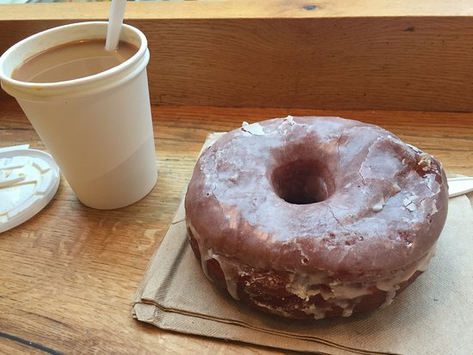
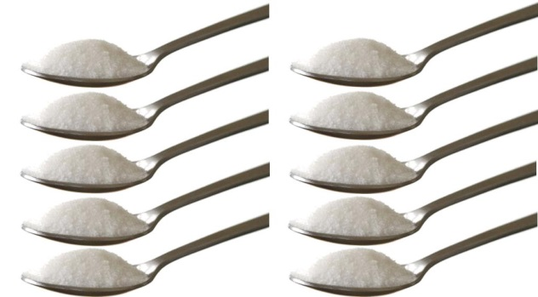
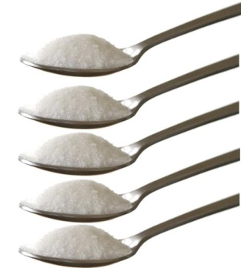
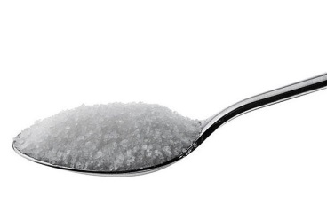
Breakfast #1
Large coffee, double-double
1 doughnut
Lots of calories, fat and
16 teaspoons of sugar
No fibre, vitamins or minerals
How many food groups?
0
Notes:
Let’s take a look at some typical breakfasts and see if they are considered healthy.
The World Health Organization recommends no more than 12 tsp of added sugar per day, but that we would benefit if we were to eat no more than 6 added tsp per day.
Coffee – 30 grams of sugar; 14 grams of fat and 270 calories.

Slide 16
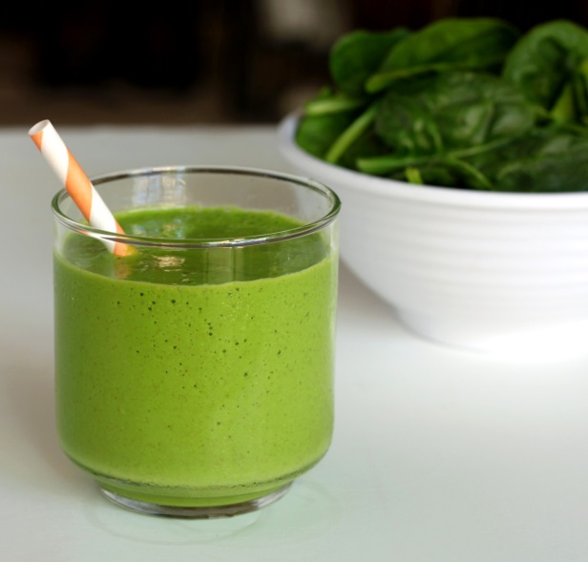
Healthy Breakfast #1
Healthy fruit smoothie
Made with fresh or frozen fruit, plain yogurt, milk and spinach.
The nutrients will vary
Lots of vegetables and fruit = vitamins, minerals, phytochemicals and will keep you healthy!
How many food groups?
2
Notes:
Have it with a whole wheat toast and you’ll have 3 food groups served for this breakfast.

Slide 17
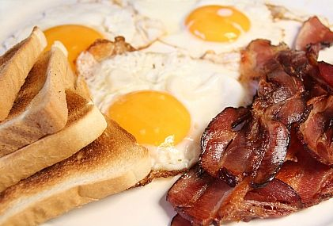
Breakfast #2
3 eggs
5 slices of bacon
2 slices of white bread with butter
Large coffee, double-double
Lots of calories, saturated fat and
16.5 tsp of fat
No fibre, very little vitamins or minerals
How many food groups?
2
Notes:
82 grams of fat = 16.5 tsp of fat
You only need 2-3 servings of meat and alternatives per day (2 for females and 3 for males). 3 eggs = 1.5 servings. Therefore almost all the servings for females and ½ of the amount of servings for males.
While white bread is listed on the food guide, the food guide also makes the recommendation that at least ½ of our servings should be whole grain each day. White bread (and other ‘white’ grain products) are not healthy choices.

Slide 18
Healthy breakfast #2
2 egg omelet with 1 cup worth of peppers, mushrooms and onions
1 slice whole wheat bread
Black coffee
1 apple
This breakfast will give you energy and lots of nutrients to keep you going!
How many food groups?
3

Slide 19
Breakfast #3
3 pancakes with butter and syrup
Large coffee, double-double
Lots of calories, sugar and fat.
No fibre, very little vitamins and minerals
How many food groups?
1
Notes:
Pancakes – 519 calories; 90 grams of carbs; 15 grams of fat
Coffee – 30 grams of sugar; 14 grams of fat and 270 calories.

Slide 20
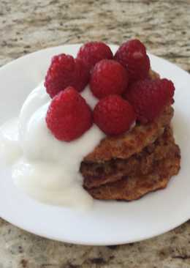
Healthy breakfast #3
2 whole grain pancakes
2 Tbsp plain yogurt
½ cup raspberries
1 cup of black tea
This breakfast provides you with fibre, calcium, lots of vitamins, minerals and phytochemicals!
How many food groups?
3

Slide 21
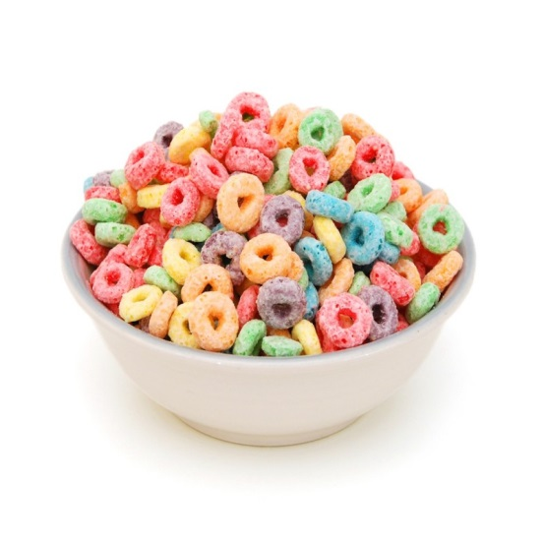
Breakfast #4
2 Pop tarts
1.5 cups of Fruity Os with milk
1 bottle of orange unsweetened juice
35 tsp of sugar!
How many food groups?
2
Notes:
Pop tarts – 68 grams carbs; 14 grams of fat
Fruity Os - 28 grams of sugar (8 tsp) – first ingredient on the ingredient list is sugar!
Bottle of juice = 500 ml = 46 grams of sugar/10 tsp sugar
Food groups:
-vegetables and fruit, but it’s not the best quality of vegetable and fruit servings.
-milk and alternatives

Slide 22
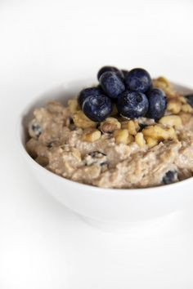
Healthy Breakfast #4
Steel cut oatmeal
1% milk
½ cup blueberries (fresh or frozen)
Fresh walnuts
Cinnamon
Lots of fibre, phytochemicals and antioxidants!
Lots of taste!
How many food groups?
4

Slide 23
It’s time to share
Who would like to share what they had for breakfast today?
Would you consider this a healthy breakfast?
How could you make it healthier?
Do you have any breakfast tips that you can share with the group?
Notes:
Ask other participants to share their suggestions on how to make this breakfast healthier.
Does it include vegetables and fruit?
Could/would you realistically eat the healthier breakfast?

Slide 24
THANK YOU!
Notes:
Do you have any questions about today’s presentation?
Are there other topics you’d like to hear about at future sessions? If so, please let me know.
Now, let’s play a game called: “What’s in your breakfast?”

