Slide 1
Mental Wellness Program
National Native Alcohol and Drug Abuse Program (NNADAP)
Community-Based
First Nations and Inuit Health Branch
Manitoba Region

Slide 2
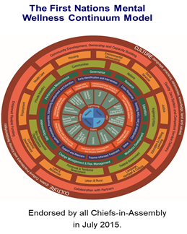
Manitoba Region – FNIHB Mental Wellness
National Inuit Suicide Prevention Strategy
Manitoba FNIHB Mental Wellness funds a range of culturally-relevant mental wellness services that are guided by Indigenous-led strategies - the First Nations Mental Wellness Continuum Framework, Honouring Our Strengths and the National Inuit Suicide Prevention Strategy.
The Mental Wellness component funds and supports community-based programming and services that aim to reduce risk factors, promote protective factors, and improve health outcomes associated with the mental wellness of First Nations and Inuit.
Launched in 2016
Note: Mental Health Counselling Benefits/NIHB is not part of the Mental Wellness Program.
Mental Wellness Program
Notes:
The MW Programs fund community-based programs and services that aim to provide treatment, reduce risk factors, promote protective factors and improve health outcomes associated with the mental wellness of First Nations people and Inuit.
As guided by Indigenous-led strategies, the First Nations Mental Wellness Continuum Framework, Honouring Our Strengths, and the National Inuit Suicide Strategy, the goal of the MW Programs is to provide First Nations and Inuit communities, families and individuals with culturally-relevant mental wellness services and supports guided by priorities established by First Nations and Inuit communities.

Slide 3
Mental Wellness Program Alignment
Beginning in the 2020-2021 fiscal year the Mental Wellness community based programs were aligned under one Mental Wellness Program.
There are no stand alone programs, all are under one code and program (Mental Wellness Program Q21G)
The goal is to provide communities with flexibility to develop their programming and use their funding in a way that best meets their mental wellness needs and priorities.
Brighter Futures
Community Based National Native Alcohol and Drug Abuse Program
Mental Wellness Teams
Mental Wellness Program Alignment
Building Healthy Communities
National Youth Suicide Prevention Strategy
Canadian Drugs and Substances Strategy
Mental Wellness Program

Slide 4
Manitoba Region – Recipient Based Programs
The Mental Wellness Program funds recipient-based programming through Contribution Agreements (CA) and Specific Project Allotments (SPA) which provides community-based emotional and cultural support services to IRS/IDS survivors, families and communities.
Indian Residential Schools
(IRS)
Missing and Murdered Indigenous Women and Girls
(MMIWG)
Contribution Agreement
Recipient Based Programs
Indian Day Schools
(IDS)
Expanded Trauma Informed
(ETI)
Emotional Support
Cultural Support
Note: Please contact Jerry McDonald for matters related to IRS/IDS/MMIWG/ETI at jerry.mcdonald@sac-isc.gc.ca
Mental Wellness Program
Notes:
Recipient Based Programs through CA and SPA:
Indian Residential Schools
Indian Day Schools
Missing and Murdered Indigenous Women and Girls
Expanded Trauma Informed
Cultural support providers (CSP’s) and Resolution Health Support Worker (RHSW’s) within the IRS RHSP provide emotional and cultural service to IRS Survivors and their families.
Emotional and Cultural Support Services:
(i.e., talking circles, pipe ceremonies, sweat lodge ceremonies, cultural camps, land-based workshops, fasting camps, Sundances, grieving/loss sessions, naming ceremonies, walking ceremonies, traditional language classes, drum-making, ribbon shirt/skirt making and more).
Indian Day Schools (IDS) is to ensure IDS students and their families have access to ongoing culturally appropriate level of community-based emotional and cultural support services.
MMIWG Supports provided by MKO/Flex CA (falls under the Mental Wellness Umbrella), the funds are to be used to support access to Health and Cultural Supports.
The MMIWG Liaison Unit’s (located at Manitoba Keewatinowi Okimakanak Inc. MKO) primary function is to support families and communities who are impacted by missing and murdered Indigenous women and girls, survivors of violence, Two Spirit and gender diverse people; and ensuring survivors, families and communities have access to ongoing culturally appropriate community-based mental wellness, emotional and cultural support services.
Expanded Trauma Informed this funding is to increase the number of community-based, Indigenous health and cultural support providers (i.e. salary and related costs for workers to provide emotional support and cultural support).
Expanding the existing network of health and cultural support providers will reduce the burden on health and cultural support workers, and will improve access to culturally-grounded supports to new people.

Slide 5
Outline
Today, let’s learn about the community-based National Native Alcohol and Drug Abuse Program!
1. What is it?
Who is it for?
What is it like?
6. Manitoba Treatment Centres
2. Treatment & Detox
7. National Youth Solvent Abuse Program
3. Types of Activities
8. Recovery
Roles & Responsibilities
4. Roles &
Responsibilities
9. Tools & Resources
5. Intake Process
Certification Incentive Funding
National Native Alcohol and Drug Abuse Program
Notes:
Presentation Outline:
We will provide an overview of the National Native Alcohol and Drug Abuse Program Community-Based Component and what it encompasses.
We will discuss what it is, who it is for, what is it like, type of activities, roles and responsibilities of a community based worker, intake process, Manitoba Treatment Centres, Certification Incentive Funding, Recovery, Youth Solvent Abuse Program, and Tools and Resources.
Now, let’s get started.

Slide 6
What is NNADAP? Who is it for?
What is the National Native Alcohol and Drug Addiction Program?
A community program that offers services and activities to support individuals and families dealing with substance abuse and addictions.
Who is it for?
Any community individual or family that is dealing with substance use and addiction challenges.
A safe place to seek help!
A network of support.
National Native Alcohol and Drug Abuse Program
Notes:
Background: NNADAP originated in the mid-1970s as part of a national pilot project to address alcohol and drug abuse. The program was made permanent in 1982 because of the "urgent and visible nature of alcohol and drug abuse among First Nations people and Inuit". This stability enabled NNADAP to better coordinate with other programs in the promotion of community health and sober lifestyles.
The National Native Alcohol and Drug Addiction Program (NNADAP) offers services and activities that aim to support First Nations and Inuit Peoples dealing with substance abuse, as well as to reduce and prevent alcohol and drug addiction issues.
NNADAP is the primary network in place to respond to First Nations and Inuit substance abuse issues.
NNADAP is comprised of two components:
Community based treatment; and
National In-Person treatment
Community-based NNADAP is designed to assist First Nations and Inuit communities operate initiatives that aim to reduce and prevent alcohol, drug and substance abuse (i.e. Prevention, health promotion, assessment and intervention, referral, aftercare and follow-up services).

Slide 7
What is the program like?
National Native Alcohol and Drug Addiction Program community-based workers support individuals and families through a process of accessing treatment options.
Community workers help individuals and families with the following:
Locating an in-house treatment centre.
A priority spot at a detox centre (not a prerequisite) can be arranged once a start date is confirmed at a treatment centre.
Offering prevention initiatives, intervention and aftercare activities.
National Native Alcohol and Drug Abuse Program
Notes:
Community workers help individuals and families with the following:
Locating an in-house treatment centre within the MB Region.
A priority spot at a detox centre (if requested by individual) can be arranged once a start date is confirmed at treatment centre.
Offering Prevention, Intervention and Aftercare activities.

Slide 8
Treatment and Detox
Does the individual require detox?
Yes?
No
Start the intake referral process to a Treatment Centre
Find Detox treatment for individual:
While individual waits for acceptance to treatment centre, provide a network of support.
Upon confirmation, assist in finding detox treatment
Main Street Project
Rapid Access to Addictions Medicine (RAAM) Clinics
Upon acceptance into detox, start approval process for individual via authorization through the Medical Transportation Referral Unit, Non-Insured Health Benefits program.
Detox treatment approved without confirmation of bed.
National Native Alcohol and Drug Abuse Program

Slide 9
What type of activities are offered?
National Native Alcohol and Drug Abuse Program
Prevention Activities
Intervention Activities
Aftercare Activities
Community NNADAP workers are responsible for identifying community needs and delivering program activities.
Prevention Activities
Public Awareness Campaigns
Public community meetings
Developing content for schools on alcohol and drug abuse
Spiritual and cultural events
Intervention Activities
Recreation activities for youth Discussion groups
Spiritual and cultural programs
Aftercare Activities
On-going Counselling
Sharing Circles
Support Groups and Visits
Community Elder-led Groups
Outreach Visits
Alcoholics Anonymous meetings
Note: Activities vary based on the size and needs of each community
National Native Alcohol and Drug Abuse Program
Notes:
Community-based NNADAP workers provides prevention, intervention, aftercare and follow-up services in First Nations and Inuit communities across Canada.
NNADAP workers are responsible for identifying community needs and delivering program activities
Activities fall into three key areas:
Prevention activities aimed at preventing serious alcohol and other drug abuse problems, include: Public awareness campaigns, public meetings, public speaking, developing content for schools on alcohol and drug abuse, school programs, news media work, land-based activities, cultural and spiritual events, external motivational speakers.
Intervention activities aimed at dealing with existing abuse problems at the earliest possible stage, include: Recreation activities for youths, discussion groups and social programs, and local First Nations and Inuit spiritual and cultural programs.
Aftercare activities aimed at preventing alcohol and drug abuse problems from reoccurring, include: Counselling, sharing circles, support groups, crisis intervention, support visits, outreach visits; treatment referrals, medical referrals, and detox referrals.
Examples of activities: Land-based activities, cultural or spiritual ceremonies, Elder-led support groups, A.A. in-person or virtual meetings, awareness events such as information sessions on the NNADAP program, events to address the stigma of addictions, and activities that involve and welcome community members to become aware of substance abuse and addictions.
NNADAP workers can reach out to their Tribal Councils to assist with Public awareness campaigns, developing content for schools, CA holders, Jordan’s Principle for Recreational activities.

Slide 10
Roles and Responsibilities
4. Guidance & Support
3. Awareness & Promotion
2. Case & Referral Management
5. Recovery Support
Key Components of community-based NNADAP treatment workers Responsibilities
1. Program & Service Delivery
6. Network & Strengthen Relationships
National Native Alcohol and Drug Abuse Program
Notes:
National Native Alcohol and Drug Abuse Program community-based workers provide referral services, education, awareness and prevention initiatives.
RESPECT AND UNDERSTANDING – YOUR COMMUNITY BASE, COMMUNITY INDIVIDUALS, RESPECTING AND PROTECTING THEIR CONFIDENTIALITY, WHETHER A CLIENT PREFERS TO CONNECT WITH YOU AT THE HEALTH CENTRE OR AT THEIR HOME OR A DESIGNATED MEETING PLACE, IT IS AT YOUR DISCRETION, YOU WILL KNOW WHAT WORKS FOR YOU AND COMMUNITY MEMBERS.
PLANNING AND IMPLEMENTING A VARIETY OF SERVICES AND ACTIVITIES
ASSESS
GUIDANCE & SUPPORT
NETWORK & LIAISON
Key functions/responsibilities of NNADAP worker:
1.
Offering prevention initiatives, intervention and aftercare activities (Program & Service Delivery)
Ensuring that the NNADAP worker ensures Professional Integrity (respect and understanding of individuals and families and maintaining privacy/confidentiality at all times)
2.
Screening, assessments, case and referral management
Case and treatment planning
Record keeping
Aware of bed availability in the MB Region
Arranging travel for individuals and/or families
3.
Client Education and Community Awareness initiatives
4.
Counselling/providing guidance and advice
Pre-treatment care, treatment care
5.
Discharge planning
Ensuring aftercare activities to ensure relapse prevention and help individuals on their journey towards healthy living and wellness.
6.
Networking and collaborating with a wide variety of other community Professionals in order to strengthen and maintain positive relationships.

Slide 11
What is the Intake Process?
4-Step Process for Intake to Treatment Centres in the Manitoba Region
1
2
3
4
Individual contacts the NNADAP community worker to inquire about substance abuse treatment services.
*No prerequisite for referral.
NNADAP community worker will complete intake assessment and start referral process by seeking out FNIHB Treatment Centre(s) for availability.
*If no bed availability
Treatment application package sent out by the NNADAP community worker to the requested Manitoba Region Treatment Centre(s).
Once approval is confirmed, a request for travel will be sent to the NIHB Medical Transportation Referral Unit for authorization.
*Out of Province Treatment *
If no bed availability in the Manitoba Region, individuals may go out of province for treatment.
Contact the neighboring treatment centres (SK, ON, AB) to obtain intake assessment and treatment forms.
Once approval confirmed, a request can be sent to the NIHB Medical Transportation Referral Unit for travel arrangements and authorization. Individual must have valid photo identification (i.e. treaty card, driver’s license, or passport) otherwise travel will not be arranged for out of province.
What is the intake process?!?!
What are the steps?
National Native Alcohol and Drug Abuse Program
Notes:
**3 – NNADAP worker should be prepared and know the MB Region treatment centre bed availability. Sourcing out availability for individuals**
* If no in-house treatment is available in the MB Region, individuals may go out of province for treatment.

Slide 12
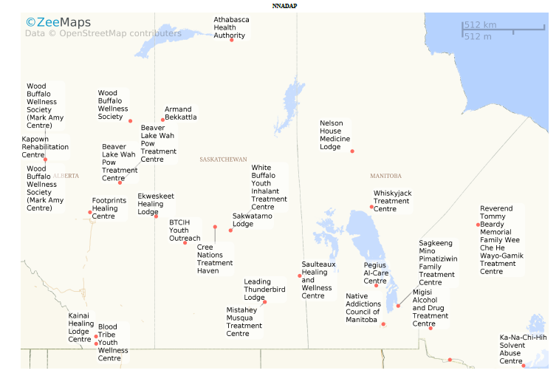
Manitoba Region Treatment Centres
NNADAP supports a national network of 52 in-house treatment centres with over 700 beds across Canada.
Manitoba Region (5)
Mikaaming Mino Pimatiziwin Healing Lodge
Sagkeeng First Nation
1-866-329-0736
Native Addictions Council of Manitoba
Winnipeg
204-586-8395
Nelson House Medicine Lodge
Nisichawayasihk Cree Nation
204-484-2256
Peguis Al-Care Treament Centre
Peguis First Nation
204-645-8995
Whiskyjack Treatment Centre
Norway House Cree Nation
204-359-8995
National Native Alcohol and Drug Abuse Program
Notes:
Ideally, you are looking at the closest/nearest site of service (SK, ON, AB), if in-house treatment not available in the MB Region.
National link to the list of national treatment centres can be found on slide 14.
Closest/nearest site of service, if not available in MB Region.
Alberta has 6 treatment centres
Saskatchewan has 10 treatment centres
Manitoba has 5 treatment centres
Ontario has 11 treatment centres

Slide 13
National Youth Solvent Abuse Program
What is the National Youth Solvent Abuse Program?
A national in-patient treatment program that compliments community-level activities aimed at preventing youth solvent abuse.
Provides culturally appropriate treatment, specialized treatment and recovery programs for First Nations and Inuit youth (nationally aged 10-25 years, may vary by region) experiencing solvent abuse.
Youth-focused treatment centres in all regions of Canada.
Whiskyjack Treatment Centre, Norway House Cree Nation (youth aged 12-17 years)
Offering a care approach that includes pre-treatment, treatment and post-treatment care.
National Native Alcohol and Drug Abuse Program
Notes:
Youth Based Program under the National Youth Solvent Abuse Program.
Manitoba Region: Whiskyjack Treatment Centre, Norway House Cree Nation
12 to 17 years youth/adolescence program focused on substance, drug and alcohol abuse treatment.
NNADAP worker would follow the same procedures as for an adult.

Slide 14
Recovery
What is expected after treatment is over?
NNADAP worker supports individuals and families in their early recovery to prevent relapse and help them in their journey toward healthy living and wellness.
Addiction recovery is a long-term process that continues after treatment is over.
Provide aftercare activities to help recovering individuals and families with triggers, stress, cravings and urges that they may face when treatment is over:
Community recovery plans vary and may include:
A.A. or Narcotics Anonymous In-person or virtual online meetings
Recovery support groups (i.e., sober support network)
Cultural or spiritual activities on the land
Post-treatment counselling
Home-visits
Community Acknowledgement, Love, Acceptance and Joy
National Native Alcohol and Drug Abuse Program
Notes:
Community Acknowledgement, Love, Acceptance and Joy.
Community Welcome Home
The best way to celebrate an individual(s)/families return from treatment is with a community welcome home event/party (certificate of achievement signed by Chief and Council), honour song, feast, dancing, cultural/activities, etc).
Surrounding an individual with love, acknowledgment, acceptance and the joy is the perfect community welcome home message that removes the stigma of shame, guilt and blame that often accompanies substance abuse.

Slide 15
Yearly Certification Incentive Funding
Recruitment and Retention Incentive Funding Investments:
This investment fund is to enhance current recruitment and retention activities for all accredited and certified addictions workers in Manitoba First Nation communities.
Recipients are eligible to receive certification from a certifying body (i.e., Canadian Council of Professional Certification, Canadian Addiction Counsellors Certification Federation, and Indigenous Certification Board of Canada).
This funding will provide monetary incentives for eligible certified workers ($4,000 per certified worker/per year paid directly to worker).
I hear there is a yearly certification incentive?!?! Tell me more!
National Native Alcohol and Drug Abuse Program
Notes:
Did you know?
As a NNADAP worker in the community, you are eligible to receive workforce retention funding ($4,000).
RECRUITMENT AND RETENTION INVESTMENTS
THE INVESTMENT IS TO ENHANCE CURENT RECRUITMENT AND RETENTION FOR ALL ACCREDITED AND CERITIFIED ADDICTIONS WORKERS IN MANITOBA FIRST NATION COMMUNITIES.
This funding will be provided in one lump sum and is inclusive of:
Gathering proof of certification from the Manitoba NNADAP workers;
Providing the $4,000 fund directly to the NNADAP workers (when certification is attained); and
The funds will be added in one lump sum to the contribution agreement.
Please share this with your prevention and treatment workers.
A great opportunity for prevention and treatment workers to get certified.
For more information, please contact your Ken Genaille at the Peguis Al-Care Treatment Centre, kengenaille@peguisal-care.ca

Slide 16
Tools and Resources
National Native Alcohol and Drug Abuse Program
https://www.sac-isc.gc.ca/eng/1576089851792/1576089910366
National Youth Solvent Abuse Program
https://www.sac-isc.gc.ca/eng/1576090099314/1576090141721
National Non-Insured Health Benefits Treatment Centres List:
https://www.sacisc.gc.ca/eng/1576089851792/1576089910366
Other Resources:
Alcoholics Anonymous in Manitoba – Online Meetings
https://aamanitoba.org/meetings
Narcotics Anonymous in Manitoba – Online Meetings
https://mascna.org/wp/meetings/
Thunderbird Partnership Foundation (free courses and toolkits)
https://thunderbirdpf.org/
Guide on Treatment Planning for Substance Abuse & Sample Treatment Plans
https://www.swmbh.org/wp-content/uploads/Tx_Planning_for_SUD_v3.0.pdf
National Native Alcohol and Drug Abuse Program
Notes:
Useful resources about the NNADAP/NYSAP programs.
And other resources to assist you in your role.
September 27, 2021, a resource toolkit was sent out by the MB Mental Wellness Unit on Treatment Planning to all HD’s in communities.
A resource toolkit on Treatment Planning highlighting:
What a treatment plan is
Why treatment plans are important
Developing a treatment plan, identifying problems
Creating a goal(s)
Creating Objectives
Interventions
Examples of treatment plans
Source: Treatment Planning for Substance Use Disorders, Southwest Michigan Behavioural Health.
Thunderbird Partnership – offers free online courses/toolkits on mental wellness, substance use and addictions.
Alcoholics Anonymous/Narcotics Anonymous in Manitoba – Online Virtual Meetings using a variety of software platforms (Zoom, Skype, etc) based on internet availability in community.
You will find an online meeting list at the A.A. Manitoba site indicated.

Slide 17
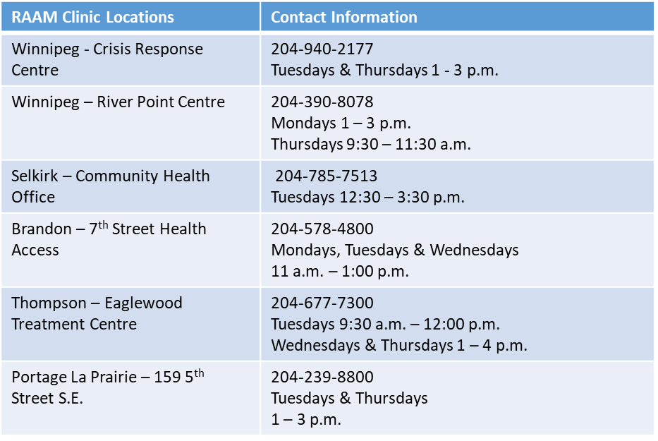
Tools and Resources con’t
Rapid Access to Addictions Medicine (RAAM) Clinics:
Walk-In Clinic(s) that individuals (ages 18+) can visit to get help for substance use and addictions without an appointment.
Services are provided on a first come, first served basis, with some prioritization based on urgency. Individuals must show up during clinic hours.
https://sharedhealthmb.ca/services/mental-health/raam-clinic/
National Native Alcohol and Drug Abuse Program
Notes:
Note: These are walk-in clinics, not in patient treatment.
Information can be found at the link indicated below.

Slide 18
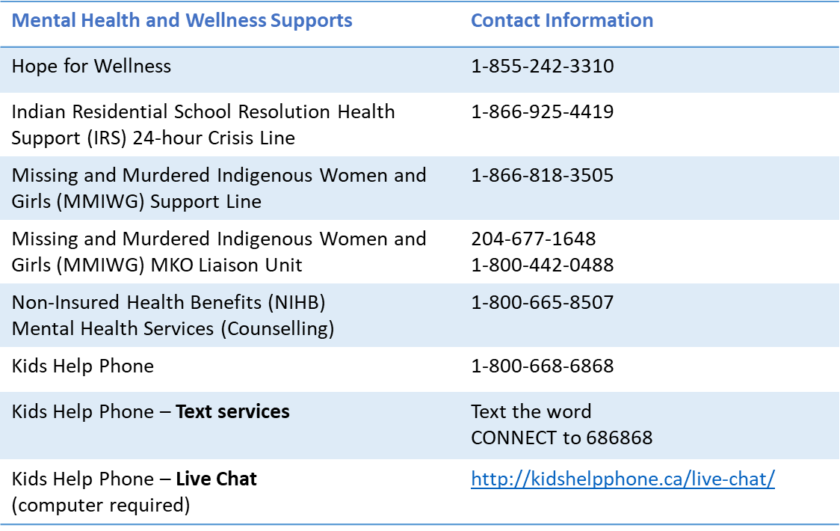
Community Resources – Crisis Lines
In response to a crisis, there are a variety of community telephone crisis help line supports and resources available for First Nations and Inuit clients:
Mental Wellness Program
Notes:
The following table provides contact information for crisis and wellness supports available for First Nations and Inuit clients.
These crisis supports will assist individuals who are experiencing a personal or situational crisis.
Hope for Wellness offers experienced and culturally competent counsellors, services available 24 hours a day, 7 days a week.
IRS Cultural and Emotional Health supports are provided by local Indigenous organizations and include access to Elders, Knowledge Holders, traditional healers, and ceremonies.
Kids Help Phone’s e-mental health services are available 24/7 for kids, teens and young adults.
Crisis services are free and confidential.
Telephone support is available toll free, 24 hours per week, to support the individual in crisis.

Slide 19
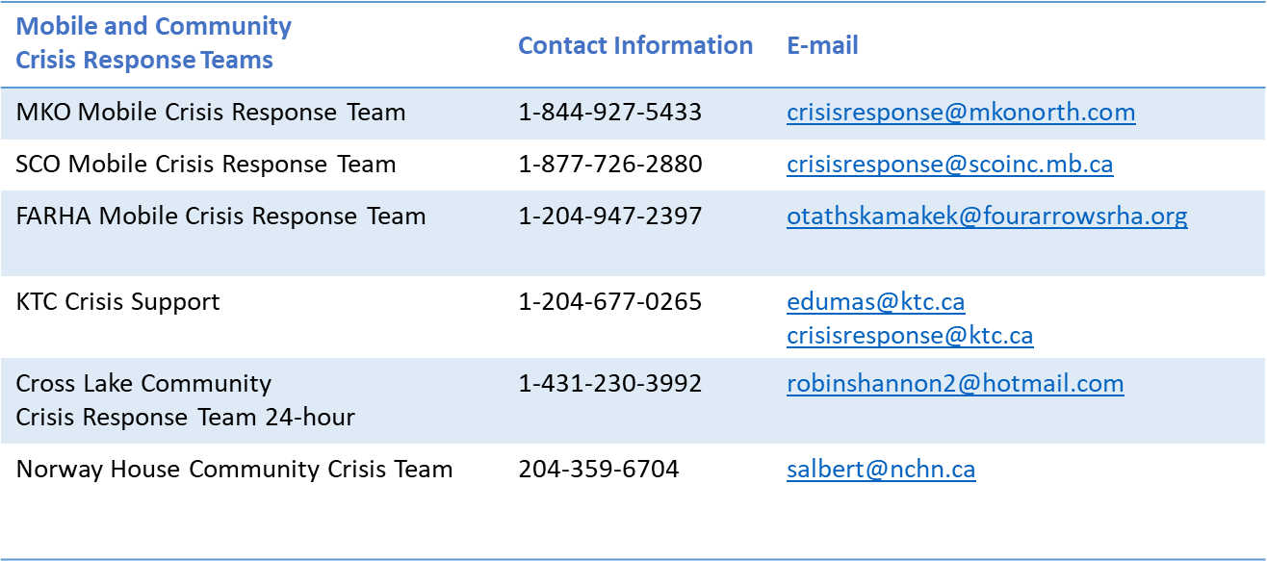
Crisis Response – Mobile and Community Crisis Teams
Mobile Crisis Response teams provide crisis response, intervention and case coordination services in a holistic, culturally sensitive and safe manner.
SERVICES INCLUDE (but not limited to): Critical incident stress debriefing, sharing circles, one-on-one counselling, mental wellness therapy, referrals, grief and loss support, post-suicide response, comfort – traditional and clinical support services, continuity of care, prevention training and capacity building with local wellness teams, individual client assessments such as suicide assessment & safety plan, self-esteem and depression scale and mental wellness status.
Mental Wellness Program
Notes:
Crisis in your community?
Call one of the Mobile Crisis Response Team/Community Crisis Team Lines as shown in the table.
To request assistance, you will be asked information regarding the crisis including;
Nature and circumstances of the crisis
The community contact person, and
The local resources available at community level to be included in the planned response intervention.
The Mobile Crisis Response teams will determine the intervention and deployment in a timely manner to ensure the crisis is supported, appropriate referrals are made and after care is in place.

Slide 20
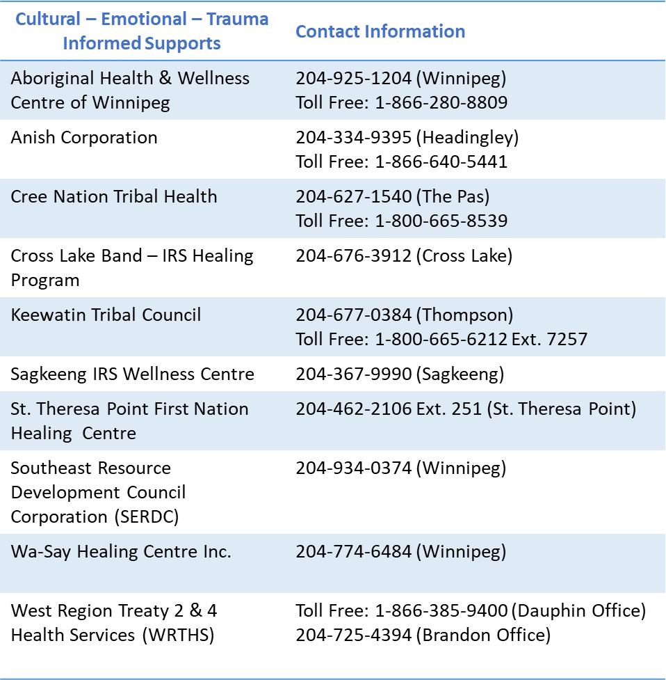
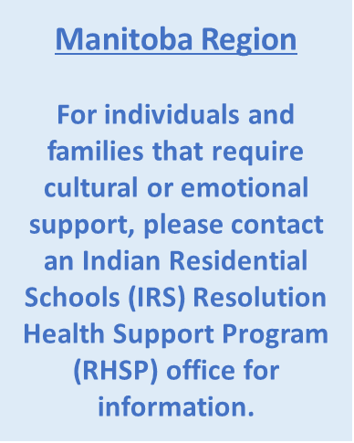
Resources – IRS/IDS/TI
Mental Wellness Program
Notes:
Indian Residential Schools (IRS)
Resolution Health Support Program
IRS students and their families can access cultural and emotional services at the following places in the MB Region:
10 IRS CA’s – Manitoba Region Contact Information
Aboriginal Health & Wellness Centre of Winnipeg
Anish Corporation (Headingley)
Cree Nation Tribal Health (Winnipeg)
Cross Lake – IRS Healing Program (Cross Lake)
Keewatin Tribal Council (Thompson)
Sagkeeng IRS Wellness Centre (Sagkeeng)
St. Theresa Point First Nation Healing Centre (St. Theresa Point)
Southeast Resource Development Council Corporation (Winnipeg)
Wa-Say Healing Centre Inc. (Winnipeg)
West Region Treaty 2 & 4 Health Services (Dauphin and Brandon Offices).

Slide 21
Thank you! Meegwetch
Please contact your Tribal Council for guidance and support.
For all other questions contact:
FNIHB Manitoba Region - Mental Wellness Team at: mbmentalwellness-bien-etremental@sac-isc.gc.ca
OR
Carrie Thibert, Mental Wellness Clerk,
FNIHB Manitoba Region, Mental Wellness Program
431-279-3983
*Carrie will direct your inquiry to the appropriate MW team member*
National Native Alcohol and Drug Abuse Program
Notes:
Thank you!
Please contact your Tribal Council for all information necessary for guidance and support on the NNADAP community worker role.

