Slide 1
Oral Health and Diabetes Mellitus

Slide 2
Oral Health and Diabetes
People with diabetes face a higher risk of:
Dry mouth: Unmanaged diabetes can decrease saliva flow, resulting in dry mouth. Dry mouth can further lead to soreness, ulcers, infections and tooth decay. Increase in incidence of dental decay in diabetic patients. Hyperglycemia and medications can lead to reduced salivary flow, causing a dry mouth. This allows for growth of Streptococcus mutans, resulting in development of dental decay
Individuals with a longer disease duration are at a higher risk for developing dental decay
Gum inflammation (gingivitis) and periodontitis: Besides weakening white blood cells, another complication of diabetes is that it causes blood vessels to thicken. This slows the flow of nutrients to and waste products from body tissues, including the mouth. When this combination of events, the body loses its ability to fight infections. Since periodontal disease is a bacterial infection, people with unmanaged diabetes might experience more frequent and more severe gum disease.
Cleveland Clinic 2019

Slide 3
Oral Health and Diabetes
Poor healing of oral tissues: People with unmanaged diabetes do not heal quickly after oral surgery or other dental procedures because blood flow to the treatment site can be damaged.
Oral Candidiasis (Thrush): People with diabetes who frequently take antibiotics to fight various infections are especially prone to developing a fungal infection of the mouth and tongue. The fungus thrives on the high glucose levels in the saliva of people with unmanaged diabetes. Higher prevalence in diabetics vs non diabetics
Wearing dentures (especially when they are worn constantly) can also lead to fungal infections.
People with diabetes who smoke are at an even higher risk, up to 20 times more likely than non-smokers to develop thrush and periodontal disease. Smoking also seems to impair blood flow to the gums, which might affect wound healing in this tissue area.
Cleveland Clinic 2019

Slide 4
Oral Candidiasis (Thrush) Signs and Symptoms
Creamy white lesions on the tongue, inner cheeks, and sometimes on the roof of your mouth, gums and tonsils
Slightly raised lesions with a cottage cheese-like appearance
Redness, burning or soreness that may be severe enough to cause difficulty eating or swallowing
Slight bleeding if the lesions are rubbed or scraped
Cracking and redness at the corners of the mouth
A cottony feeling in the mouth
Loss of taste
Redness, irritation and pain under dentures

Slide 5
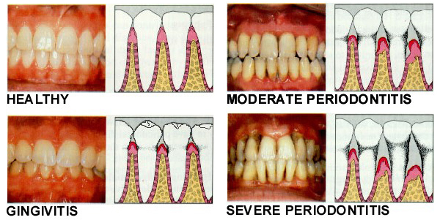
Periodontal (Gum Disease)

Slide 6
Signs of Periodontal Disease
Gums that bleed when you brush and or floss
Red or swollen gums
Bad breath or bad taste that won’t go away
Gums that have pulled away from the teeth
Pus between the teeth and gums
Teeth that are painful, loose or move
Changes in the way your teeth fit together when you bite
Changes in the way your partial dentures fit

Slide 7
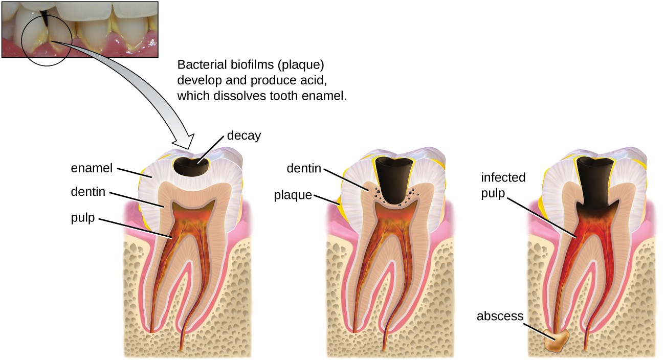
Dental Decay

Slide 8
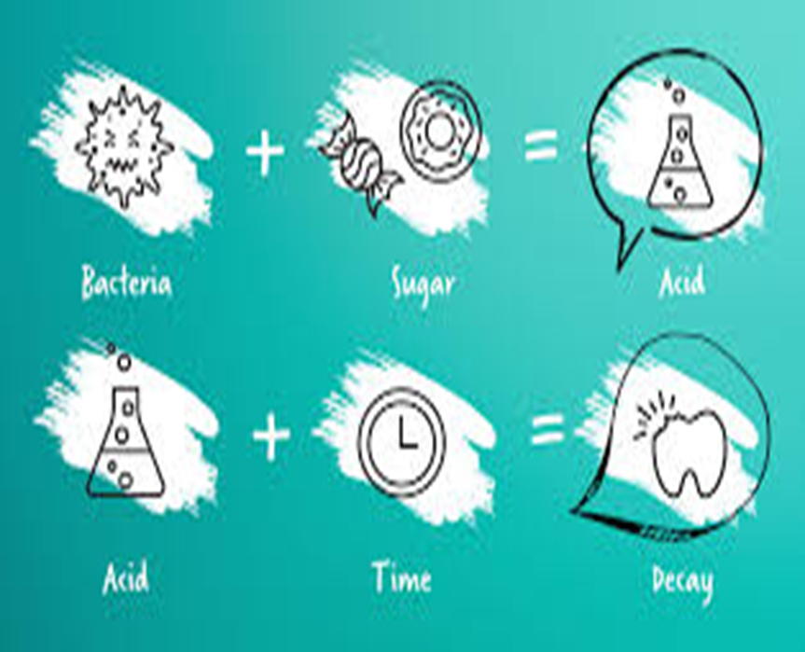
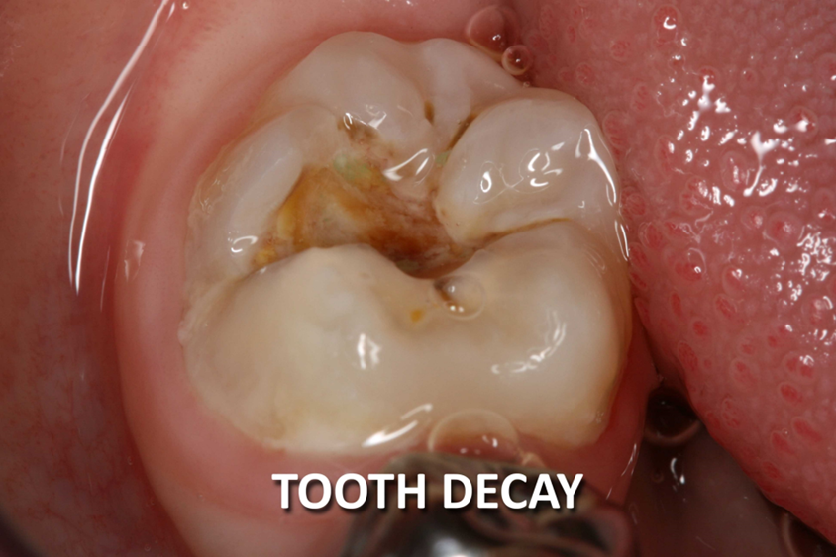
Dental Decay

Slide 9
Dental Decay

Slide 10
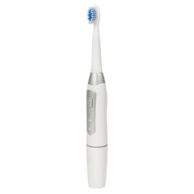
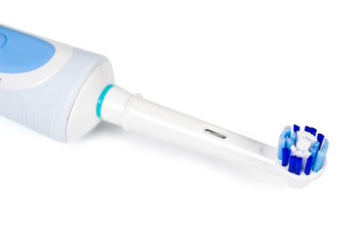
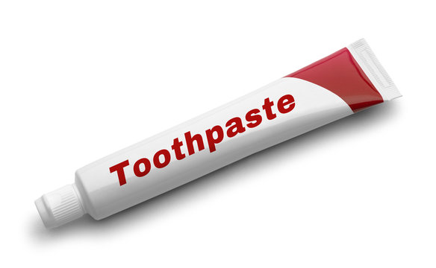
Toothbrushing

Slide 12
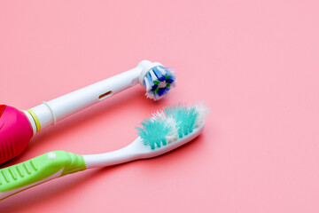
When to Replace Your Toothbrush

Slide 13
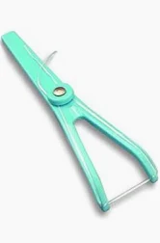
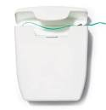
Flossing

Slide 14
Step 1
Break off about 18 inches of floss, wrapping most of it around one of your middle fingers. Wind the remaining floss around the same finger of the opposite hand. This finger will take up the floss as you move along.

Slide 15
Step 2
Hold the floss tightly between your thumbs and forefingers.

Slide 16
Step 3
Guide the floss between your teeth using a gentle, rubbing motion. Never snap the floss into the gums.

Slide 17
Step 4
When the floss reaches the gum line, curve it into a C shape against one tooth. Gently slide it into the space between the gum and the tooth.

Slide 18
Step 5
Hold the floss tightly against the tooth, slightly away from the gums. Gently rub the side of the tooth with an up-and-down motion, following the shape of the tooth. Repeat this method on the rest of your teeth, top and bottom. Don’t forget the back side of your last teeth (at the very back of your mouth.)

Slide 19
Denture Care

Slide 20
Denture Care
Remove and rinse dentures after eating
Place towel in sink so dentures won’t break if drop them
Handle dentures carefully
Be sure not to bend or damage the plastic or clasps when cleaning
Clean mouth after removing dentures
Use soft bristle brush on natural teeth and guaze or soft toothbrush to clean tongue, cheeks, roof of mouth
Remove denture adhesive from gums
Brush dentures at least daily
Soak and brush dentures with soft-bristled brush and non abrasive denture cleanser

Slide 21
Denture Care
Soak dentures overnight
Most dentures need to remain moist to keep their shape
Do not use denture soaking solution on partial dentures with metal parts
Check with Dental professional about properly storing denture’s overnight
Rinse dentures thoroughly before placing in mouth, especially if using denture soaking solution
These solutions can contain harmful chemicals if swallowed
See your dental professional if you have a loose fit
Loose dentures can cause irritation, sores and infection

Slide 22
Denture Care
AVOID:
Abrasive cleaning materials
Whitening Toothpastes
Bleach containing products
Hot water

Slide 23
Oral Health Care
Dental and Medical professionals are both part of the diabetes care team
Regular dental visits are important. Treating gum disease may be able to help lower your blood sugar over time.
Tell your dental professional that you have diabetes and what medications you take
Tooth decay and periodontal disease are preventable with regular at home dental care and visiting your dental professional on a regular basis
Brush teeth at least twice a day with a fluoride toothpaste for at least 2-3 minutes
Floss teeth once a day
If you smoke, quit. Smoking increases your risk of gum disease and can worsen your diabetes.

Slide 24
Resources

Slide 25
Resources
Canadian Dental Association
https://www.cda-adc.ca/en/oral_health/index.asp#intro
Diabetes Canada
Canadian Dental Hygienists Association
https://www.cdha.ca/cdha/The_Profession_folder/Resources_folder/Fact_Sheets_and_Resources/CDHA/The_Profession/Resources/Fact_Sheet_and_Resources.aspx?hkey=47b7bc0c-35c7-4d06-ba96-da9b2ea80c7d#tabs-1
https://diabetes.ca/about-diabetes/stories/diabetes-and-your-teeth

Slide 26
Resources
University of Manitoba (Dry Mouth)
https://umanitoba.ca/dentistry/sites/dentistry/files/2021-06/Special-Considerations-Jan-2018.pdf
American Diabetes Association
Clinical Diabetes Volume 23, Issue 4
Diabetes and Periodontal Infection Making the Connection.pdf
Presented by Sherri Scott, Dip DT, Dip DH
COHI Dental Therapist, MB Region
First Nations and Inuit Health Branch/Department of Indigenous Services Canada

