Slide 1
Sodium Analyzer
ADI activity

Slide 2
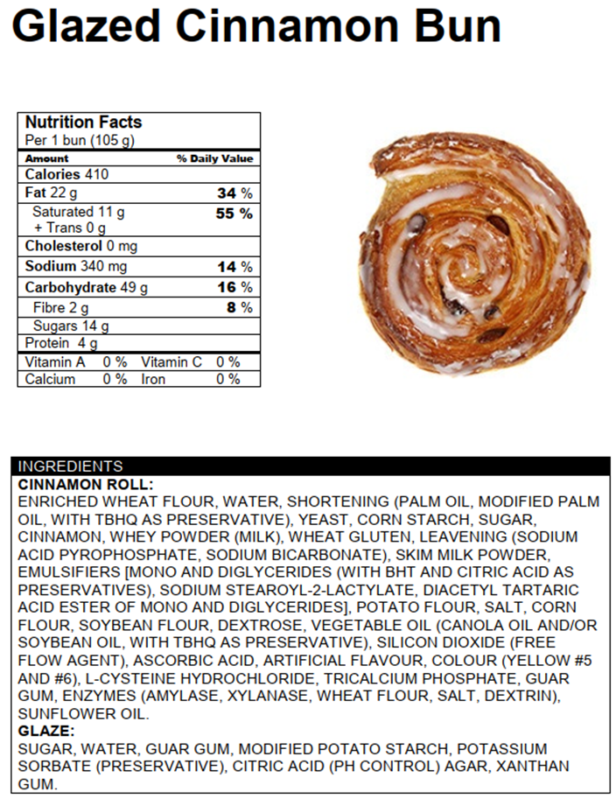
Amount of Food Eaten= 1 bun (105 g)
Amount of sodium=
340 mg
% DV=
14%
Is it a little (<5%)?
No

Slide 3
Whole bag (250g)
Amount of Food Eaten= Whole bag
Amount of sodium=
1650 mg
% DV=
70%
Is it a little (<5%)?
No

Slide 4
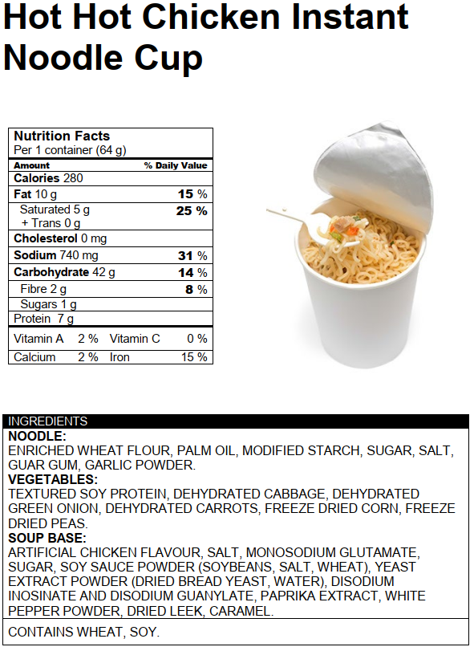
Amount of Food Eaten= 2 1 noodle cup (64 g)
Amount of sodium=
740 mg
% DV=
31%
Is it a little (<5%)?
No

Slide 5
Amount of Food Eaten= 2 tsp (10 mL)
Amount of sodium=
280 mg
% DV=
12%
Is it a little (<5%)?
No

Slide 6
Amount of Food Eaten= 4 nuggets
Amount of sodium=
330 mg
% DV=
14%
Is it a little (<5%)?
No

Slide 7
Amount of Food Eaten= 2 slices (1/3 of pizza/ 176 g)
Amount of sodium=
1100 mg
% DV=
46%
Is it a little (<5%)?
No

Slide 8
Total for the day:
Amount of Sodium: 4393 mg
% Daily Value: 189%
Is it a little (<5%)?
No
If 1 teaspoon salt= 2300mg of sodium, roughly how many teaspoons of salt are consumed if someone were to eat all these foods in one day?
ANSWER: about 2 teaspoons

