Slide 1
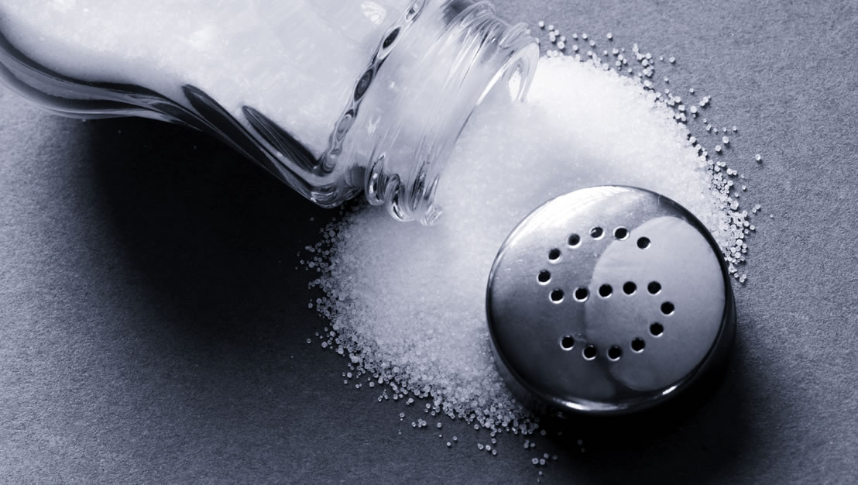
Sodium
ADI Presentation, 2023
Notes:
Today I will present on ‘sodium’.
The presentation will last about 15-20 minutes and then we will do an activity called: ‘Sodium Analyzer?’

Slide 2
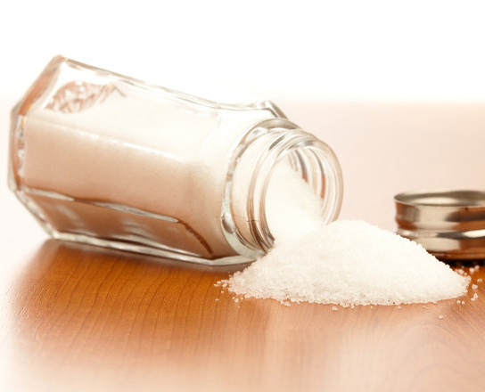
Outline
What is sodium?
How much sodium are we eating?
Where do we get our sodium?
The dangers of too much sodium
Tips for eating less sodium
Reading food labels
Notes:
Here’s an outline of what we will talk about during today’s presentation.

Slide 3
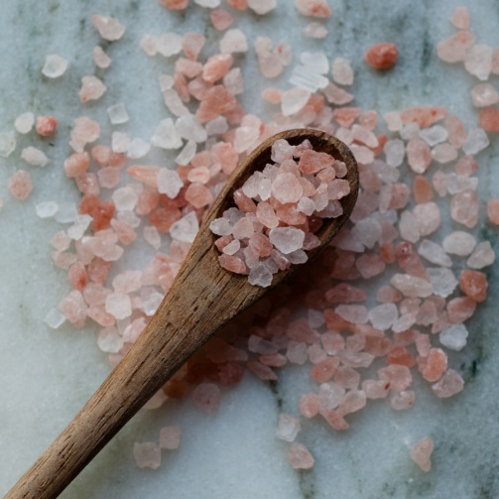
What is sodium?
Sodium is a mineral found in food and in table salt
All types of salt are high in sodium
Kosher salt, sea salt, gourmet salts all have about the same amount of sodium as table salt
They are not healthier choices
Notes:
Sodium is a mineral found in food and in table salt.
All types of salt are high in sodium.
Kosher salt, sea salt, gourmet salt, pickling salt and smoked salt all have about the same amount of sodium as table salt. They are not healthier choices. They all have the same amount of sodium per teaspoon as table salt.

Slide 4
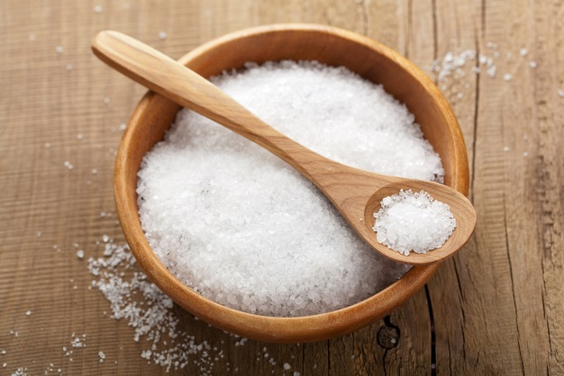
How much sodium are we eating?
We need a small amount of sodium to stay healthy
Adults need 1,500 mg of sodium daily
Canadians are getting about 3,400 mg of sodium daily
Aim for less than 2,300 mg of sodium each day
Notes:
We need a small amount of sodium to maintain health
We need 1,500 mg of sodium per day to maintain our health
However most Canadians are getting about 3,400 mg of sodium per day (more than twice the amount we need!)
To reduce your risk of chronic disease, aim for less than 2300 mg of sodium per day.
Children need only 1000 to 1500 mg of sodium per day.
People with health conditions like high blood pressure or kidney disease may need to aim for lower sodium intakes and should follow the advice of their dietitian or healthcare provider.

Slide 5
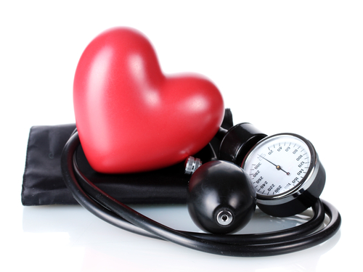
The dangers of too much sodium
Too much sodium can cause:
High blood pressure
Stroke
Heart disease
Kidney disease
Notes:
We all need a certain amount of sodium in the body as it regulates blood pressure, helps keep your body’s fluids in balance and keeps muscles and nerves running smoothly.
However, eating too much sodium can lead to high blood pressure, stroke, heart disease and kidney disease. Eating too much sodium can be harmful to our health.
Increased blood pressure is the leading risk for death in countries like Canada.
• Six million Canadian adults have high blood pressure, which is about 19% of the adult population.
• Of Canadians with high blood pressure:
– 17% are unaware of their condition.
– Only 66% have it treated and under control.
• 9 in 10 Canadians will develop high blood pressure or hypertension during their lives.
• One in three Canadians who have hypertension would have normal blood pressure if they consumed less sodium in their diets.

Slide 6
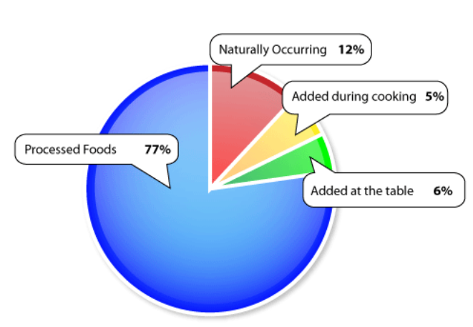
Where do we get our sodium?
Notes:
Most of the sodium found in the typical diet comes from processed or prepared foods, not the salt shaker.
Learn how much sodium is in the foods that you eat.
Processed or prepared foods Most of the sodium we eat (77%) comes from processed or prepared foods like deli meats, pizza, sauces and soups. Packaged and ready-to-eat foods, fast foods and restaurant meals are also often high in sodium.
Naturally occurring Sodium is found naturally in small amounts in foods like milk, fresh meats, fruits and vegetables.
Ingredients added during cooking and at the table Sodium is found in salt, sauces, condiments and dressings that are added during cooking and at the table.

Slide 7
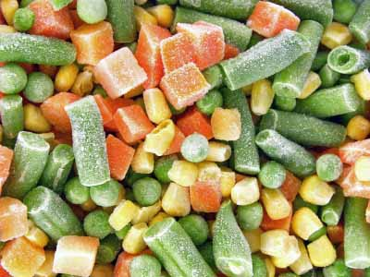
Tips for Eating Less Sodium: Vegetables and Fruit
Eat fresh vegetables and fruit for snacks
Choose frozen vegetables with no added salt
When preparing vegetable dishes, add flavour with herbs and spices instead of salt
Look for canned and jarred foods with “no added salt or sodium”.
Rinse canned vegetables with cold water
Notes:
Try fresh vegetables and fruit for snack instead of prepackaged snacks.
Choose frozen vegetables with no added salt – It’s typically easy to find frozen vegetables with nothing added to it. Lots of times these are cheaper, as they do not come with a fancy cheese/butter sauce. Those that have cheese or sauces will likely have a higher sodium content.
When preparing vegetable dishes, add flavour with herbs and spices instead of salt
When at the grocery store, look for products with a sodium content of less than 15% DV (Daily Value). We will go over how to do this later in the presentation.
When choosing canned vegetables, choose those with no added salt, or rinse canned vegetables to wash away some of the sodium.

Slide 8
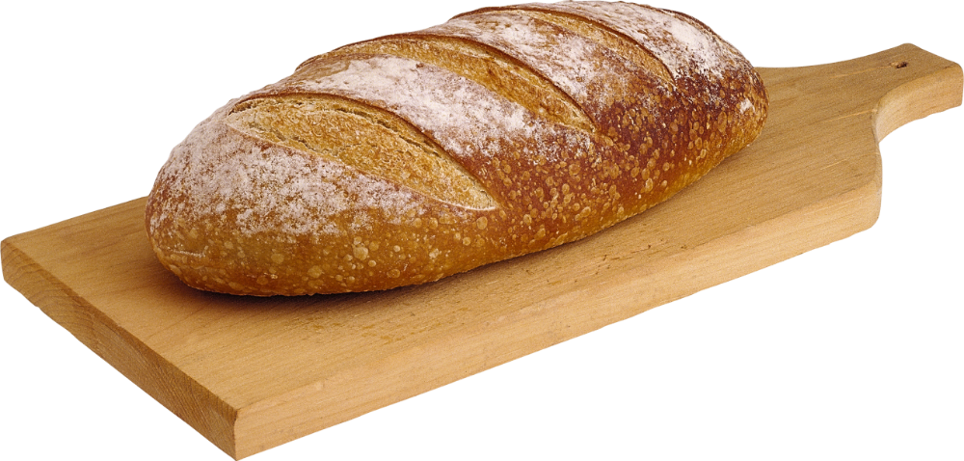
Tips for Eating Less Sodium: Whole Grain Foods
Use grains such as barley, quinoa and rice which are naturally sodium free
Cook pasta, rice, barley and other grains in unsalted water
Add flavour using herbs and spices
Try unsalted butter or margarine with your bread
Read the nutrition facts table and choose breads, cereals and other grain products that are lower in sodium
Notes:
Use grains such as barley, quinoa and rice which are naturally sodium free
Cook pasta, rice, barley and other grains in unsalted water or "no salt added" broth instead of salty broth.
Add flavour using herbs and spices
Try unsalted butter or margarine with your bread
Many packaged grain products are high in sodium. Even healthy cereals, such as All Bran, has over 300 mg of sodium per ½ cup serving.
Breads, breakfast cereals and bakery products also contain sodium even though they may not taste salty so be sure to read food labels and compare foods using the nutrition facts table to choose those that are lower in sodium most often.

Slide 9
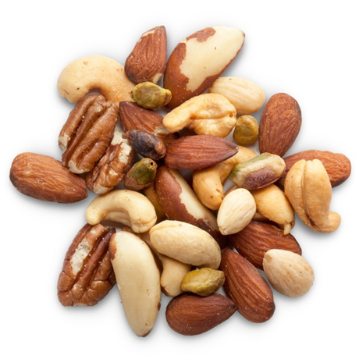
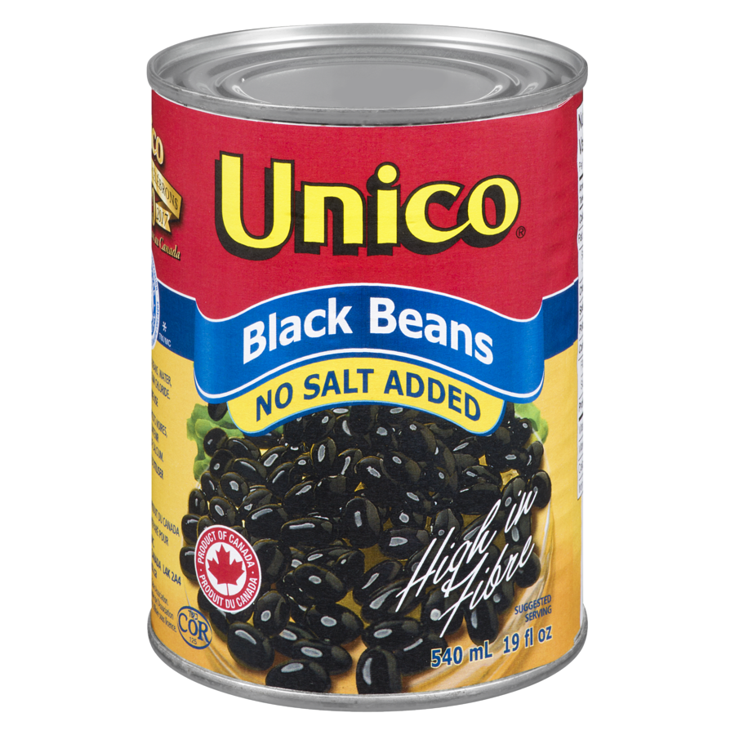
Tips for Eating Less Sodium: Protein Foods
Buy unseasoned meat, poultry, fish, seafood and tofu
Choose unsalted nuts and seeds
Buy low sodium canned beans or dried beans, peas, and lentils
Choose unflavored canned meats and fish, season it yourself with herbs/seasonings
Flavour fish, tofu or meat with lemon or pepper instead of adding salt, sauces or gravy
Taste your food before adding salt
Read and use food labels to make an informed choice

Slide 10
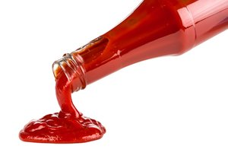
Tips for Eating Less Sodium: Low Sodium Cooking Tips
Cook with little or no salt
Use less salt than what a recipe calls for
Use less seasoning than what comes with packaged foods
Limit high-sodium condiments (BBQ sauce, soy sauce, ketchup, mustard, relish)
Use onions, garlic, lemon, herbs and spices to add flavor
Cook by grilling, braising, roasting, searing and sauteing to bring out the natural flavors in food and reduce the need to add salt
Notes:
Flavour food with herbs and spices instead of salt, celery salt, garlic salt or onion salt.
Use less of the seasoning that comes with taco kits, packaged macaroni and cheese, pasta, and rice mixes.
Limit high-sodium condiments such as BBQ sauce, soy sauce, ketchup, mustard, relish, pickles, hoisin sauce, fish sauce, and oyster sauce, olives, salad dressings, capers, jarred salsas, pizza/pasta sauce.
Cook by grilling, braising, roasting, searing, and sautéing to bring out the natural flavors in foods – that will reduce the need to add salt.

Slide 11
Tips for Eating Less Sodium: Flavor with Herbs and Spices
Basil - with tomatoes and pasta
Cumin - adds flavour to soup, stews, and sauces
Curry - with meat, poultry, soup, stews and dips
Dill - with fish, potatoes, and eggs
Oregano - in pasta, soup, and salads
Parsley- with seafood, vegetables, chicken, and eggs
Rosemary - with chicken, lamb, and pork
Thyme - with beef, chicken, rice or soup
Notes:
Flavour foods with herbs and spices instead of salt. Your taste buds will adjust to less salt in your food. Here are a few ideas to get you started:
basil - tastes great with tomatoes and pasta
cumin - adds flavour to soup, stews, and sauces
curry - powder - good with meat, poultry, soup, and stews
dill - pairs well with fish, potatoes, and eggs
oregano - perfect in pasta, soup, and salads
parsley- good with seafood, vegetables, chicken, and eggs
rosemary - delicious with chicken, lamb, and pork
thyme - goes well with beef and chicken

Slide 12
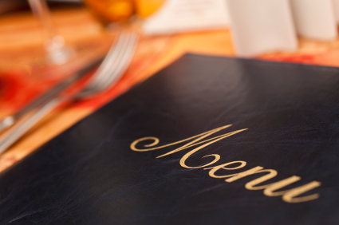
Tips for Eating Less odium: When Eating Out
Order smaller portions or share with someone
Ask for gravy, sauces and salad dressings “on the side” and use only small amounts
Flavour your food with lemon or pepper instead of adding salt, sauces or gravy
Ask for your meal to be cooked with less salt
Check the nutrition information of menu items before you order and choose foods with less sodium
Notes:
Order smaller portions or share with someone.
Ask for gravy, sauces and salad dressings “on the side” and use only small amounts.
Flavour your food with lemon or pepper instead of adding salt, sauces or gravy.
Ask for your meal to be cooked with less salt
Check the nutrition information of menu items before you order and choose foods with less sodium.
Keeping portions under control
Most restaurants serve a lot more food than you need. These tips will help you keep portion sizes reasonable.
Skip super-sized meal deals. The extra calories, fat, and sodium aren't worth it.
Avoid all-you-can-eat buffets.
Order an appetizer and a small salad instead of an entrée.
Share your meal with someone.
Take home half your meal and keep leftovers in the fridge for the next day.
Ask if smaller portions are available or share the meal with a friend. Or, ask for a to-go box when you order and place half the meal in the box to eat later.

Slide 13
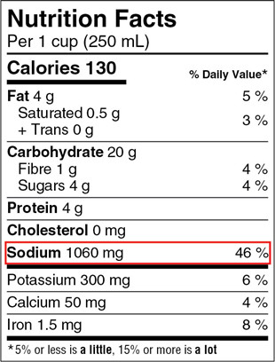
Reading food labels
Look for words such as "sodium-free," "low sodium," "reduced sodium," or "no added salt" on the package
Use the % Daily Value (%DV) to compare product:
5% DV or less is a little
15% DV or more is a lot
Choose products with no more than 15% DV of sodium
Notes:
Read the label
Limiting packaged or ready-to-eat foods and take-out meals is a great way to control your sodium intake. But if you're going to eat packaged foods, be sure to read the label first.
Choose unsalted or low-sodium foods whenever possible. Look for words such as "sodium-free," "low sodium," "reduced sodium," or "no added salt" on the package.
Use the % Daily Value (% DV) on the label to compare products and see if the food has a little or a lot of sodium. Choose products with no more than 15% DV of sodium per serving.
About percent daily value
The % DV is found on the right-hand side of a nutrition facts table. It is a guide to help you make informed food choices. It shows you if the serving size has a little or a lot of a nutrient:
5% DV or less is a little
15% DV or more is a lot
This applies to all nutrients with a % DV.

Slide 14
THANK YOU!
Notes:
That brings us to the end of the presentation. Before we move onto the activity, are there any questions about today’s presentation?
Now, let’s play a game called: ‘Sodium Analyzer’

