Slide 1
SLEEP…SLEEP…SLEEP The Benefits of Sleep
Barbara Thompson, Tribal Diabetes Coordinator
West Region Treaty 2&4 Health Services
January 22, 2024

Slide 2
“Feeling good doesn’t just happen.
Living a life in balance means taking the necessary time to renew yourself.
You can renew yourself through relaxation or
you can totally burn yourself out by overdoing everything.”
December 2023
Notes:
Did you know that March 15 is World sleep day , no it doesn’t mean you sleep all day
It is dedicated to The Canadian Sleep Society is a national organization committed to improving sleep for all Canadians through support for research, promotion of high-quality clinical care, education of professionals and the public, and advocacy for sleep and sleep disorders medicine.
“Healthy sleep for healthy Canadians”
More on that another time.

Slide 3
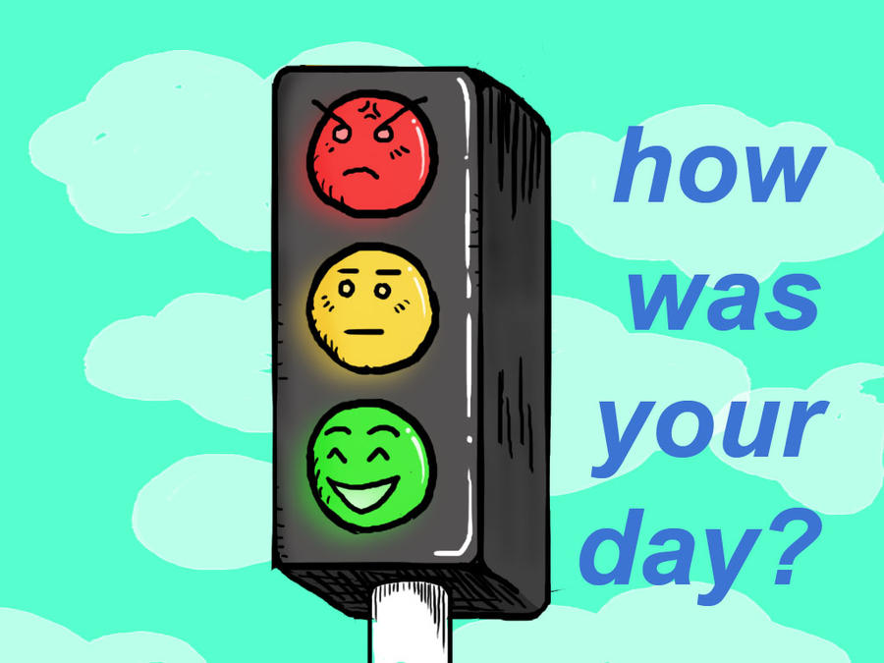
Question- Do you know how to start your day right? I will give 5 seconds for answers
Notes:
Answer--- You start it by preparing for it the evening before.

Slide 4
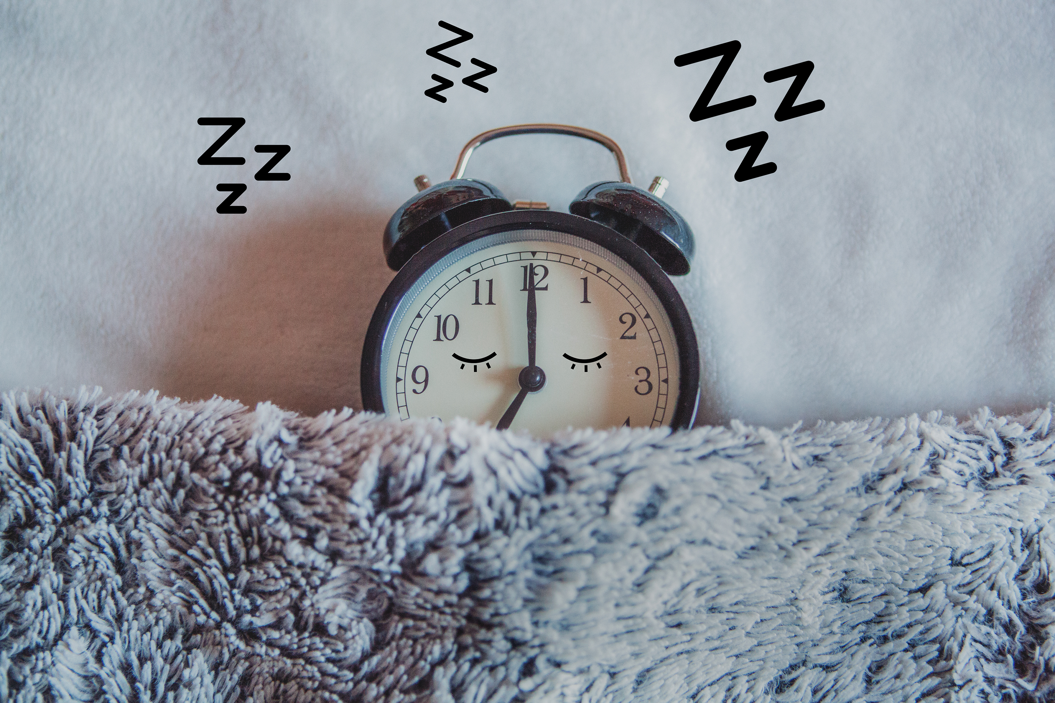
Make Sleep a Priority
Sleep is important to an individual
In a 24 hour cycle the body needs between 6-9 hours of sleep;
During this sleep period your body repairs and replenishes itself on a cellular level
And it is beneficial to your mental health.
Notes:
although we all have worries and family concerns, it is best to lay those aside to get the benefits of a proper sleep. While life gets in the way of sleep every now and again, don’t make sacrificing sleep a regular practice.

Slide 5
DIET MEDICATION EXERCISE SLEEP
For people with type 2 diabetes, going without sleep can damage your health, because a lack of sleep is positively correlated with increased insulin resistance.
Seen in this light, sleep is just as important as the other legs of the diabetes treatment stool: diet, medication, and exercise.
Taking away one of these legs can throw your whole treatment regimen out of balance.
Diabetes Treatment
Notes:
What may you ask does sleep have to do with it?
Like the rest of your Diabetes regime, getting a good night’s sleep is essential to good health for any population. But for those with a chronic health condition like type 2 diabetes, it takes on added importance.
Fortunately, the steps you take to better manage your type 2 diabetes will also help you sleep better at night.
The following suggestions are a few ways to help ensure a good night’s rest.

Slide 6
Diabetes Checklist: What to Do Before Bed
Notes:
When the lights go out, we should get to sleep right, but then we suddenly start remembering important things that we don't want to forget, sometimes it isn’t just about remembering but worries, fears and anxieties start setting in.
Such thoughts are not conducive to a relaxed state of mind and a good night's sleep.

Slide 7
What to Do in the Evening Before Going to Bed
Plan your breakfast and lunch for the following day.
Check your blood sugar before bed.
Have glucose tablets at bedside in case of low blood sugar episodes
Avoid eating too close to bedtime.
Take any prescribed medications as directed.
Floss and brush.
Put screens away an hour before bed.
Find a soothing ritual to repeat each night.
Make sure you have adequate diabetes supplies for the next day.
If you suspect you may go low or high during the night, ease your worried mind!
Drink plenty of water early in the evening .
If you use a diabetes device, make sure it is in working order.
These are just examples and suggestions, find what works for you and once you design it so it will work for you it may take a couple of weeks to get into the habit, but once you develop a plan that works FOR YOU, you may then be on a path to getting a better sleep.
Notes:
The following are suggestions, you may want to find what works for you to get a goodnights sleep. It may also help if perhaps you can find out what is disrupting your sleep and find ways to alleviate them.
So, the first one is:
Know what you’re going to have for breakfast and get ingredients ready. Pack meals and snacks the night before.
Instead of risking surprises in the middle of the night, make these occurrences less likely by checking blood sugar before bed and doing what you need to do according to your blood sugar and treatment plan.
Have something next to your bed such as dextabs or even a cookie and juice box, in case you experience a low blood sugar during the night. Having a plan in the event you experience a low blood sugar during the night may help alleviate some of your worry and help you get a goodnights sleep.
It’s not ideal for digestion and it can help complicate blood sugar management because you may have insulin-on-board while sleeping which may cause a low blood sugar or you may not catch a rise in blood sugar until it’s much higher than what is ideal.
Take prescribed medications as you were told by the pharmacist.
Elevated blood sugar can help multiply bacteria in your mouth overnight. It’s always a good idea to brush and floss before going to bed.
If you have trouble getting to sleep, try putting your phone or tablet away earlier and do something calming instead.
It could be chamomile tea, reading a book, cozying up to a loved one, or taking a warm bath. Find what works for you.
That way you’re ready to grab-and-go without forgetting test strips or glucose tablets.
Use your good foresight to set an alarm for some time in the middle of the night to check your blood sugar. It’s worth it when you discover a high or low and can take care of it.
Have your fluids early in the evening and avoid drinking too much too close to bedtime, so your bladder doesn’t interrupt your sleep
Make certain there isn’t anything you need to take care of like a low battery or low insulin in a pump cartridge, for example.

Slide 8
EVENING SNACK SUGGESTIONS
250 ML.(I CUP) STRAWBERRIES WITH 125 ML.(1/2 CUP ) SKIM MILK
30 grams (1 ounce) low fat cheese and 4 whole grain crackers
250ml.(1 cup) blueberries
175 ,l.(3/4) sugar free, low fat plain yogurt
750 ml.(3 cups) air-popped popcorn(plain)
250 ml(1 cup) skim milk with 2 small low-fat cookies (arrowroot or graham crackers)*
1 slice whole grain bread with 40 g (1/4 can) tuna and 1 tsp. light mayonnaise
Notes:
These are suggestions for an evening snack.
You can connect with a dietician to ask what you can have as an evening snack especially if you have diabetes and what time you should be eating this snack.

Slide 9
Lights Out!
With Type 2 Diabetes you want to make sure you have a good quality sleep.
In a new study it was found that exposure to dim light such as those produced by television screen, tablet or smart phones in your bedroom or in the bed with you, increased the body’s insulin resistance.
The body needs a restorative sleep away from bright lights.
The message is “Turn off all electronic devices and keep them away from your sleeping area before you fall asleep”
Notes:
Sleep research scientists have long held the belief that restorative sleep must take place away from bright lights.
But a surprising finding from a 2016 research study was that exposure to dim light, such as that produced by a television screen, tablet or smartphone in your bedroom or in the bed with you increases your body’s insulin resistance.
Further, In 2022 the latest sleep study regarding dim light found that sleeping with dim light can raise blood sugar and the heart rates of healthy people.
Light helps our body maintain an internal clock, which coordinates biological functions like the release of hormones.
This is exactly what you want to avoid if you have type 2 diabetes, so be sure to turn off all electronic devices, or better yet keep them away from your bedroom, before you fall asleep

Slide 10
Get Exercise
According to the National Sleep Foundation moderate-intensity exercise such as walking, bicycling or jogging can make it easier to fall and stay asleep
Beware, as they also cautioned that high-intensity aerobic exercise or anaerobic activity like weightlifting did not improve sleep quality, be prepared to do these types of activities at least 3-4 hours before preparing for sleep.
Notes:
Exercise works wonders for people with type 2 diabetes because even a moderate amount of movement each day can reduce your insulin resistance.
Moderate-intensity exercise such as walking, bicycling or jogging can also make it easier to fall and stay asleep, according to the National Sleep Foundation.
That same source also cautioned that high-intensity aerobic exercise or anaerobic activity like weightlifting did not improve sleep quality.
This is not to say that these activities should be avoided, but as with all exercise, aim to work out at least 3-4 hours before bedtime. This is because the adrenaline and endorphins that exercise releases need to hit their peak levels before you lie down to sleep.

Slide 11
To Coffee or NOT to Coffee
Avoid late-day coffee breaks
Caffeine works to increase alertness by replacing a neurotransmitter, adenosine, at receptors in the brain,
Caffeine peaks about 2 hours after consumption and works on a 4–6-hour cycle, so if you are in the habit of having a late afternoon coffee limit it to before 5 pm if your bedtime is around 11 pm. To ensure a good quality sleep.
Notes:
Caffeine is mostly a harmless substance that is proven to have a lot of health benefits, but one thing it can do is wreak havoc with your sleep patterns.
This is because caffeine works to increase alertness by replacing a neurotransmitter, adenosine, at receptors in the brain.
Adenosine is by nature sleep-inducing, but the molecular structure of caffeine closely mimics adenosine, and these receptors in the brain fall for the deception.
The result is that for quality sleep to occur, caffeine can’t still be influencing brain activity.

Slide 12
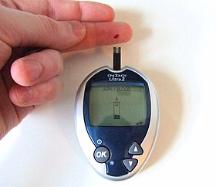
Blood Glucose Monitoring
Monitoring your blood sugar is part of your self-care regime and if you have type 2 Diabetes try not to run a high reading such as 11.1 mmol/L before bedtime.
Having high blood sugars may increase the urge to urinate as your body wants to get rid of the excess sugar in your blood, and in turn your urine.
This is very hard for your kidneys as it puts extra strain on the kidneys and dehydrates you.
It also significantly disrupts your sleep pattern when you have to get up every couple of hours to use the bathroom.
Notes:
Check Your Blood Sugar Level Closely in the Evening, that being said because of the limit that has been put on strips plan to check every other night especially if you have been having sleepless night.

Slide 13
To Alcohol or Not To Alcohol
Avoid alcohol before bed
Although a night cap sounds relaxing, it disrupts your sleep pattern in the long term.
Alcohol upsets your body’s circadian rhythms which dictate the functionality of all major organs.
The liver is one of these major organs, and the liver treats alcohol a a toxin to be expelled, creating a crisis situation of sorts when the liver may other wise be dormant.
Alcohol also has unpredictable effects on your blood sugar levels as it may raise blood sugar levels initially and sometimes lowers it longer term this always makes diabetes management more complicated.
So, much like caffeine if you want to have a drink in the evening try to time it about 3-4 hours before bedtime and limit the amount consumed.
Notes:
While a nightcap might relax you and make you feel sleepy initially, alcohol actually disrupts sleep in the longer term. This is because alcohol upsets your body’s circadian rhythms, which dictate the functioning of all major organs. One of those organs is your liver, and the liver treats alcohol as a toxin to be expelled, creating a crisis situation of sorts when the liver might otherwise be more dormant.
Alcohol also has unpredictable effects on your blood sugar levels, depending on what type of alcoholic drink you have and how much you consume. Alcohol sometimes raises blood sugar initially, sometimes lowers it longer-term, and it always makes diabetes management more complicated. Much like caffeine, if you have an alcoholic drink in the evening, try to have it 3-4 hours before bed if possible.
For interest sake :Acceptable Amount of Alcohol
The amount of alcohol that a person can safely consume, without any possibility if getting drunk, depends on his age, gender and overall medical history. So, it is always better to consult a doctor.
Usually, two drinks for men and one drink for women, a day, is considered as the ideal amount of alcohol, which has the remotest possibility of causing any harm.
A man should not have more than four drinks in a day, while women should strictly adhere to the maximum limit of three drinks in a day. You go beyond this and you are inviting trouble for yourself.
Those who have crossed the threshold of forty years should limit themselves to not more than three drinks in a day, at any cost. Going beyond this means putting stress on the heart.
Do not have a cocktail of different types of liquor. If you having whisky at a party, stick to whisky. Alternating between two or three different drinks, say whisky and beer or beer and vodka, is a big no-no.

Slide 14
Journaling for a goodnight sleep
Why Night Journal?
Filling out a journal at bedtime is particularly useful, especially for those who find it hard to settle the mind down in the evening and sometimes struggle to get or fall asleep.
We all carry worries around with us. These worries are drowned out or temporarily forgotten amidst the noise of the day, as we rush around for work, family, school, exercise, and all the rest of it.
When the busy day settles down and the television is switched off and we've logged out of social media platforms, these worries, fears, and concerns make their way to the forefront of our minds.
So, it is good to take a few minutes to recall, get ready for tomorrow, and give yourself a little time to let go of your day.
You can also do this as an evening exercise, rather than right at bedtime, after you have turned off all other electronic devices.
Notes:
Evaluating the Day & Putting it to Bed
A night journal helps you put the day to bed. It is a chance to evaluate the day, accept that it has happened, and then to let it go.
A night journal gives us a chance to put the day into perspective and close that chapter of our lives.
How to Write Your Night Journal
You don't need to fill out the journal in bed, You can fill yours out on the sofa or wherever you are in the house.
However, it's pretty much the last thing you do before going to sleep.
That's the point of the exercise.
Doing this regularly will signal to your brain that the day is ending, that you are letting everything go and preparing to sleep.
Night Journal Prompts
A journal may consist of five headings, as follows:
Tomorrow's goal
Today's achievements
Let it go!
Happy thought for the day
Positivity score: 1 -10
Keep it Simple
Keep it really simple and to the point.
It should take you no more than five minutes.
Here is an example for each using the categories above.
1. Tomorrow's Goal
In this section, include a simple statement or a list of tasks.
Your statement could be something all-encompassing such as “Be more grateful”, or something with intention such as “Do a random act of kindness”, or “Go for a morning run”.
Or it could be a list-based answer, covering a handful of important things that you really want to do tomorrow:
Meditation: 15 minutes in the morning.
Send email to one of your coworkers about the project.
Book the car in for a service.
Arrange dinner date with my child, spouse or parent.
2. Today's Achievements
Again, this could be a bulleted list of tasks that you did, or a statement regarding your feelings or behavior, or both.
Finished my project
Walked for ½ hour today.
Felt less stressed and more patient with others
3. Let it Go
This section should come to you very easily and requires just a few words.
If there was something particular that happened during the day that is playing on your mind, this is the section to write it down in.
It could be something that disappointed you, something that upset you, or something that made you angry.
My disagreement with mom. It doesn't matter, we're both still here for each other.
Didn't get what I wanted. Never mind, something else will come up.
Blaming the past. I can't change it.
4. Happy Thought for the Day
This can be something that happened to you, happened to someone else, or something random that you thought about.
It can be anything that made you smile, made you happy, or made you have positive thoughts.
Positivity Score
This is the shortest section and simply requires you to note a number 1-10.
Again, don't think about it too much.
You should be able to feel out the exact number to apply to the day. You can use half numbers too. Perhaps you think 8 is too much and 7 sounds too low, but 7.5 feels about right.
This is where you put the day to bed.
If it is a low number because the day didn't leave you feeling positive, that's no problem. In fact, it's a positive thing: because you have drawn a line under the sand and tomorrow you will look forward to improving on that number.
And if it's a high number, great! Draw a line under the sand and aim to go into tomorrow just as positive as today.
Night Journaling – Recap
Preferably use a notepad/book and pen rather than a phone or tablet (remember dim lights?)
No more than 5 headings/sections
Keep writing concise and to the point
Should take no longer than 5 minutes
If you have a blank notebook then by all means use this template. If you are using a phone, you can simply type out the template and use it over again in a notepad app.
However, it is preferable that you didn't use a phone, not least because there is something satisfyingly intimate and relaxing about writing things down with a pen and paper.
I realize that for the younger generation this might seem a bit alien, so if you do use your phone I suggest that you disconnect from the Internet and your data plan well before you get into bed – disconnecting is an important part of sleep hygiene and getting a good night's rest.
Note: You can get elaborate notepads, but a notebook will also serve the purpose, once it is filled and you have moved on to another notebook you can shred it or burn it.

Slide 15
Good Night!
If you have diabetes your diabetes management should be a priority in your life.
Sleep is of equal value as all the other pillars to your SMART goal
in achieving a stable blood glucose reading.
Getting a good quality sleep will improve your diabetes management,
your overall health, your mood and
it will likely extend to having good quality waking up as well.
Notes:
Making your diabetes management a priority in your life dictates that you give sleep equal attention to the other pillars of healthy living like diet, exercise, and medication. Getting more and better sleep now will improve your diabetes management, your overall health, your mood, and it will likely extend your overall waking hours as well.

Slide 16
Thank you for being with us today enjoy the rest of your day.

Slide 17
References:
-Chronotype: Implications for Epidemiologic Studies on Chrono-Nutrition and Cardiometabolic Health
Advances in Nutrition
Verywell health*
Healthline
WebMD
Synergy
Search sleep like the dead

