Slide 1
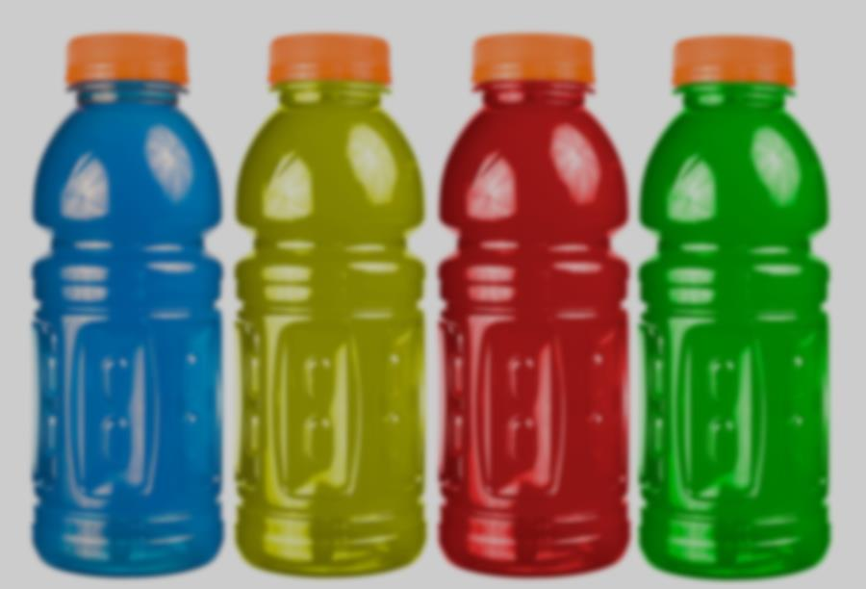
Sports drinks
Notes:
Today I will present on ‘Sports Drinks’.
The presentation will last about 15-20 minutes and then we will do an activity called: “sports drinks: fact or fiction”

Slide 2
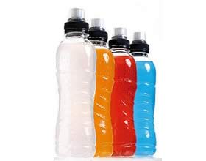
Outline
What are sports drinks?
Who should use sports drinks?
What should I look for in a sports drink?
How much should I drink?
Sports drinks vs. energy drinks
Healthy eating and exercise
Healthy drinking and exercise
Notes:
Here’s an outline of what we will talk about during today’s presentation.

Slide 3
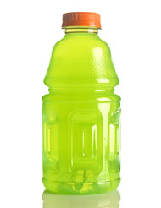
What are sports drinks?
Beverages made of :
Water
Sugars
Electrolytes (potassium, calcium, sodium & magnesium)
Used to rehydrate and replace electrolytes lost through sweating
Made with specific amounts of sodium and sugar
May help improve your sports performance
Notes:
Sports drinks are beverages made of water, sugars, and electrolytes, which are minerals such as sodium, potassium calcium and magnesium. Electrolytes keep the body's balance of fluids at the proper level.
People use sports drinks to replace water (rehydrate) and electrolytes lost through sweating after activity.
Sports drinks are made with specific amounts of sodium and sugar to make it easy for your body to absorb. Sports drinks can also restore carbohydrate that the body uses during activity.
Sports drinks may help improve how well you perform a sport by replacing the nutrients that are lost in your muscles.

Slide 4
Sidney Crosby endorses a certain sport drink… does anyone know what drink he supports?

Slide 5
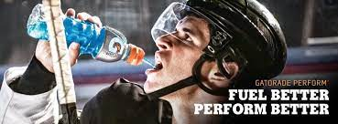
Notes:
Gatorade!!!
How much Gatorade do you think he drinks during a hockey game?
He typically drinks ½ Gatorade mixed with water in the first period and for the remainder of the game, just water!!!!

Slide 6
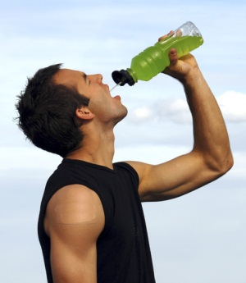
Who should use sports drinks?
ATHLETES!
With very high sweat rates
Who are exercising very hard for more than 1 hour at a time
Who are exercising in hot and humid conditions
Notes:
Why Do I Need to Drink During Exercise?
The goal of drinking during exercise is to prevent dehydration.
When you exercise you produce heat, which your body can help to control through sweating. When you sweat it helps cool your body but you can also lose water and electrolytes. If sweat, water and electrolytes are not replaced by taking in enough fluids then you become dehydrated. Dehydration can lead to health issues such as heat exhaustion and heat stroke. As little as 2% dehydration (e.g. a 1.4 kg (3 lb) loss for a 68 kg or 150 lb – individual) can hurt your athletic performance.
Sports drinks are specially designed to replace the sweat and electrolytes that you lose in sweat and to provide energy in the form of carbohydrate for active muscles and the brain. They can benefit a wide variety of athletes, including those:
With very high sweat rates (1L/h or more);
Exercising either very hard or for a long time (more than one hour) including endurance and team sport athletes;
Exercising in hot and humid conditions or while wearing protective sports equipment such as with hockey and football.
Sports drinks are not meant for people who are leisurely active, or for young children who are playing sports, but not sweating or not playing for longer than 1 hour at a time.
Non-athletes are usually not exercising long enough or at a level intense enough to need sports drinks. Plain water is usually the best choice.
A very select group of the population (athletes) could benefit from using sports drinks. As for the rest of the population, they can rehydrate and refuel by drinking water and eating a healthy diet.
I will talk more about healthy drinks and foods for the general population in future slides.

Slide 7
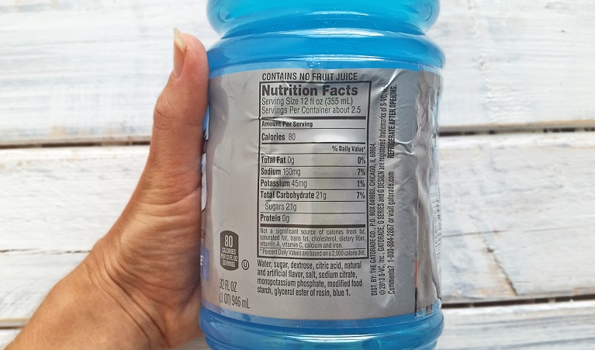
What should I look for in a sports drink?
Water
Most important ingredient
Flavour
May help you drink more fluids
Sodium
Improves hydration and may help to prevent muscle cramps
Aim for 460 to 690 mg of sodium per litre
Carbohydrate (sugar)
Sugar improves taste, keeps blood glucose from dropping, and helps fuel active muscles and the brain
Aim for 30-60 g of carbohydrate per hour of activity
Notes:
Water
This is the first and most important ingredient.
Make sure your sports drink is not carbonated so that it is easy to drink and doesn't make you feel full or bloated.
Flavour
Flavour may help you drink more fluids compared to plain water; this is especially true for children or teen athletes.
Sodium
Sweat contains more than water. Have you ever noticed a white powder on your workout clothes or skin? That is the salt you lose in sweat. The salt in sports drinks improves hydration and may even help to prevent muscle cramps in some individuals.
Sports drinks should contain at least 460 to 690 mg of sodium per litre although ultra-endurance athletes or athletes prone to cramping may require more.
Carbohydrate (sugar)
Sugar improves the taste, helps you drink more, keeps blood glucose from dropping, and helps fuel active muscles and the brain so that you can exercise longer and harder.
Consuming between 30-60 g of carbohydrate per hour of activity can improve endurance and high-intensity stop and go sport performance, prolong time to exhaustion, improve power output and delay fatigue.
Too much carbohydrate can upset your stomach and hurt your performance. To prevent stomach and intestinal upset be sure your drink has no more than 80 g of carbohydrate per L. Your body is able to easily absorb anywhere from 30 to 80 g of carbohydrate per litre. Note that juice, pop, and energy drinks contain more than 100 g of carbohydrate per L (are too high in sugar), so they are not good for using during exercise.
High sugar drinks can often increase the risk of dehydration and cause bloating, nausea or stomach upset.
Water or sports drinks are the best choice while playing sports.

Slide 8
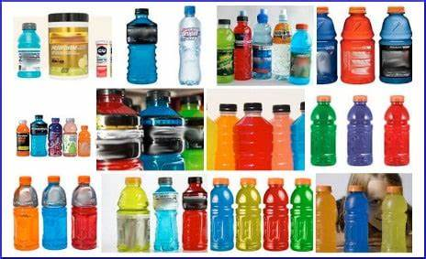
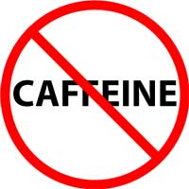
What should not be in a sports drink?
Herbs
Amino acids
Caffeine
Notes:
Carbohydrates and minerals like sodium are the only ingredients proven for safety and performance.
Other ingredients such as herbs, amino acids and caffeine should be avoided.

Slide 9
How much should I drink?
It depends on….
The temperature outside
How much you sweat
Your weight
Some guidelines:
Drink 1-2 cups of water or sports drinks up to 4 hours before the activity
Drink more if:
- You sweat lots
- You are wearing heavy sport equipment
- You are exercising in the heat
Notes:
How much should I drink?
This depends on things like the temperature outside and how much you sweat. Most people can meet their fluid needs by following these tips:
Up to 4 hours before playing a sport, slowly drink about 5 to 7 mL per kilogram of body weight. This is approximately 1 to 2 cups of water or sport drink. This amount will be different depending on your weight.
If over the next 2 hours no urine is produced or it is dark in colour, slowly drink another 1/2 to 1 1/2 cups of water or sport drink.
Start drinking early and regularly to help replace all the water lost through sweating.
Drink more sport drink if:
You sweat a lot
You are wearing heavy sports equipment (like in hockey or football)
You are exercising in the heat

Slide 10
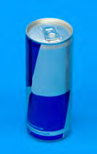
Sports drinks vs. energy drinks
Sports Drinks :
Contain water, electrolytes, sugar
Aim is to rehydrate
Contains no caffeine
Energy Drinks:
Claim to energize, improve alertness and delay fatigue – NOT PROVEN
Contain lots of caffeine
Contain amino acids, medicinal herbs, vitamins & minerals
Bottom line: Energy drinks are NOT appropriate to drink while exercising.
Notes:
Sports drinks are geared to rehydrate you when you are active for more than 60 minutes. They provide the needed nutrients in the right amounts to rehydrate you. A good sports drink does not contain any caffeine.
Energy drinks claim to stimulate, energize, improve alertness and delay fatigue to people drinking them. However, this has not been proven.
They are considered a natural health product and not a food.
Energy drinks are carbonated, so they are hard to consume enough to proper hydrate while exercising.
Caffeine is a major ingredient in energy drinks that distinguish them from other beverages. Caffeine has both beneficial and detrimental effects. Caffeine is a stimulant – helps with increased wakefulness and alertness. However, too much caffeine has negative side effects such as:
Racing heart
Anxiety
Shaking
Dizziness
Upset stomach
Sleep problems
Trouble breathing
Skin numbness
Seizures, Hallucinations, and death.
Caffeine intake from energy drinks has been linked to more serious events including liver and kidney damage, seizures, high blood pressure, heart failure and death.
Energy drinks also contain many other ingredients including sugar, amino acids (taurine), medicinal herbs (ginseng, gingko biloba, milk thistle & guarana), vitamins and minerals. The claim is made that all these ingredients are said to provide us with more energy. However, this has not been scientifically proven.
We should get our energy from eating and drinking a healthy diet, getting lots of physical activity and needed sleep.

Slide 11
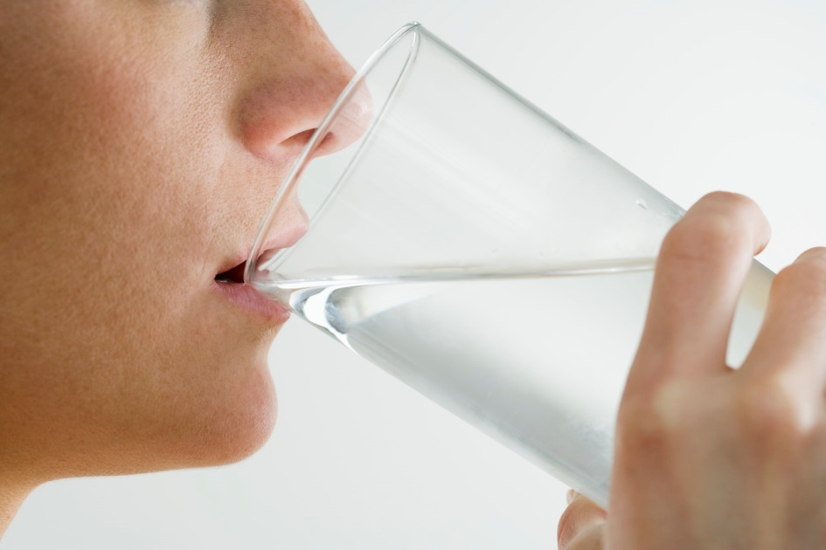
Healthy drinking & exercise
How much fluid you need to drink depends on factors, such as:
Age
Gender
Activity level
Temperature outside
To stay hydrated, aim daily for:
Men 19 years & older = 12 cups
Women 19 years & older = 9 cups
Your body loses water by sweating, breathing and getting rid of waste.
If you lose more fluid than you take in …you may get dehydrated.
Notes:
It is a myth that every person needs 8 cups of water per day.
How much fluid you need to take in each day depends on a number of factors including:
Age
Gender
Activity level
Temperature outside

Slide 12
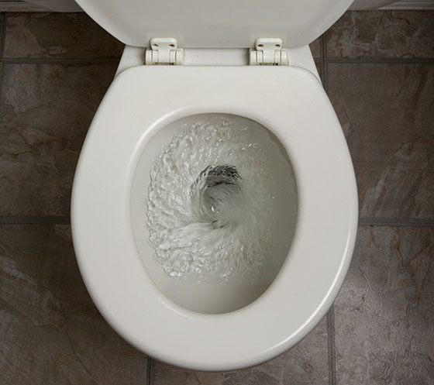
Healthy drinking & exercise
Stay well hydrated by drinking before, during, and after exercise
Water is the best choice when you exercise for less than 1 hour
Check the colour of your urine to see if you are dehydrated:
Pale yellow color urine = hydrated
Dark yellow urine = dehydrated
Notes:
To keep you hydrated during your sports activities:
Stay well hydrated by drinking before, during and after exercise to replace your sweat losses. If you exercise for less than 1 hour at a time, water is usually your best choice. Table 1 provides a fluid guide to help prevent dehydration.
Check the colour of your urine to see if you are dehydrated:
Plenty of pale yellow (e.g. lemonade colour) urine is a sign you are well hydrated
A small amount of dark yellow (e.g. apple juice colour) urine could mean that you are dehydrated

Slide 13
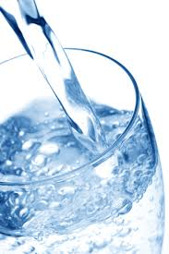
tips to stay hydrated:
Drink a glass of water when you wake up each morning or before you go to bed
Always have water with you
Drink a glass of water before eating your meals
Don’t ignore thirst
Drink water or another healthy drink when you feel thirsty

Slide 14
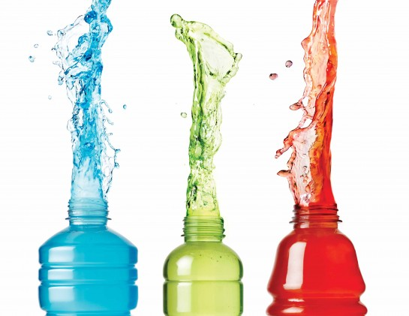
Thank you
Notes:
Do you have any questions about today’s presentation?
Are there other topics you’d like to hear about at future sessions? If so, please let me know.
Now, let’s play: “sports drinks: fact or fiction”

