Slide 1
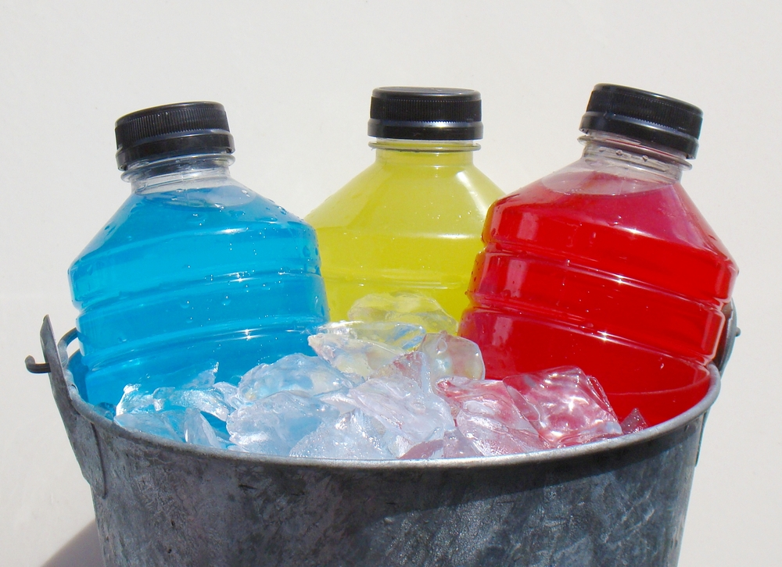
Sports drinks : Fact or Fiction?
ADI activity
2016
Notes:
We will now play a Sports Drinks: Fact or Fiction game (true or false). Put your thinking hats on and good luck!
ADI worker: You can split the group in two and play this as a (somewhat) competitive game. Have little prizes ready to offer to the winning team.

Slide 2
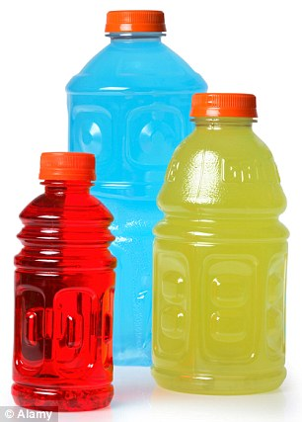
Fact or Fiction?
Sports drinks are typically made of :
Water
Sugars
Electrolytes (potassium, calcium, sodium & magnesium)
Notes:
Fact! (True).
Sports drinks are beverages made of water, sugars, and electrolytes, which are minerals such as sodium, potassium calcium and magnesium. Electrolytes keep the body's balance of fluids at the proper level.
People use sports drinks to replace water (rehydrate) and electrolytes lost through sweating after activity.
Sports drinks are made with specific amounts of sodium and sugar to make it easy for your body to absorb. Sports drinks can also restore carbohydrate that the body uses during activity.

Slide 3
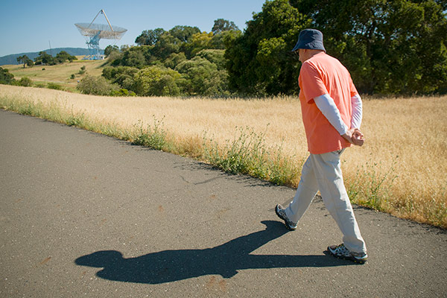
Fact or Fiction?
Anyone going for more than a 20 minute leisurely walk would benefit from drinking a sports drink.
Notes:
Fiction (False).
Sports drinks are not meant for people who are leisurely active, or for young children who are playing sports, but not sweating or not playing for longer than 1 hour at a time. Non-athletes are usually not exercising long enough or at a level intense enough to need sports drinks. Plain water is usually the best choice.
A very select group of the population (athletes) could benefit from using sports drinks. As for the rest of the population, they can rehydrate and refuel by drinking water and eating a healthy diet.

Slide 4
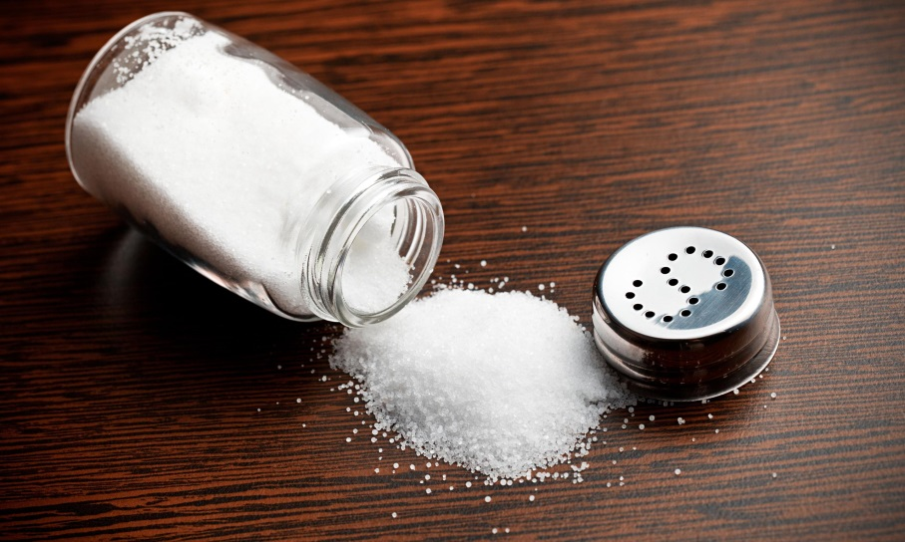
Fact or Fiction?
Sports drinks should have sodium in them.
Notes:
Fact (true).
The salt in sports drinks is to provide back electrolytes that you lost when sweating and may even help to prevent muscle cramps in some individuals.
Sports drinks typically contain 460 to 690 mg of sodium per litre although ultra-endurance athletes or athletes prone to cramping may require more.

Slide 5
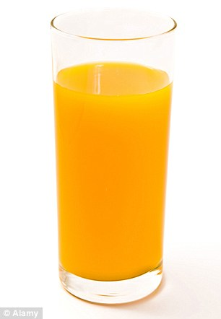
Fact or Fiction?
Orange juice is a better option as a beverage for athletes to consume during a high endurance and long (for more than 60 minutes) activity instead of a sports drink.
Notes:
Fiction (false).
Depending on the activity, Water or sport drinks are the best choices while doing activities/sports.
Consuming between 30-60 g of carbohydrate per hour of activity can improve endurance and high-intensity stop and go sport performance, prolong time to exhaustion, improve power output and delay fatigue.
Too much carbohydrate can upset your stomach and hurt your performance. To prevent stomach and intestinal upset be sure your drink has no more than 80 g of carbohydrate per L. Your body is able to easily absorb anywhere from 30 to 80 g of carbohydrate per litre.
Note that juice, pop, and energy drinks contain more than 100 g of carbohydrate per L (are too high in sugar), so they are not good for using during exercise. High sugar drinks can often increase the risk of dehydration and cause bloating, nausea or stomach upset.

Slide 6
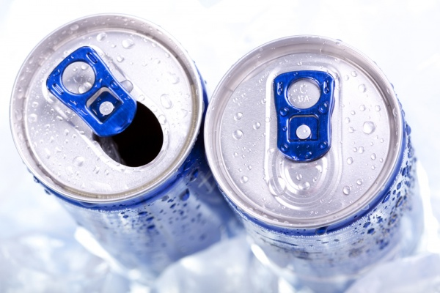
Fact or Fiction?
Sports drinks contain as much caffeine as energy drinks.
Notes:
Fiction (false).
Carbohydrates and minerals like sodium are the only ingredients proven for safety and performance.
Other ingredients such as herbs, amino acids and caffeine should be avoided which are more typically found in energy drinks. Energy drinks have lots of caffeine.

Slide 7
Fact or Fiction?
How much an athlete should drink during activity depends on weight, gender, and how much a person sweats.
Notes:
Fact (true).
In addition to what is noted, other factors that can affect how much an athlete drinks includes the temperature outside, whether he or she is wearing heavy equipment (hockey, football), etc.

Slide 8
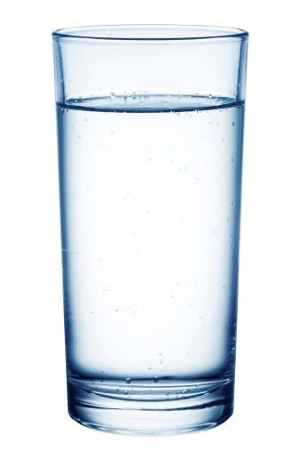
Fact or Fiction?
As a guideline, athletes should drink 4 cups of fluids 1-2 hours before their endurance activity.
Notes:
Fiction (false).
This is likely too much fluid in a short amount of time and may lead to bloating.
Most people can meet their fluid needs by following these tips:
* Up to 4 hours before playing a sport, slowly drink about 5 to 7 mL per kilogram of body weight. This is approximately 1 to 2 cups of water or sport drink. This amount will be different depending on your weight.
* If over the next 2 hours no urine is produced or it is dark in colour, slowly drink another 1/2 to 1 1/2 cups of water or sport drink.
Start drinking early and regularly to help replace all the water lost through sweating.

Slide 9
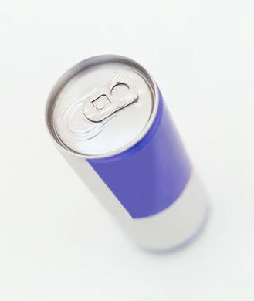
Fact or Fiction?
Athletes would get the same benefits from drinking a sports drink vs. drinking an energy drink during an endurance activity.
Notes:
Fiction (false).
Energy drinks are not appropriate to consume while exercising.
They are carbonated and therefore are hard to consume enough to proper hydrate while exercising.
They have too much caffeine and not a good balance of the vitamins, minerals and nutrients needed to rehydrate individuals who are very active.

Slide 10
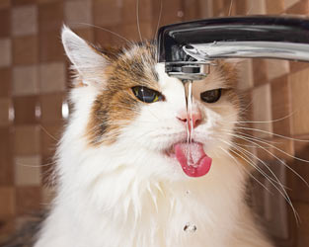
Fact or Fiction?
If you lose more fluid than you take in you can get dehydrated.
Notes:
Fact (true).
Your body loses water by sweating, breathing and getting rid of waste. If you lose more fluid than you take in you can get dehydrated.
To stay hydrated, aim daily for:
Men 19 years & older = 12 cups
Women 19 years & older = 9 cups
TIP: sip water during the day every 5- 7 minutes to prevent dehydration.
If your mouth feels dry you are already dehydrated.

